Slide 1
Validation Practices & Validity Evidence for Productive Skills Testing _ STANAG 6001
Roxane Harrison
English Language Program Department
Partner Language Training Center Europe

Slide 2
Results of BAT-S and BAT-W alignment studies
Of nations participating:
Speaking scores ranged from 0 percent to 83 percent alignment
Writing scores ranged from 0 percent to 60 percent alignment
This further highlights need for validation of speaking and writing tests
Notes:
Validating tasks and prompts is good practice in test development. BAT alignment research re-iterates need for such validation – to ensure that STANAG 6001 test scores are as standardized from country to country as possible.

Slide 3
Test factors that can influence scores
SLP
Rating
The Speaking test/OPI
Or
The writing test
Rating scales and scoring procedures
Written performance
The test instrument
Spoken performance
Rating criteria
Raters
Performance on Test
The test-taker
Notes:
Need ways to mitigate threats to validity and proof of having mitigated – validity evidence at all stages.
Possible reasons for misalignment with BAT from ACTFL examiners:
Testing rehearsed (rather than unrehearsed) language – misalignment of test type/purpose
E.g. using discrete questions in speaking test when goal is to measure spoken language proficiency
Inconsistent interpretation of STANAG 6001 – inadequate tester/rater training or norming

Slide 4
A Validity Argument

Slide 5
3 sample claims:
The STANAG 6001 test tasks are adequate substitutes for those performed in the target language domain.
The STANAG 6001 test yields results that are consistent across assessment contexts (e.g., across test forms, tasks, and judges.)
The scores on the STANAG 6001 speaking and writing test are an adequate reflection of the observed test behavior (i.e., scoring procedures are appropriate and clear, and test administration processes are carried out as intended by test designers.)
Notes:
These are sample claims – adapted from PELA (get ref – add to biblio at end)

Slide 6
How can we support our claims?
with compilations of evidence . . .

Slide 7
Score need
Administration/ performance
Rating/
evaluation
Score use
Test development
Purpose of assessment
Validity evidence is created and collected throughout the test development cycle.
Starting at the planning phase, tasks, criteria and instructions must correspond to STANAG 6001 descriptors, CTA statements, and established test development guidelines.
Scores
Tasks, criteria, instructions
Performance Criteria
Diagram adapted from Luoma 2004

Slide 8
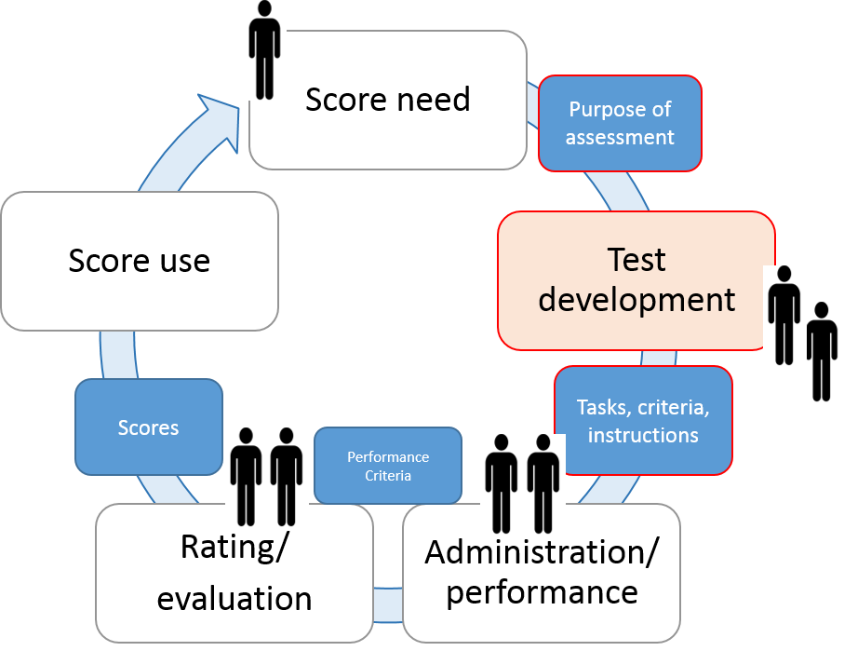
Validation Practices and Validity Evidence
Test Development Phase

Slide 9
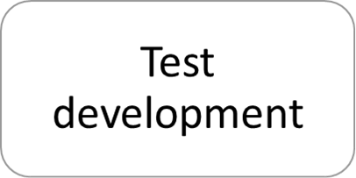
Countering validity threats in
Do tasks/prompts reflect CTA for level?
CONTENT
TASKS
ACCURACY
TEXT
WHAT A PERSON CAN TALK ABOUT
Topics, subject areas addressed; settings
WHAT A PERSON CAN DO WITH THE LANGUAGE
Tasks accomplished, attitudes expressed, tones conveyed
HOW WELL A PERSON CAN USE THE LANGUAGE
Acceptability, quality and correctness of message conveyed
WHAT TYPE OF TEXT A PERSON PRODUCES
Length and organization of texts; discourse types

Slide 10
Do tasks and criteria implement the construct?
CLAIM: The test tasks are adequate proxies for those performed in the target language domain.
Test(s)
(including
Scoring)
Notes:
A more complicated way of working the same question as the previous slide – and a diagram from KANE and OGLESBY to visually demonstrate how specs are linked to the construct, the construct within the domain and ultimately, individual test tasks, prompts and criteria on the test (as defined by specs)

Slide 11
Do tasks, prompts, and criteria implement the construct?
CLAIM: The test tasks are adequate proxies for those performed in the target language domain.
Do test specifications outline content, topics, tasks and accuracy for each productive skill at each level of STANAG 6001?
Do test specifications define the number of tasks and topics required for each skill at each level?
validity evidence

Slide 12
Do tasks, prompts, and criteria implement the construct?
CLAIM: The test tasks are adequate proxies for those performed in the target language domain.
Do writing prompts and speaking tasks clearly elicit the desired language?
Do you have item moderation checklists for speaking and writing prompts?
Do they match the test specifications?
Have any test-user questionnaires been administered regarding:
clarity of questions/prompts?
suitability of tasks and topics?
time allowed for writing?
clarity of instructions?
other?
If so, what is done with the results? Modified tests and items? Reports?
Validity evidence

Slide 13
Sample Moderation of Tasks and Prompts
Prompt/Task or Question: | STANAG 6001 proficiency level | Target function | Content / Topic | Discourse type expected | Context (formal, informal, N/A)
What do you do to prepare for a typical day?
Malone, M. 2012. Investigating CEFR & ACTFL Tasks through Prompt and Elicitation Research in Tschirner, E. (Ed) Aligning Frameworks of Reference in Language Testing; Stauffenburg Verlag Brigitte Narr GmbH: Tubingen
Notes:
Speaking tasks to elicit language samples:
Tasks or prompts allow speakers to demonstrate behavior that simulates their abilities to use the language to accomplish such tasks outside of the testing situation.
Tasks consist of integral components called features – which should be controlled by an examinee for a given proficiency level.
Function – the action that speech is intended to perform, such as narrate, explain, describe or complain; successful accomplishments of a single function requires control of specific morphology and/or syntax skills, e.g. giving directions requires use of second-person verb forms (simple present and/or imperative) and conjunctions that indicate sequence
Context – Characteristics of situation in which speech takes place including identity of the interlocutor, relationship between speaker and interlocutor, level of formality of the situation, and location of the interchange
Content – The subject matter of the interchange
Discourse type – the length of utterances (words, phrases, sentences, sentence strings, paragraphs) and the degree to which utterances are memorized or formulaic as opposed to created by the speaker

Slide 14
Productive skills Tasks and Prompts
Successful tasks have the following characteristics:
They are appropriate to the level
They are open-ended
They are clear
Unsuccessful tasks have one or all of the following characteristics
The prompts are unclear
They are inappropriately contextualized
They are transitional
They are off-level

Slide 15
Interviewer training – reduce variance
Interviewer behavior can influence test performance and scores
Accommodation of (perceived) lower level candidates
(supportive practices including speech modification and repetition)
Elicitation styles
Interview training (often over-looked) reduces variance
Test Protocol – Tasks and Topics must be prescribed for consistent assessment results
Elicitation- response cycle
Tester stance

Slide 16
Do tasks, prompts, and criteria implement the construct?
CLAIM: The test tasks are adequate proxies for those performed in the target language domain.
Is speaking interview training conducted?
What is included in the training?
What records are kept regarding interview training?
Are speaking exam interviewers monitored?
What records are kept?
Training materials
Validity
evidence

Slide 17
MODERATING PROMPTS

Slide 18
What STANAG 6001 writing tests intend to measure:
Level 1 – can write to meet immediate personal needs
Text types/genres: lists, short notes, post cards, short personal letters, phone messages, and invitations as well as filling out forms and applications.
Level 2 – can write simple personal and routine workplace correspondence and related documents
Text types/genres: memoranda, brief reports and private letters
Level 3 – can write effective formal and informal correspondence and documents on practical, social and professional topics
Text types/genres: essay-length argumentation, analysis, hypothesis, and extensive explanation, narration and description

Slide 19
Weigle’s Framework for Writing Prompts:
SUBJECT MATTER:
Does the task rely on background knowledge that might not be available to all the test takers?
Does the subject require the writer to use relevant aspects of their language ability?
Might the subject matter arouse emotions that are counter-productive to a good test performance?
It is interesting/motivating?
INPUT:
Does the prompt draw on background knowledge that might not be available to all test-takers?
Is there enough scaffolding (i.e., support for test taker) or too much?
Does the prompt material introduce construct irrelevant factors (e.g., reading?)

Slide 20
Weigle’s Framework (continued):
Genre:
Is the intended form and/or function of the output appropriate
Is the task authentic?
Could the discourse mode adversely affect test performance?
Will the genre require the test taker to use relevant aspects of their language ability?
Time allotment:
Is the time allowed sufficient or too much?
Instructions:
Are the instruction clear?
Do the instructions contain enough detail without being over long?
Do the instructions provide a context for the response, a statement of audience, the required length, the style required (formal/informal) and explain how the response will be scored?
Use of Reference Material:
Will it be beneficial for the test takers to consult reference materials (e.g., dictionaries?)
Does this introduce a construct irrelevant factor?

Slide 21
If you haven’t got one already, may I suggest…..
A moderation checklist for writing prompts incorporating factors from Weigle’s checklist and your writing test specs.

Slide 22
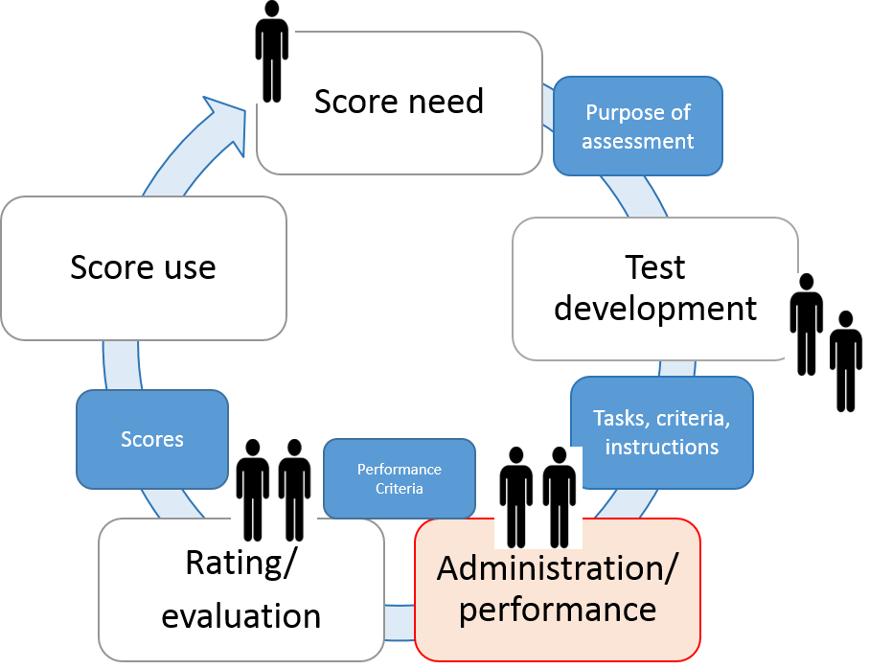
Validation Practices and Validity Evidence
Test Administration / Performance

Slide 23
Do combined tasks/prompts elicit a ratable sample – i.e., enough varied evidence of sustained, unrehearsed performance at level?
In unscripted Oral Proficiency Interviews, a checklist to remind helps interviewers ensure a ratable sample is obtained.
Your checklist should match test specifications for your speaking test

Slide 24
Sample Oral Proficiency interview guide
LEVEL 1 –
Ask and answer questions
Talk about self
Role pay – everyday sitation
LEVEL 2 – CONCRETE FUNCTIONAL
Present / past / future narration
Description
Instructions OR directions
Role play – situation with a complication
Report a current event
LEVEL 3 – ABSTRACT PROFESSIONAL
Detailed abstract description
Hypothesis / Speculation
Role play – unfamiliar role & situation
Use of formal and informal registers
Two supported opinions on abstract topics
LEVEL 4 – PROFESSIONAL TAILORING
Tailored speech to situation / audience
Roles plays – persuade, advise, negotiate
Support opinion on abstract topic
Present counter-arguments for opinion
Use formal and informal registers to convey messages with slang and/or idiomatic language to different people
Notes:
Other samples – Canada, Georgia

Slide 25
Do tasks and criteria implement the construct?
CLAIM: The test tasks are adequate proxies for those performed in the target language domain.
Are random speaking samples transcribed and/or re-listened to in order to:
ensure that speaking prompts do in fact elicit the intended language for task, level and accuracy?
ensure that language elicited is unrehearsed?
ensure that language elicited represents a ratable sample?
What records are kept?
Avoid construct
under-representation
Validity
evidence

Slide 26
Test administration validation
CLAIM: The test yields results that are consistent across assessment contexts (e.g., across test forms, tasks, and judges.)
Are test conditions and tasks uniform from one testing location to the next?
Are test conditions and tasks uniform between testing times?
Do written test administration instructions exist to outline testing conditions?
Validity
evidence
Alterations to procedures may introduce construct irrelevant variance

Slide 27
Test administration validation
CLAIM: The test yields results that are consistent across assessment contexts (e.g., across test forms, tasks, and judges.)
Standardized written test administration procedures published in a test administration manual should include….
Materials needed/allowed.
Order of presentation.
Instructions to be read verbatim.
Checking identity of test taker.
Policy to admit latecomers / leave test room.
Time limits.
Facility requirements.
Alterations to procedures may introduce construct irrelevant variance

Slide 28
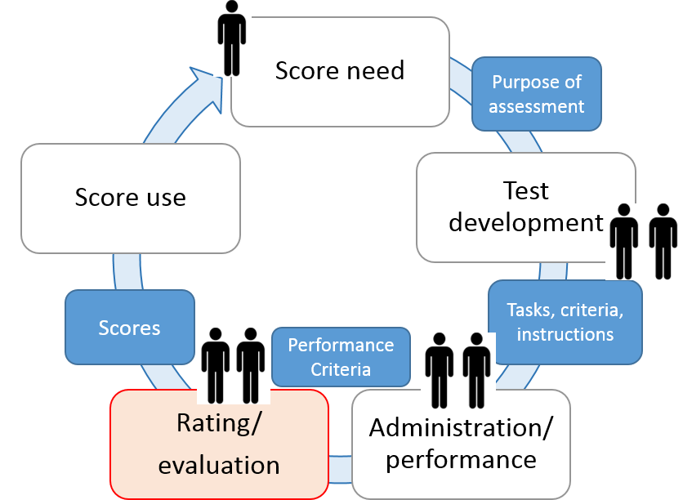
Validation Practices and Validity Evidence
Rating the performance

Slide 29
Do scoring criteria implement the construct?
CLAIM: The score on the STANAG 6001 speaking / writing test is an adequate reflection of the observed test behavior (i.e., scoring procedures are appropriate and clear, and test administration processes are carried out as intended by test designers.
Do published scoring rubrics clearly differentiate criteria required for each level?
Does rater training and norming address borderline ratings?
Validity
evidence

Slide 30
Scoring considerations
Holistic ratings vs. analytic ratings
Analytic scores must reflect salient features of written texts in a balanced way
Focused holistic scoring is based on an analytic rubric
Liz Hamp Lyons suggests the following facets be considered in a rubric or analytic rating scale:
Vocabulary
Grammatical competence
Textual competence
Accuracy
Fluency
Syntactic control
Rhetorical control

Slide 31
Reviewing and trialling scoring criteria
Are scoring rubrics for each task:
worded clearly?
efficient to use?
accompanied by responses that serve as clear exemplars?
Is the physical environment appropriate for scoring?
Do materials prevent scorers from seeing:
ratings assigned by other scores?
Identity of test taker?

Slide 32
Rater training and rater norming
Avoid rater variation
NEED FOR TRAINING:
Raters need to internalize interpretation of rating scale
NEED FOR NORMING:
Research has shown changes in rater behavior post training (low intra-rater reliability)
TRAINING AND NORMING alleviate rater tendency to harshness / leniency:
1 group of candidates, not others
1 task type, not others
1 aspect of communicative ability, not others

Slide 33
Inter- and Intra-rater reliability
How consistent are raters scores with one another?
How consistent are raters scores with themselves over time.
Statistical results and reports are validity evidence.
We have a workshop to learn to measure these aspects of scoring validity with Ulle….

Slide 34
To summarize: Scoring validation for speaking and writing
CLAIM: The test yields results that are consistent across assessment contexts (e.g., across test forms, tasks, and judges.)
Scoring captures relevant aspects of performance
Scoring procedures are fully outlined in written documents
Scoring procedures are trialled
Raters can implement scoring procedures consistently
Raters are trained
Raters are regularly normed
Raters are monitored and their ratings analyzed for inter-rater and intra-rater reliability
Inter- and intra-rater reliability inform training and norming
Notes:
Scoring Validity Considerations
Rating
Criteria/rating scale – holistic/global vs. analytic/profile
Rating process – consider role of rater – interlocutor and/or assessor? Number of interviewers will determine scoring decisions
Rating conditions – real time immediate rating or listen to a recording and rate at leisure?
Rater characteristics –
leniency / severity,
halo effect (one trait, eg grammar and vocab influences independent trait, e.g. discourse management);
Central tendency effect – overuse of middle categoory of a rating scale – avoidance of extremes
randomness effect – apply one or more categories in an inconsistent way
Bias effect – raters may show a pattern of harshenss /leniency with regard to one or more aspect of rating process – students, tasks, criteria of rating scale
Rater training
Grading and awarding – setting cut scores

Slide 35
Test factors that can influence scores
SLP
Rating
The Speaking test/OPI
Or
The writing test
Rating scales and scoring procedures
Written performance
The test instrument
Spoken performance
Rating criteria
Raters
Performance on Test
The test-taker
Notes:
Need ways to mitigate threats to validity and proof of having mitigated – validity evidence at all stages.
Possible reasons for misalignment with BAT from ACTFL examiners:
Testing rehearsed (rather than unrehearsed) language – misalignment of test type/purpose
E.g. using discrete questions in speaking test when goal is to measure spoken language proficiency
Inconsistent interpretation of STANAG 6001 – inadequate tester/rater training or norming

Slide 36
Love research?
Three (labor intensive) suggestions for further evidence to support validity CLAIMS of STANAG 6001 productive skills testing
1. Lexical Frequency Profiling Study for STANAG 6001 spoken & written texts
See: Douglas, S.R., The Relationship Between Lexical Frequency Profiling Measures and Rater Judgements of Spoken and Written General English Language Proficiency on the CELPIP-General Test. TESL CANADA JOURNAL/REVUE TESL DU CANADA 45 Volume 32, special issue 9, 2015

Slide 37
Considering post-graduate or doctoral studies?
Another (labor intensive) suggestion for further evidence to
support validity CLAIMS of STANAG 6001 productive skills testing
2. Hybrid Conversational/Discourse Analysis
of spoken & written texts from STANAG 6001 tests
See: Lazaraton, A. (2002). Studies in Language Testing 14: A qualitative approach to the validation of oral language tests. Cambridge: CUP

Slide 38
Got time on your hands?
A final (labor intensive) suggestion for further evidence to
support validity CLAIMS of STANAG 6001 productive skills testing
3. Expert ratings of language elicited in STANAG 6001 Oral Proficiency Interviews/ Speaking Tests – using checklists from descriptors
See: O’Sullivan, B. et.al, Using observation checklists to validate speaking test tasks. Language Testing 2002 19 (1) 33-56.

Slide 39
References
Advanced Language Testing Seminar Handbook (2016). Partner Language Training Center Europe (PLTCE), Garmisch, Germany.
Brown (2003) in Dubeau, J. (2006). Are we all on the same page? An Exploratory Study of OPI Ratings Across NATO countries using the NATO STANAG 6001 scale. Unpublished MA Thesis. [Accessed 2 Sep 2016 at http://natobilc.org/en/products/bilc-subjects/projects/ ]
Kane, Michael. (2006). Content-related validity evidence in test development. In S. M. Downing, & T. M. Haladyna (Eds.), Handbook of Test Development (pp. 131-153). Mahwah, NJ: Lawrence Erlbaum Associates.
Lazaraton, A. (2002). Studies in Language Testing 14: A qualitative approach to the validation of oral language tests. Cambridge: CUP
Luoma, Sari. (2004). Assessing Speaking. Cambridge: CUP
Malone, M. Investigating CEFR and ACTFL Tasks through Prompt and Elicitation Research in Tserj (ed) (year) sdfsdfsdfsdfdsf.
O’Sullivan, B. et.al, Using observation checklists to validate speaking test tasks. Language Testing 2002 19 (1) 33-56.
Shaw, S.D. and Weir, C.J. (2007) Studies in Language Testing 26: Examining writing. Cambridge: CUP
Taylor, L. (2011). Studies in Language Testing 30: Examining speaking. Cambridge: CUP
Weigle, S.C. (2002) Assessing Writing. Cambridge: CUP
Weir, Cyril J. (2005). Language Testing and Validation. Basingstoke: Palgrave Macmillan

Slide 40
The end
Thank you
and good luck!

Slide 41
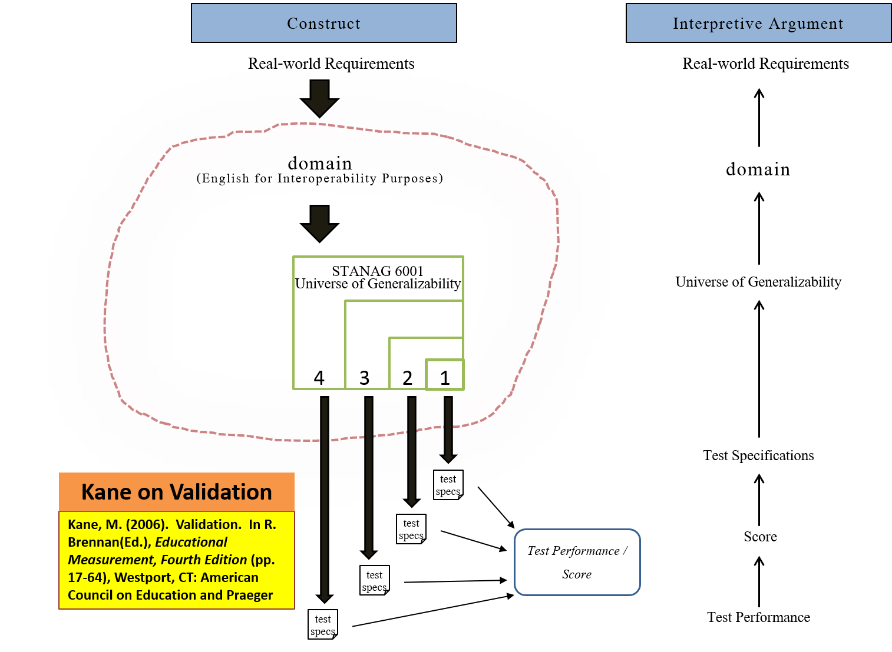
Score interpretation
What domain of language use beyond the test do we claim our inferences generalize to?

Slide 42
Score need
Administration/ performance
Rating/
evaluation
Score use
Test development
Purpose of assessment
Scores
Tasks, criteria, instructions
Performance Criteria

Slide 43
Protocol / format of test
Tasks/ prompts
Interviewer variation
Interviewer behavior & tester stance
Accommodation and support
Elicitation styles
Rater variation
Changes in rater behavior post training (low intra-rater reliability)
Lack of internalizing interpretation of rating scale
Harshness / leniency toward:
One group of candidates, not others
One task type, not others
One aspect of communicative ability, not others

Slide 44
Prompt Writing
Moderation &
Pre-editing
Trialling
Moderation & Editing
Qualitative analysis of responses
Trial review
Changes
Test construction
Examination overview, vetting and proofing
If small, move to next step
If major, return to trialling

