Slide 1
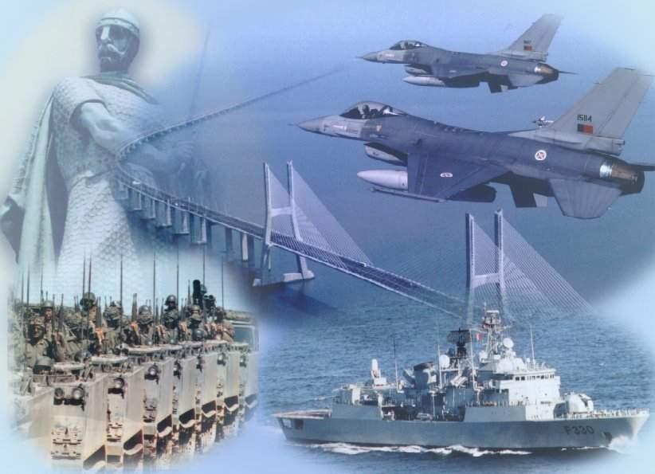
THE PORTUGUESE ARMED FORCES
BUREAU FOR INTERNATIONAL LANGUAGE CO-ORDINATION - BILC
Professional Seminar
Helsinki, Finland
04-09 October 2015
“Increasing Proficiency Levels:
What Works And What Doesn’t”
OCTOBER15
LT Estela Magalhães Parreira
Notes:
1

Slide 2
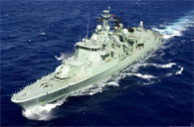
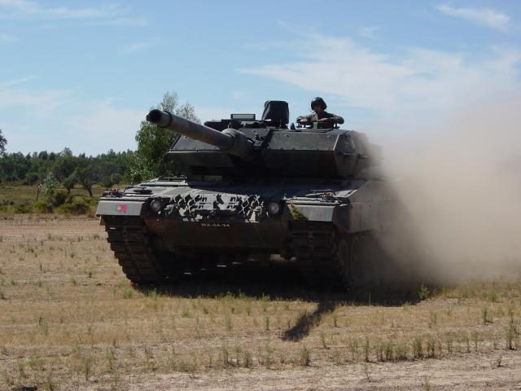
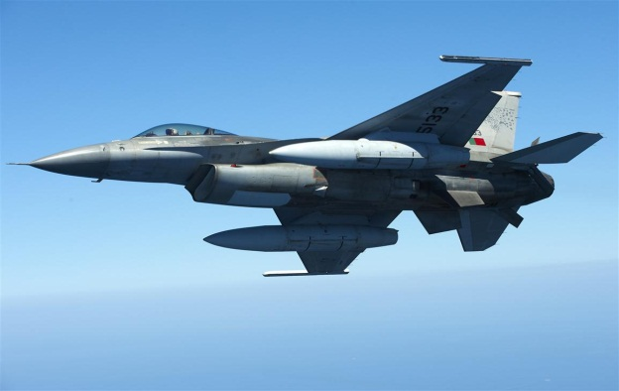
WHAT WORKS, OR… HAS WORKED
Notes:
2

Slide 3
INTRODUCTION
Notes:
3

Slide 4
STUDENT
ATTITUDE
TIME
NEED
INCREASE PROFICIENCY
MOTIVATION
APTITUDE
TEACHER
Notes:
4

Slide 5
TEXTBOOKS
MATERIALS
TOOLS
ACTIVITIES
TECHNOLOGY
Notes:
5

Slide 6
ACTIVITIES
Notes:
6

Slide 7
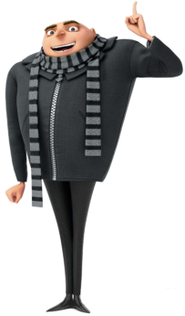
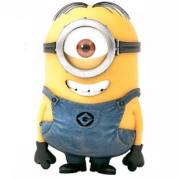
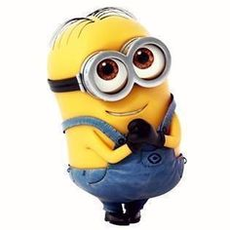
Bob
Kevin
Stuart
Gru

Slide 9
HOW IS THE WEATHER?
Gru

Slide 10
Listen to the weather forecast by Bryan Shaw and answer the questions.
What is Bryan Shaw’s profession?
__________________________________
2. What is Irene expected to make very shortly?
___________________________________
3. What weather phenomena are going to be very possible?
___________________________________

Slide 13
TEAM A
Bob
CAN YOU REMEMBER?
TEAM B

Slide 16
SUNDAY MORNING
Kevin

Slide 17
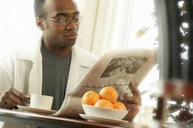
Read the text and then select the best answer.
On Sunday, Tom gets up at 10 o'clock. Then he reads his newspaper in the kitchen. He has breakfast at 11.30 and then he telephones his mother in Scotland.
In the afternoon, at 1.00, Tom plays tennis with his sister and after that, they eat dinner in a restaurant. At 6.00, Tom swims for one hour and then he goes by bike to his brother´s house. They talk and listen to music.
Tom watches television in the evening and drinks a glass of Jack Daniel's whiskey. He goes to bed at 11.30.
Where does Tom have breakfast? In the kitchen In his bedroom In the lounge
2. Who does he telephone in the morning? His sister His brother His mother

Slide 18
Read the text and then select the best answer.
On Sunday, Tom gets up at 10 o'clock. Then he reads his newspaper in the kitchen. He has breakfast at 11.30 and then he telephones his mother in Scotland.
In the afternoon, at 1.00, Tom plays tennis with his sister and after that, they eat dinner in a restaurant. At 6.00, Tom swims for one hour and then he goes by bike to his brother´s house. They talk and listen to music.
Tom watches television in the evening and drinks a glass of Jack Daniel's whiskey. He goes to bed at 11.30.
1. Tom gets up at 10am on Sundays.
True
False
2. Tom reads the newspaper in the lounge.
True
False

Slide 21
Stuart
PARTY TIME!!!!

Slide 22
You are going to organize a theme party next weekend.
Send an email to your friends to invite them. Don’t forget to inform them of the date, day of the week, time, location, dress code according to the theme you chose, etc.. You may also let them know what you will have to eat and drink and the kind of music.

Slide 25
AM I SEEING DOUBLE, TRIPLE, QUADRUPLE…?
Gru

Slide 26
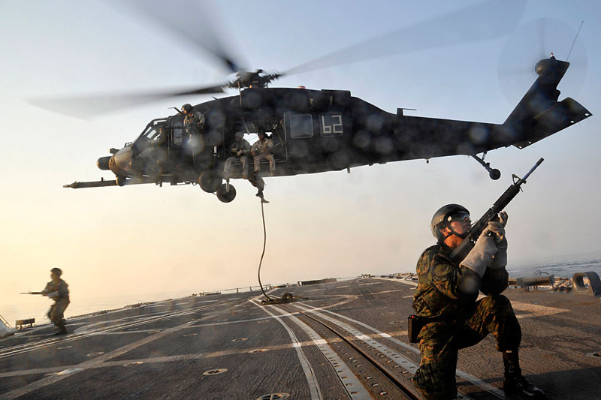
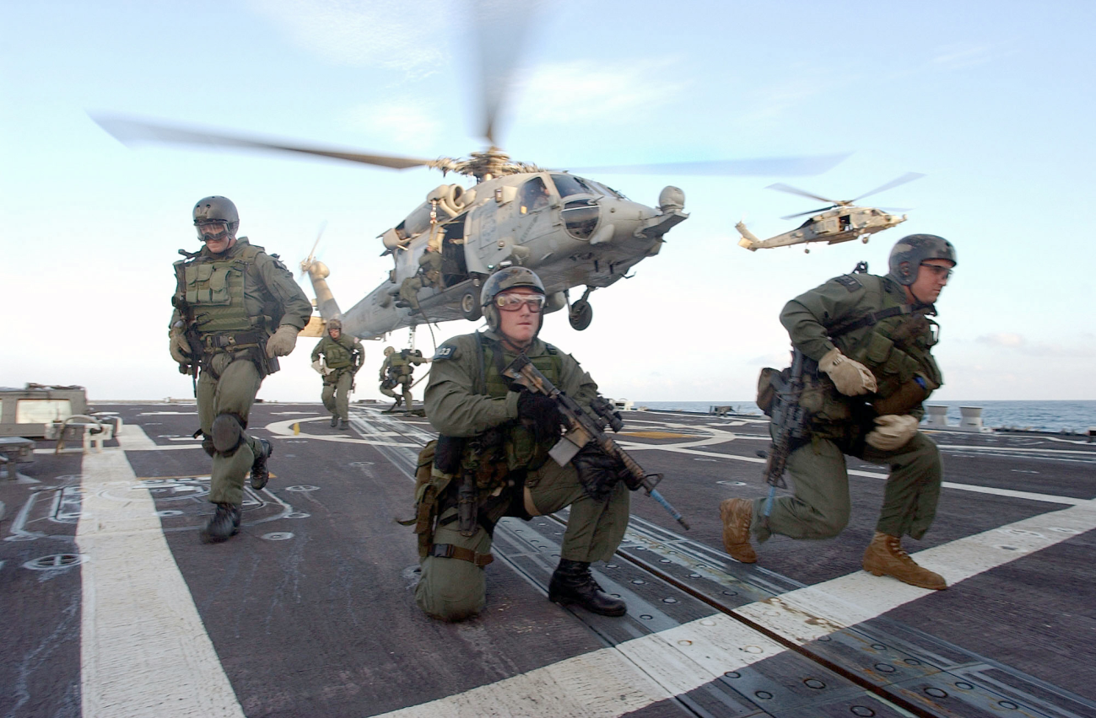
1
2
3
4

Slide 29
DESCRIBE THE PICTURE?... PIECE OF CAKE!
Bob

Slide 30
THERE ARE…
HELICOPTERS…

Slide 34
WOW!
MR. CHAPLIN IS HERE.
Kevin

Slide 35
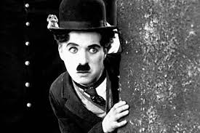
Charlie Chaplin
“…In 1896, Chaplin's mother was unable to find work;
Charlie and his older half-brother Sydney Chaplin had
to be left in the workhouse at Lambeth, moving after
several weeks to Hanwell School for Orphans and
Destitute Children. His father died an alcoholic when
Charlie was 12, and his mother suffered a mental
breakdown, and was eventually admitted temporarily
to the Cane Hill Asylum at Coulsdon (near Croydon). She died in 1928 in the United States, two years after coming to the States to live with Chaplin, by then a commercial success.
Charlie first took to the stage when, aged five, he performed in Music Hall in 1894, standing in for his mother. As a child, he was confined to a bed for weeks due to a serious illness, and, at night, his mother would sit at the window and act out what was going on outside. In 1900, aged 11, his brother helped get him the role of a comic cat in the pantomime Cinderella at the London Hippodrome. In 1903 he appeared in 'Jim, A Romance of Cockayne', followed by his first regular job, as the newspaper boy Billy in Sherlock Holmes, a part he played into 1906. This was followed by Casey's 'Court Circus' variety show, and, the following year, he became a clown in Fred Karno's 'Fun Factory' slapstick comedy company….”

Slide 36
Charlie Chaplin
Chaplin's mother died before her son was successful. True False
Chaplin first performed on the stage after he arrived in the United States. True False
His first serious job was delivering newspapers. True False

Slide 39
Stuart
CHAIN WRITING

Slide 40
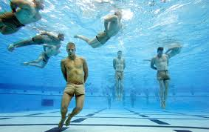
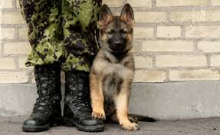
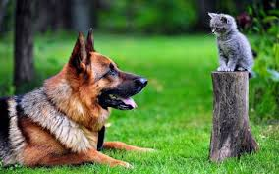
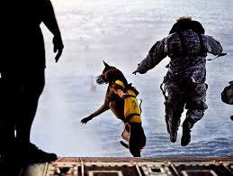
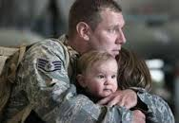
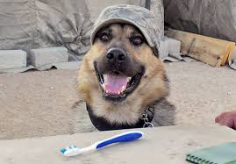
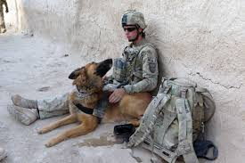
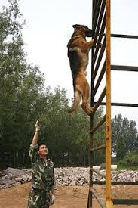
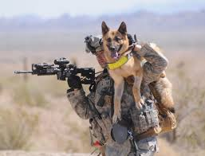

Slide 43
THE HERO!!!!
Gru

Slide 44
Listen to the Time Magazine interview with former Navy Seal Chris Kyle and answer the questions.
1. Why does Belinda Luscombe say that Kyle is going to face smattering friendly fire?
_____________________________
2. Why did Chris Kyle write a book?
____________________________
3. Why does Kyle’s wife say that when goes home he takes his cape off?
_________________________________

Slide 47
TV TALKSHOW
/
RADIO BROADCAST
Bob

Slide 48
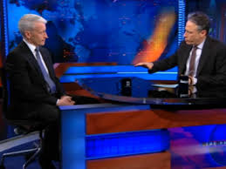
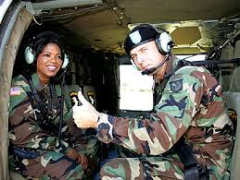

Slide 51
I’M BENCHED
Kevin

Slide 52
Stuart
SECRET MISSION

Slide 53
ZULU PLATOON
WRITE A MEMO INFORMING 1ST COMPANY SOLDIERS THAT THERE WILL BE AN INSPECTION IN THEIR BARRACKS TOMORROW AT 10.00.
THEY SHOULD NOT HAVE ANY ITEMS MISPLACED, THE FACILITY SHOULD BE NEAT AND CLEAN.
THEY SHOULD STAND AT ATTENTION BESIDE THEIR BUNKS.
THEY SHOULD WEAR THEIR BATTLE DRESS UNIFORM
YANKEE PLATOON
WRITE A SHORT AFTER ACTION REPORT TO THE COMPANY COMMANDER ABOUT THE INSPECTION IN 1ST COMPANY BARRACKS.
REPORT ON:
ANY MISPLACED ITEMS
FACILITY CLEANNESS
SOLDIERS AT ATTENTION BESIDE THEIR BUNKS
BATTLE DRESS UNIFORM

Slide 56
OH!!!
THE TITANIC…
TELL ME… TELL ME!
Gru

Slide 57
Listen to the BBC News Report “Titanic Wreck Discovery.
Summarize the News Report for your classmates.

Slide 60
DEBATE WITH ROLE PLAY
/
CAMPAIGN FOR THE ELECTIONS
Bob

Slide 66
LIVES MAY DEPEND ON IT!
Notes:
66

Slide 67
THE PORTUGUESE ARMED FORCES
BUREAU FOR INTERNATIONAL LANGUAGE CO-ORDINATION - BILC
Professional Seminar
Helsinki, Finland
04-09 October 2015
“Increasing Proficiency Levels:
What Works And What Doesn’t”
OCTOBER15
LT Estela Magalhães Parreira
Notes:
67

