Slide 1
EMILIE CLERET
HEAD OF THE ENGLISH DEPARTMENT
DIRECTION DE L’ENSEIGNEMENT MILITAIRE SUPERIEUR

Slide 2
CHALLENGES OF TEACHING
THE SKILL OF WRITING
IN ENGLISH
AT LEVEL 4

Slide 3
STUDENT PROFILES IN ECOLE DE GUERRE
160 FRENCH SENIOR OFFICERS
FROM THE 3 SERVICES, THE GENDARMERIE, THE MEDICAL CORPS, ADMINISTRATIVE OFFICERS
VERY DIFFERENT INTERNATIONAL EXPOSURE
VERY DIFFERENT EXPOSURE TO ENGLISH LANGUAGE
VERY WIDE RANGE OF LEVELS
WHAT DO WE OFFER TO THE HIGHLY PROFICIENT STUDENTS?

Slide 4
3 PROJECT-RELATED GROUPS
DEBATING
NETWORKING
RESEARCH AND WRITING

Slide 5
RESEARCH AND WRITING
AMERICAN AND BRITISH PARTNERS
A LIST OF RESEARCH QUESTIONS AND RESEARCH TOPICS
FREE CHOICE OF A QUESTION OR TOPIC
RESEARCH (READINGS AND INTERVIEWS)
RESEARCH PAPER OR ARTICLES
PRESENTATIONS IN THE US AND THE UK
PUBLICATION

Slide 6
PARTNERS AND RESEARCH QUESTIONS
UNITED KINGDOM
ROYAL UNITED SERVICES INSTITUTE
BREXIT/European Defence
The Denied Environment
Command in the Information Age
The Future of Alliances
The Impact of Autonomy on Warfare
Pol/Mil Decision-Making: Changing Paradigms

Slide 7
PARTNERS AND RESEARCH QUESTIONS
UNITED STATES
DEPARTMENT OF STATE
GLOBAL ENGAGEMENT CENTER
YALE UNIVERSITY
Weaponization of information

Slide 8
PARTNERS AND RESEARCH QUESTIONS
UNITED STATES
CABLE NEWS NETWORK
The media and the military
INSTITUTE FOR STATE EFFECTIVENESS
Failed states and terrorist networks

Slide 9
WHO IS THE TEACHER?
Native speaker, qualified to teach English as a second language
PhD
Ghostwriter, columnist, speech writer, proofreader both in the US and the UK
Writing coach
Public-speaking

Slide 10
STANAG 6001 DESCRIPTORS - WRITING
LEVEL 3
Can convey abstract concepts when writing about complex topics (which may included economics, culture, science and technology) as well as his/her professional field.
Although techniques used to organize extended texts may seem somewhat foreign to native readers, the correct meaning is conveyed.
When it is necessary for a document to meet full native expectations, some editing will be required.

Slide 11
STANAG 6001 DESCRIPTORS - WRITING
LEVEL 4
Demonstrates strong competence in formulating private letters, job-related texts, reports, position papers and final drafts of a variety of other papers.
Shows the ability to use the written language to persuade others and elaborate on abstract concepts.
Organizes extended texts well, conveys meaning effectively, and uses stylistically appropriate prose.

Slide 12
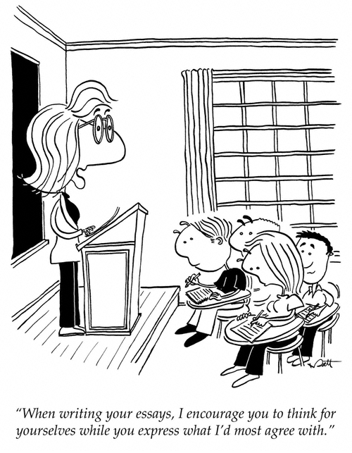
POTENTIAL DIFFICULTIES

Slide 13
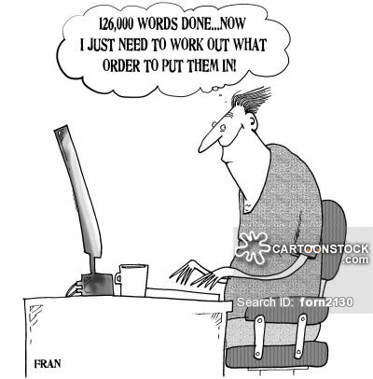
POTENTIAL DIFFICULTIES

Slide 14
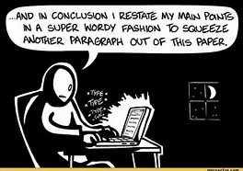
POTENTIAL DIFFICULTIES

Slide 15
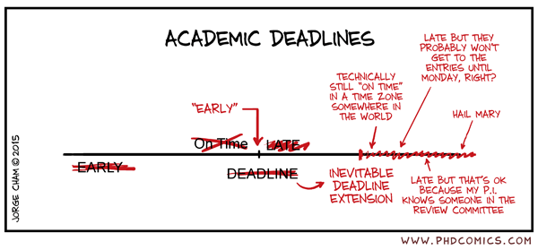
POTENTIAL DIFFICULTIES

Slide 16
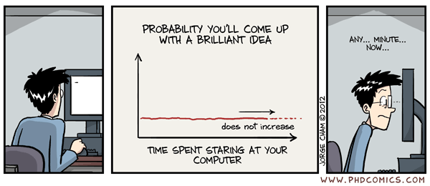
POTENTIAL DIFFICULTIES

Slide 17
SOLUTION?
PROCESS APPROACH
Focus on creativity and motivation
Five stages in the approach:
Pre-writing
Drafting
Revising
Editing
Sharing

Slide 18
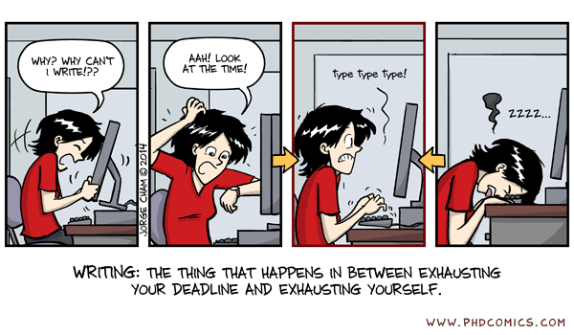

Slide 19
