Slide 1
PORTUGAL
BUREAU FOR INTERNATIONAL LANGUAGE CO-ORDINATION BILC
Language Testing Seminar
Bled, Slovenia
19-26 October 2012
“Back to Basics: Recipes for Instructional Success”
Teaching Specific Skills
LT Estela Magalhães Parreira

Slide 2
Agenda
Introduction
Teaching Skills in the Armed Forces
Conclusions

Slide 3
Introduction

Slide 4
Countries are increasingly paticipating in multinational operations theatres worldwide
MOD’s are required to engage their forces in a “Joint” context
Branches are deploying their military to operate with foreign personnel

Slide 5
This level of commitment and responsibility implies a high effort from the nations to adequately prepare the military
Apart from the military technical training, and in order to guarantee a high level of performance from the personnel deployed abroad, we must point out the importance of linguistic competences

Slide 6
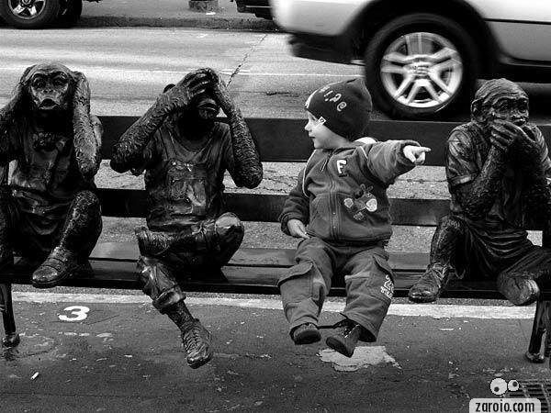
Teaching the Skills

Slide 7
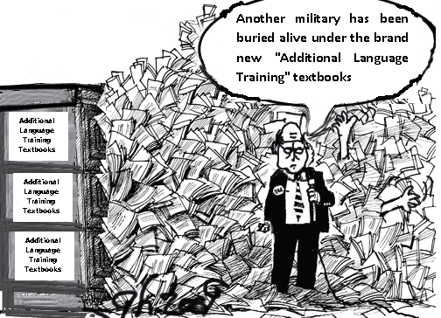
Hence, ensuing that the STANAG requirements
are met, it is important to consider the
possibility of offering the military
additional language training;
comprising mission oriented
“crash courses” to
improve the level of skills

Slide 8
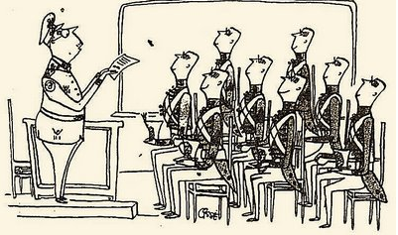
In accordance with mission specifications, and taking into consideration the premises of orienting the development of the 4 skills, pre-deployment training must include
“English Skills Enhancement”.

Slide 9
Would it be possible to pick up acceptable linguistic competences and enhance the skills by attending a “technical” course specifically developed for the missions?

Slide 10
General idea:
When military personnel fairly meet
STANAG 6001 requirements and are appointed as part of a multinational operation force, they must be able to effectively and efficiently communicate within the technical military boundaries of the mission

Slide 11
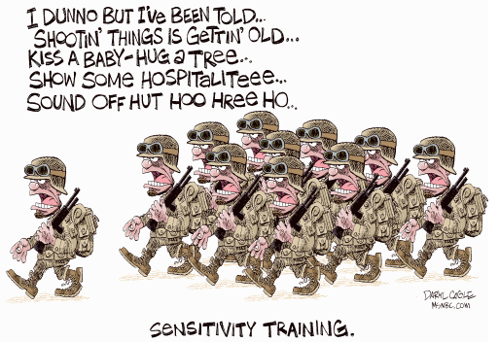
To successfuly develop a course that meets the specific features of the mission, it is important to:

Slide 12
Identify the mission:
Patrolling
Security
RECON

Slide 13
Research:
The main objective is to expose the student to an environment as close as possible to what he/she is going to experience on the field (as real as it can be within a classroom context)

Slide 14
Extensively search for materials related to the mission itself : such as SOP’s, Military English Books, STANAGS, Reports from previous deployments, realia (written documents, audio recordings…), internet
Select grammar material wisely, considering the area of intervention and responsibilities

Slide 15
Organize the Course:
After selecting/gathering the materials (vocabulary and grammar) recorded (L) and written (R) combine them into lessons
Develop exercises and tasks for the skills
Schedule all the items and estimate how much time is needed for each of them (remember it is a crash-course)

Slide 16
Textbook:
When all the material gathering, planning and estimating is done, compile it into a draft manual
Add appealing images (ex. realistic fotos)
The “pre-manual” is ready

Slide 17
Completion:
Review and revise
Make the necessary adjustments
Improve what needs improvement
Don´t forget to credit the original sources

Slide 18
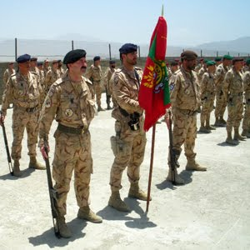
Samples of materials and / or activities for each skill:

Slide 21
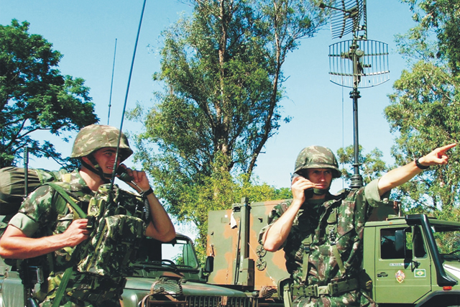
Listening

Slide 22
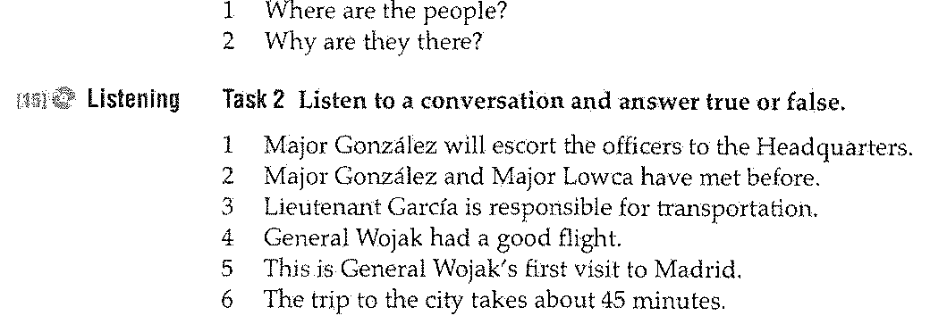

Slide 23
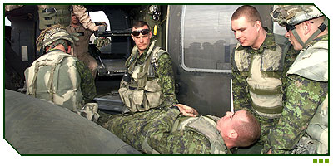

Slide 25
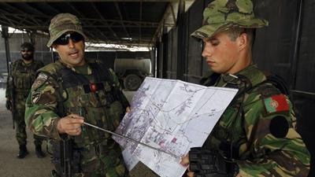
Speaking

Slide 26
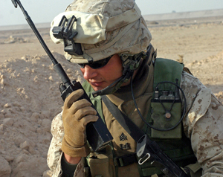

Slide 28
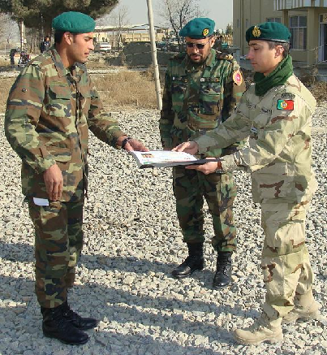
Reading

Slide 29
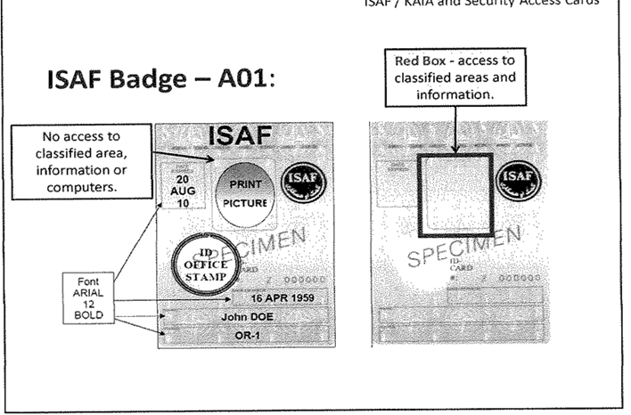

Slide 30
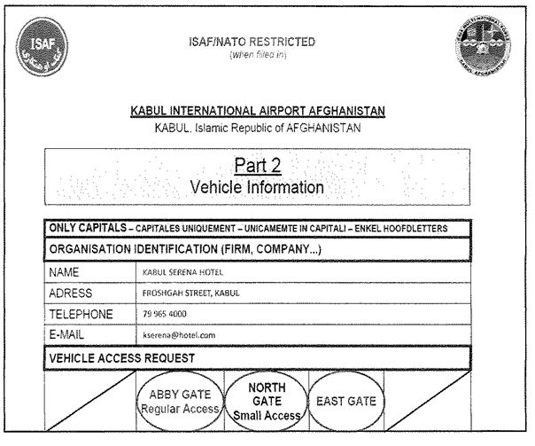

Slide 31
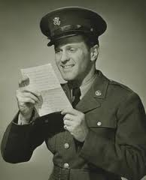

Slide 32
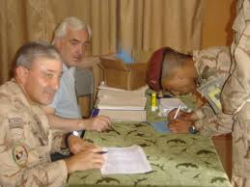
Writing

Slide 33
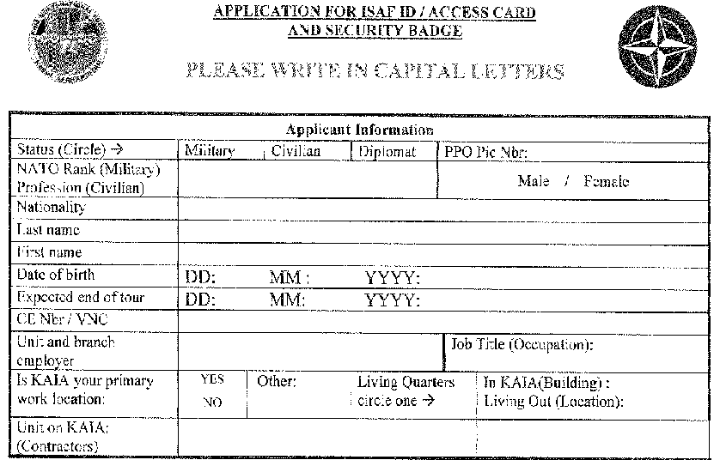
Fill out the form

Slide 34
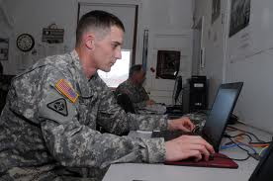
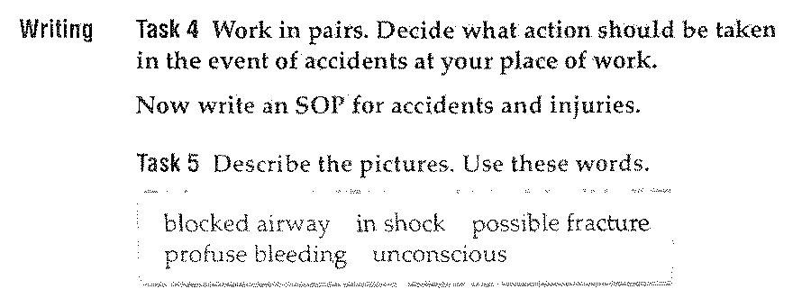

Slide 35
Conclusion

Slide 36
Even if our Military meet the STANAG requirements, we can always make an effort to improve their skills
Interoperability, safety, performance and above all
LIFE
May depend on it

Slide 37
PORTUGAL
BUREAU FOR INTERNATIONAL LANGUAGE CO-ORDINATION BILC
Language Testing Seminar
Bled, Slovenia
19-26 October 2012
“Back to Basics: Recipes for Instructional Success”
Teaching Specific Skills
LT Estela Magalhães Parreira

