Slide 1
Principles to strategic motivation.
Col. Ibrahim
MODLI
Egypt

Slide 2
What makes one student come to school happy, energetic, and enthusiastic?

Slide 3
Types of motivations
Intrinsic
Extrinsic
Autonomy
Belonging
Curiosity
Learning
Mastery
Meaning
Stars
Badges
Rewards
Fear of punishment
Fear of failure
Money

Slide 4
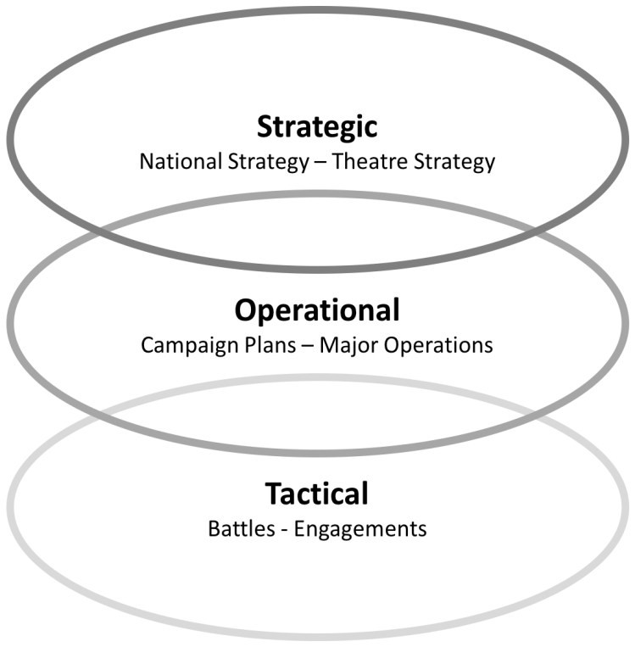
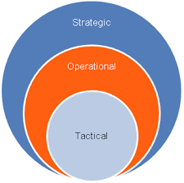

Slide 5
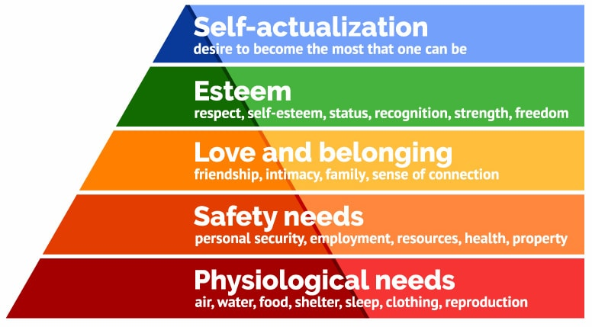

Slide 6
Strategic motivation comes true through the following:
1. Showing the ss the bigger picture. 2. Using curriculum that is closely connected to real life tasks. 3. Engaging the students.

Slide 7
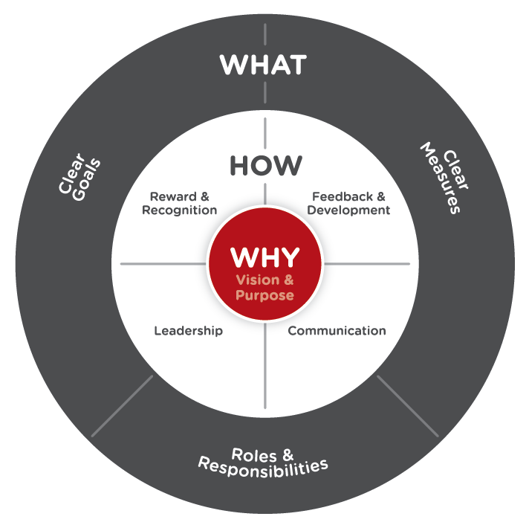
1. Showing them the bigger picture.

Slide 8
They are the most successful.
They have ability to advance their career.
They want it.

Slide 9
Why are you learning a foreign language?
Integration
Cooperation
Experience exchange
Knowledge exchange
Combined exercises

Slide 10
Brief history
Mission
Vision
Hall of fame
world peace
Peace keeping
Interoperability
Coalition

Slide 11
To show the bigger picture we need to state what.
What is going to happen next?
What are the tasks the student needs to perform?
What is required from the student at the end of his study in different skills?
What are the criteria?

Slide 12
2. Using curriculum that is closely connected to real life tasks.

Slide 13
Samples of MODLI publications

Slide 14
3. Engaging the students
Classroom activities
Guide on the side
Pair work
b. Classroom decisions
choice
in control
freedom

Slide 15
References
https://www.youtube.com/watch?v=u4ZoJKF_VuA
Teaching by principles – H. Douglas Brown

