Slide 1
Research at DLIFLC: What We Do and How We Do It
Briefing for BILC
18 October2011

Slide 2
DLIFLC Research Program
Distributed throughout Institute; led by Research & Analysis Division (RA)
RA Mission includes:
Conducting or coordinating approved studies
In-house and via contract (CASL)
Leveraging other USG entities (ARI)
Coordinating research by DLI faculty and others
Managing the Human Research Protection Program
Obtaining customer feedback
Conducting targeted program evaluations

Slide 3
Center for the Advanced Study of Language (CASL)
NSA-sponsored University-Affiliated Research Center, at University of Maryland
Conduct targeted research in support of USG language professionals
Now in 8th year
Advantages for DLIFLC
Client agencies may use CASL via NSA contract
Trusted agent; substantial DLIFLC experience
Several DLIFLC-relevant projects under way

Slide 4
Some DLI-Relevant Projects
CASL Projects
“Passage-Length” Study
Tone Aptitude
Lexical Learning and Homework
Optimal Feedback in Distance Learning
DLAB2
Army Research Institute Project
Delivering Language and Cultural Training to Deployed Troops
Notes:
CASL Projects]
“Passage-Length” Study [no added slides; just talk it]
Tone Aptitude [no added slides; just mention briefly in passing]
Lexical Learning and Homework [no added slides; just talk them both]
Optimal Feedback in Distance Learning [add 1 slide for this and ARI]
DLAB2 [add 1-2 slides on this]
Army Research Institute Project
Delivering Language and Cultural Training to Deployed Troops [include on the one slide with the CASL dL feedback project]

Slide 5
Update the DLAB
Defense Language Aptitude Battery (DLAB) is the most validated test of language aptitude but is 40 years old and may be outdated.
Goals for the DLAB2:
Fine tune the current DLAB to better predict learning outcomes and understand and prevent attrition
Improve measurement of the cognitive skills and abilities required for language learning success at DLIFLC
Assess the personality traits required for language learning success in the rigorous environment that is DLIFLC
Assess motivation for language learning; do not assume it!

Slide 6
DLAB2: Study method
Participants: New enrollments in first week at DLIFLC
N = 1,312 students in the final data analysis
Followed them for the duration of their time at DLIFLC, up to 64+ weeks later
Language Categories: I, III, IV
Test battery:
32 Biographical variables
22 Cognitive variables
26 Personality variables
28 Motivation variables

Slide 7
DLAB2 Constructs
Cognitive
Some of current DLAB
Verbal ability
Mathematical ability
Abstract reasoning
Working memory
Biographical
Revised/reduced DLAB section 1
Prior formal language learning
Number of prior foreign languages learned
Non-cognitive
Academic Achievement
Academic Adjustment
Intellectual Efficiency
Learning Orientation
Order
Persistence
Physical Conditioning
Sociability
Tolerance
Well Being/Optimism
*Aesthetics & Depth as neutral filler dimensions

Slide 8
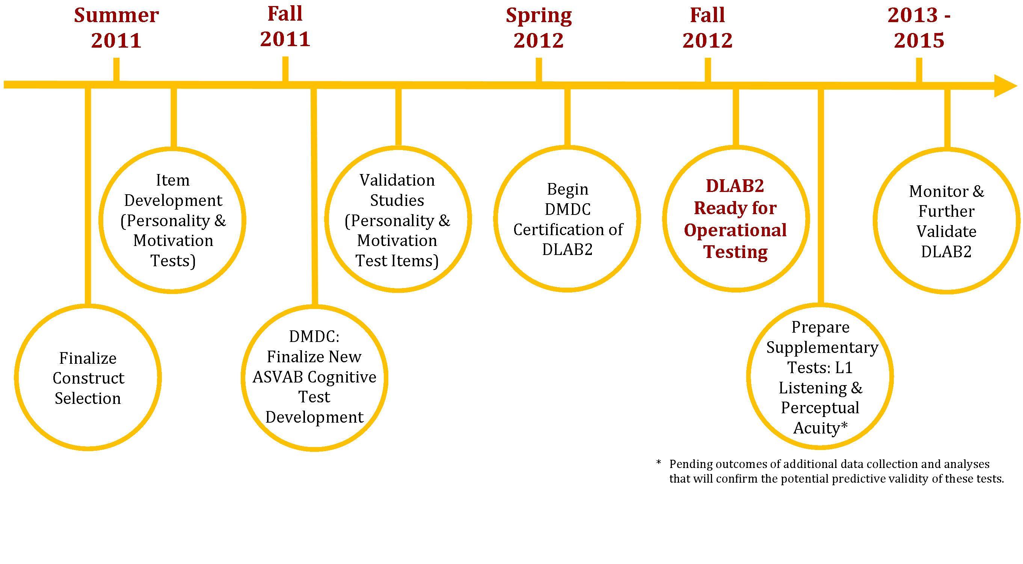
DLAB2 Timeline

Slide 9
Distance Learning Projects
Army Research Institute:
“Optimal Approaches to Delivering Foreign Language and Cultural Training to Deployed and Pre-deployment Forces”
CASL:
“Authentic Input, Learner Output, Interaction and Feedback on Error in Distance Learning Context”

Slide 10
Research at DLIFLC
“We help people find out!”

