Slide 1
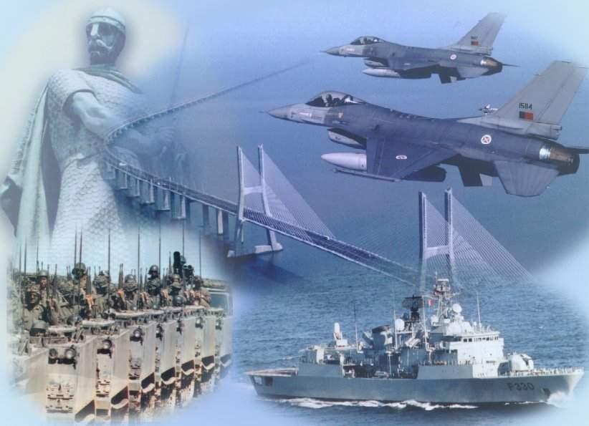
THE PORTUGUESE ARMED FORCES GENERAL STAFF
BUREAU FOR INTERNATIONAL LANGUAGE CO-ORDINATION - BILC
BILC Professional Seminar
Tbilisi, Georgia
1-5 October 2017
Standardization in the Portuguese Armed Forces
- Challenges and Benefits -
LtCdr Marta Gabriel

Slide 2
Standardization in the Portuguese Armed Forces
Standardization – an approach
2. Current situation
2.1. Who are we?
2.2. What is our business?
2.2. What are our challenges?
2.3. What have we been doing to improve?
3. Benefits of standardization

Slide 3
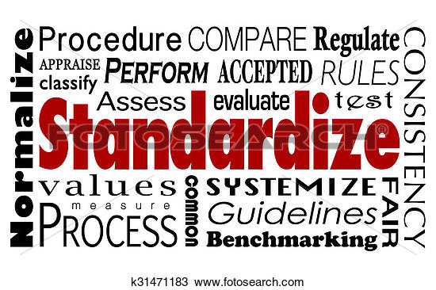
1. Standardization – an approach

Slide 4
1. Standardization – an approach
Standardization is a system that promotes a combined and aligned effort leading to a common goal.
http://www.collabridge.com/wp-content/uploads/2013/05/standardization.jpg

Slide 5
Standardization in the Portuguese Armed Forces
Standardization – an approach
2. Current situation
2.1. Who are we?
2.2. What is our business?
2.2. What are our challenges?
2.3. What have we been doing to improve?
3. Benefits of standardization

Slide 6
2. Current situation
2.1. Who are we?
Facility | Location | Human Resources
Portuguese Armed Forces General Staff HQ Language Lab | Lisbon – MoD | 2 Civilians 1 officer
NAVY English Language Department | Almada – Naval Base | 4 officers 2 NCO
ARMY Army Languages Center | Caldas da Rainha | 9 civilians 4 officers
AIR FORCE Air Force Languages Center | Ota | 3 officers 1 NCO

Slide 7
2. Current situation
2.2. What is our business?
Facility | Training | Testing (Jan-Sep17)
Portuguese Armed Forces General Staff HQ Language Lab | Upon request | 72 tests (59 English + 13 French)
NAVY English Language Department | English French – upon request | 135 tests (English) Provided some preparation in French for a specific mission
ARMY Army Languages Center | English and French | (around) 500 tests
AIR FORCE Air Force Languages Center | English and French | 134 tests (11 English + 121 French)

Slide 8
2. Current situation
2.3. What are our challenges?
Downsizing of human resources
Retention of personnel (contract)
Training of specialized personnel - not a priority
Alignment – interpretation of STANAG 6001 descriptors/levels (new members)
Alignment and improvement of national regulation

Slide 9
2. Current situation
2.4. What have we been doing to improve?
Updated and improved Directive, issued by the Chief of Defense (21JUN17)
Developing the Regulation on test specifications, test development, test administration – ongoing task
Promoting meetings with testing and training specialists from the services – on a regular basis

Slide 10
2. Current situation
2.4. What have we been doing to improve? (con’t)
Sharing and promoting BILC invitations to courses, workshops and seminars
Promoting the access to BILC Sharp to most members
Developing a shared page in the General Staff internal webpage - ongoing

Slide 11
Standardization in the Portuguese Armed Forces
Standardization – an approach
2. Current situation
2.1. Who are we?
2.2. What is our business?
2.2. What are our challenges?
2.3. What have we been doing to improve?
3. Benefits of standardization

Slide 12
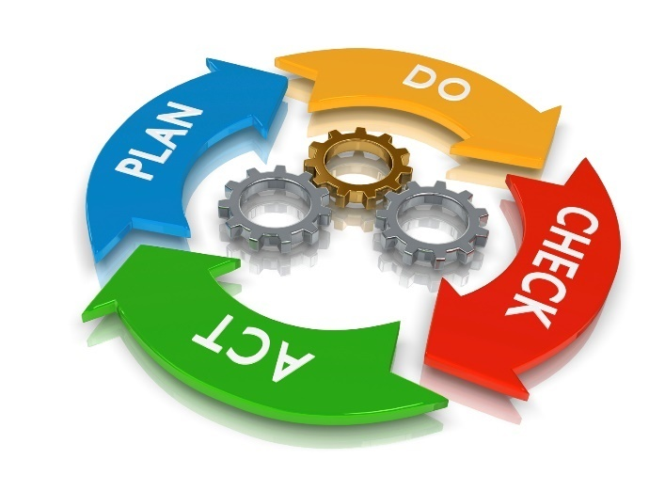
3. Benefits of standardization
System
Training and testing
Alignment
STANAG 6001
Directives
internAtional and national
Reliability
valiDity
combIned and common
gray Zones
Assessment
objecTivity
interoperabIlitity
cOmmunication
laNguage

Slide 13
THE PORTUGUESE ARMED FORCES GENERAL STAFF
გმადლობთ
Thank you
Obrigado
mcgabriel@emgfa.pt
martitagabriel@gmail.com

