Slide 1
Statistical analysis using MS Excel customized file
Cosmin Sala
Suzana Horvat
STANAG 6001 Testing Workshop
Bonn, 2022

Slide 2
Mini-workshop objectives
Present
... a customized Excel file with programmed in formulas for statistical analysis based on CTT
Understand
... the way a customized Excel file works to deliver item/test statistics
Learn
... to use a customized MS Excel file to get the required results
Discuss
... acceptable values/intervals and conclusions that could be drawn
Receive
… constructive feedback from language assessment experts

Slide 3
Your national testing practices
Discussion in small groups:
Test characteristics and frequency of testing
Test population characteristics
Tools used for statistical analysis
Data analysis/interpretation – team members or outsourced experts?
Classical Test Theory or Item Response Theory
Test summary report

Slide 4
Statistical analysis
TEST STATISTICS
Mean – AVERAGE()
Mode – MODE()
Median – MEDIAN()
Standard deviation – STDEV()
Range
Skewness - SKEW()
Kurtosis – KURT()
ITEM STATISTICS
Facility value
Discrimination index/B-index
Distractor efficiency
Pearson product-moment correlation PEARSON(),CORREL()
TEST RELIABILITY
Alpha coefficient
Alpha if item deleted
KR-20, KR-21

Slide 5
Specialized Excel file - advantages
Budget reasons
Security of IT infrastructure
User-friendly and easy to learn
Simplicity of data input
Easy access to the raw/converted data in the table

Slide 6
Specialized Excel file - description
Data worksheet
designed to insert/manipulate raw data
computes the values/indices used to evaluate the test/items
Results worksheet
displays the results in a relatively easy to read/interpret fashion

Slide 7
Data Worksheet
contains user dedicated areas (editable) and computing areas (locked)
can be used to evaluate up to 50 items and up to 300 test takers
there are some limitations regarding data input

Slide 8
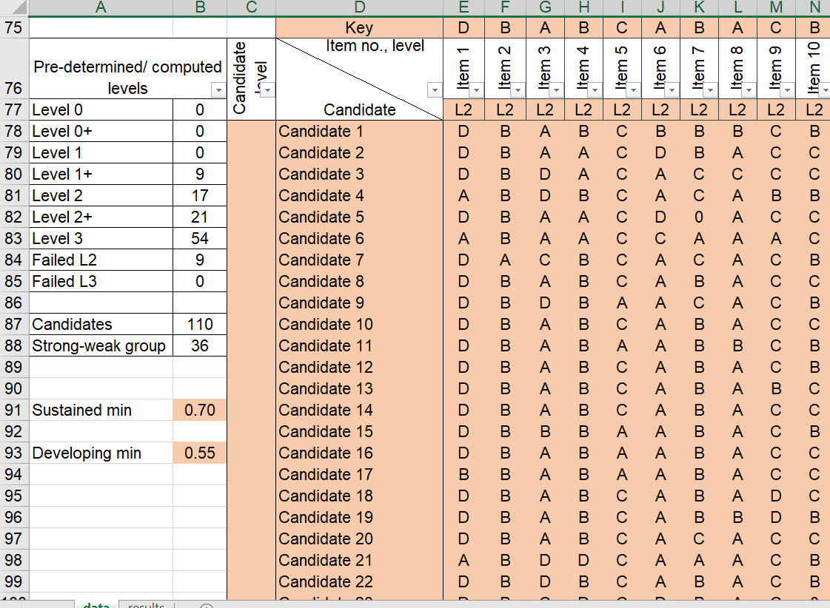
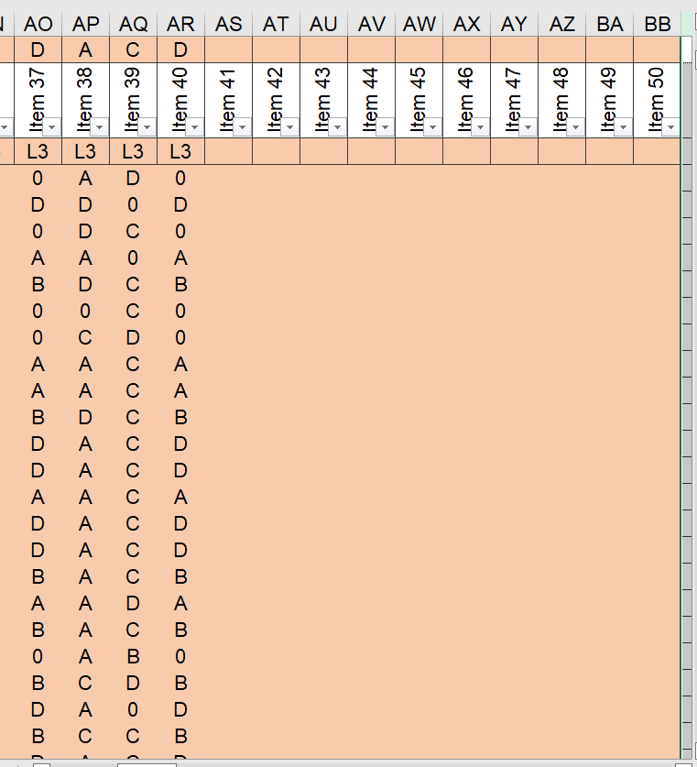
Data Worksheet - User Dedicated Areas

Slide 9
Data Worksheet – Sorting/Computing Areas
Notes:
areas used for computing the results are responsible for:
raw data converting and total score/level calculation,
ordering converted scores based on total score,
variance and alpha computing,
distractor analysis based on total score,
ordering converted scores based on the test takers’ level,
distractor analysis based on pre-established/calculated level.
Apart from these areas, on the top of the worksheet (usually hidden rows), there are results’ areas (that are transferred to data worksheet for an easier visualization).

Slide 10
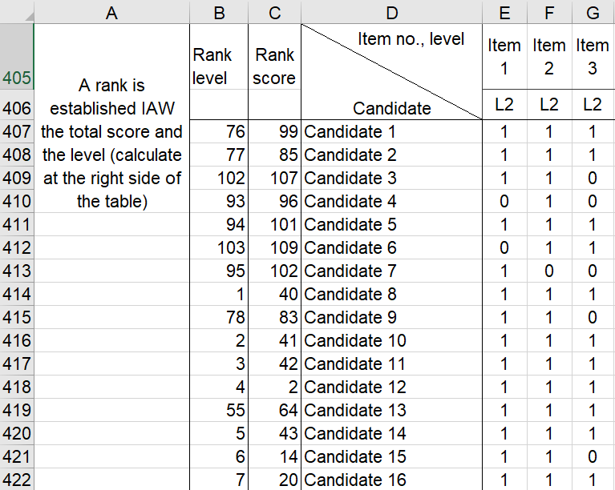
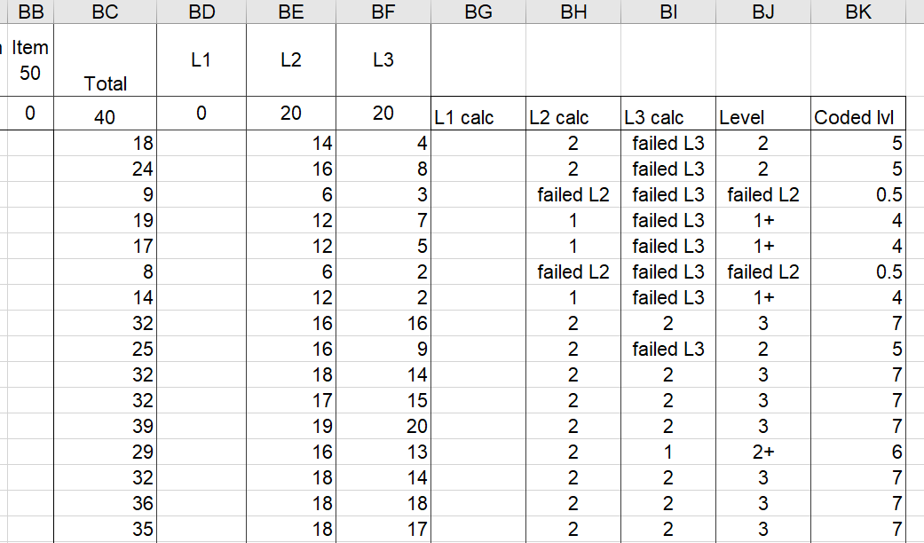
Raw Data Converting, Score/Level and Rank Calculation
Notes:
Area used as a step in calculating DI, B-index, FV per level, and distractor analysis.

Slide 11
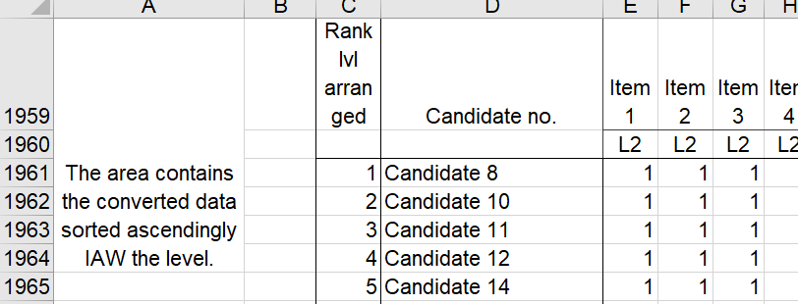
Sorting Converted Data based on Total Score/Level
Notes:
Area used for DI calculation.

Slide 12
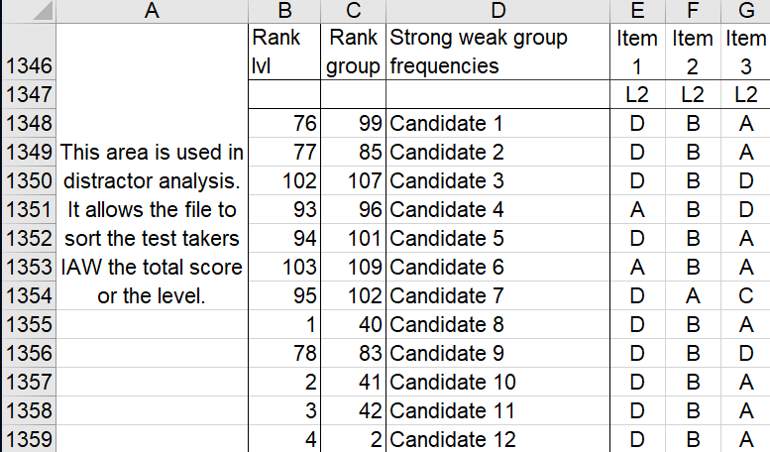
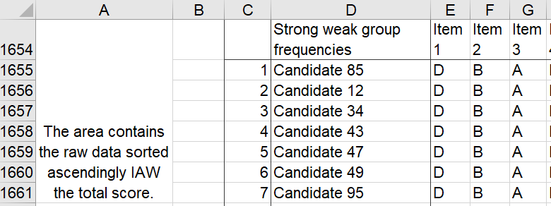
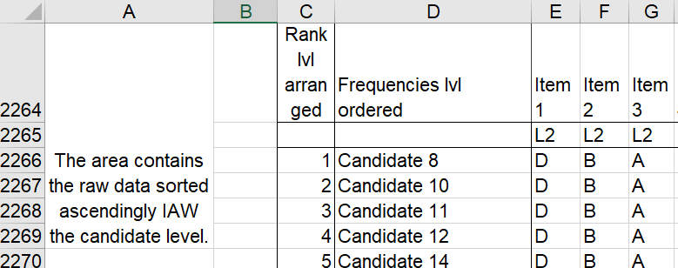
Sorting Raw Data based on Total Score/Level

Slide 13
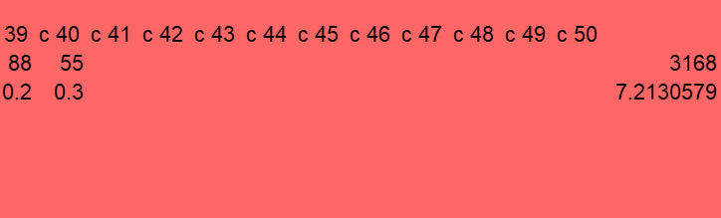
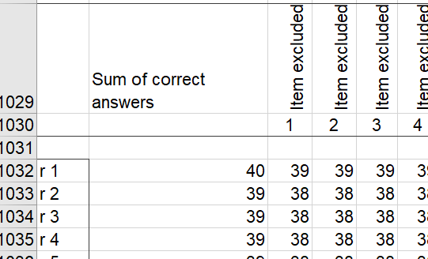
Variance and Alpha Calculation
Notes:
Areas used to find out the variance for each item, and variances of total scores to finally determine alpha coefficient.

Slide 14
Results Worksheet

Slide 15
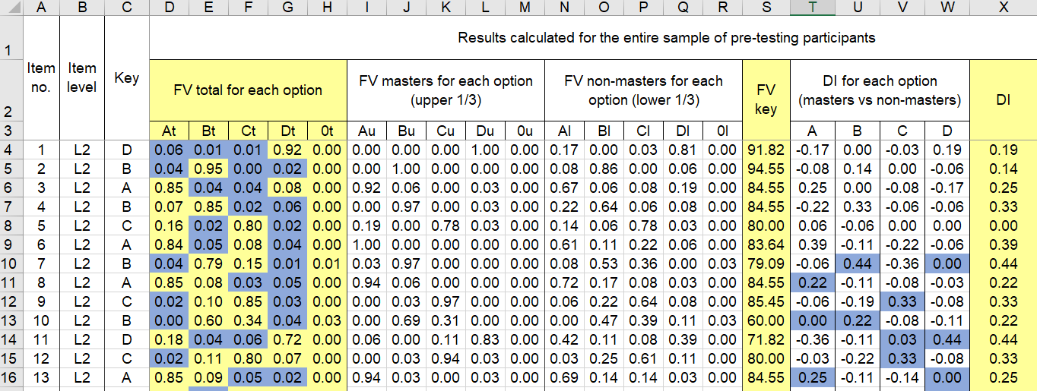
Results Worksheet Results obtained based on total score

Slide 16
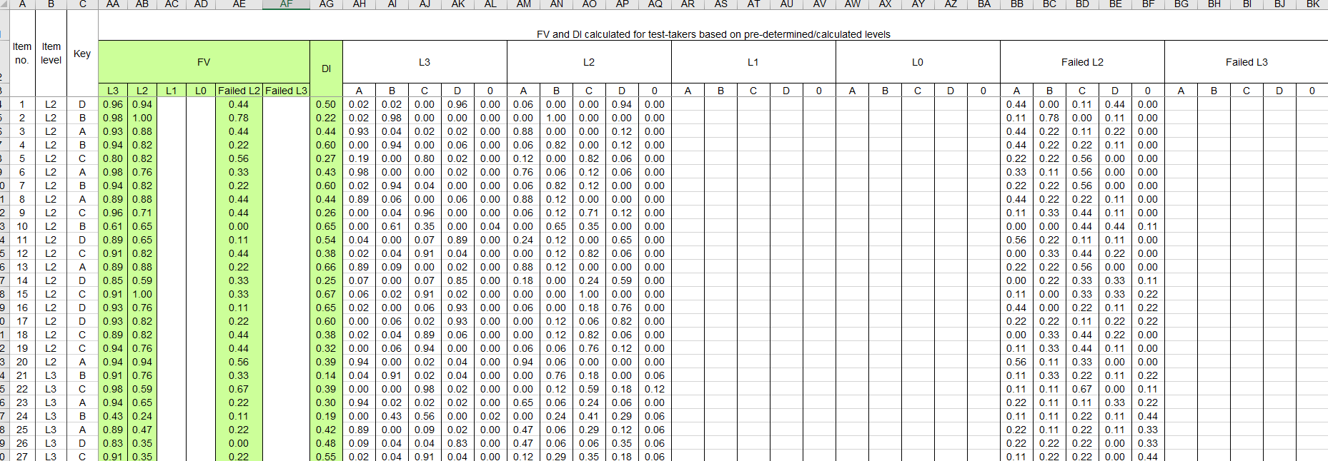
Results Worksheet Item statistics based on participants' levels
Notes:
DI in this table is B-index.

Slide 17
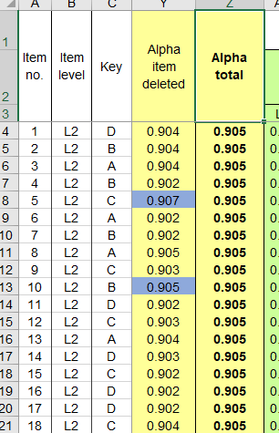
Results Worksheet Internal consistency/reliability coefficient

Slide 18
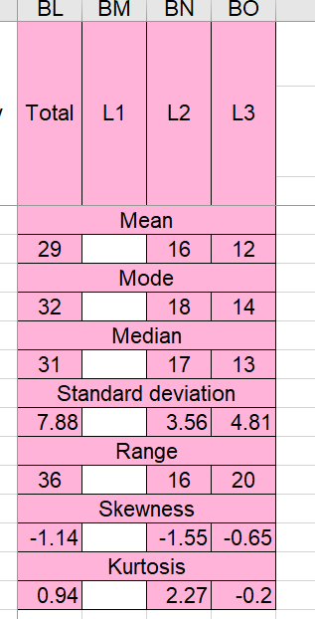
Results Worksheet Measures of central tendency/dispersion

Slide 19
Hands on experience
Work in groups (2-4 persons)
Open the blank file
Copy the data from the raw data file
Copy the row containing the level of the item
Copy the row containing the correct option
Copy the column with the level for each test-taker (STANAG level obtained on previous test)
Set the minimum sustained performance and minimum developing performance percentages (if there is no level already assigned to the test takers)
Go to results page and observe the results, make decisions regarding the items (keep, review, reject)

Slide 20
Feedback
Does the MS Excel customized file calculate all the statistics you need?
Can it be used by testers with basic Excel skills?
Do you have any suggestions for improvement?

Slide 21
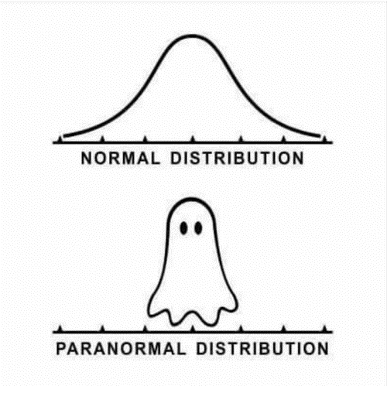
Thank you!

Slide 22
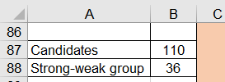
Results calculation - example

