Slide 1
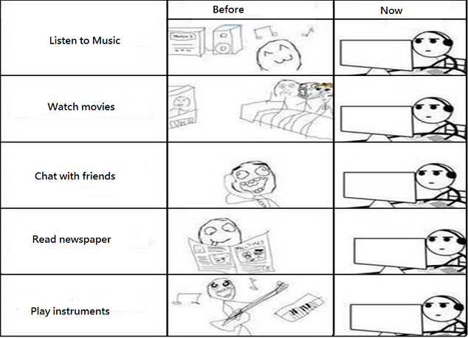
Before vs. Now

Slide 2
Select Developments in Technology and Their Applicability to Language Learning Christine Campbell christine.m.campbell@dliflc.edu

Slide 3
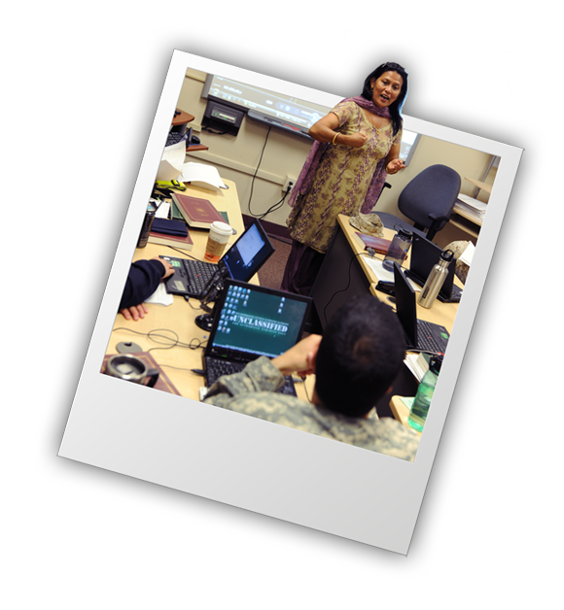
Current Technology Developments
“Technology will not replace
the teacher but the teacher who does not use
technology will be
replaced.”
Clifford, ?

Slide 4
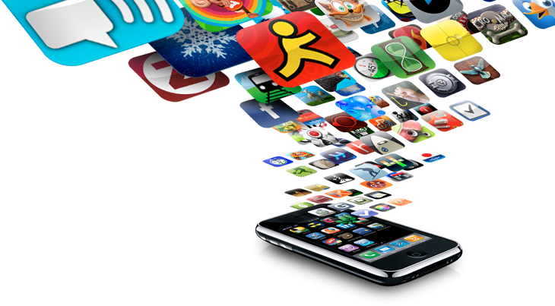
Select Developments in Technology
More Blended and Online Courses
More Blended Flipped Classrooms
Greater Interactivity through the Use of
Gamification Principles in Lesson and Curriculum
Design
Increase in the Number of Virtual Assistance
Technologies

Slide 5
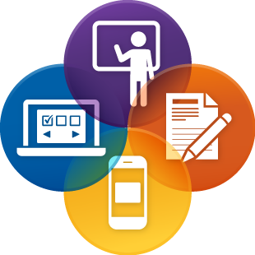
More Blended and Online Courses
Blended (=Hybrid):
Where online products
are integrated into the face-to-face (F2F)
classroom during the class hour or after
class as homework or preview of
content for the following class…

Slide 6
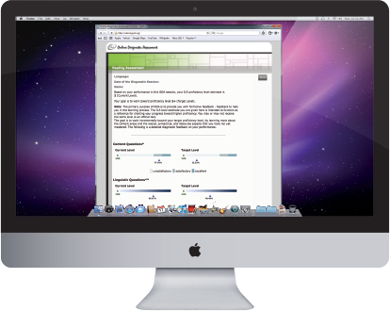
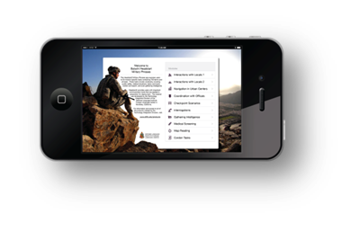
More Blended Flipped Classrooms
Flipped Classroom:
Course content, typically online lectures and
presentations, are provided to learners to preview
before coming to class so class time can be
dedicated to active processing of course content
through class discussion and other higher-order
thinking activities

Slide 7
Developments (cont’d)
Greater Interactivity through the Use of Gamification Principles in Lesson and Curriculum Design

Slide 8
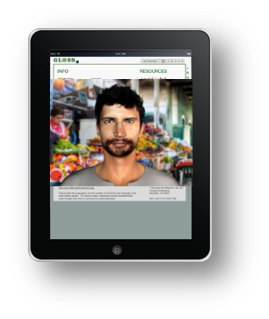
Increase in the Number of Virtual Assistance Technologies
Real-time collaboration
in virtual reality
E.g., Oculus Rift; Oculus VR;
Double Robotics robot; Leap
Motions; Swivl
“Mixed reality” w/ 3D
Holograms via HoloLens

Slide 9
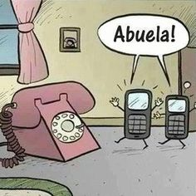
Future Generations?

Slide 10
“Our walls no longer make the boundaries of our classrooms.”
Wesch, 2007

Slide 11
Questions?
Thank you for coming

