Slide 1
TESTING DIRECTIVES:
The Rhyme & Reason behind Evaluation
Jana Vasilj-Begovic, FL Stds O – MPG, Canada & Associate BILC Secretary
Skopje, September 2017

Slide 2
Scope of Presentation
Definition & Purpose of Test Directives
Contents
Mission Statement
Types and Purpose of Testing
Application of Directive
Time on Task and Final Linguistic Objectives

Slide 3
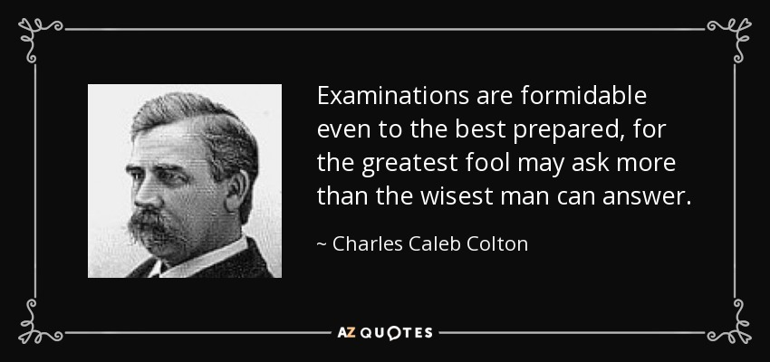

Slide 4
Definition & Purpose
Document outlining evaluation-related policy as part of the FL Education & Training
Purpose:
to make testing transparent
to state its role in evaluating training/courses
to contribute to accountability
to explain types and purpose of tests

Slide 5
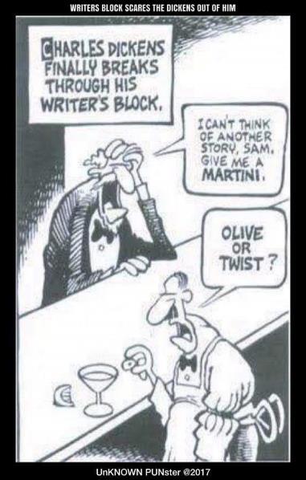
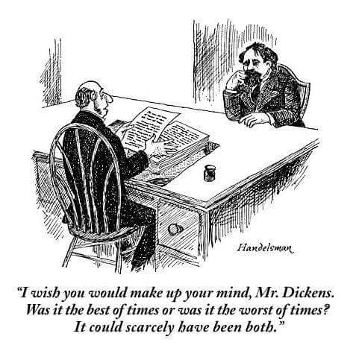

Slide 6
CONTENTS Mission Statement
Under the provisions of DAOD 5031-11 Foreign Languages, issued 2008-04-25 by Chief Military personnel (CMP), MPG Language Programs, Detachment Asticou (formerly CDA) is responsible for evaluating course members and training to ensure that standards are being met and that training reflects the most economical means of achieving results.

Slide 7
Contents Types and Purpose of Tests
Types of Evaluation (client-tailored) Formative & Summative):
Aptitude Tests
Achievement Tests
Enabling Checks
Performance Checks
Pro-chievement Tests
Certification Tests

Slide 8
Aptitude Tests
Predict likelihood of success
Serve as a selection process tool
Identify strengths and weaknesses
Serve as basis for planning pedagogical strategies

Slide 9
Enabling Checks
Measure progress along general proficiency line
Inform of students’ readiness for On-the-Job-Training
Predict success on final certification tests and Performance Checks
Notes:
When they are administered.

Slide 10
Performance Checks
Measure attainment of Performance Objectives
Report success as PASS/FAIL
Predict success on the job

Slide 11
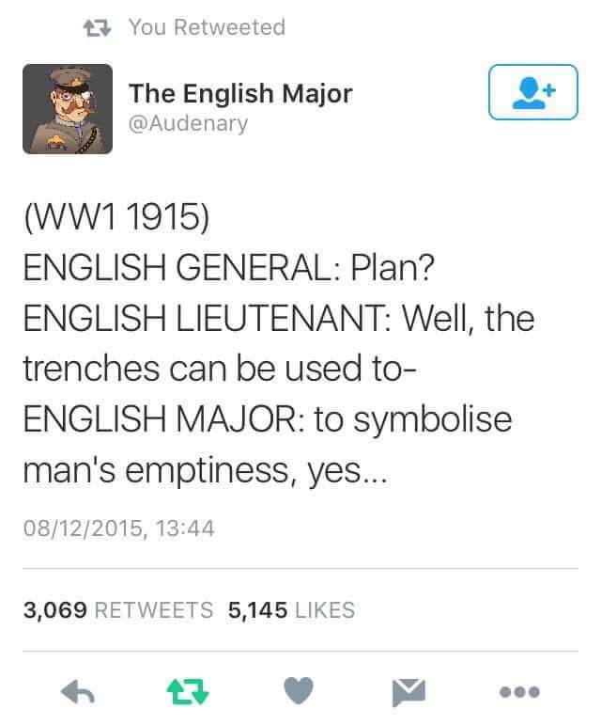

Slide 12
Certification Testing
Three digit profile (listening, speaking and reading)
Types of testing instruments used
Policy regarding test viewing

Slide 13
Application of Directive Language Specialist Courses
Purpose | Instrument | Characteristics
Formative evaluation | Quizzes, Achievement Tests | Administered regularly No re-take Diagnostic, feedback Administered by local standards or teachers Linked to curriculum Can be reviewed by students or teachers Successive failures may lead to PRB
Progress Tests | Enabling Checks | Measure progress along general proficiency line Report OJT readiness
Summative Evaluation | Performance Checks PO 001: Transcribe target language PO 002: Translate target language into English | Failed PC (either part) is course failure
Certification Testing | Listening, speaking, reading | Profile for all students and CAF members

Slide 14
Final Linguistic Expectations
 | Listen. | Speak. | Read. | Writ. | Trans. | Transl.
FLS (COMM RSCH) | 2+ | 1+ | 2+ | - | Pass/ Fail | Pass/Fail
Exchange | 2 | 2 | 2 | Pass/Fail | - | -
ACV | 2 | 2 | 2 | Pass/Fail | - | -
CDA * | 1/2 | 1/2 | 1/2 | Pass/Fail | - | -
CDAA* | 1/2 | 1/2 | 1/2 | Pass/Fail | - | -

Slide 15
Time on Task & Objectives
Language Cat. | I | II | III | IV
Examples | Spanish Dutch Norwegian Italian Portuguese | German Romanian Indonesian | Hebrew Hungarian Russian Turkish Pashtu Persian Polish | Arabic Japanese Korean Chinese
Weeks | 25 | 34 | 47 | 63
Notes:
I recently saw a new table of expected linguistic objectives based on training duration. It was produced by the Canadian Global Affairs. They train diplomats and they have data on how much time it takes to train someone from 2+ to 3 in Cat 4, for example depending on their aptitude.

Slide 16
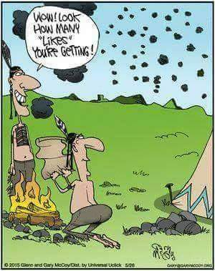

Slide 17
Thank you!

