Slide 1
Interactive Presentation and Hot Topics: Using Technology for STANAG 6001 Testing
Troy Cox, PhD
Brigham Young University
Corina Ispas

Slide 2
Technology Use Survey Results

Slide 3
Respondents
N = 31
Representing 20 nations and NATO
Austria
Belgium
Bulgaria
Croatia
Czech Republic
DNK
France
Germany
Italy
Latvia
Mongolia
NATO
North Macedonia
Norway
Poland
Portugal
Romania
Slovakia
Slovenia
Spain
Ukraine

Slide 4
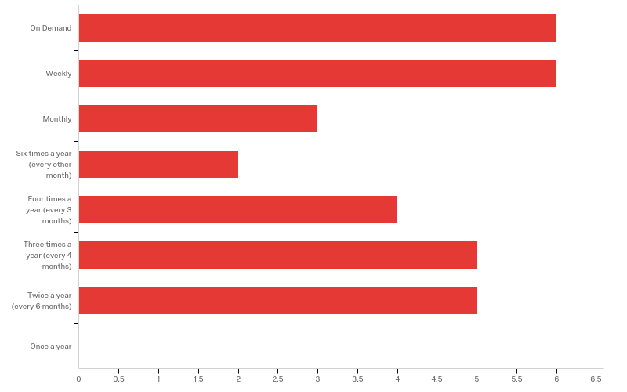
Q2 - How frequently do you administer language tests in a year?
On Demand
Weekly
Monthly
6 Times a Year
4 Times a Year
3 Times a Year
2 Times a Year
Once a Year

Slide 5
Q3 - Approximately how many people do you test in a year?
Mean | 823.69
Std Deviation | 2709.02
Minimum | 1
Maximum | 15000
Count | 29

Slide 6
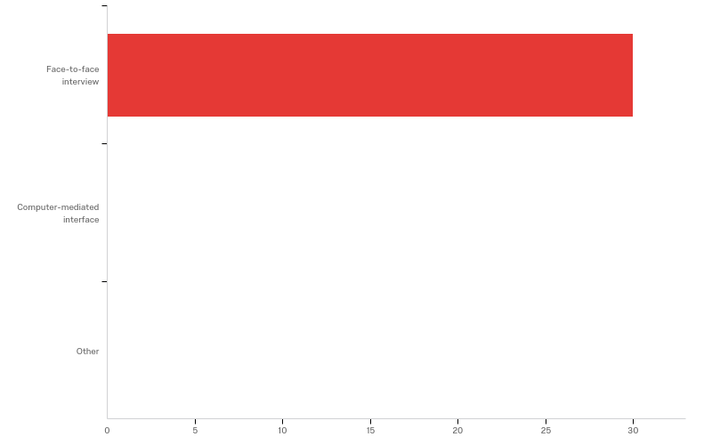
Q4 - How do you test speaking?
Face-to-Face
Computer-mediated interface
Other

Slide 7
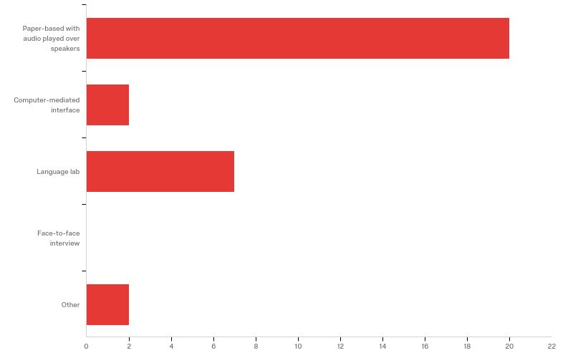
Q5 - How do you test listening?
Paper-based with audio played over speakers
Computer-mediated interface
Language Lab
Face-to-Face Interview
Other
Other - Text
paper-based with audio via lap-top (one per testee)
Paper-based with audio played over infra-red headsets

Slide 8
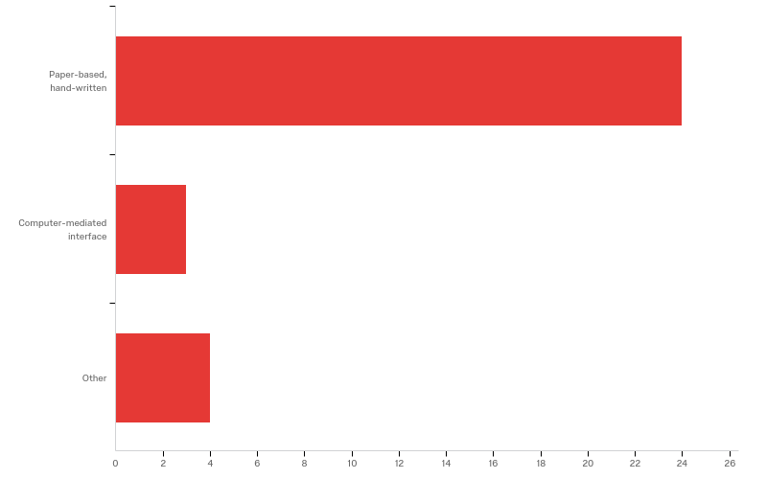
Q6 - How do you test writing?
Paper-based, hand -written
Computer-mediated interface
Other
Other - Text
Computer-based, typed
paper-based + lap-top to write on. Hand-written is a seldom-used option.
Task handed out on paper, text written on pc (word document) and emailed to testers.

Slide 9
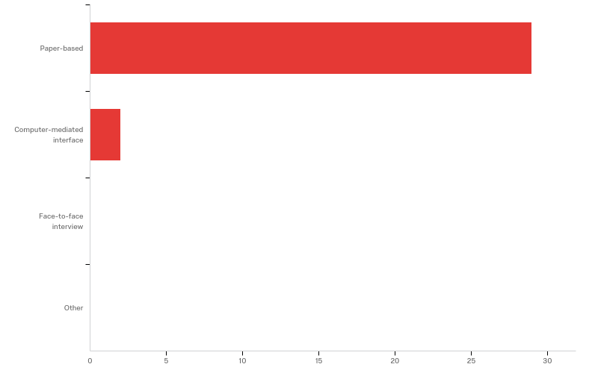
Q7 - How do you test reading?
Paper-based
Computer-mediated interface
Face-to-face interview
Other

Slide 10
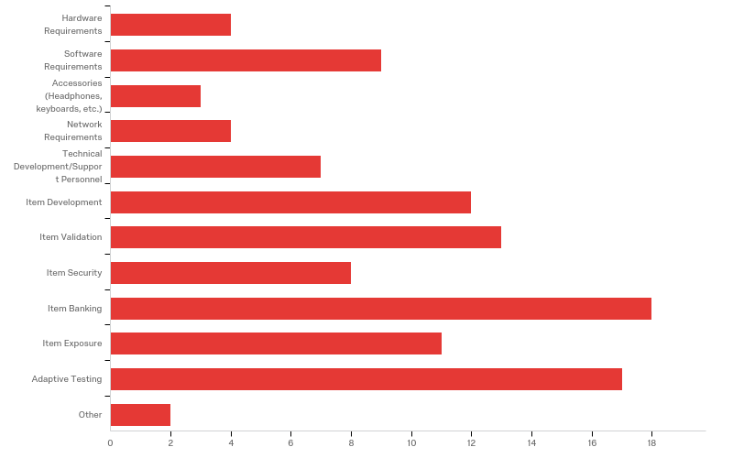
Q8 - What topic areas would you like us to address?
Hardware Requirements
Software Requirements
Accessories
Network Requirements
Technical Development/Support Personnel
Item Development
Item Validation
Item Security
Item Banking
Item Exposure
Adaptive Testing
Other

Slide 11
Q9 - Comments:
Comments:
any of the above, as we are still in the stone age as far as computer-delivered testing is concerned.
I would like to know 1) which software could enable us to extract a conversation without background noise, and 2) how to efficiently develop item banking.
Everything which is connected with items' behavior would be of interest to me
The main issue for me is to be able to download any document from the net to prepare the listening tests. And then , It would be so helpful to be able to separate the conversation/ the speech from any other background noise belonging to the downloaded podcast. For this process, audacity is helpless.
besides the two annual exam sessions, we are also testing on demand
none
1) With regard to speaking, testing is sometimes conducted on the telephone and via videoconferencing depending on logistics, costs and other factors. 2) With regard to listening, examinees are tested in a language lab and are given a paper booklet that contains the question (stem) and multiple choice answer options. Examinees hand mark their answers on an answer sheet. The audio is delivered via computer and headphones. 3) The Italian Armed Forces are currently making combined efforts towards standardizing and implementing computer-delivered testing, item banking, statistical analyses, etc.
We administer tests on a daily basis - 2 - 5 times a week (there is not this option to select in the first question)

Slide 12
Questions To Answer Before Administering High Stakes Tests via Computers
BILC Testing Workshop
Tours, France
September 5, 2019

Slide 13
Introduction
Most classroom tests are low stakes, and thus instructors can experiment with computer-based testing relatively easily. Once the tests become high stakes, however, a number of issues need to be addressed to ensure the tests are valid, reliable and secure.

Slide 14
Things to Consider
Computer-based Testing
Physical Set-up
Test Creation
Test Security
Test Administration
Test Scoring
Test Reporting
Items
Development
Validation
Banking
Exposure
Adaptive Testing
In 3 minutes, look at the topics above and write down everything you think is important to consider.

Slide 15
Physical Set-up
In small groups, determine what resources are needed to start testing with computers.

Slide 16
Physical Set-up
Do you have the funds for computers?
Do you have a network with access to servers?
If not, are you prepared to distribute and gather results one at a time?
Do you have (or have access to) the technical expertise to set up the computers?
Do you have (or have access to) the technical expertise to install the software?
Do you have a way to restrict the IP addresses of the computers (client and server) to improve test security and reduce the likelihood of external, unauthorized access?

Slide 17
Test Creation
In small groups, discuss what resources are needed to create computerized tests.

Slide 18
Test Creation
Do you have the funds for the software to create the tests?
Is there existing software?
How will you support it?
If hiring a programmer, what steps need to be taken to ensure continuity of the product?

Slide 19
Test Security
In small groups, discuss what you need to do to ensure your tests are secure.

Slide 20
Test Security
Do you have a plan on how your items will be secure and less likely to be compromised when stored and accessed digitally?
Do you have a Non-Disclosure Agreement (NDA) for anyone that will have access to the items?
Do you have end user and proctor agreements in place to safeguard item integrity?
Do you have a system in place to check-in students and ensure the identity of the test-taker?

Slide 21
Test Administration
In small groups, determine what resources are needed to administer computer-based tests.

Slide 22
Test Administration
Do you have adequate staffing (proctors, tech support) to ensure smooth test delivery?
Do you have adequate numbers of devices (including accessories like headphones) to serve your testing circumstances?
Do you have any back-ups for equipment failure?
Do you have system in place to log problem or irregularities that occurred?

Slide 23
Test Scoring
In small groups, determine how responses will be scored.

Slide 24
Test Scoring
Do you have a system in place to store results in a central location such as a server?
If not, do you have staffing to move from machine to machine to copy results to a portable drive?
Do you have software to score the tests automatically?
Do you have software to assign raters to judge open-ended assessments such as speaking or writing?
Do you have a system to ensure the raters are assigned in a manner to minimize rater drift?
Do you have method to account for rater disagreement established?

Slide 25
Test Reporting
In small groups, determine what decisions need to be made about reporting the results

Slide 26
Test Reporting
Will the examinees receive their scores at the time they take the assessment?
If so, do you have a way to ensure answers aren’t exposed via brain dumps?
Will the examinees have an electronically secure method to receive their scores?

Slide 27
Corina Case Study

Slide 28
Item Development for Computer-based Testing

Slide 29
Item Development
Test Specification (Blue Print)
Item Specification (Spec sheets-electrical, plumbing, etc.)

Slide 30
Item Specifications should …
Be detailed enough that someone else can write an item based on the description
Contain
General Description
Instructions
Prompt Attributes
L1 or L2
Timing constraints
Response Attributes
Sample Item

Slide 31
To validate items
Use Item Specifications
Have experts judge the items (reverse engineer)
Have examinee focus groups do a sensitivity check
Have an editor proofread the items
Administer items to ensure they are functioning as intended
Keep an incident log to note any anomalies during trialing
Use item statistics to investigate anamolies

Slide 32
Items vs testlets
Items
Testlets
Single response to some stimulus
Multiple responses to ONE stimulus
Series of questions on same passage
NOT RECOMMENDED
Context dependent item sets in which the questions can be constant but the input can vary
Purposefully assembled items that are administered in a group

Slide 33
Items in item banks should have
Naming conventions
Version control
Fields for
History
Usage/Exposure
Meta-data (content, level, etc.)
Difficulty parameters (IRT)
Security protocols (ie “plants” to detect cheating, etc.)

Slide 34
What you need to do IRT

Slide 35
Computer Adaptive Tests
Advantages
Disadvantages
Test is tailored to each examinee
Cheating by looking at neighbors is diminished
Test CAN be shorter
Item exposure can be reduced
Examinees can’t go back and change answers (local independence)
Development is MUCH more expensive
All items need to be calibrated prior to being included
Item exposure needs to be carefully monitored-some items might be overexposed due to ability of examinees
Examinees can’t go back and change answers (face validity)

Slide 36
Computer adaptive tests need
Starting criteria for initial estimation of person ability
Algorithms for choosing items/testlets from item bank
Stopping criteria

