Slide 1
Difficulties related to authentic assessment: implications for language test design
BILC Seminar, Budapest, October 2016

Slide 2
Presentation outline
Emergence of the need for authenticity in language assessment
Defining authenticity in language assessment
Implications of theories for test design

Slide 3
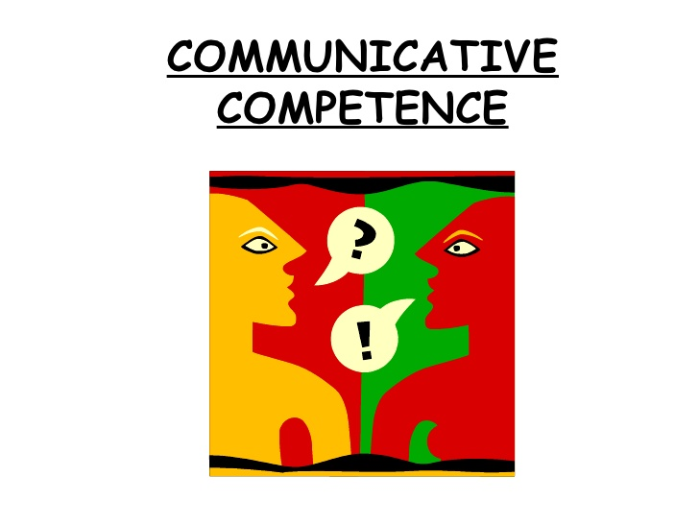
1. Emergence of the need for authenticity in language testing
Canale and Swain (1980):
Model of Communicative Competence
„grammatical competence is not a good predictor of communicative competence“ (p. 13)

Slide 4
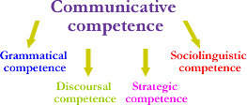
Canale and Swain (1980)
Implications: shift of focus from
testing test-taker´s knowledge about
language to testing test-taker´s ability
to use language
discrete-point testing to performance-
based testing

Slide 5
Performance-based testing
Authenticity cornerstone of performance-based testing
one of the criteria
against which the
usefulness of a test
should be evaluated
(Bachman & Palmer, 1996;
Brown, 2004; Carrol, 1980)

Slide 6
2. Defining authenticity in language assessment
2.1 Widdowson (1978)
„Genuineness“ vs. „Authenticity“
Authenticity of the text
„characteristic of the relationship between the passage and the reader“
(p. 80)

Slide 7
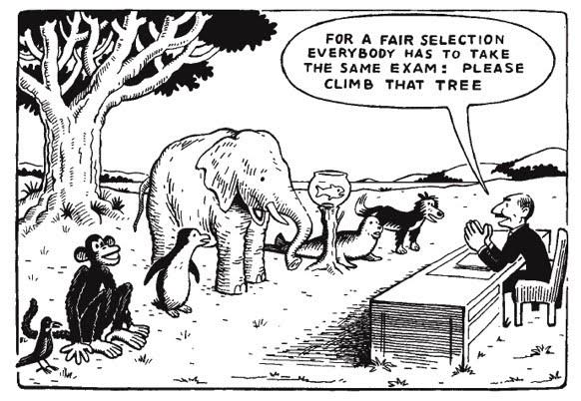
2.2 Bachman (1990)
„real-life approach“
Authenticity = “the extent to which test performance replicates some specified non-test language performance” (p. 301).
Authenticity = the degree of match between
test tasks and target language
use tasks

Slide 8
Limitations of the real-life approach:
- difficulty of integrating authenticity
into language testing (Fulcher, 2000)
“modern performance tests that attempt to mirror some criterion situation in the external world are no more than role-plays or simulations” (p. 492)
- limited content validity (Bachman, 1990)
- limited generalizability (Bachman,
1990)

Slide 9
ii) „interactional/ability approach“
test performance = of performance, based on which inferences can be drawn about the test-taker’s real communicative language abilities
Much attention is paid to trying to determine “what combination of test method facets is most likely to promote an appropriate interaction of a particular group of test takers with the testing context” (Bachman, 1990, p. 317).

Slide 10
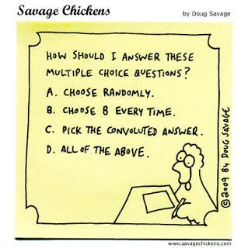
Authenticity Test Taker Test task „the extent and type of involvement of the test taker’s individual characteristics in accomplishing a test task” (Bachman, 1990, p. 25) “

Slide 11
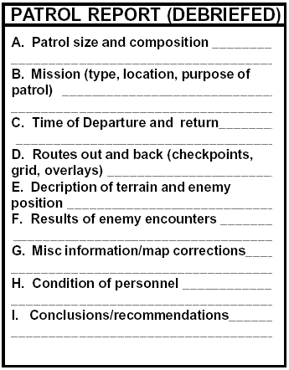
3. IMPLICATIONS OF THEORIES FOR TEST DESIGN
i) authenticity of task input
ii) simulation of real-life tasks
iii) test-taker´s engagement in the task

Slide 12
i) Authenticity of task input
Authenticity of stimulus material – desirable
However, authentic input materials
„are not automatically good materials, or necessarily appropriate for learners and their specific goals“ (Lynch & Mendelsohn, 2000)
- level of difficulty
- construct relevance
- content representativeness
- characteristics of the
intended test-takers

Slide 13
ii) Simulation of real-life tasks
Real-life tasks have been found to
have positive impact on test-takers’
performance on a test (e.g., McAlister,
2000; Canagarajah 2006; Messick,
1996; Phan, 2008)
Pursuit of 100% authenticity in language
assessment = „pursuit of chimera“
(Alderson,1981, p. 57)
BE REALISTIC WHEN INCORPORATING AUTHENITICITY INTO LANGUAGE TESTS
Appropriate sampling

Slide 14
iii) Test-taker´s engagement in the task
Authenticity through engagement = one of the most crucial types of authenticity (Widdowson, 1978; Bachman, 1990; Gan, 2012)
„unless a learner is somehow ̔engaged’ by the task, unless they are genuinely interested in its topic and its purpose, and understand its relevance, then the other types of authenticity may count for very little” (Guariento & Morley, 2001p. 351) “
Detailed construct definition & appropriate sampling
Required

Slide 15
Final remarks
Achieving relative authenticity is a difficult endeavour that involves making a lot of trade-offs
Balance authenticity against reliability, validity, practicality, interactiveness, a positive impact and washback, always bearing the purpose of the test in mind

Slide 16
References
Alderson, J. C. (1981b). Report of the discussion on communicative language testing. In J. C. Alderson & A. Hughes (Eds.), Issues in language testing. ELT Documents 111 (pp. 55–65). London, UK: The British Council. Retrieved April 1, 2015, from http://www.academia.edu/7306806/Issues_in_Language_Testing_Rev isited
Bachman, L. F. (1990). Fundamental considerations in language testing. Oxford,
UK: Oxford University Press.
Bachman, L. F., & Palmer, A. S. (1996). Fundamental considerations in
language testing. Oxford, UK: Oxford University Press.
Brown, H. D. (2004). Language assessment: principles and classroom activities.
White Plains, NY: Longman Pearson Education.
Canale, M., & Swain, M. (1980). Theoretical bases of communicative approaches
to second language teaching and testing. Applied Linguistics, 1(1), 1–47. doi: http://dx.doi.org/10.1093/applin/I.1.1
Canagarajah, S. (2006). Changing Communicative needs, revised assessment
objectives: testing English as an international language. Language
Assessment Quarterly, 3(3), 229–242.
doi: http://dx.doi.org/10.1207/s15434311laq0303_1

Slide 17
Carroll, B. J. (1980). Testing communicative performance. Oxford, UK: Oxford University Press.
Fulcher, G. (2000). The ̔communicative̕ legacy in language testing. Sytem,
28(4), 483–497. doi: http://dx.doi.org/10.1016/S0346- 251X(00)00033-6
Gan, Z. (2012). Test-task authenticity: the multiple perspectives. Changing
English: Studies in Culture and Education, 19(2), 237–247.
doi: http://dx.doi.org/10.1080/1358684X.2012.680765
Lynch, T., & Mendelsohn, D. (2000). Listening. In N. Schmitt (Ed.), An
introduction to applied linguistics (2nd ed., pp. 193–210). London, UK: Arnold.
Messick, S. (1996). Validity of performance assessment. In Philips, G. W &
National Centre for Education Statistics (Eds.), Technical issues in large-scale performance assessment (pp. 1–18). Washington
DC, USA: U.S. Department of Education, Office of Educational Research and Improvement. Retrieved April 6, 2015, from http://nces.ed.gov/pubs/96802.pdf

Slide 18
Mc Alister, B. (2000). The authenticity of authentic assessment: what the research says… and doesn't say. In R. Custer (Ed.), Using
authentic assessment in vocational education (pp. 19–31). Columbus, OH: ERIC Clearinghouse on Adult, Career, and Vocational Education. Retrieved April 3, 2015, from http://calpro-online.org/eric/docs/custer/custer4.pdf
Phan, S. (2008). Communicative language testing. TESTL Working Paper Series, 6(1), 3–10. doi: http://dx.doi.org/10.1177/1362168808089921
Widdowson, H. G. (1978). Teaching Language as Communication. Oxford, UK: Oxford University Press.

Slide 19
Thank you for your attention!

