Slide 1
BILC Testing Workshop Tours, France September 3-5, 2019
Workshop #1
BAT2 Speaking

Slide 2
BAT2 Speaking Workshop Agenda
Welcome and Introductions
BAT2 S – Overview
Format
Protocol
Rating
Review pre-workshop assignment
Listen to snippets
Listen to BAT2 samples
Q/A

Slide 3
What is the NATO BAT2-S?
The BAT is a telephonic conversation between one tester and one interviewee
1
The Benchmark Advisory Test answers the question:
2
“What can a person DO in a language?”

Slide 4
About the NATO BAT2-S
Adaptive and Interactive
Conversation-like
… but in fact
Highly structured
Required components
Notes:
Explain the meaning of each of these terms. Point out the conversation “veneer” is just that. The Interview is designed to elicit a sample of language in which the tasks for the level can be addressed. Those tasks that cannot be elicited through a conversational mode, are elicited via other means (Role Plays and Preludes). At this point, let participants know that you are going to begin with a broad overview of the OPI and then address each aspect in greater detail. The next couple of slides will serve an an “Advanced organizer” for what’s coming.

Slide 5
Goal of Every BAT2-S
“ceiling” ↑
“floor” ↓

Slide 6
Why are we doing this?
Ensure a common understanding of terminology used in NATO testing contexts
All testers across all member nations share a common terminology that allows them to talk about performance
Prepare testers and raters to participate in a benchmarking research initiative

Slide 7
Possible Outcomes of Probing
Can consistently handle tasks at level
Establishes a new floor and “working level”
Cannot handle one or more criteria for the level
Establishes the ceiling
“Linguistic Breakdown”
The BAT-S does not probe above L3

Slide 8
How to Recognize Linguistic Breakdown
Deterioration/Increased errors
Dead-ending
Diminished fluency
Silence
Avoidance
Substitution/Use of another language
Non-verbal indicators

Slide 9
Role Plays
Interview strategy to test functions that are not readily elicited in conversational mode
Role plays
Obligatory at working level
Optional at ceiling

Slide 10
Role Play Situations
At L1 -
Ability to handle a simple social situation
At L2
Ability to deal with and resolve a situation with a complication or unexpected turn of event.
At L3
Ability to deal with a linguistically unfamiliar situation

Slide 12
How do we rate?
Recognize the linguistic task at each level
At each level there are expectations with regard to Content, Text type, and Accuracy that are indispensable for performance of the task at the given level
Every question targets a linguistic task at a specific level

Slide 13
Activity: Identify the task and level
Question | Task | Level
Tell me about your first day in Mexico. What happened that day? Tell me all about it.
What arguments speak in favor of increasing the legal driving age to 21?
Tell me about your best friend. Why do you like that person?
Notes:
Fill in task and level as a group and then do the Handout with 20 questions for practice in pairs.
Questions can be taken from the snippets they are going to hear later in the afternoon.

Slide 14
Rating the Sample
Listen to the speaker’s response to the task elicited by the tester
Rate only performance during the “core” phase
Compare performance of tasks with the Assessment Criteria
Decide whether the response is at level or below level

Slide 15
Rating the Sample At Level Performance
At level performance = Meets all the criteria and the response is either
Strong or
Minimal
Minimal performance at level
Meets criteria for level
Minimal quantity and/or quality for the level
Generally does not exceed minimal requirements
Typically, no features of the next higher level
Notes:
BELOW LEVEL performance of a task means that the response
does not meet one or more of the assessment criteria of the level of the task
does not show control of the linguistic features required for the level
PARTIAL performance means that the response may
meet some or most, but not all, of the assessment criteria for the level
show evidence of some or most, but not all, of the linguistic features of the level
TOTAL BREAKDOWN in performance means that the response
meets few if any of the assessment criteria for the level
shows little or no evidence of the linguistic features of the level

Slide 16
Rating the Sample Below Level Performance
Below-level performance = Does not meet all the criteria
Does not meet one or more of the assessment criteria of the level of the task
Does not show control of the linguistic features required for the level
Below level - Partial performance
May show evidence of some or most of the linguistic features of the level
Below level – Total breakdown
Shows little or no evidence of the linguistic features of the level

Slide 17
Rating Protocol
In order to be rated at a level, the performance must meet
All the criteria for the level
Across all the tasks and topics of the level
All the time

Slide 18
“Plus” Levels 0+, 1+, 2+
“Plus level” proficiency as described in this document is understood as language proficiency that is more than halfway between two base levels.
“Plus level” proficiency substantially exceeds the base skill level but does not fully or consistently meet all of the criteria for the next higher base level.

Slide 19
In order to assign a “plus” rating
Sample must contain all the requirements for the base level
Sample must contain a sufficient number of spirals to the next higher level to make a case for the plus level
Performance in response to the spirals must show patterns of strength

Slide 20
Another Way of Looking at the Plus Rating
Consider the performance when targeting the next higher level
Listen for a “preponderance of evidence” of ability at the next higher level during the spiraling
Notes:
You can add here that if the speaker really fails on one of the probes – that can be forgiven if the performance on the other three probes is strong.

Slide 21
Recap – the Plus Rating
Substantial amount of language is at the next higher level
Performance at next higher level is not sustained across the tasks and topics of the next higher level

Slide 22
Rating the Interview
Rate the entire interview holistically, considering performance across topics and tasks
Refer to the Assessment Criteria
Compare your preliminary rating to the STANAG descriptors
Use the Interview Review Grid to summarize the interview

Slide 23
The Interview What are we not rating
First impressions
Personality
Originality or uniqueness
Charm/likeability (or lack of it)
Name, title, position
Effort or enthusiasm
Opinions relative to your own

Slide 24
BAT2 S Rating – Words of Wisdom
Consider the overall performance
Consider all the criteria for the level
Evaluate the ability to carry out the tasks in terms of the other criteria
Content, context, text type, accuracy
Evaluate HOLISTICALLY

Slide 25
Let’s Listen and Rate!

Slide 26
Extra Slides

Slide 27
STANAG Assessment Criteria
Speaking
Level | Tasks What a person can do with the language (tasks accomplished, atti­tu­des expressed, tones con­vey­ed) | Content / Topics What a person can talk about (subject areas, activities and jobs addressed; settings) | Accuracy How well a person can use the language (acceptability, quality and correct­ness of message conveyed) | Text produced (length and organi­zation of utterance; kinds of discourse)
0 | No functional ability. | None or isolated words. | Unintelligible. | Random words and phrases.
0+ | Can make short utterances and ask very simple questions using memorized material and set expressions. | Immediate survival needs such as greetings, brief personal data, numbers, time expressions, common objects. | Understandable with difficulty even to a native speaker used to dealing with foreigners. | Memorized words and short phrases.
1 | Can create sentences; begin, maintain, and close short conversations by asking and answering simple questions; satisfy simple daily needs; resolve basic situations. | Everyday survival topics and courtesy requirements. | Intelligible with some effort to a native speaker used to dealing with foreigners; often miscommunicates. | Discrete sentences.
1+ | Able to participate in predictable conversations about all survival needs and limited social demands; shows limited/inconsistent ability to describe, narrate, give instructions. | Basic needs, own back­ground, family, interests, travel, and simple work-related matters. | Faulty but comprehensible to a native speaker used to dealing with foreigners. | Strings of related sentences.
2 | Can describe people, places, and things; narrate current, past and future activities in full paragraphs; state facts; give instructions or directions; ask and answer questions in the workplace; deal with non-routine daily situations. | Concrete topics such as own background, family, interests, work, travel, and current events. | Understandable to a native speaker not used to dealing with foreigners; sometimes miscommunicates. | Full paragraphs, minimally cohesive.
2+ | Able to communicate in many informal and formal conversations; uses language effectively to describe, narrate, report facts, give detailed instructions and directions, handle unfamiliar situations; uses it less effectively to support opinions, clarify points, answer objections. | Practical, social, everyday professional topics, particular interests, special fields of competence, and to some extent abstract topics. | Communicates relatively well with native speakers not used to dealing with foreigners. Speech is usually appropriate to the situation, with occasional errors in vocabulary, more complex structures, or pronunciation. | Discourse beyond the paragraph level.
3 | Can converse in most formal and informal situations; discuss abstract topics; support opinions; hypothesize; deal with unfamiliar topics and situations; describe in detail; clarify points. | Practical, social, professional and abstract topics, particular interests, and special fields of competence. | Speaks readily, with only sporadic non-patterned errors in basic structures. Errors almost never interfere with under­standing and rarely disturb the native speaker. | Extended discourse.

Slide 28
What are we rating?
We are rating holistically a speaker’s performance of specific linguistic tasks.
Content, Context, Accuracy and Text Type are assessed in relation to the Tasks.

Slide 29
Criteria used in rating
Tasks
What the speaker can do with the language
Content
What topics, subject areas, settings, situations
Accuracy
Acceptability and quality of the language, comprehensibility of the message
Text type
How the message is organized: words, phrases, sentences, paragraph, extended discourse
Notes:
In discussing accuracy we include lexical accuracy, grammatical structure control, pronunciation, intonation, delivery, etc.
We will always refer to accuracy as comprehensibility to include all these concepts

Slide 30
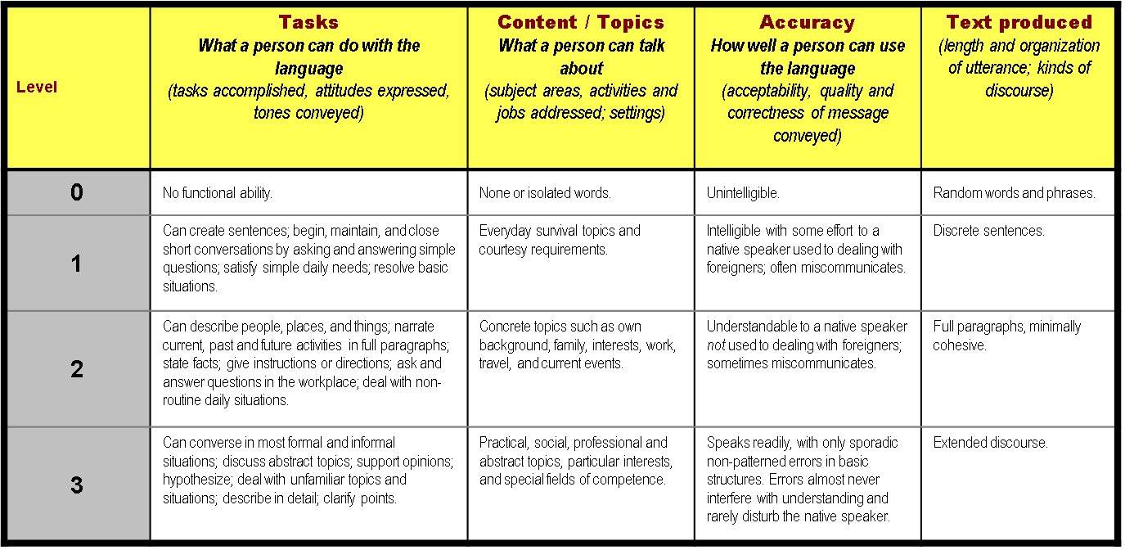
Assessment Criteria Chart

Slide 31
How are BAT2S ratings determined?
The STANAG 6001 (Ed.5) Descriptors
Demonstrate the level of performance
Descriptors are ranges
Criterion-referenced
We compare performance with descriptors and not with other speakers

Slide 32
STANAG 6001.5 Speaking Descriptors
Based on hierarchy of global tasks
Six base levels: 0-5
All base levels (except 5) are further divided into base and plus levels.
BAT2 S Targets Levels 0+ to 3 only
BAT2 S Ratings are reported as Base Levels and Plus levels
Raters assign one of the following ratings
0+, 1, 1+, 2, 2+, 3
Notes:
1. Four levels are delineated according to a hierarchy of global tasks. This hierarachy is summarized in a rating scale spanning a wide range of performance profiles. Page 3
2. Each major h level represents a profile of functional language ability.
3. The sub-levels differ from each other in terms of the quantity as well as the quality of language produced and in some cases by the tasks performed.

Slide 33
Base Levels of the NATO STANAG 6001 Scale
Level 1
Survival
Creates, functions with language
Conversational
Asks and answers questions
Speaks in sentences

Slide 34
Major Levels of the NATO STANAG 6001 Scale
Level 2
Functional
Speaks with confidence
Describes with detail
Narrates in all major time frames
Reports facts; gives instructions / directions
Handles a situation with a complication
Reports on current events
Speaks in paragraphs

Slide 35
Major Levels of the NATO STANAG 6001 Scale
Level 3
Professional
Supports opinions and hypothesizes
Converses in casual, social, and professional settings
Handles topics and issues on an abstract level
Speaks in connected paragraphs-extended discourse

Slide 36
STANAG 6001.5 Speaking Highlights Chart
Level 1 speakers are characterized by the ability to: | Level 2 speakers are characterized by the ability to: | Level 3 speakers are characterized by the ability to:
Participate in simple, direct conversations on generally predictable topics related to personal needs and daily activities. | Participate actively in conversations in most informal and some formal settings on topics of personal and general interest, such as work, background and interests, travel, current events. | Participate fully and effectively in most formal and informal conversations on topics related to practical, social and professional needs.
Create with the language, ask and answer simple questions. | Narrate and describe in major time frames. | Provide a structured argument to explain and defend opinions and develop effective hypotheses within extended discourse.
Communicate personal meaning by combining language elements in discrete sentences and strings of sentences. | Sustain communication by using, with suitable accuracy and confidence, connected discourse of paragraph length and substance. | Pronunciation, albeit foreign, rarely disturbs the native speaker.
Begin, maintain and close a simple situation without a complication. | Deal effectively with unanticipated complications through a variety of communicative devices. | Handle a linguistically unfamiliar situation.
Can interact with native speakers used to speaking with non-natives. | Can interact with native speakers not used to dealing with non-natives. | Can maintain a level of linguistic accuracy; i.e., no patterns of error.
Employ simple and limited vocabulary in familiar, everyday exchanges. | Give detailed instructions or directions | Discuss topics abstractly as well as concretely.
 |  | Combine effectively structure and broad vocabulary to convey meaning

Slide 37
What is the goal of every BAT2S?
Produce a speech sample that clearly demonstrates:
What a speaker can do (“Floor”)
What a speaker cannot do (“Ceiling”)

Slide 38
Goal of Every BAT2-S
“ceiling” ↑
“floor” ↓

Slide 39
What makes a Sample Ratable?
All the prescribed elements across a variety of topics
Sustained performance at one level
Inability to sustain performance at the next higher level

Slide 40
NATO BAT2-S Structure
Three Phases:
Initial
Core
Tasks at level (level checks)
Tasks that target the next higher level (probes)
Role Play
Final
Notes:
Quick overview of the terms – you will come back to each one separately.

Slide 41
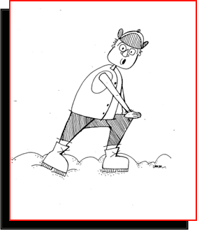
Initial Phase
Relax the candidate
Find out who the person is
What the individual does
Background and experiences
The interviewee’s interests
Get a preliminary sense of speaker’s level
Gather enough information to select a “working level”
Gather topics for testing tasks in Core phase
Notes:
Start with social courtesies and conversational openers
Ask open-ended questions
Identify topics
Biographical information
Educational background
Professional experience
Travel and other extra-community experiences
Listen
At the end of the warm up phase, select a working level.

Slide 42
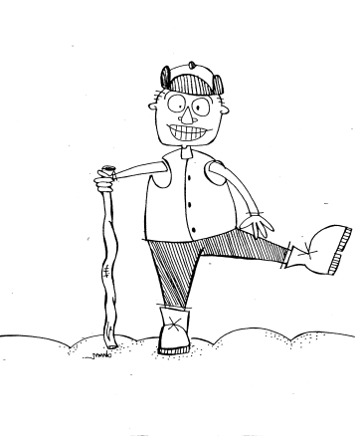
The Core Phase – Level Checks
Showing what the CAN do
Questions target the working level (level checks)
Opportunity to use spoken language that best represents the examinee’s level of spoken language
Establish the FLOOR

Slide 43
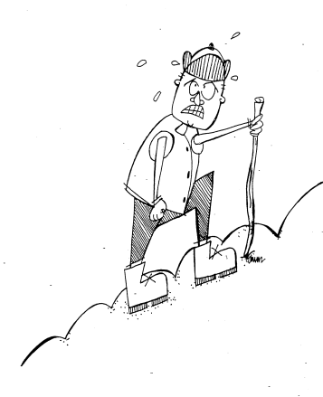
The Core Phase - Probes
Proving what the speaker CANNOT do
“Spiral” a topic already developed at floor level
Target one level above the floor
Establish the CEILING

Slide 44
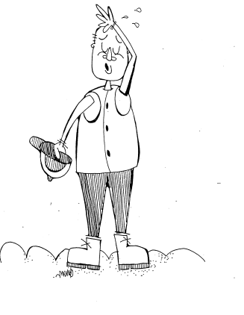
The Final Phase
Targeted at the level of comfort or below
Leave the interviewee with a “can-do” sense
“The interview is almost over. What plans do you have for later?”

Slide 45
Suggested BAT2 S Format
0+ | 1 3 L1 Tasks Minimum 2 L2 tasks | 2 5 L2 Tasks Minimum 2 L3 Tasks | 3 3 L3 Tasks 3 Topics/Issues
Lists in some content areas such as: People Numbers Foods Colors Objects Clothing Months Weather Dates, etc. | □ L1 Short Conversation □ L1 Role Play □ L2 Past Narration □ L2 Description □ L1 Ask Questions If considering 1+ Add □ L2 CE Report □ L2 Instructions | □ L2 Past Narration (T#1) □ L2 Description (T #2) □ L2 CE Report (T#3) □ L3 Supported Opinion (T#3) □ L2 Directions/ Instructions (T4) □ L3 Abstract (T#5) □ L2 Role Play If considering 2+ Add □ L3 Hypothesis (T #5) □ L3 Supported Opinion (T #5) | □ L2 Past Narration □ L2 Description or CE ------------------------------ □ L3 Abstract (T#1) □ L3 Supported Opinion (T#2) □ L3 Hypothesis (Topic 2) □ L3 Supported Opinion/Abstract (T#3) □ L3 RP

Slide 46
Tester Review Grid
Summary of the tester’s and the speaker’s performance
Rating tool
Can do and Cannot do reflect performance in the Core Phase
Rationale summarizes performance
Quality assurance tool

Slide 47
Sample Rating Grid
Tester Trainee Name:__________________ Interviewee Name: __________________ Rating: __1+__
Language of interview: English
Warm up: The interviewer begins by asking the speaker to introduce herself. She is able to give basic biographical information with ease. She provides a short paragraph describing each of her sons. The interviewer then asks her about her home and daily activities. She can clearly satisfy simple and predictable needs and provide biographical information. She creates sentences with ease and facility, at times linking them into short paragraphs. (In the areas of Lexical Control, Sociolinguistic Competence, Delivery, and Texts Produced, her performance shows some of the features of a Level 2 speaker.)
Tasks | Level of task | Topic | Questions | Working Level or Spiral | At level Response?
 |  |  |  |  | Yes | Partially | No
Engage in simple conversation; create with language | 1 | Family | Tell me about your oldest son. | WL | √
Narrate (past) | 2 | Family | Tell me a story about your son. | Spiral |  | √
Handle L1 situation | 1 | Travel arrangements | Reserve a rental car | WL | √
L2 complication | 2 | Travel arrangements | Reserving rental car (with complication) | Spiral |  | √
Narrate (past) | 2 | Personal information | Tell me how you found your car. | Spiral |  | √
Current event report | 2 | Education | Tell me about current issues at your son’s school | Spiral |  | √
Narrate (future) | 2 | Future personal plans | Tell me about your plans for the future | Spiral |  | √
Ask simple questions | 1 | Personal conversations | Ask me some questions | WL | √
Wind-down
Can do: Engage in simple conversations; create with language; handle basic survival situation, all while consistently producing sentences; ask simple questions. |  |  | Cannot do: Narrate in major timeframes with consistency across range of topics; describe in detail; discuss current events; deal with complications.
Interviewee Rating Rationale: This sample is rated 1+. Her speaking ability extends beyond immediate survival needs. Her accuracy in basic grammatical relations is evident, although not consistent. She exhibits many features of a Level 2 speaker in terms of Lexical Control, Sociolinguistic Competence, Delivery, and Texts Produced. While handling Level 1 tasks, her Structural Control more closely resembles the descriptor for a Level 2 speaker. However, she cannot maintain the Tasks and Functions of a Level 2 speaker, and when attempting to narrate in all major time frames, her accuracy and cohesiveness decline. She does not attempt to deal with a non-routine daily situation.

