Slide 1
The importance of a common language in European military exchange programme
Division External Relations
LtKol SBH DUBOIS Dirk

Slide 2
Agenda
Introductory notions
The start of the Initiative
Stocktaking
Council Declaration
Implementation
Quick Wins
Lines of Development
Why a common language?
Questions

Slide 3
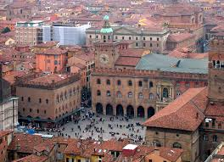
Introductary notions

Slide 4
History of Military Erasmus
2008 French Presidency
Initial stocktaking
Council Conclusions
2009
Creation IG
5 Quick-wins
Lines of Developments
FRONTEX briefing

Slide 5
Assumptions
Financial crisis
Early entry of young officer in international environment
Will perform better if he has been in contact with other nationalities before.

Slide 6
Scope of the Initiative (1/2)
Military training institute
Academic education
Basic military training
Professional training
Military academy/cadet
Vocational training
Staff and command Training

Slide 7
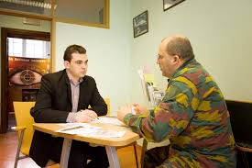
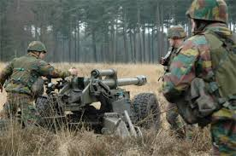
Scope of the Initiative (2/2)
First appointment in
operational unit
Recruit

Slide 8
Proposed measures at European level
Academic component of initial officer training
Develop training modules on international issues (academic component of officer training). A training module on the ESDP (now CSDP) is available. Training modules should be developed in other areas relating to international security. These training modules will be made available to national military colleges.
Make it easier for national military colleges to access and use the Internet-Based Advanced Distance Learning (IDL) system which is being developed by the European Security and Defence College (ESDC), to enlarge the scope of available teaching material.

Slide 9
Proposed measures at European level
"Basic military training" and professional components of initial officer training
Develop an equivalence system for the military components of initial officer training. The implementing working party will examine the possibility of using the European Credit Transfer System (ECTS) which also covers the academic aspects of initial officer training.
Draw on the Erasmus programme to establish mechanisms to promote officer exchanges.

Slide 10
Measures at national level
Encourage Member States and their national military training colleges to make full use of the instruments and measures offered by the Bologna process.
Encourage national military training colleges to increase the mobility of military students and teaching staff among the Member States.
Encourage Member States to recognise the training which their officers have received at establishments in other EU Member States.
Encourage the teaching of EU languages, in particular the teaching of a second foreign language, in order to extend the range of potential exchanges.

Slide 11
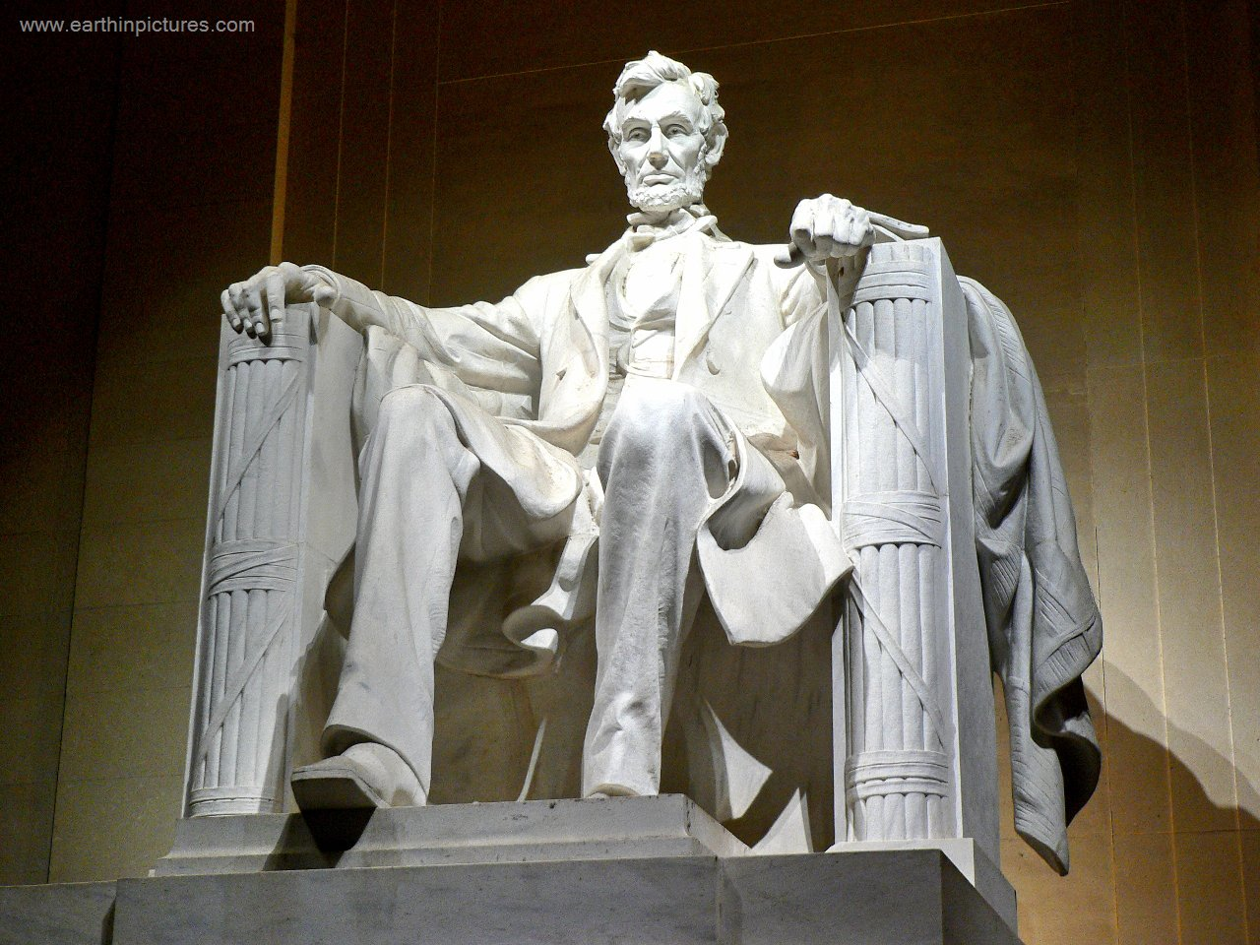
“The probability that we may fail in the struggle ought not to deter us from the support of a cause we believe to be just”

Slide 12
Implementation
Quickwins

Slide 13
Quick win overview
Implementation of Common Module on ESDP
Access to data of detailed stocktaking on internet
Dedicated Forum
Framework agreement
Develop 5 other common modules

Slide 14
Implementation
Lines of Development (LoD)

Slide 15
Overview of LoDs
System of equivalences (Mil)
Comparison of courses based on competences
Develop IDL specific content
Create IT platform
Develop supporting mechanisms
Encourage national implementation
Military Lifelong Learning Programme
Develop additional common modules

Slide 16
A common language?
http://biblelight.net/Tower-of-Babel.htm

Slide 17
A common language?
Descriptors: not scope of this audience
Working languages: English and French (both for NATO and EU CSDP)
Reality check:
in EU only few countries teach French, (almost) all teach English
Operational language for military = English
Cultural pressure: young people are better in English

Slide 18
A common language?
Lessons learned from EC’s Erasmus-programs!
Universities of smaller language groups attract few students
More and more university courses in English
Standards for professors as a consequence!
Influence of new media: facebook, twitter,…: international contacts between young people are the standard, often in English

Slide 19
Language standards
Even if English is used
Heavily influenced by national languages (e.g. no use of article for Slavic speaking people)
Vocabulary
Grammar
In some cases difficult to understand without a minimum knowledge of the native tongue of the speaker: danger of misunderstandings!

Slide 20
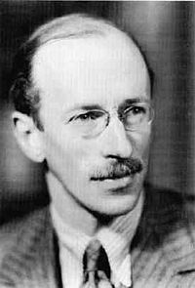
‘The only thing harder than getting a new idea into the military mind is to get an old one out.‘
(Sir Basil H Lidell Hart)

