Slide 1
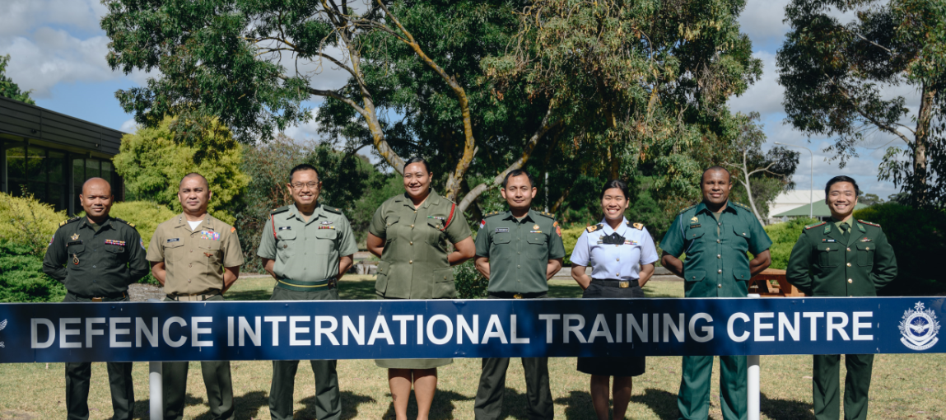
Ms Kristin Walters, Head of Language Training Section,
Defence International Training Centre (DITC),
RAAF Williams, Laverton, Melbourne, Australia
Notes:
Good morning everyone.
My name is Kristin Walters, and I am the Head of the Language Trg Section, supervising 10 EL teachers and 5 different courses at the Defence International Trg Section, in Melbourne, Australia.
I have been working at DITC since Nov 2017 so not quite 6 full years, and this was preceded by 3 years in Muscat, Oman, working to establish the Military Tech College’s English Dept. I also worked for 20 years in Malaysia teaching English and running the Cambridge CELTA teacher training course at the British Council lang center in KL. But I began my lang teaching career way back when, at the same school I work for now, actually. It had a different name and was a lot smaller then.

Slide 2
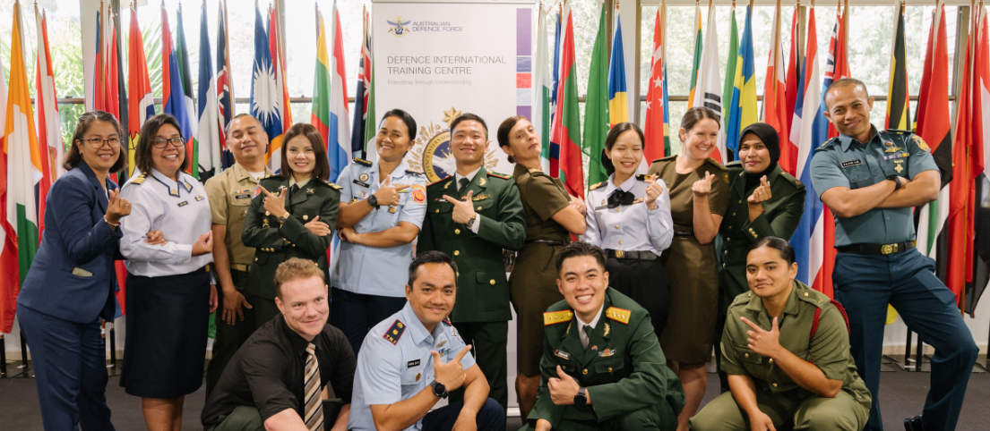
Challenges in defining military English vocabulary for low level English learners
2024 NATO-BILC Military Terminology Conference 08-12 Apr, 2024,
Swedish Defence University, Stockholm, Sweden
Notes:
I’m hoping that this workshop today will provide us all an opportunity to share thoughts and questions, as well, if we are lucky some potential answers for challenges we face as materials developers for defining mil terminology.
The context and content of my presentation here at this conference is inspired by the work I and a small team of materials developers (2 full-time teachers) have been conducting over the last 2 years, on a Military English materials writing project.
I’m very happy to be here to showcase what we have been developing, but also to have us discuss what you may have been working with.
Title: Challenges in defining military terminology for low-level learners of English
Description:
The presentation will look at the challenges faced by the team of English for Special Purposes (ESP) materials developers at the Defence International Training Centre (DITC), in Melbourne, Australia working on a Military English materials development project. The project aims to develop materials that contextualize and support the teaching and learning of ‘Military English’ for low level learners of English, primarily from South-East Asia. The context of the project will be established and exemplified and the challenges in developing definitions of the Military English vocabulary explored. We will look at what the team has endeavored to put in place to solve these challenges, including the use of colleagues from the ADF, online tools and reference materials, as well as the use of Chat GPT in producing definitions suitable for low-level English users. As time permits, any questions will be responded to at the conclusion.

Slide 3
‘Military English’
What is ‘military English’? How would you define it? What is it NOT? What about ‘low level learners’?
What materials do you use to teach military English? Do you teach ‘lower level learners’ at all?
Provide a couple of examples of ‘military English’ and ‘low level’
What are the challenges you face in this field? (i.e. teaching / translating ‘military terminology’ / ‘military English’, / teaching to low level classes) What ‘solutions’, if any, do you employ?
Notes:
So before going any further let’s discuss the key terms within this workshop. As an area of ESP, one that is very under-researched – the challenge that confronted us right at the start – we had to know what we were focussing on.
Discuss : what is military terminology / English, to you? How define it? What about low levels?
Examples of this? 2-3
What examples of MilEnglish materials do you know /use, if you teach English? What do you use if you teach Mil terminology? Do you teach or deal with low level learners at all?
What are some of the challenges you face in this field, from your perspective?
5 -10 mins mins w partner beside you.
Be ready to give some FB.
Elicit some FB …what do you want to convey here?
What are the issues that I can relate to here? Why is this important?
Georgieva and Marinov (2017) pointed out that when investigating aspects of the language of the military as a special type of English for specific purposes (ESP) or providing lists/glossaries with military terms or slang words, English speaking scholars use, often interchangeably, the meta-terms military language, military terminology, military slang, military lingo, military jargon, military argot, soldier’s language, army language and some more to describe the characteristics of the language, used by military personnel and organizations.
The important ingredient of the Military Language as a type of ESP is military terminology because the terminology is that part of linguistics that describes the lexicon of special languages. In the broadest sense, military terminology includes terms for designating military organizations, personnel, military ranks and hierarchy, armament and military equipment, military systems, types of military activities, tasks and operations, which are defined in doctrines, strategies, manuals, guides, orders and similar specialized military/ defense national and international documents (Georgieva and Marinov, 2017).
Military English is defined by Defence International Training Centre (DITC) as an area of English for Specific Purposes which uses military contexts to teach military specific language, for the purpose of meeting the language and communication needs of military personnel engaged in international cooperation assignments.

Slide 4
Scope
Key terminology
What is Defence International Training Centre? Where and who are we? What do we do?
A recent engagement project – Military English materials development. Why? For whom?
Materials development challenges and considerations – language, ESP syllabus, target audience, resources
Notes:
Context: ESP project at DITC – what is DITC – unit make up, what we do who is DITC?
What are we doing at DITC? project / concept brief what is the Mil English project - concept
Who are our targeted audience – teachers and learners, examples of learners and teachers MELT ss, lang teachers in
Examples
What have we been using to develop mats and define terms – reference docs: ADF colleagues, glossary from BILC, ADF glossary, online dictionaries, Challenges – where do these come from?
Tools and tech: Vocab Profile, Text Inspector??
Need sthg else? Low level learners - none of these are graded to a level that is accessible for our learners: chat GPT + human interaction – let’s try
Question time
What have we been using to develop mats and define terms – reference docs: ADF colleagues, glossary from BILC, ADF glossary, online dictionaries, Challenges – where do these come from?
Tools and tech: Vocab Profile, Text Inspector??
Need sthg else? Low level learners - none of these are graded to a level that is accessible for our learners: chat GPT + human interaction – let’s try
Question time
CLT, survey results, mil English lesson on demining

Slide 5
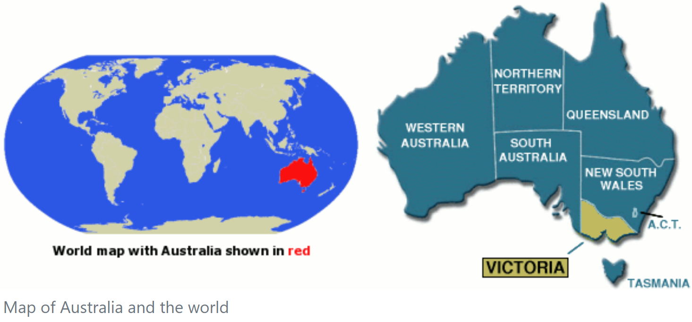
Defence International Training Centre (DITC)
Australian Defence College (ADC)
Australian War College
Australian Command and Staff Course (ACSC)
Defence Strategic Studies Course (DSSC)
Australian Defence Force Training Centre (ADFTC)
Defence International Training Centre (DITC)
Notes:
The Australian Defence College, is in the Australian Capital Territory, capital city of Canberra.
The sub-unit I have added here is just some of the parts of the org , so for example I haven’t included the ADF Academy that provides three-year fill-time under-grad univ programs to commissioned officer from all three services.
Through the Aus War College, ADC offers post-grad level career courses to both ADF and international mil pers. For MAJ and equivalent there is the ACSC, and for senior officers, there is the DSSC. All 1 year courses.
The ADF Training Centre – apart from what is here, also covers the POTC, the Mil Chaplian’s College, the Defence Force School of Languages and us, DITC. Some of you may have met my colleagues from DFSL, Anna Ivanova – so DFSL offers foreign lang instryctiosn to ADF pers, while at DITC we perform a mirror function of foreign mil pers studying English w us.
ADC is in Canberra, while we at DIT are situated in Melb. on RAAF Base Williams, Melbourne, Victoria.
Essentially, every non-English speaking foreign military student who comes to Australia for any kind of training w the ADF, comes through DITC for admin support first, and then goes off to target course at another mil installation around the country, or they stay with us for their target course.

Slide 6
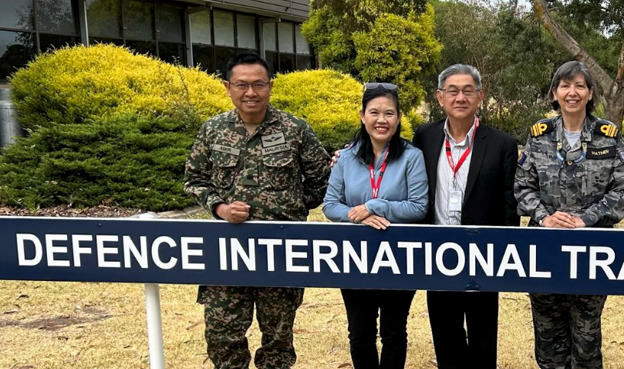
Insert image of ditc
Notes:
DITC is a small tri-service school with both uniform and civilian staff. The CO and some of the admin staff are mil pers, and we have 3 education officers from the Army, Navy or Air Force who act as instructors on our programs. Australian civil servants work for the Dept of Defence and they are the lang instruction SMEs.
Staff also includes Seconded Officers from 8 other countries – Cambodia, Indonesia, Malaysia, Phillipines, Papua New Guinea, Thailand, Tonga, Vietnam who in the main work as Eng lang instructors in their defence forces. They stay with us for 2 years. Apart from delivering training, they play a crucial welfare support role for learners at DITC from their countries when they come on course.

Slide 7
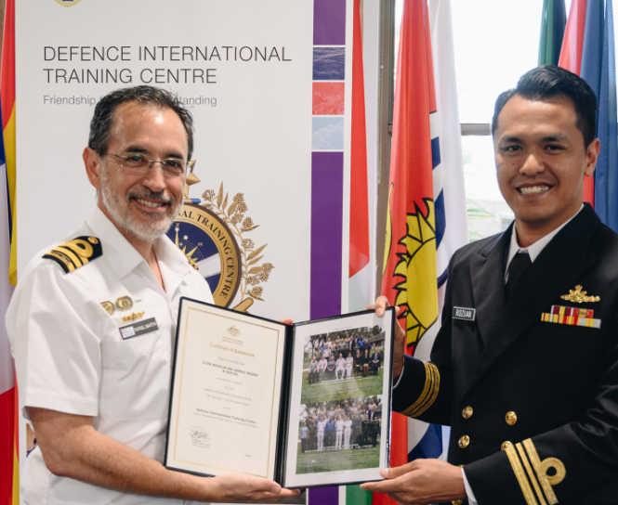
Notes:
DITC’s role is to provide training and admin support in support of Australia’s international defence engagement, mainly through the Defence Cooperation Program.

Slide 8
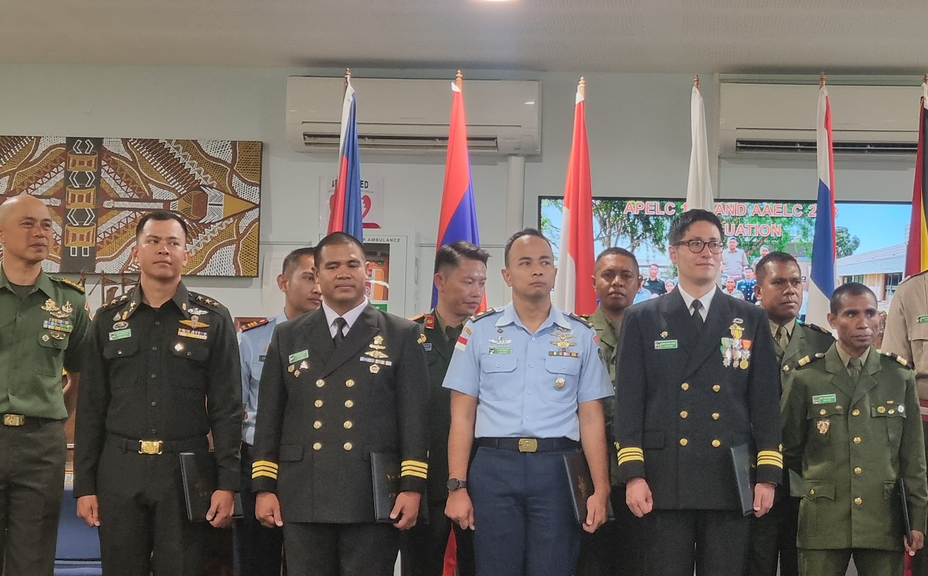
Students from the Indo-Pacific region, Southeast and North Asia e.g. Indonesia, Malaysia, Timor Leste, Thailand, Vietnam, Laos, Cambodia, and Japan, Mongolia, India, Pakistan, the Pacific (Tonga, Fiji, Vanuatu, Solomon Islands etc) and the Middle East (UAE, Iraq, Jordan)
Approx 1000 students per year.
Major business:
teach English language at Pre-Int, Int and Advanced levels,
academic and military prep courses,
train English language teachers from region in beginner through to advanced methodology.
Notes:
Australia has a strong relationship w the Indo-Pacific region in the delivery of trg.
DITC receives learners of all ranks (NCOs. ORs and Officers, all services, incl Police, for example) from a wide range of countries from Southeast and North Asia e.g. Indonesia, Malaysia, Timor Leste, Thailand, Vietnam, Laos, Cambodia, and Japan, Mongolia, India, Pakistan, the Pacific (Tonga, Fiji, Vanuatu, Solomon Islands etc) and the Middle East (UAE, Iraq, Jordan)
Approx 1000 students per year move through the school. Around 2/3rds of this figure stay only for the Admin and Reception Period before transferring to target course somewhere else in Aus / the ADF.
The other 1/3 that stay with us at DITC, stay for courses that are anywhere btn 1-to- 3 months to study either a language course, a teacher education course or a prep training course i.e, prior to ADC or RMC, ADFA.

Slide 9
DITC’s Military English project: definition, aim
Military English is defined by Defence International Training Centre (DITC) as an area of English for Specific Purposes which uses military contexts to teach military specific language, for the purpose of meeting the language and communication needs of military personnel engaged in international cooperation assignments.
Aim: to develop up-to-date, stand-alone, classroom-ready resources relevant to Australia’s partners in the region, to support a move away from older resources as the core materials, to support teachers professionally to integrate these materials into their own ‘Military English’ syllabi
*CSSL = a partner language school, in the Royal Cambodian Armed Forces
Notes:
Mil Eng project at DITC
As part of our lang teaching section, in mid-late 2022 we answered an initiative from the International Policy Division in the Dept of Defence to meet an increased outreach to our region for English language support.
As a result of consulting with these partner schools in Thailand, Cambodia, Vietnam, Indonesia etc, we proposed a military English development projet.
Our partner schools in the region have Military English in their curricula but the Ts needed sthg new / more.
So, our aim is to develop classroom ready resources to enhance the language and communication goals of their military personnel, and to support the teachers delivering this to their classes.
We launched the project officially at our Regional English Language Schools Seminar (RELS) in Aug 2023.

Slide 10
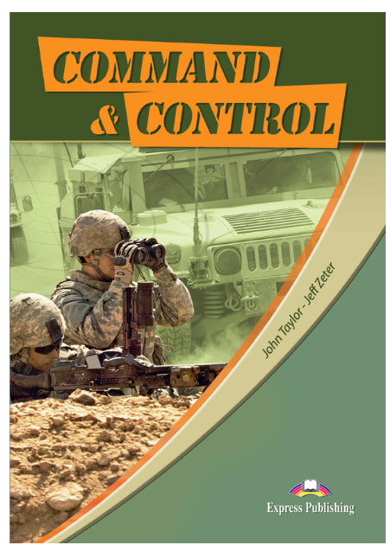
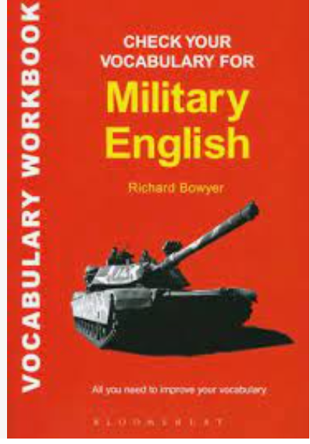
Notes:
Some of you may recognise these as the textbooks in use in many places to teach Military English.
Ever used them – did you mention any of these in the discussion at the start of this workshop?
Question: What do you think of them?
For me, and schools in Stheast Asia –
Euro-centric
Ltd presence of the ADF / regional references
Dated – which of course these days bc things seem to be moving so much more quickly than prior to the internet age, seems to be sthg that can happen as soon as a book goes on the shelf
So they may still have their place in many parts of the world but for us way down there in the bottom part of the Indo-Pac, what these have to offer is less relevant in some cases
Military English Tactical and Peacekeeping Operations: Coursebook: 1 – 3 2019
by Robert Andrew Buckmaster (Author)
Title: Career Paths: Command & Control
ISBN: 978-1-4715-6249-5
Level: A1, A2 & B1
Authors: John Taylor, Jeff Zeter, Eli publishing, 2017
Check Your Vocabulary for Military English
R. Bowyer, 2015
Bloomsbury Publishing
Campaign 2 Student Book Paperback – 1 January 2005 – this is what is most used in the region, and it’s the oldest
by Simon et al Mellor - Clark (Author)

Slide 11
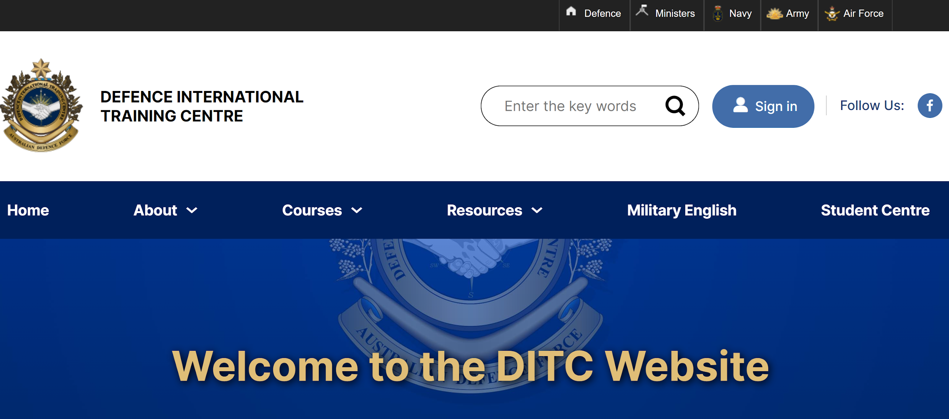
Military English project: Current state
Access: downloadable from DITC website
Projected materials on website by end FY23/24:
30 Lessons
30 Vocab Builders
Each resource has
Student’s worksheet with extra video activity, and Quizlet QR code for vocabulary practice,
a Teacher’s version with tapescript, answers and guidance for less experienced teachers,
audio for any listening based tasks, and as a model of the pronunciation of the vocab
Notes:
So our project decided to NOT make a book, but to be a little more flexible in approach and use our website as a store of materials for teachers to download from.
Each resource is a Teacher version as well as student worksheet and where appropriate audio files.
Students’ version has tasks and usu a QR code for a quizlet activity, and a youtube video for extended listening.
The teachers’ versions have the exact same plus the answers, guidance on how to run the activities, as needed, as well other ideas and talso tapescript and audio files
Why harddcopies/ teacher facing? Bc looking at target that is still quite conservative when it comes to learning. We discussed a mobile app that was student facing for the delivery of these but in the end thought we’d go this route first.

Slide 12
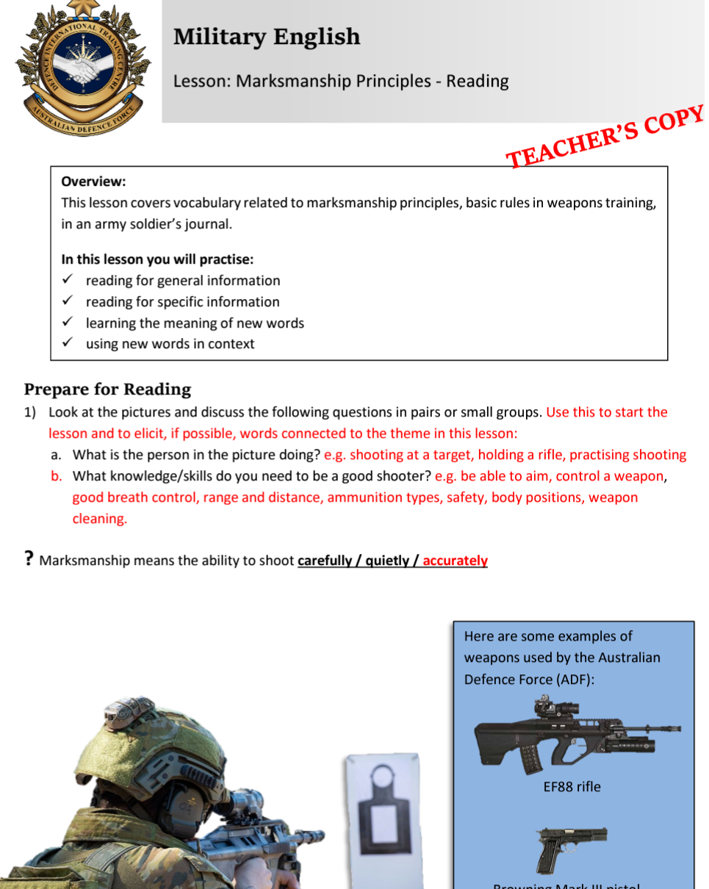
Format: (1) shorter length ‘Vocab Builder’ with concrete vocab items and images, and (2) longer length ‘Lesson’ (semi-authentic text-based) to present and practice Military English vocabulary
Content: topics / themes developed from needs analysis surveys conducted in 2022(and ongoing); generic military English – each lesson addresses themes/scenarios which are relevant to a wide variety of English learners in the military.
Level: Pre-Intermediate - Intermediate
Notes:
There are two different formats of classroom materials – one for shorter periods of classroom time meaning teachers can use this as a filler or warmer, one for longer ‘whole lessons’
Shorter: Vocab Builders: VBs contain vocabulary work – present and practise. Duration: 30- 60 min. Focus is on concrete vocab that can be presented or exemplified via images.
Longer: Lessons: Lessons contain ME vocabulary work, integrated with the practice of one or more language macroskills eg reading, listening, speaking and writing. It’s generally a text-based presentation of the vocab with pre and post language and skills practice. Duration: 60-90 min. Teachers are encouraged to use lessons in their entirety or to use a combination of one or more tasks in a lesson/worksheet to suit their needs.
The target audience is what we like to consider our partner language schools operating in the region providing English as a second / foreign language instruction to military personnel. The materials based on topics / themes developed from needs analysis survey and focus group discussions with these stakeholders. The main concept will be generic military English – each lesson addresses themes/scenarios which are relevant to a wide variety of English learners from their military contexts. The materials are pitched at all services, army, navy and air force, but considering the lack of an air force for many of our partners this sthg we do less of.
Level: Pre-Intermediate – Intermediate – largest target audience for English language schools in the region.
What the materials are not….
a book of lists of vocabulary translated into another language/ a glossary of terms that have no context – that wouldn’t work within our multi-lingual context anyway
It is not ADF slang / Aussie slang whilst trying to incorporate ADF imagery and ‘presence’ they are also meant to be English for an international audience
What ARE they then?
They ARE classroom ready resources for teachers to help them integrate Military English into lessons / courses. The materials being made for teachers to manipulate how they see best fits their circumstances.

Slide 13
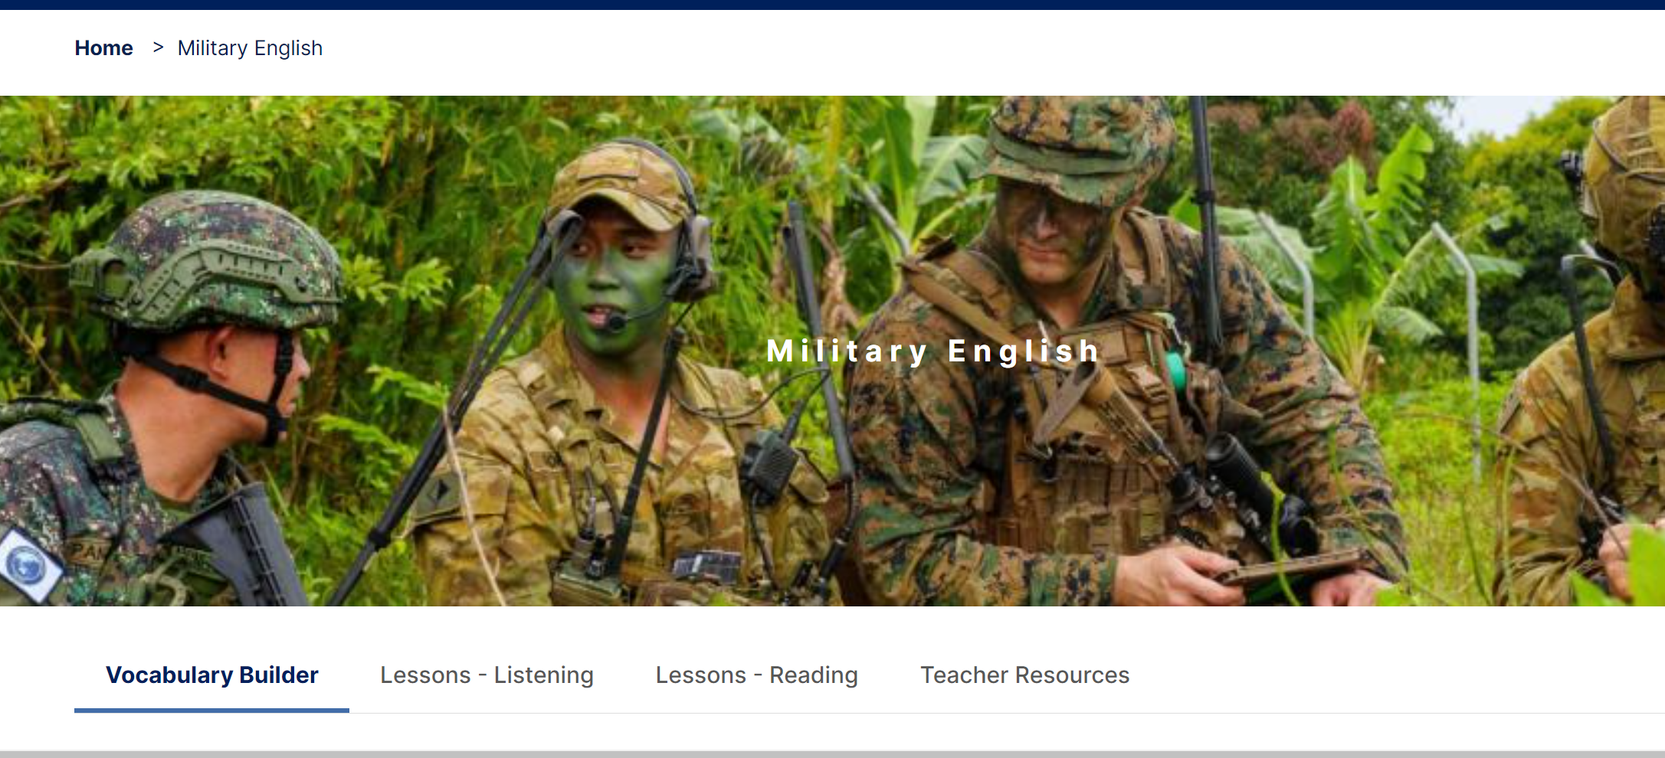
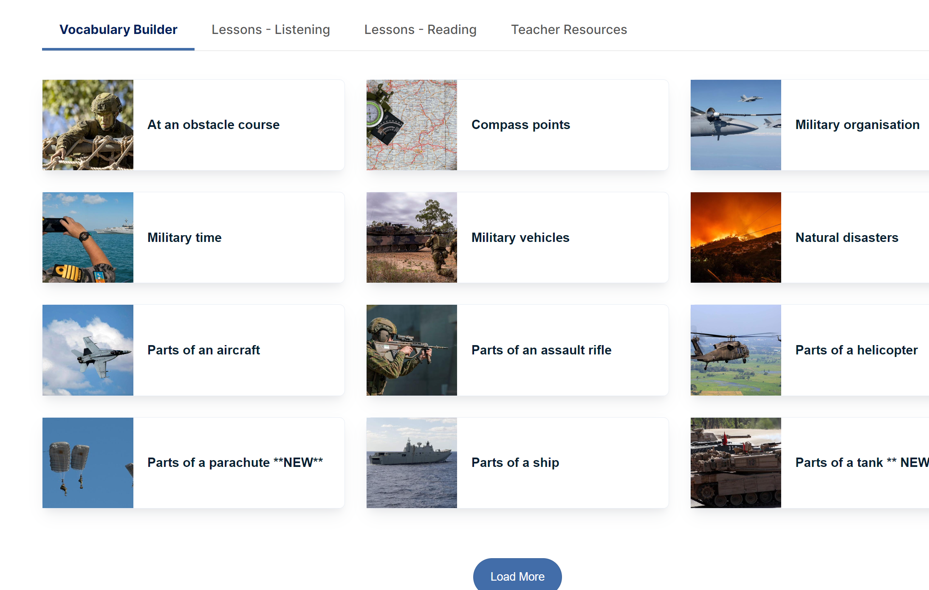
Notes:
So, we’ll be going to this site in a minute.
You’ll see on the landing page, tabs for VB – Lessons Listening – Lessons – Reading – Teacher Resources
Activity: AB on the table, As go to Lesson – Listening and Cs go to a Lesson – Reading of your own choice. Note, no –one is looking at VB bc concrete vocab so no ‘definitions’ as such on these materials but just images that ‘define’ the item.
Pls, look thru the material, the ss HO, the Ts notes (listen to the audio if you like). Also look at the vocab / vocab table in the lesson.
Do the matching task in your head, if you like – do the matches work for you?
Any comments on the definitions – you are going to play the role of ‘critical friend’ here.
Give you max 5mins. Then re group for another 10mins to meet s.o who looked at the other style of Lesson and describe the material you looked at: topic, tasks and if the vocab definitions work for you.

Slide 14
Notes:
Let’s go – scan the QR code to go to the website on your phone
Activity: - anyone need instructions again?
5 mins max for exploring mats, then 5-10 mins chatting w partner
go to a Lesson – Listening if you are seated on my right, but if you are on the left, go to a Lesson – Reading of your own choice
Have a look at a lesson, the ss HO, the Ts notes and then in particular look at the vocab table in the lesson.
Do the matching, do you agree with the definitions?
Re group – meet s.o who looked at the other style of Lesson and describe the material you looked at: topic, tasks and if the vocab definitions work for you.
FB = FB from activity: any positives you saw? did you see whose definitions could be improved? Pls let me know.
FB from the grp –Q’ns or comments about the materials?

Slide 15
Materials development and vocabulary definitions: challenges
Are you developing materials? What materials do you need to develop for / in your context?
What challenges, if any, do you face in developing materials for teaching ‘military English’?
What challenges are there in producing the definitions for any military English for your learners?
Notes:
So, now that you’ve seen some of the materials and know the context like to focus on the second half of this workshop – challenges for materials developers.
First, let’s think about this – what challenges have you faced / do you face? Can you imagine any difficulties my team might be facing?
Can you find s.o you haven’t spoken to you yet and have a brief discussion with them. 10mins.
FB – thoughts?

Slide 16
Materials development and vocabulary definitions: challenges
Challenges for materials developers ….
civillian EFL teachers
authentic texts
military terminology/ language
Military English = ESP
….to create definitions of military English for learners whose…..
military and language backgrounds are varied
educational background of military pers may be limited
language learning backgrounds may be limited
L1 (non-romance) is very different to English (i.e. very few cognates between e.g. Khmer and English)
Notes:
So, now that you’ve seen some of the materials and know the context like to focus on the second half of this workshop – challenges for materials developers.
What do I think is the issue?
Having begin preparing this and reflecting back on the ;last 2 years of involvement in this project, my own summary is …. developers, texts, language, target audience – these are my challenges in the main, but for defining mil terminology, I think the two largest issues are the language itself and the level of my learners.
So, let’s look at these two issues and consider ways forward with these.
Challenges for materials developers ….
civillian EFL teachers – who have much less, if any operational understanding of differences in words e.g. casings and shrapnel (I had thought they were the same, but not until an ADF colleague actually showed me a bullet and it’s parts did I understand the issue here!)
military terminology/ language
authentic texts
Military English = ESP (usually high level language skills)
ESP falls outside of CEFR / level descriptors a lot of the time so whilst we think we are but not a lot of other choice – use these but have to reply on / apply our own understanding of learners, language and levels
…to create definitions of military English for learners whose…..
military and language backgrounds varied – cadets, army, navy, air force, police,
English ‘type’ – US / UK English vs AUS/ ADF English
learners’ L1 (non-romance) –no. of cognates btn English and most other languages in Indo-pacific (except for borrowings, ofc) are rare.
As an example, Bahasa Indonesia is the official language of Indonesia. As such, it is spoken to some degree of fluency by over 220 million people, but oddly enough, less than 10% of the population actually speaks it as their mother tongue. The rest of the population speaks one of over 700 local languages and uses Indonesian only in formal situations or to communicate with other ethnic groups. Though there is a standardized version of the language, spoken on newscasts and printed in the national media, Indonesian varies from region to region. Despite it being a young and quite dynamic language in its many borrowings from English, Dutch and so on, English and Indonesian, however, are worlds apart, having West Germanic and Austronesian roots, respectively.

Slide 17
Challenges defining military terminology: language in context
Studies have shown that military terminology that masks violence and danger with humorous or benign language indeed effectively alters perception. For instance, “A March 25 Times Mirror poll showed that the euphemism of ‘collateral damage’ for ‘civilian casualties’ was startlingly effective in blunting public sentiment ….”
Taken from: Wilson, A. (2008) Military Terminology and the English Language, https://cpercy.artsci.utoronto.ca/courses/6362-WilsonAdele.htm Accessed March 04, 2024
Notes:
No. 1 Challenge – language of military – mil don’t wear cams only on their bodies, camouflage also in their ‘speak’
Our materials based as much as poss on using/ exploiting authentic texts, so as to address the actual language in use.
But language of defence is one of the biggest obstacles.
We established the idea of mil terminology / Language at the start but we may not have mentioned the issue that is inherent to what the military is and how language can sometimes be a blind.
Example: asset (in a ‘civilian sense’ this is a fab thing to have, implies positive) but in mil?
Assets: weapons or could be people that have been captured and from whom intel needs to be gathered (? My own use of vague language here when I mean obtained / taken by force from them!)
Can you think of any other examples?
Vagueness as a blind to the mess that war is
Complexity of system that is the military and war
The mil culture and language which is of its own making and pos nec as a form of defence

Slide 18
“....hard to find [a wordlist] related to the military. The main reason is probably the complexity of the military system. “ Chiang-Chiang Oyang, Using a Corpus-Based Approach to Select Military Vocabulary for an ESP Course NPUST Humanities and Social Sciences Research: Pedagogy Vol. 17 No. 1 March, 2023 pp. 89 ~ 114
“………., military culture …… emphasizes values such as discipline and self-sacrifice that stem from the imperative of military effectiveness and success on the battlefield” (Center for Strategic and International Studies, 2000, p. 1). Thus, military organizations develop a culture into themselves, distinguished by an emphasis on hierarchy, tradition, rituals and customs, specific uniform and insignia.”
V. GEORGIEVA and P. MARINOV INTERCULTURAL INTERACTIONS IN A MILITARY CONTEXT Land Forces Academy Review Vol. XXII, No 3(87), 2017
Bowyer (2015) mentions the fact of the separate branches in militaries, and that they also have their own culture and language. “... Without the background knowledge of military terms, the central idea cannot be obtained. “
Notes:
Mil terminology can be impenetrable to civilians/ teachers / mats developers, and also to junior / inexperienced recruits in target countries whose mil lives have only just begun
“…while our civil culture appropriately emphasizes liberty and individuality, military culture down-plays them and emphasizes values such as discipline and self-sacrifice that stem from the imperative of military effectiveness and success on the battlefield” (Center for Strategic and International Studies, 2000, p. 1). Thus, military organizations develop a culture into themselves, distinguished by an emphasis on hierarchy, tradition, rituals and customs, specific uniform and insignia.” – one could extend this or understand tby this that here ‘culture’ must also mean ‘language’.
Bowyer (2015) mentioned that English is the language most frequently used in international military and peacekeeping operations. The military has four major branches (Army, Navy, Air force, and Marine corps). Each branch has its terminology. Military ideology can be expressed by military terminology. For example, military terminology can explicate military action or affair. Without the background knowledge of military terms, the central idea cannot be obtained. Since it contains the ethos of the military, this vernacular is deeply ingrained in everyday speech. Even despite the differences among the individual armed forces the similarities in training and customs are enough to provide clear intertextual references over time.

Slide 19
Challenges defining military terminology: language level and the nature of ESP
ESP is generally designed for at least Intermediate and above learners (Hutchinson and Waters, 1987): most of our target audience would like the materials to be pitched lower at around A1/A2 / Beginner/ Elementary
We take it for granted that teaching an ESP course also means learners have awareness of their own ‘industry’. Can this be true of cadet students, or new recruit students?
ESP does not have a great deal of research materials supporting innovations or materials development, but needs analysis is the start – target audience is varied
Common use level descriptors such as a CEFR do not match the common core language in use in an ESP context
Notes:
2nd challenge is the nature of the language being ESP i.e. English for Specific Purposes is the idea that language is used in a particular manner within the social groups where a certain set of people belong. In this context we are talking about belonging to the military, doing jobs within a defence force, which of course can be more than numerous!
“foreign language teaching and training that addresses immediate and very specific needs of learners who need that language as a tool in their education, training or job. Needs analysis is the underlying "driver" for the development of these programs/ materials”
ESP is often a course of language learning that suits learners who already have some basics – so poss for Int learners and above (research by Hutchinson and Waters suggest this)
We take it for granted that teaching an ESP course also means learners have awareness of their own ‘industry’. We are developing materials for use by target audience that are teaching new recruits and cadets as well as other experienced mil members. How much actual knowledge of military culture and operations do they have?
ESP does not have a great deal of research backing up the approaches, the language. But it is noted that ESP is often based on learner needs and eliciting this via needs analysis. Whiule we spent time doing this early on, we poss needed to do more of this esp as Southeast Asia has many different countries and languages, a huge variety of learners and teachers, levels and militaries.
Common use level descriptors such as a CEFR do not match the common core language in use in an ESP context
Hutchinson and Waters (1987) defined English for Specific Purposes (ESP) was a language learning approach based on learners’ needs.
ESP characteristics as following: (1) ESP meets specific purposes of the learners; (2) ESP makes use of underlying methodology and activities of the discipline it serves; (3) ESP is centered on the language appropriate to these activities in terms of grammar, lexis, register, study skills, discourse and genre. Besides, ESP also has some variable characteristics such as: (1) ESP may be related to or designed for specific disciplines; (2) ESP may use, in specific teaching situations, a different methodology from that of general English; (3) ESP is likely to be designed for adult learners, either at a tertiary level institution or in a professional work situation. It could, however, be for learners at secondary school level. However, in some cases, ESP is also designed for high school students; (4) ESP is generally designed for intermediate or advanced students, and (5) Most ESP courses assume some basic knowledge of the language system, but it can be used with beginners.

Slide 20
Challenges defining military terminology: defining for low level learners
There are two resources being developed around the topic of ‘mine clearance’ – a Vocab Builder, and a Lesson.
The vocabulary items for the Lesson need to be defined for inclusion in the material.
Use whatever tools you may access (your own experience, an online dictionary or a military glossary) to create useful definitions to add into the material.
Remember, the definitions must be approximately A2 level.
Notes:
Put you in place of materials developers now.
Task is to look at some words from this newest lesson on ‘mine clearance’ as a task in a PKO.
Define the words in any way that works for you - use your own experience, any tools that can help.
Remember, definitions needed for materials pitch towards A2 learners.
Work in pairs , groups make definitions – compare with another pair/ grp.
FB – What tools used, why, what else did you use to define words apart from the ‘tools’ ?? What problems do you see in any of this? What challenges did you have?
Solutions?
VB = visor // body armour // personal protective equipment (PPE) // landmine// prodder // trip wire // sniffer dog // booby trap // shrapnel // bullet casing // metal detector i.e. all concrete items that will support an intro to the topic and begin to aid visualising of the topic
Lesson = a text based lesson and further exploration of vocab on topic (HO – final drafted text of Women work in mine clearance)
Words to teach / review in this lesson (via draft material – may still yet be edited – there are 17 words here but that’s too many so need to edit further:
peacekeeping mission (already been taught in other lessons , so omit from teaching list?)
commander
mine clearance
Humanitarian (already been taught in other lessons , so omit from teaching list?
safe path
breaching
To advance
retreat
‘demining’ (taught in VB, but think it’s good to review it in this lesson)
de-activate
explosions
unexploded ordnance (UXO)
mortars, (this is quite concrete, so could it be added to the VB?)
projectiles
grenades this is quite concrete, so could it be added to the VB?)
improvised explosive devices (IEDs)
explosive ordnance disposal (EOD).

Slide 21
Military English project: Materials development - sample
It was in 2014, that a UN peacekeeping mission finally had a female commander. Major-General Kristen Lund from Norway led the UN’s peacekeeping mission in Cyprus. Now, other work in peace-keeping that women are beginning to do, is the important task of demining.
Demining is the job of clearing land, after war or ‘post-conflict’, so that people can return to their homes and get back to a normal life. The only way to clear a minefield of landmines is to deactivate them one at a time. This is a very slow and dangerous job and accidental explosions can happen. Demining is taking place in over 60 countries where landmines or unexploded ordnance (UXO) is still a daily problem. In Syria, as well as UXO such as mortars and grenades, ISIS left improvised explosive devices (IEDs) everywhere. They are inside cooking pots, mobile phones, even children’s toys.
Zeina Saleh of the UN Mine Action Service (UNMAS) in south Lebanon is one of the very few women working in demining. In November 2019, Zeina, and six other young women working for UNMAS around the world, received the UN Secretary-General Award for working in explosive ordnance disposal (EOD).
“I am extremely interested in the work that I do, and I am very happy and proud to be working for UNMAS,” Zeina adds. “Yes, I know that this is [an important] job, but I have learned how to protect myself and also to protect others.”
(239 words) Adapted from: https://unifil.unmissions.org/award-winning-zeina-saleh-defies-gender-norms-clearing-south-lebanon-mines // https://textinspector.com/
Notes:
Forgive the dense text up here – this is my possible sample text for the lesson (a reading lesson).
This text has been through many forms and through a programme called Text Inspector to get it to this form that a pre-int ss may be able to cope with.
This website can support a lot of the grunt work in identifying language issues from a level perspective (despite it not being fit for ESP purpose but better than nothing).
The text has 12 bolded Mil English words for teaching in this lesson on ‘mine clearance’. I also have words for a VB that will be used to support this text-based lesson, but as they are the very concrete words like ‘metal detector’ we will teach those through images.
It’s the bolded words here that may NOT be so easily represented that we need definitions. So, remember, define the words in any way that works for you - use your own experience, any tools that can help. In XX groups, take 6 words each.
Remember, definitions needed for materials pitch towards A2 learners.
Work in pairs , groups make definitions – compare with another pair/ grp.
FB – What tools used to help you come up w definition?
Anyone use anything else?
Did you have any problems? What problems do you see in any of this? Solutions?

Slide 22
Challenges defining military terminology: resources used for definitions
The Oxford Essential Dictionary of the US Military (Oxford Univ Press 2002);
Dictionary of Military Terms 3rd Edition (R. Bowyer, Bloomsbury, 2008);
The Dept of Defense Dictionary of Military and Associated Terms (2001, Amended through to 2010);
BILC Glossary
https://dictionary.cambridge.org/dictionary/learner-english/
https://www.oxfordlearnersdictionaries.com/
ADF Glossary (internal document only)
…my ADF colleagues!
Notes:
What dictionary or glossary did you use? Did you use any of these?
Were they helpful? Why / not? Any more helpful than others?
I’ve used any and all of these tools at some point, to get to a definition. Most helpful is if I can go and talk to an ADF member, but, EdOs often lack real operational experience so even they have limited exp to answer my question.
Luckily I have recently had an Air Force EdO post in who happened to be, in a prior life, a ‘tankie’ so could answer my questions about the difference btn shrapnel, bullet casings and projectiles the other week.
The choice of dictionary type is influenced and determined by its accessibility and sufficient contents of the dictionary involved. From the perspective of dictionaries as tools, a mobile-app dictionary creates ubiquitous opportunities for extensive vocabulary learning (Lee, 2015).
Learner's dictionaries are, thus, not to be considered a special type of dictionaries, but constitute a more general category including various types of learner's dictionaries according to their functions or combination of functions.
The purpose of the dictionary is often efficiency, versus depth or context.
Dictionary definitions tend to be thin descriptions, rather than thick or fully orbed ones.
Generic definitions. Dictionary definitions tend to limit particularity, detail, and the concrete. This is because of the concerns of efficiency.
Meanings of terms are impacted by culture and individual leaders in history.
Meaning is deeply implicated in context (and history and story).

Slide 23
Challenges defining military terminology: new tech resources
What about AI?
Me: In the military they use the word, deactivate in the context of landmine clearance. What does deactivate mean?
ChatGPT: …..deactivate means to render a landmine safe by removing its ability to explode. This typically involves disarming the explosive mechanism or neutralising its function so that it no longer poses a threat.
Me: Can you write that again so a beginner user of English will understand?
ChatGPT: …means making them safe by stopping them from exploding. This could involve taking out the part that makes them work so they can’t hurt anyone…
Rewritten to grade yet further: deactivate: to take out the part of a landmine that will make it explode, to make it safe.
Notes:
And…..apart from dictionaries…what new tech resources can be used?
AI is a great tool for teachers to assist in development of resources.
Obv caveat that it isn’t perfect nor the ans to all our prayers.
Have begun using this to elicit definitions so ‘a beginner user of English’ will understand.
Chat GPT
Me: In the military they use the word, deactivate in the context of landmine clearance. What does deactivate mean?
ChatGPT: …..deactivate means to render a landmine safe by removing its ability to explode. This typically involves disarming the explosive mechanism or neutralising its function so that it no longer poses a threat.
Me: Can you write that again so a beginner user of English will understand?
ChatGPT: …means making them safe by stopping them from exploding. This could involve taking out the part that makes them work so they can’t hurt anyone…
Rewritten to grade yet further: deactivate: to take out the part of a landmine that will make it explode, to make it safe.
To note: omit passive forms, modal auxiliary verbs, restructure sentence forms to use active, present simple forms when possible, reduce use of connectors, use two shorter sentences /phrases rather than 1 longer one, use high frequency vocab when possible i.e. not the target vocab, but retain authenticity

Slide 24
Sources of definitions: new tech resources (Chat GPT)
Check with e.g. ChatGPT asking for a definition that ‘a beginner user of English’ will understand.
Let’s go back to the words you were looking for definitions for before. Now use ChatGPT or AI of own choice.
Be aware of what prompt is going to elicit the best response: e.g. Define XXX in its military context so that A BEGINNER USER OF ENGLISH can understand.
Results?
Notes:
Let’s go back to the words you were looking for definitions for before – now use ChatGPT but note use of second query only seems to get results that are useful
prompt: Define XXX in its military context so that A BEGINNER USER OF ENGLISH can understand.
Results?

Slide 25
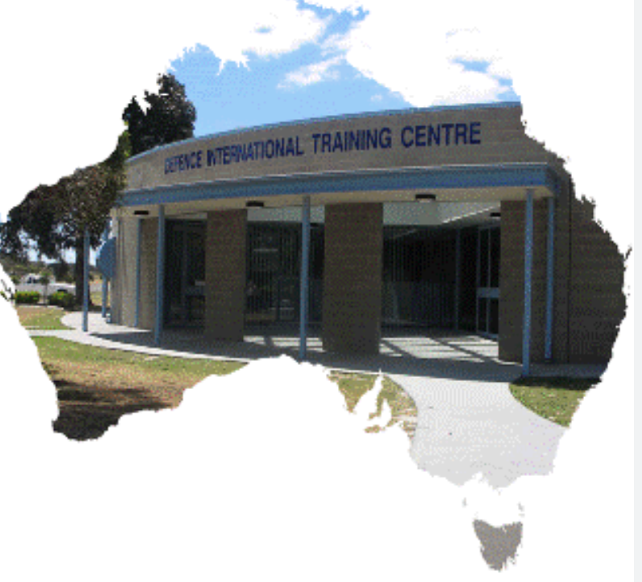
Summary: considerations for defining military English for low levels
VBs with concrete vocab = use images to ‘define’ vocab, and remove the vagueness of ‘military terminology’ when possible
Exploit military colleagues as ‘translators’ of the military language, and then civilian EFL SMEs to rework this as needed
Exploit available tools especially new tech resources but apply own expertise in language learning and teaching to suit ESP context
Request…..Military English version of an AWL (i.e. frequency of usage glossary) for materials developers ☺
Notes:
Solution to this…..use ADF colleagues as much as possible, at least they are EFL teacher trained when they come to us
Solution to this…..use Text Inspector to analyse original authentic text and grade it, only want approx. 12-14 words per lessons and need the texts to be supportive but also accessible for learners
Military English corpus of 1000 most commons words needed!
Solution to this…..what was your solution to this task? How did you produce definitions that you were happy with? One step? Prob not. Use a range of dictionaries, use own awareness of graded language, use colleagues to check the accuracy of the definitions, in context

Slide 26
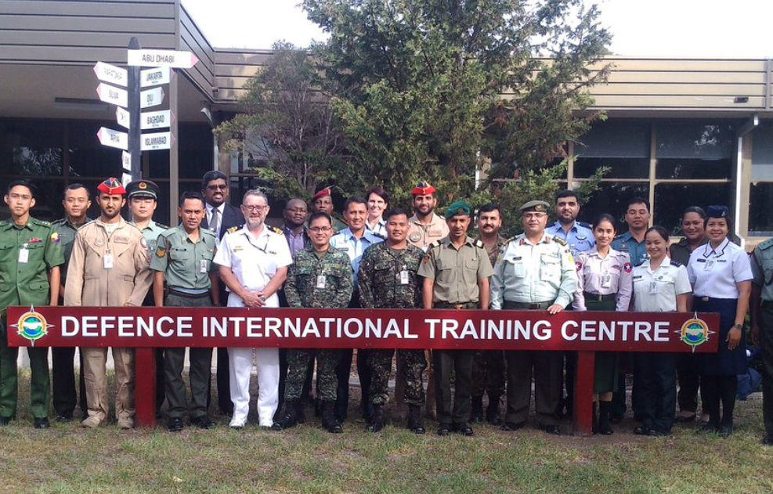
Question Time
Thank you for your participation.
Are there any questions?

Slide 27
Reference List
Bowyer, R. (2008) Dictionary of Military Terms Third Ed., Bloomsbury
Cambridge Learner’s Dictionary (Accessed online https://dictionary.cambridge.org/dictionary/learner-english/ )
Georgieva, V, and P. Marinov Intercultural Interactions in a Military Context Land Forces Academy Review Vol. XXII, No 3(87), 2017
Hijuelos-Cruz, I, E.Medina-Carballosa, R. Perez-Almaguer English for Specific Purposes (ESP): A Theoretical Approach for Syllabus Design, Luz, vol. 19, núm. 4, pp. 116-127, 2020, Universidad de Holguín Oscar Lucero Moya
HAO Wen-hui, SONG Mei A Demand Analysis and Teaching Design of English for Specific Military Purposes for Non-commissioned Officers in Journal of Literature and Art Studies, vol. 10, No.10, 2020

Slide 28
Reference List
Nguyễn Thị Tố Hoa1 & Phạm Thị Tuyết Mai Difficulties in Teaching English for Specific Purposes: Empirical study at Vietnamese Universities in Journal of Higher Education Studies Vol 6 No. 2, 2016
Oxford Learners Dictionary (Accessed online https://www.oxfordlearnersdictionaries.com/definition/english/calibre?q=calibre )
Thomson E. (2014) Battling with Words: A study of language, diversity and social inclusion in the Australian Department of Defence
Text Inspector website: https://textinspector.com/
Wilson, A. (2008) Military Terminology and the English Language

Slide 29
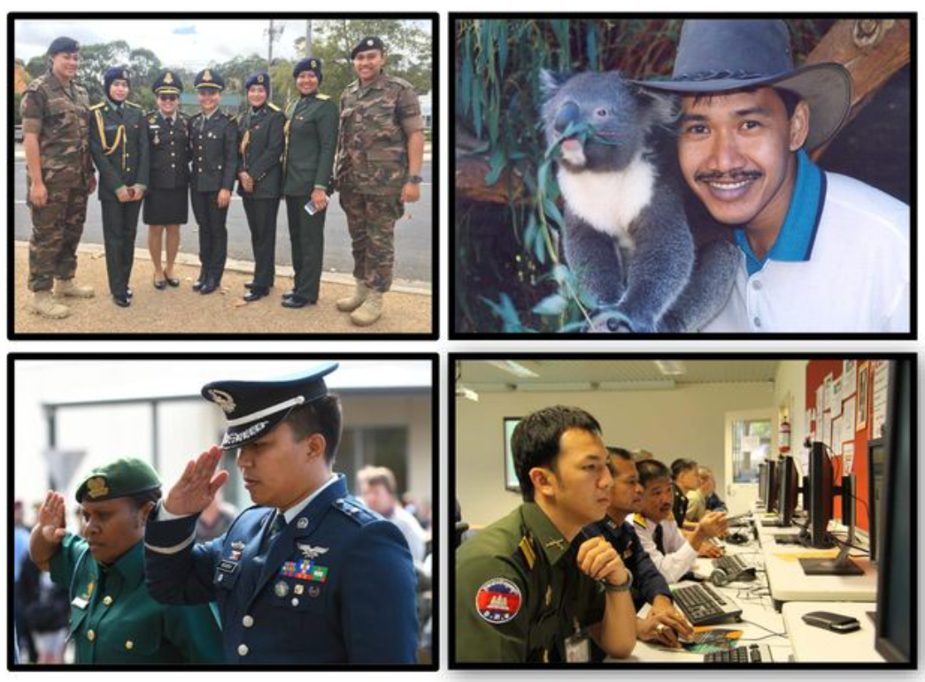
Thank you
kristin.walters@defence.gov.au

Slide 30
Title: Challenges in defining military terminology for low-level learners of English
Description:
The presentation will look at the challenges faced by the team of English for Special Purposes (ESP) materials developers at the Defence International Training Centre (DITC), in Melbourne, Australia working on a Military English materials development project. The project aims to develop materials that contextualize and support the teaching and learning of ‘Military English’ for low level learners of English, primarily from South-East Asia. The context of the project will be established and exemplified and the challenges in developing definitions of the Military English vocabulary explored. We will look at what the team has endeavored to put in place to solve these challenges, including the use of colleagues from the ADF, online tools and reference materials, as well as the use of Chat GPT in producing definitions suitable for low-level English users. As time permits, any questions will be responded to at the conclusion.

Slide 31
Sources of definitions

Slide 32
Sources of definitions

Slide 33
The Oxford Essential Dictionary of the US Military
asset n.
any piece of materiel that can be deployed advantageously against an enemy, or if belonging to an enemy, whose destruction will result in an advantage.... ...
caliber ˈkælǝbǝr Brit. calibre n.
1 the internal diameter or bore of a gun barrel: a .22 caliber repeater rifle.2 the diameter of a bullet, shell, or rocket....calibered adj. ...

Slide 34
Department of Defense Dictionary of Military and Associated Terms
asset (intelligence) — Any resource — person, group, relationship, instrument, installation, or supply — at the disposition of an intelligence organization for use in an operational or support role. Often used with a qualifying term such as agent asset or propaganda asset. (JP 2-0)
caliber/calibre – no entry

Slide 35
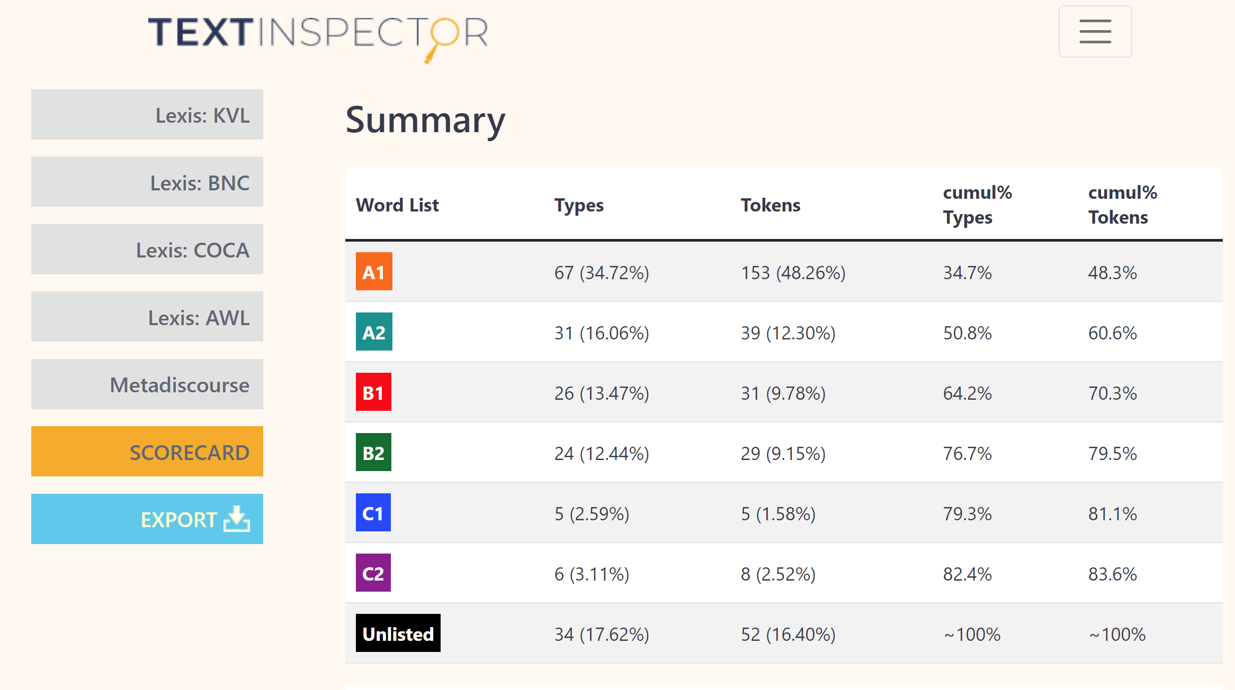
Military English project: Materials development
Text analysis
Notes:
Text analysis shows actually a pretty solid set of A1 words but that there were still
(a) too many words
(b) Too many high level

Slide 36
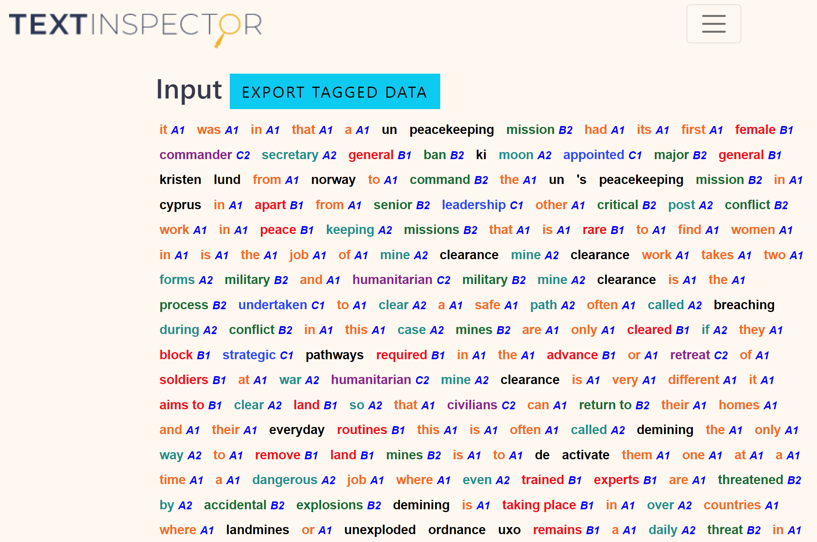
Notes:
Text Inspector will show you exactly which words are marked at which level.
And if you Export tagged data – elicits a spreadsheet of all the words their level (CEFR) and a meaning!!

Slide 37
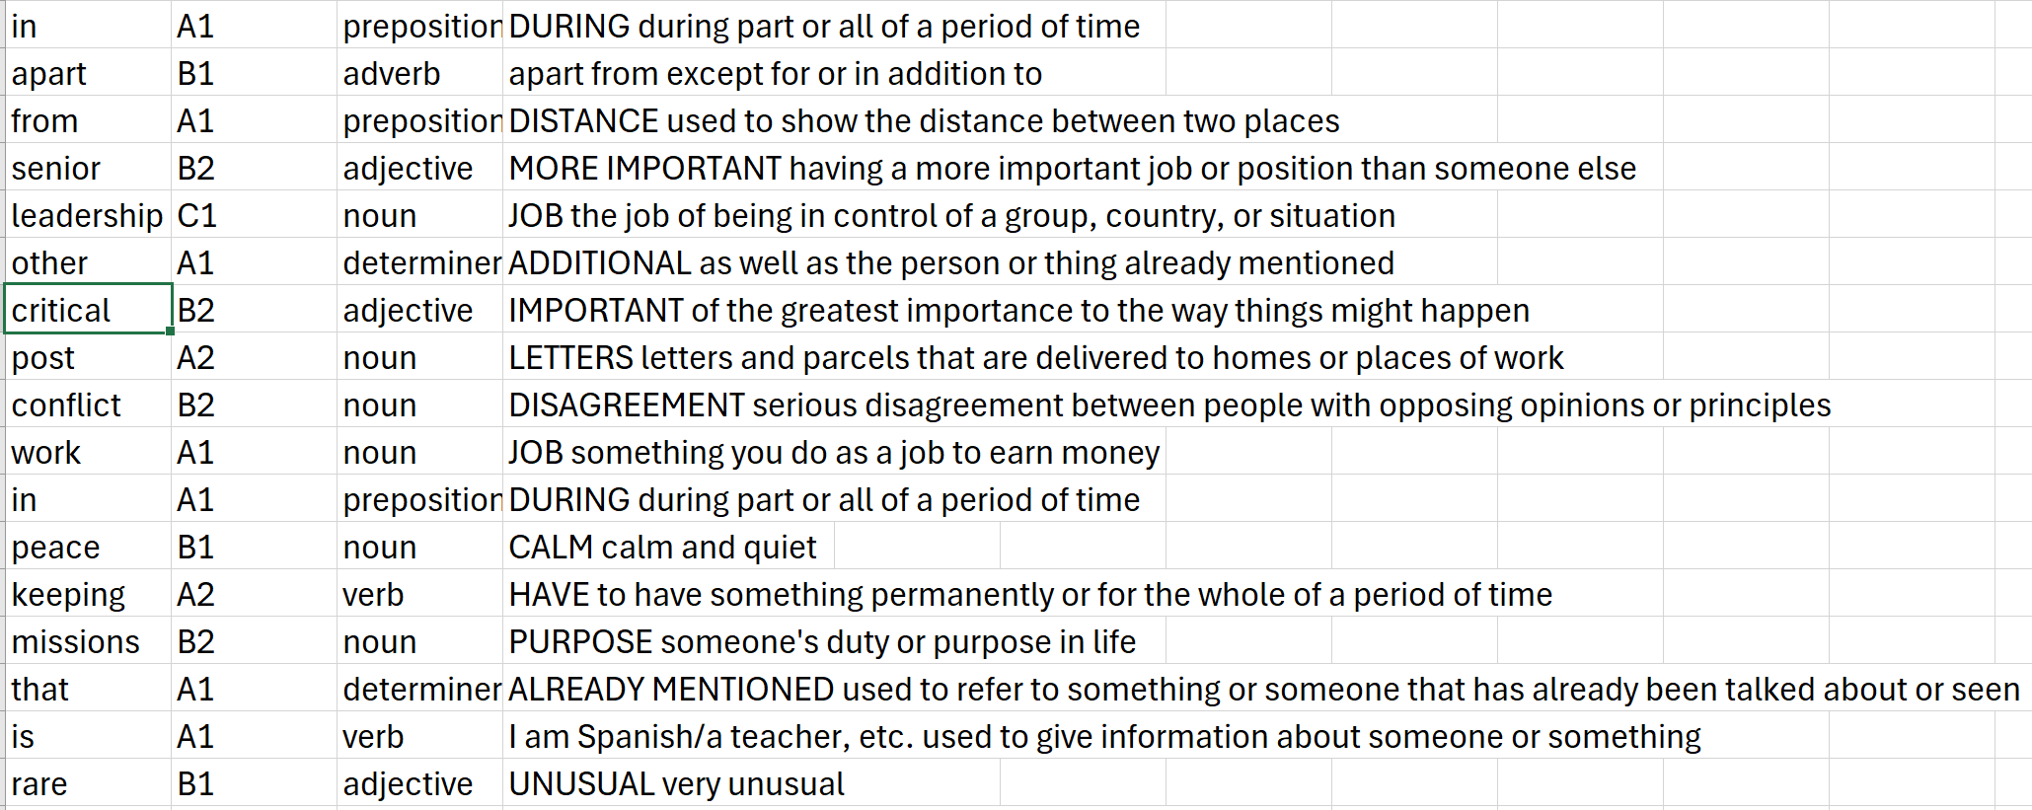
Notes:
Export tagged data – elicits a spreadsheet of all the words their level (CEFR) and a meaning!!.
And possibly some help in identifying a useful synonym that will help w the grading.
See example here. Now obv there are problems with this, but as you can see….LOL, we can work most of these out.

Slide 38
It was in 2014, that a UN peacekeeping mission had its first female commander. Secretary-General Ban Ki-moon chose Major-General Kristen Lund from Norway to lead the UN’s peacekeeping mission in Cyprus in 2014.
Apart from senior leadership, other important post-conflict work in peace-keeping missions that we don’t often find women in, is the job of mine clearance.
Mine clearance work takes two forms: military and humanitarian. Military mine clearance is what soldiers do to clear a safe path (often called ‘breaching’) in conflict. In this example, mines are only cleared if they block strategic pathways needed in the advance or retreat of soldiers at war. Humanitarian mine clearance is very different. It aims to clear land so that people can return to their homes and their everyday routines. This is often called ‘demining’.
The only way to remove land mines is to de-activate them one at a time—a dangerous job where even trained experts are threatened by accidental explosions can happen. Demining is taking place in over 60 countries where landmines or unexploded ordnance (UXO) remains a daily problem. In Syria, as well as unexploded ordnance (UXO) such as mortars, projectiles and grenades, ISIS purposefully left improvised explosive devices (IEDs) everywhere. They are inside containers, cooking pots, mobile phones, even children’s toys.
Zeina Saleh of the UN Mine Action Service (UNMAS) in south Lebanon is one of the very few women working in demining., under extremely risky conditions. In November 2019, Zeina, and six other young women working for UNMAS around the world, received the UN Secretary-General Award for working the gender imbalance in the field of explosive ordnance disposal (EOD).
“I am extremely passionate about the work that I do, and I am very happy and proud to be working for UNMAS,” Zeina adds. “Yes, I know that this is a risky job, but I have learned how to protect myself and also to protect others.”
Notes:
Using both the output from Text Inspector and my own awareness of the level of learners / language and wanting to shorten the text a little, with more to go on this, I edited the text.
CEFR level descriptors

Slide 39
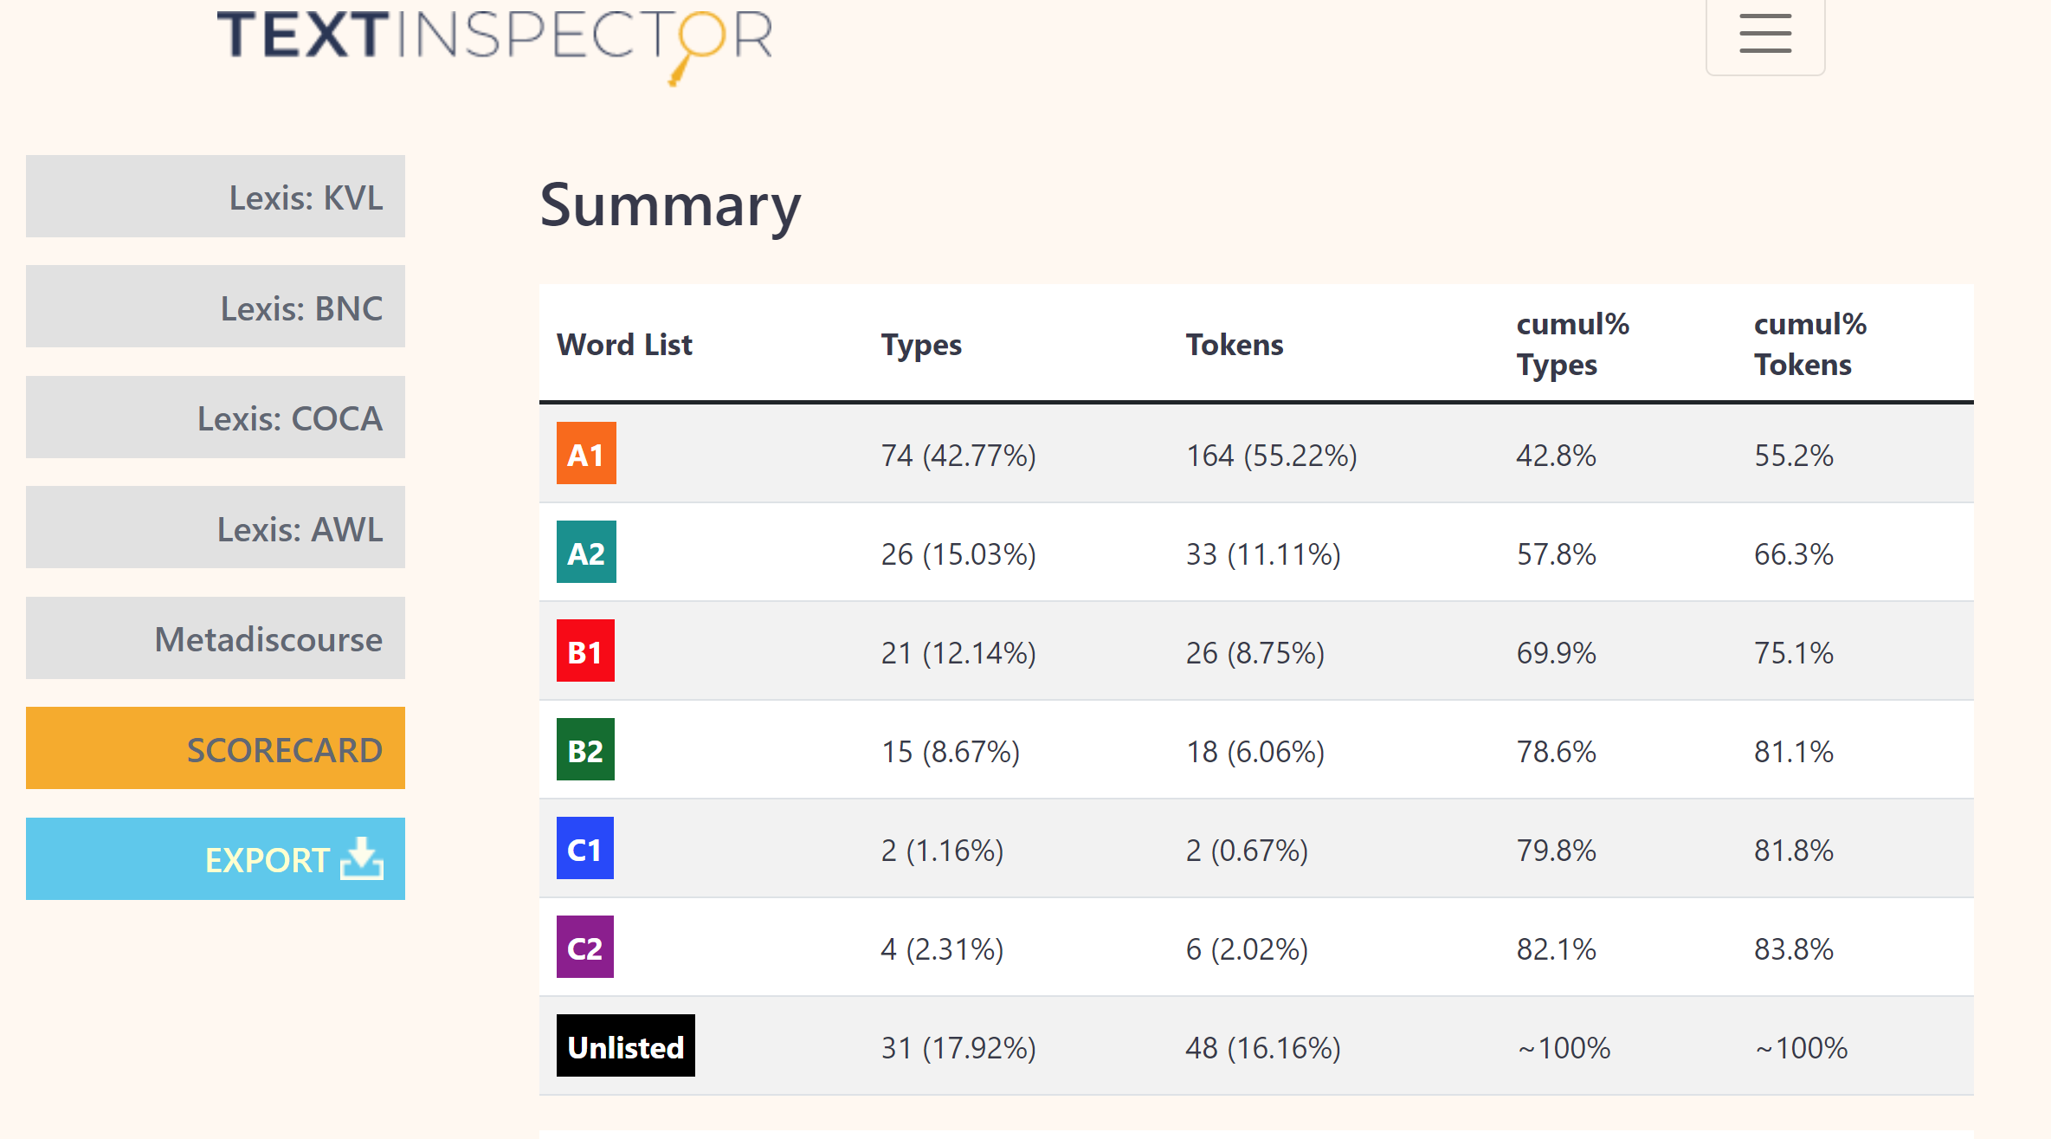
Notes:
As you can see the list of A1 words has grown from 67 to 74, and B1 words decreased from 26 down to 21, B2 down from 24 to 15, C1 down from 5 to 2, and so on.

