Slide 1
Work Shop: Translation and Interpretation
BILC in Brügge, May 4-8, 2014 Satu, jari – finland
nana - georgia
suvda – Mongolia
Katarzyna, Maciej – Poland
christine - uk

Slide 2
Work Process Translation
Introduction of elements af translation theory, best practises
presentation of ILR descriptions (levels 2,2+,3)
exchange of views and experience in the field
Discussion of different aspects of translation based on an article from ”Telegraph” (uk-website)
Short discussion of aspects of translating military texts

Slide 3
Work Process Interpreting
Introduction of elements of theory, practises and ”working tools” related to interpreting
presentation of ILR description (level 3)
exchange of views and experience
Short ”scenario-based” exercise
”Hot wash-up” on both issues, proposals for the final presentation

Slide 4
Food for further consideration Translation
-> 2: possible element of ”grammar-translation” learning process
2->3: translation ”for real” to develop:
translation skills for future translators
general ”language awareness” and contrastive understanding – process and class room discussions more important as final result (first language competence, style/register, translatability)
practical approach to handling elements of target language culture
introduction af sufficient elements of translation theory and a number of working tools and guidelines recommended
translation is an excellent preparation for interpreting

Slide 5
Food for further consideration Interpreting
->2: conversation exercises
2+->3: interpretation (ideally 3->4) to develop:
interpretation skills for future interpreters
understanding of the complexity of working together with an interpreter and ”best practises” in this area
awareness of the challenges related to expressing exact meanings of other persons, not chosing your own words
introduction of elements of theory and number of ”tools” (note-taking and short-term memory enhancing techniques) recommended
important to stress the differences between translation and interpretation

Slide 6
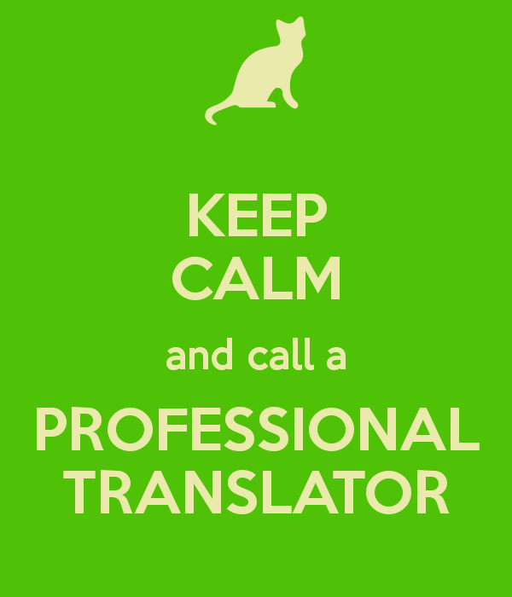
Translation and interpreting
Both ”skills” are more necessary and widely applied than generally anticipated during multinational operations and activities related to arms control and other CSBM’s, as well as during military co-operation

Slide 7
