Slide 1
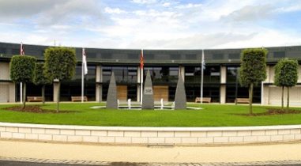
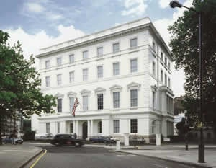
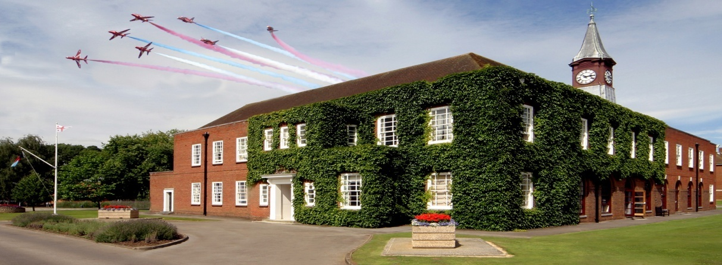
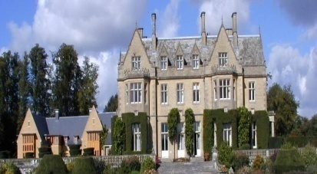
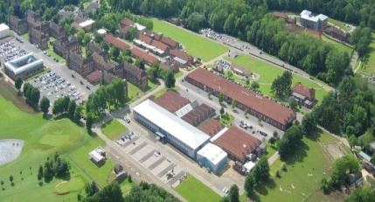
UK DEFENCE LANGUAGE TRAINING – THE NEW LOOK
NATO BILC CONFERENCE - BRUGES, MAY 2014
Christine Adamson, Member of the Chartered Institute of Linguists

Slide 2
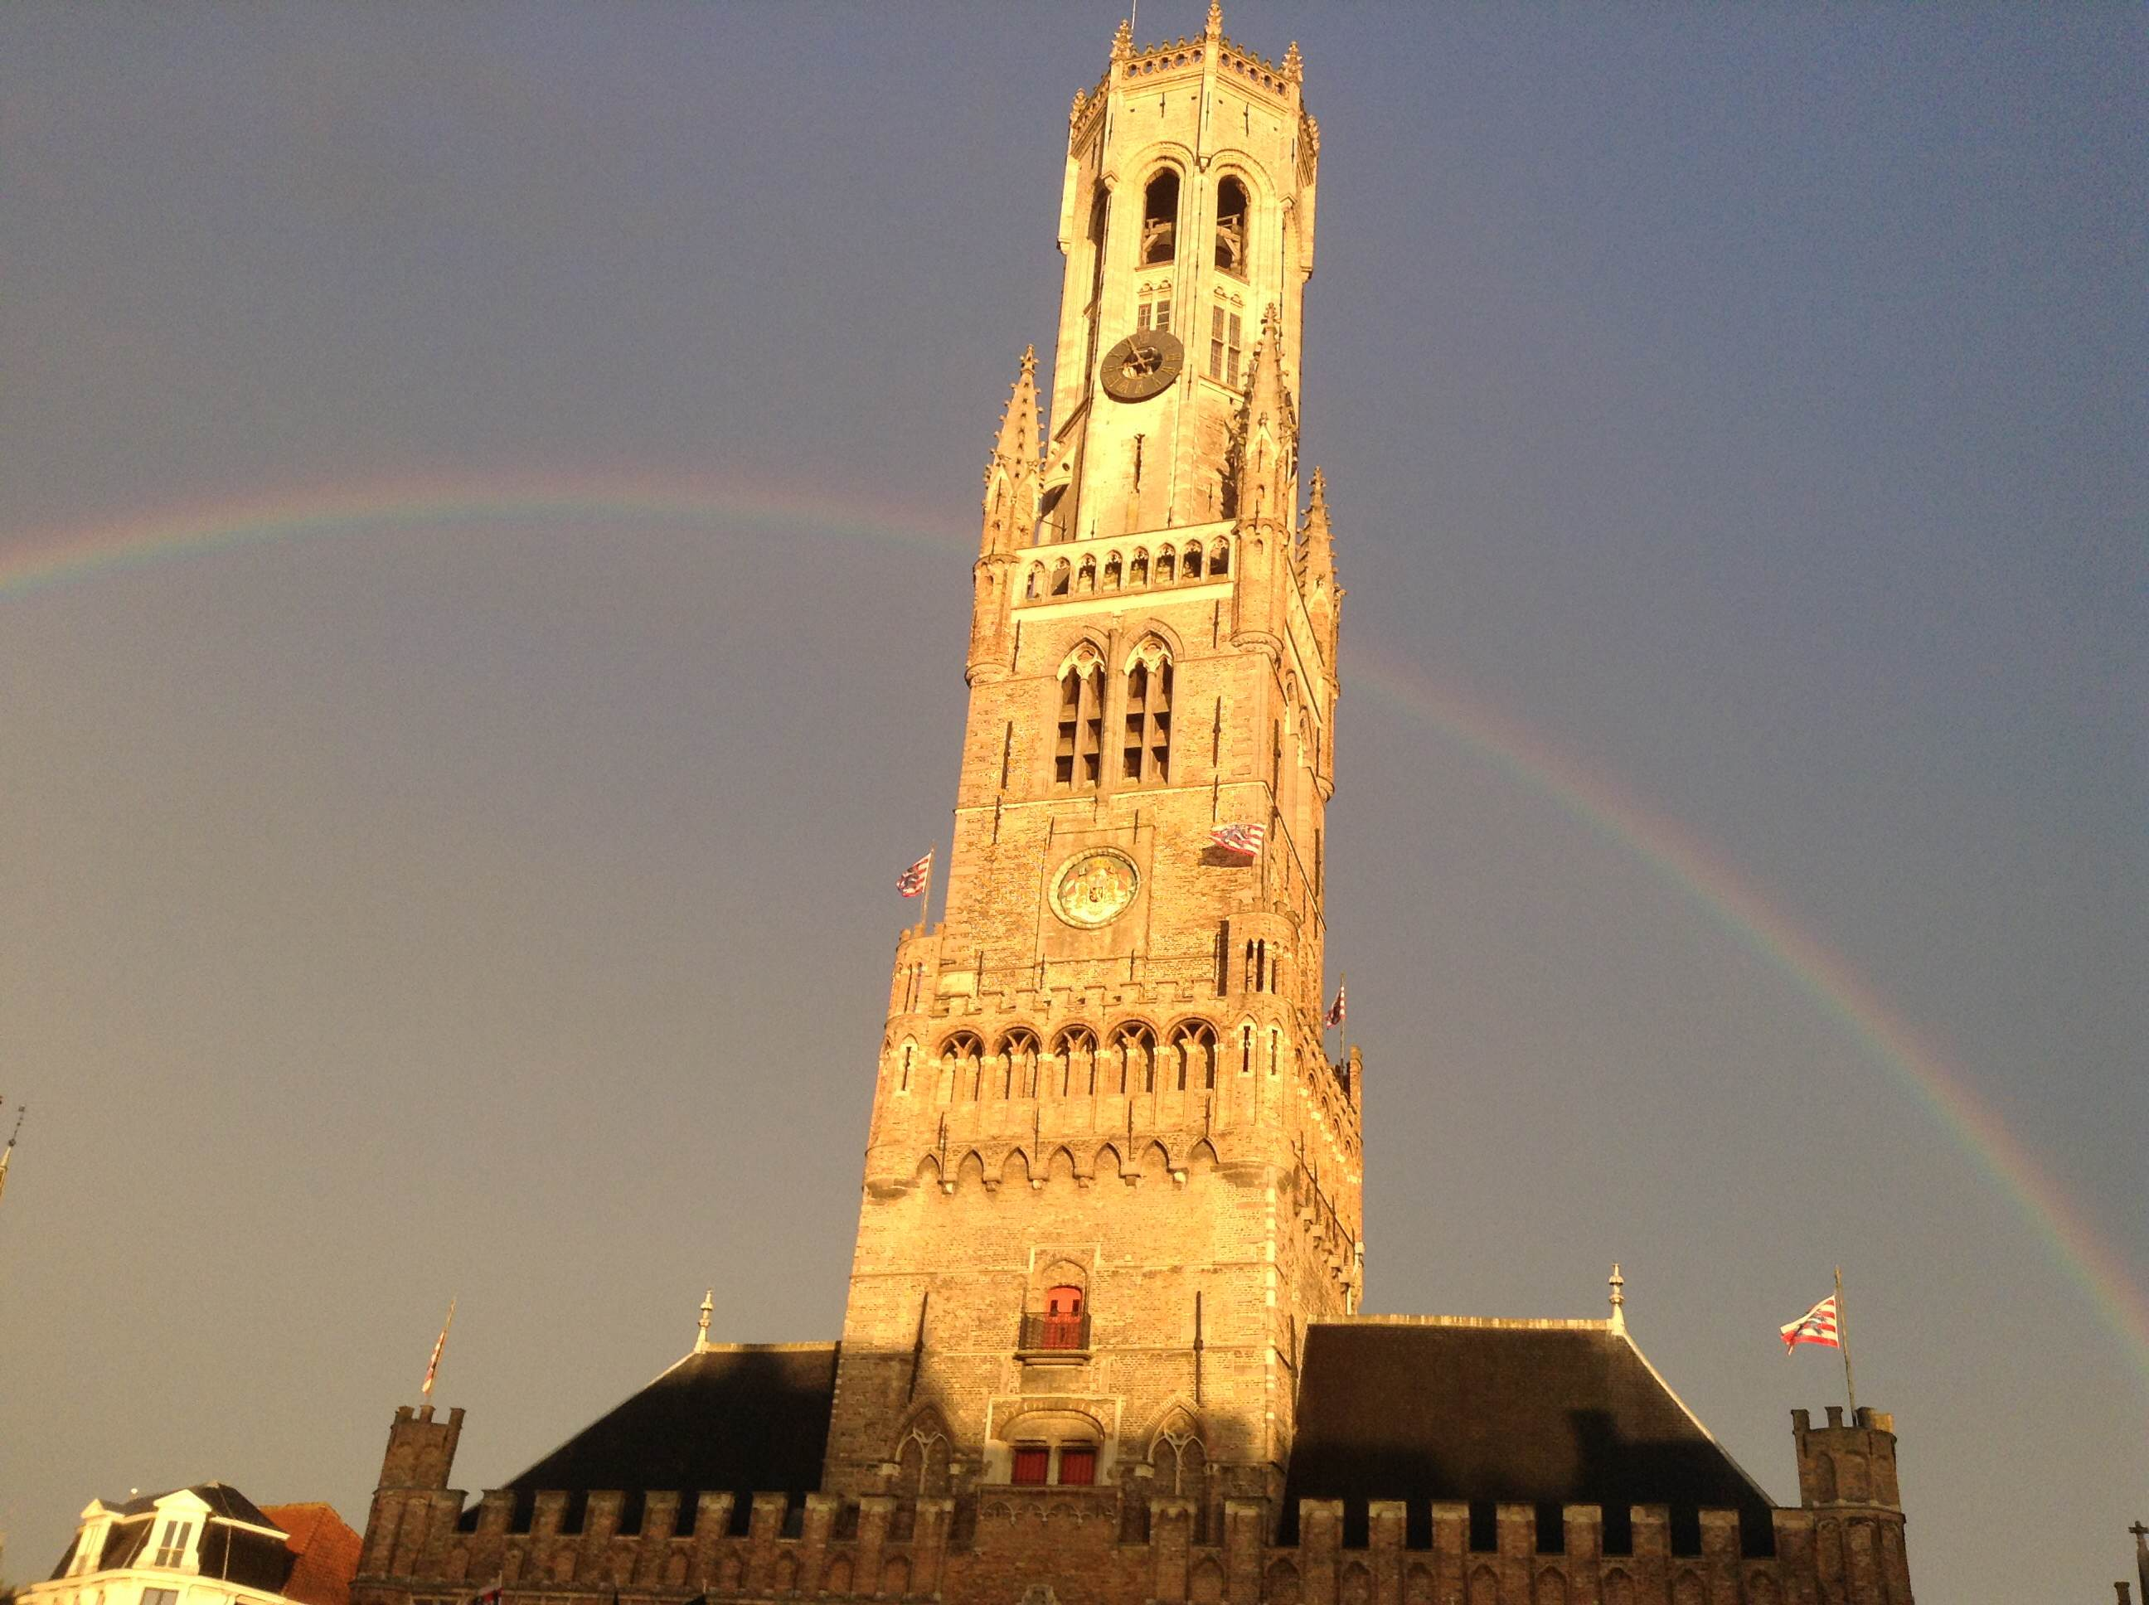
In Bruges – Magic Moments

Slide 3
UK DEFENCE LANGUAGE TRAINING – THE NEW LOOK
NATO BILC CONFERENCE - BRUGES, MAY 2014
Christine Adamson, Member of the Chartered Institute of Linguists

Slide 4
JFC’s mission is to develop and prepare an integrated Joint Force, including the generation of assigned joint enabling capabilities, for current and future operations commanded by the designated Joint Force Commander.
Notes:
The main purpose of the Joint Forces
Command is to make sure the Joint Force is
consistent and to use joint enablers to support
current and contingent operations. They monitor
and manage performance and risk against
current and contingent Defence capability. They
also make sure they prioritise joint training and
joint and single-service capabilities to deliver
most effectively.

Slide 5
TRAINING DELIVERY AUTHORITY (TDA) FOR C&L TRAINING
The TDA is responsible for the provision of individual training or education, to agreed standards and in accordance with extant and funded Defence and single Service policies, on behalf of the customer(s).
It is the conduit through which a Training Organisation/School is commanded/headed, resourced and administered.
Joint Service Publication (JSP) No 822 : DEFENCE SYSTEMS APPROACH TO TRAINING

Slide 6
Defence Academy Vision
Our vision is of a Defence Academy with a global reputation for excellence in the delivery of high-quality and relevant education, training, research and advice that is continuously improving to meet the evolving needs of Defence and Security.
Professional skills for Defence and Security
6
Defence Academy
© Crown Copyright
Notes:
Self explanatory
Recently refreshed and approved by Defence Academy’s Policy Board (chaired by CDS)

Slide 7
Defence Academy Mission
To prepare people in Defence to meet the challenges of the future;
To play a leading role in developing the strategic thinking capability of Defence;
To advance and promote the defence and security interests of the UK and its allies and partners through Training and Education.

Slide 8
Current Context
Complex security challenges and the changing role of Defence;
The value of training and education (people as the “asymmetric edge”);
The changing nature of education (including learning technologies);
Defence Transformation;
The financial climate.
8
Defence Academy
© Crown Copyright
Notes:
Complex security challenges. Defence as part of security continuum.
Value. “Future Character of Conflict” (DCDC, 2010):
– military purchasing power of potential adversaries increasing, so
technological and equipment superiority no longer guaranteed;
– Adversaries will seek asymmetric advantage;
therefore we need better understanding, better adaptation, mental agility
Changing nature of education. How do people learn? Technology offers new opportunities.
Financial climate. Tough, but manageable.

Slide 9
Outputs 2012/13 - Total Training Days 387,313
By activity

Slide 10
Outputs : 2012/13 - Total Training Days 387,313
By student body

Slide 11
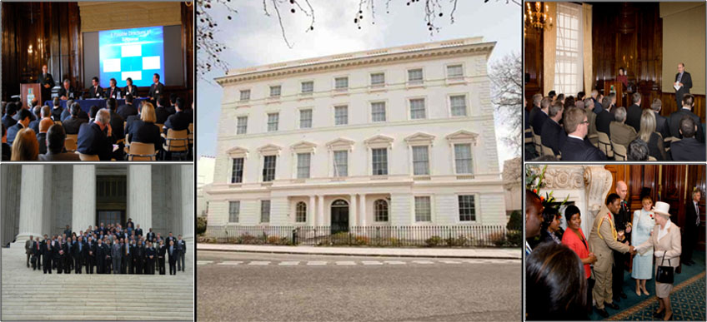
Royal College of Defence Studies (RCDS)
Prepares selected senior military officers, government officials and appropriate individuals from the private sector, from the UK and elsewhere, for senior leadership and management roles, by developing strategic understanding and the capacity for strategic thinking
11
Defence Academy
© Crown Copyright
Notes:
Update on colleges:
RCDS:
strategic thinking;
102 Members – 42 from UK; 60 from 50 countries
Military, civil servants, diplomats, private sector;
International Studies MA (King’s College, London).

Slide 12
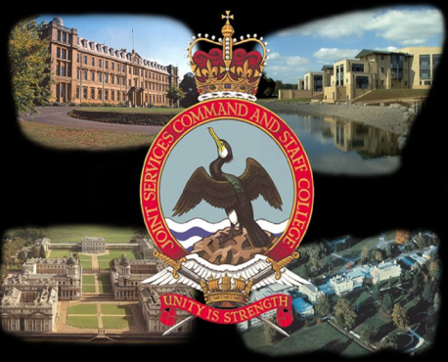
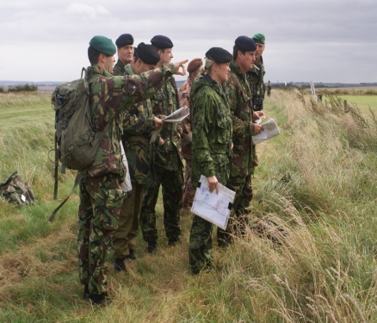
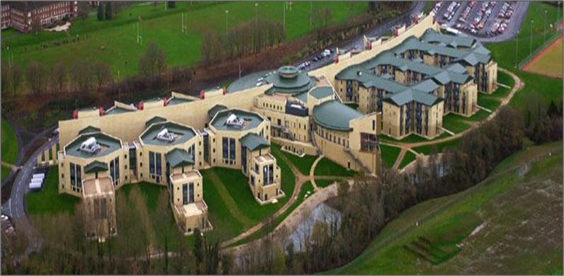
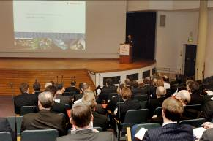
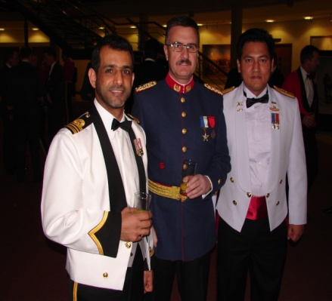
Joint Services Command and Staff College (JSCSC)
Provides world class Command and Staff education and training in order to enhance operational capability.
12
Defence Academy
© Crown Copyright
Notes:
JSCSC:
Brought together RN, Army and RAF Staff Colleges
Largest course is Advanced Command and Staff Course:
– Major/Lt Col level
– Over 260 – nearly 90 internationals from 49 countries
– UK members falling gently
– Reviewing course for post 2014
Intermediate courses still largely single Service
HCSC
– small increase in size (to 36) wef Jan 2013
Many bespoke courses

Slide 13
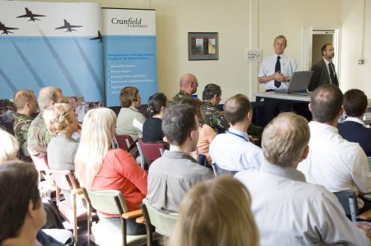
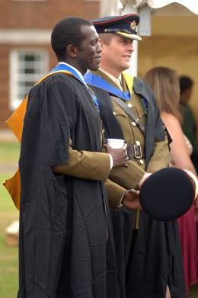
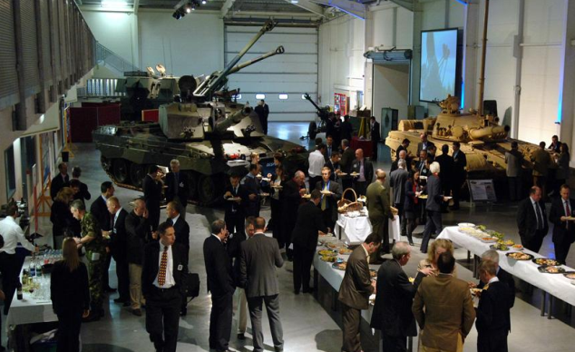
College of Management & Technology (DA-CMT)
Develops and delivers high quality education, training, research and advice in technology, management & leadership, acquisition and all aspects of Defence business in order to sustain and enhance Defence capability.
13
Defence Academy
© Crown Copyright
Notes:
The Part of the Academy with the widest range of courses – from corporate leadership through technology to languages – and subject to most change.
Generic management training has ceased – now provided by Civil Service Learning. College provides “defence-specific” or “defence-contextualised” training – particularly in support of the Defence Transformation programme.
Acquisition and technology T&E is being reviewed and adapted to ensure that it meets the needs of the new Defence Operating Model, ie delegation of capability management to the single Service Commands and JFC.
Other big development concerns language training ….

Slide 14
The Armed Forces Chaplaincy Centre
Develops, promotes and provides spiritual, moral and pastoral care, education and training in the Armed Forces in order to sustain service personnel and their families.

Slide 15
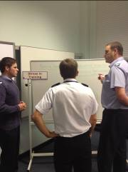
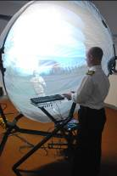
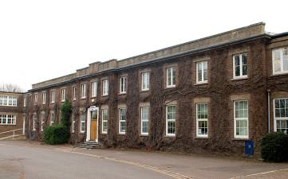
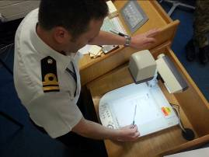
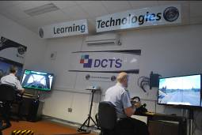
Defence Centre for Training Support
(DCTS)
Delivers Defence instructional staff and supervisor, training support specialist, training manager and learning technologies facilitation courses; provides bespoke learning technologies consultancy/advice on training application and implementation.
15
Defence Academy
© Crown Copyright
Notes:
Became part of the Defence Academy on 1 November 2012. Based in Kermode Hall at RAF Halton.
Outputs:
Defence Training Support and Instructional Courses. e.g Instruction Techniques, Train the Trainer, Course Design, Needs Analysis, Trg Audits etc
Training Policy and Support. Technical authors for Defence T&E Policy (JSP 822) and Defence Trg Sp Manuals (DTSMs).
Learning Technology (LT). Design, development and application of Defence related LT, encompassing simulation, emulation, e-learning. DCTS will also provide a consultancy service on LT based learning solutions.
Defence Learning Portal (DLP). Manages and develops as directed by the Defence E-Learning Delivery and Management Capability (DELDMC) and DLP Programme Board.
Course Franchising. Allows other trg organisations to deliver Defence Instructional Techniques (DIT) and Defence Train The Trainer (DTTT) courses under licence.
Instructor Accreditation. External accreditation of Service instructors against nationally recognised standards and qualifications.

Slide 16
A small cross-governmental civil service unit, housed by the Defence Academy but supported and governed by MOD, DFID, FCO and Cabinet Office
Helps HMG deliver its international priorities under the Building Stability Overseas Strategy (BSOS) and International Defence Engagement Strategy
By building public service capacity in selected countries, brokering/promoting civil service to civil service partnerships, managing ‘outreach’ (inward and outward visits)
16
Defence Academy
© Crown Copyright
Notes:
NSG disbanded end-March 2012. International consultancy team preserved and transferred to Defence Academy.
Origins of team go back to 1980s. Focus is governmental capacity-building, particularly finance and HR systems.
Complements Academy’s international work.

Slide 17
Where we were

Slide 18
Language Training - Challenges
MOD budget deficit / Planning Rounds / SDSR
Adverse financial climate
Re-validation of the requirement for C&L training
Implementation of an affordable training model

Slide 20
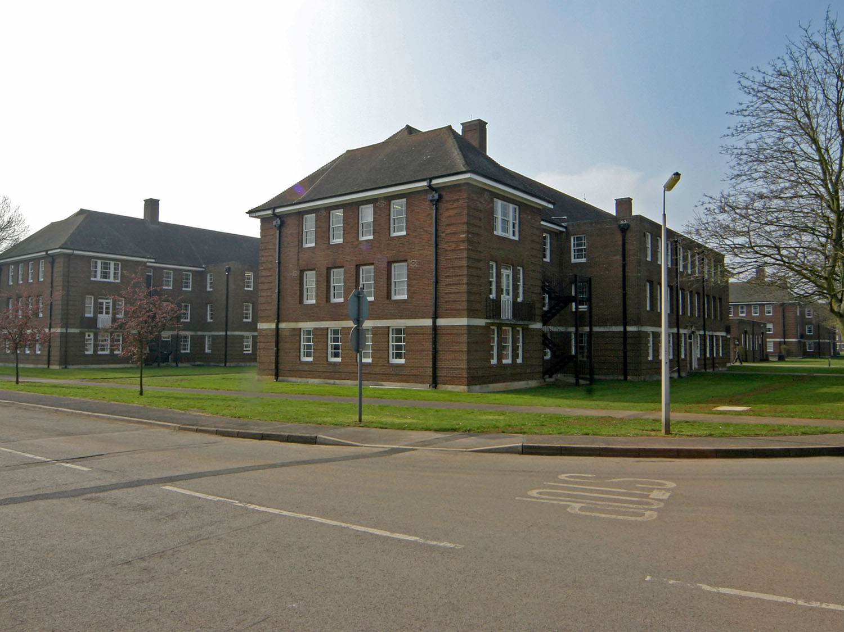
The Defence Centre for Languages & Culture
To provide English and Foreign Language training in order to enhance the UK’s Defence and Security capability, and to contribute to Defence Diplomacy.
IOC: 1 Sep 13
FOC: 1 Apr 14

Slide 21
HRH Prince Michael of Kent GCVO

Slide 22
“We need technology in every classroom and in every student and teacher’s hand, because it is the pen and paper of our time, and it is the lens through which we experience much of our world.”
David Warlick

Slide 23
CORE LANGUAGES
Arabic
Dari
English as a Foreign Language
Farsi
French
Pashto
Russian
Spanish

Slide 24
[dstl]
As a trading fund of the Ministry of Defence (MOD), the Defence Science and Technology Laboratory (Dstl) is run along commercial lines, accountable to government, to the taxpayer and to the UK Armed Forces we support in the field. Dstl’s work is funded by customer contracts from MOD.

Slide 25
‘To have someone on my team who understands the culture and speaks the language has been absolutely invaluable’ COS COM UKTG

Slide 26
INTERNATIONAL DEFENCE ENGAGEMENT STRATEGY
www.gov.uk / International Defence Engagement Strategy

Slide 27
CROSS-GOVERNMENT
FCO Language skills in Diplomatic Excellence initiative
MOD, DfID and other Departments engaged
E-Learning contract
Face-to-face training contract
Collaborative approach to exam procurement???
Accreditation
Training Synergies
Cross-deployments
Aptitude Testing
Cultural training
Technology Enhanced Learning (TEL)
Continuing Professional Development (CPD)
Notes:
Government direction is encouraging the public sector towards greater inter-Departmental cooperation to achieve cost efficiencies and best practice in all domains. In August 2011, the Foreign Secretary launched an initiative “Language Skills in Diplomatic Excellence” which MOD supports.
1. Led by the FCO, working with a number of Departments, a Cross-Government contract for E-learning has been signed with Rosetta Stone, achieving very significant cost savings compared to previous individual contracts. Rosetta Stone is not the panacea but will address some discrete requirements. We will continue to look at other, more Defence focussed, e-learning packages.
2. FCO has procured a cross-government contract for language training available for all Departments to use – this represents efficiencies of scale. We will have to be vigilant and ensure that when driving down costs, in the commercial environment, cost efficiencies do not come at the price of quality.
3. Next steps will include blended learning and scoping the art of the possible in terms of collaborative training for cross-cultural working.
4. Whilst both have their own language training centres, MOD and FCO have established clear potential for cooperation in the field of language training.
Shared Training: For Defence Diplomats designate, engagement with their Foreign Office colleagues in other aspects of the Defence Diplomacy training pipeline is considered to be one of its most valuable aspects, offering the opportunity to increase contextual knowledge of the FCO and to appreciate shared values. A bespoke, collaborative MOD/FCO C&L training programme, delivered in Central London where there are endless opportunities for local “immersion” would involve the expertise of our trainers from A to Z, would be designed from basic principles and delivered to meet the linguistic and cultural training needs, and to facilitate partnership and collaboration between MOD and FCO colleagues to support the one-team UK footprint in-country. We would however need to ensure that such a solution would not inadvertently jeopardise our organic capability for delivery of the wider Defence requirement.
Blended Learning: Offers more flexibility in training solutions. Possibility of delivering trg closer to where personnel live/work and residential trg when required. Cost effective and less disruptive.
Aptitude Testing: Whilst currently we use the Harvard Modern Language Aptitude Test (MLAT) to assess potential for language training, we are mindful that this is now an old test and that academic research is leading to more accurate predictors of success. With other Departments, we are assessing the potential for a pan-Government approach to aptitude testing.
External Accreditation: In line with Defence policy, we must look to have our language training accredited by an acknowledged qualifications awarding agency. In the UK there are currently only 2 awarding bodies able to cover the range of languages we teach: The Chartered Institute of Linguists covers 40 languages with its Certificate in Bilingual Skills and Asset languages covers 25 languages.
All this is very much work in progress (WIP). We are working to establish all the opportunities - and the risks

Slide 28
‘If the English language made any sense, lackadaisical would have something to do with a shortage of flowers.’ Doug Larson

Slide 29
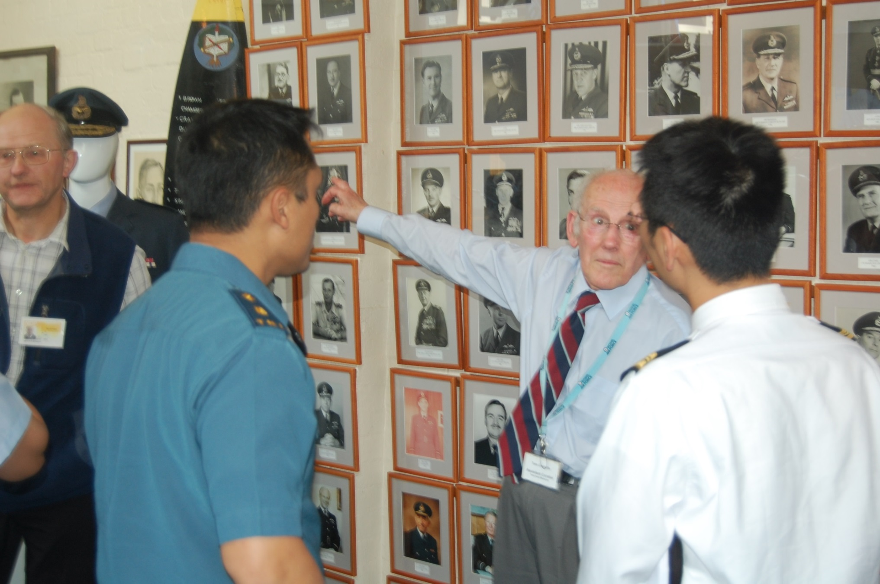
Initial enquiries to our Joint Training Requirements Authority - the Defence Operational Languages Support Unit (DOLSU)
DEFAC-HQ-TECDOLSUSO2TRAINTEG@mod.uk
Major Pauric Newland

Slide 30
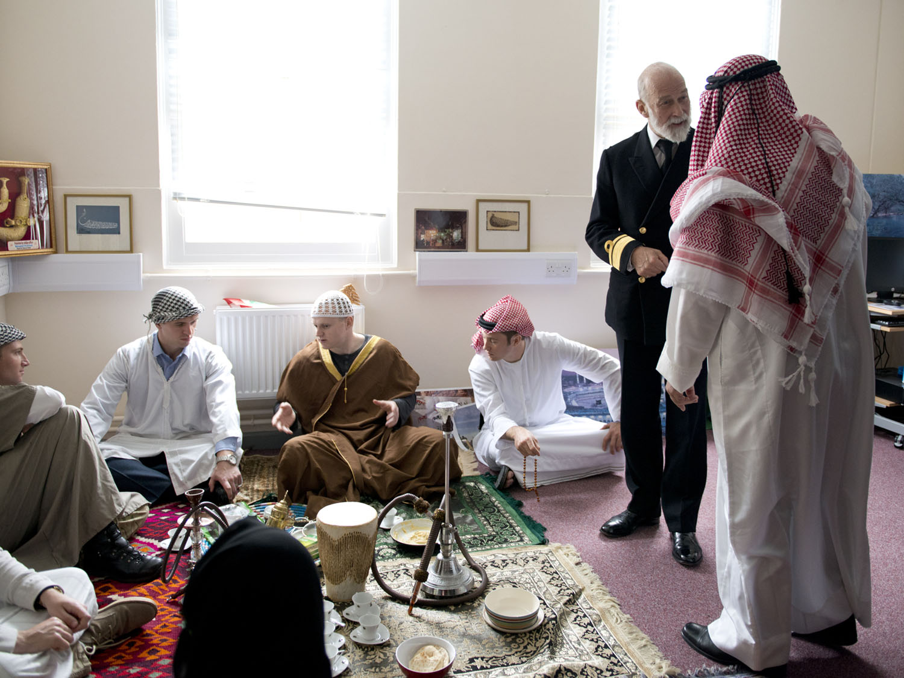
‘Culture is a little like dropping an Alka-Seltzer into a glass- you don’t see it, but somehow it does something.’
Hans Magnus Enzensberger

Slide 31
LEVEL | DESCRIPTOR
AWARENESS | Cultural Awareness provides a basic knowledge of cultural issues, an understanding of their importance and impact, and the ability to apply this knowledge to predictable scenarios to create desired effect. All MOD personnel are to have Cultural Awareness.
COMPETENCE/ PRACTITIONER | Cultural competence provides an intermediate knowledge of cultural issues, the comprehension of their importance and impact, the ability to apply this knowledge, skill and attitude to unpredictable scenarios. Personnel with duties specifically dealing with the local population, authorities or media are expected to have an intermediate knowledge of cultural issues.

Slide 32
LEVEL | DESCRIPTOR
EXPERTISE | Cultural expertise allows for the comprehension of the subject’s importance and impact, the ability to apply this knowledge and skill to unpredictable or specific scenarios, and analyse and evaluate the effect in order to contribute to Understanding throughout the operational cycle and influence planning from the earliest stages. Cultural Expertise is likely to be confined to Cultural Specialists in the Defence Cultural Specialists Unit (DCSU) and SMEs involved in Military Influence who require and advanced knowledge of cultural issues.

Slide 33
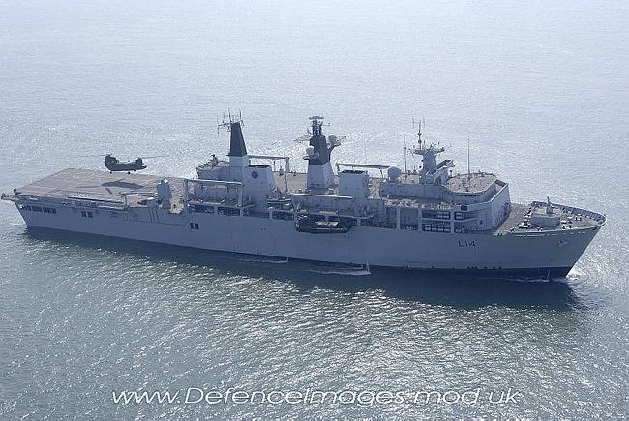
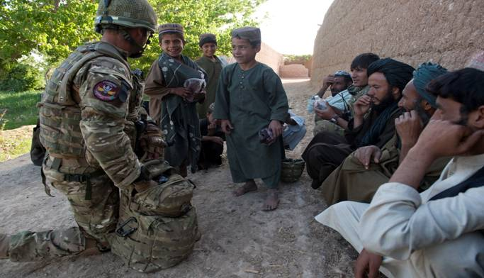
Established in April 2010
Mission – to improve Defence Cultural Capability
Main effort to date deployment of CULADS to support Op HERRICK (Afghanistan) and the UK Maritime Component
Integration of culture component

Slide 34
