Slide 1
DILIGENT DESIGN
Professional Seminar
13-18 October 2013
Stockholm, Sweden
Building blocks to maximize learning

Slide 2
models of instructional design

Slide 3
Establishing clear training goals

Slide 4
Learner centred models

Slide 5
BACKWASH EFFECT

Slide 6
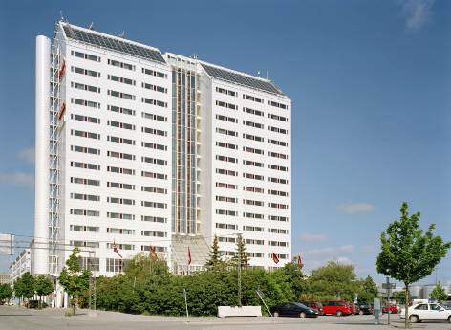
ARIADNE SCANDIC HOTEL

Slide 7
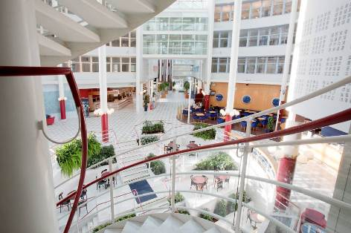

Slide 8
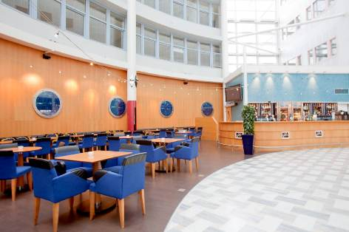

Slide 9
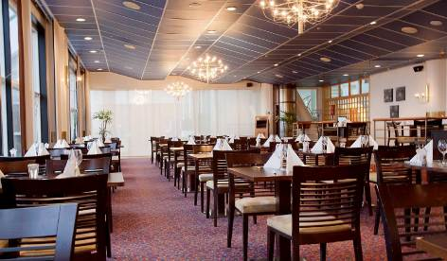

Slide 10
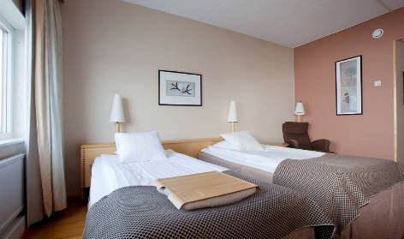

Slide 11
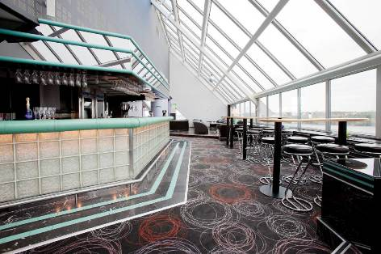

Slide 13
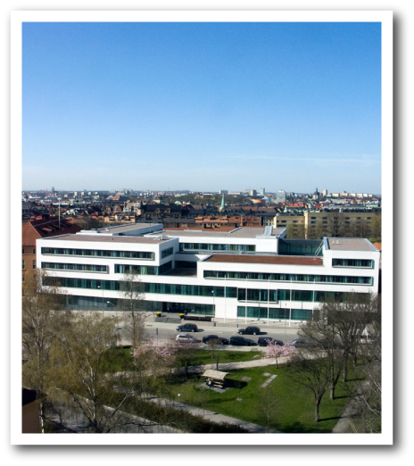
Notes:
The name 'Stockholm' easily splits into two distinct parts – Stock-holm, "Log-islet", but as no serious explanation to the name has been produced, various myths and legends have attempted to fill in the gap. According to a 17th century myth the population at the viking settlement Birka decided to found a new settlement, and to determine its location had a log bound with gold drifting in Lake Mälaren. It landed on present day Riddarholmen where today the Tower of Birger Jarl stands, a building, as a consequence, still often erroneously mentioned as the oldest building in Stockholm.^{[1]} The most established explanation for the name are logs driven into the strait passing north of today's old town which dendrochronological examinations in the late 1970s dated to around 1000. While no solid proofs exists, it is often assumed the Three Crown Castle, which preceded the present Stockholm Palace, originated from these wooden structures, and that the medieval city quickly expanded around it in the mid 13th century.^{[2]} In a wider historical context, Stockholm can be thought of as the capital of the Lake Mälaren Region, and as such can trace its origin back to at least two much older cities: Birka (c. 790–975) and Sigtuna, which still exists but dominated the region c. 1000–1240 — a capital which has simply been relocated at a number of occasions.^{[3]}

Slide 18
