Slide 1
2024 NATO BILC STANAG 6001 Testing Workshop Bergen, NORWAY
BILC INFORMATION BRIEFING
BILC Secretariat
Notes:
Welcome….
15th Anniversary of the STANAG 6001 Testing Workshop (75 years of NATO, 30 years of the Professional Development Seminar)

Slide 2
Bureau for International
Language Co-ordination
NATO’s consultative and advisory body for language training and testing issues
Main responsibility: custodian of STANAG 6001
Community of language teaching/testing professionals from MoDs and defense-sponsored organizations
Mission:
To promote and foster interoperability among NATO and Partner nations by furthering standardization of language training and testing.
To support the Alliance's operations through the exchange of knowledge and best practices, IAW established procedures and agreements.
Notes:
BILC has been NATO’s advisory body since 1966, and its involvement is integral to the implementation of strategic planning in NATO.
BILC is the custodian of STANAG 6001 (Edition 5, vr.2)
As the statement captures, our primary mission is to promote interoperability among NATO and partner nations through standardization of training and testing practices. Our goal is to foster the exchange of knowledge and best practices.

Slide 3
BILC Steering Committee
GBR (1966-1981)
DEU (1982-1996)
USA (1997-2008)
CAN (2008-2014)
USA (2014-2016)
BGR (2016-2019)
SVN (2019-2022)
HRV (2022-2025)
Chair
Irena Prpić Đurić
Senior Advisor
Dr. Ray Clifford
Secretaries
Suzana Horvat
Borjana Soldo
Associate Secretaries
Dr. Edelmira Nickels
Peggy Garza
Julie Dubeau
Jana Vasilj-Begovic
Notes:
BILC is comprised of three constitutional components: a. Members. b. The Secretariat. c. The Steering Committee.
This is our formal structure.
Participating nations are represented at BILC through a Steering Committee.
The Secretariat is accountable to its steering committee, which meets in person each year at the annual conference, but is informed and consulted year-round through email.

Slide 4
STANAG 6001 (A TrainP-5) ed. 5, ver. 2 Key to Interoperability
Language proficiency descriptions developed by BILC
Standardization Agreement = STANAG
Adopted by NATO in 1976
SLP (Standardized Language Profile) SLP 3232
Four numbers for Listening, Speaking, Reading, and Writing
0-5 scale (0: No Ability; L1: Survival: L2: Functional; L3: Professional; L4: Expert; L5: equivalent to a highly-articulate, well–educated native speaker)
SLPs in job descriptions, prerequisites for training, Language Capability Goals, Partnership Goals, etc.
BILC is responsible for periodically updating STANAG 6001
Notes:
The primary responsibility of BILC, as it has been mentioned, is to be the custodian of STANAG 6001. It is the standard that drives most BILC activities. It is not a how-to guide like other STANAGs, but a set of definitions of proficiency levels in 4 skills. Still, it is the standard to which we adhere, and forms the backbone of our training and testing systems. It influences what and how language is taught and tested.
It is also the guidance underpinning the serious subject of Standardized Language Profiles (SLPs), which are found in many basic personnel requirements, not to mention national directives and ministerial orders related to military personnel. It can be found on the BILC website.
At each Level there are separate descriptions of performance for each skill area. Taken together in the order Listening-Speaking-Reading-Writing, the corresponding 4 numbers form a Standardized Language Profile (SLP).

Slide 5
NATO Language Training Context
Each nation is responsible for own training & testing program.
Training durations vary greatly from nation to nation.
No common tests, only a common standard - STANAG 6001.
Nations certify their military with SLPs based on own STANAG - based tests.
Some nations have no tests.
Notes:
‹#›
“…English language is the foundation of interoperability…” Gen Ralston, former SACEUR
Still, in NATO, language training is a national responsibility, each nation is responsible for its training / testing program. There are no common tests - only a common standard - There is no central authority controlling language training, testing and accuracy of results. BILC can and does make recommendations, but BILC does NOT impose on national programs.
We in BILC are aware that testing methods vary, and interpretations of standard can cause differences in SLPs despite the fact that BILC has made huge progress with many nations through standardizing efforts. There are still a few nations who simply have not developed professional training and testing programs, yet still issue STANAG 6001 proficiency certificates. Furthermore, Nations may not be setting realistic training goals, for example, aiming to train all officers to level 3… This is an incredible challenge for most nations. In some nations, we know it is extremely difficult to find qualified teachers with this high level of proficiency.

Slide 6
Program of Work and Standardization Efforts
Plan the 3 annual main events and one biennial event:
Annual BILC Conference,
BILC Professional Development Seminar,
STANAG 6001 Testing Workshop; and
Military Terminology Conference
Organize & deliver specialized seminars & workshops;
Conduct research / special projects, & support nations;
Lead NATO DEEP visits to requesting NATO & Partner countries (language training & testing programmes, translation/terminology work);
Report to NATO HQ, ACT and others as required.
Notes:
So what does BILC concretely do to familiarize Partner nations with the STANAG 6001 standards and the methodology for testing to the standards. To assist them to reach a standard and interpretations of standards.
We have four main events. During our conferences, we discuss challenges common to military language training and produce reports, guidelines for the use of all of the interested nations. How long should training be to reach level 2 or 3? How do you operationalize the descriptors? How do you train testers? How do you develop reliable tests? Our conferences, seminars and workshops are themed to reflect current concerns or topical interests. They all promote the standardization of NATO and Partner nation teaching and testing systems by providing a forum for exchanging information, best practices, and new approaches in the language training, managing military terminology and testing field.
At each of them, you can meet people from teachers to school commandants, from testers to policy advisors, managers and practitioners;

Slide 7
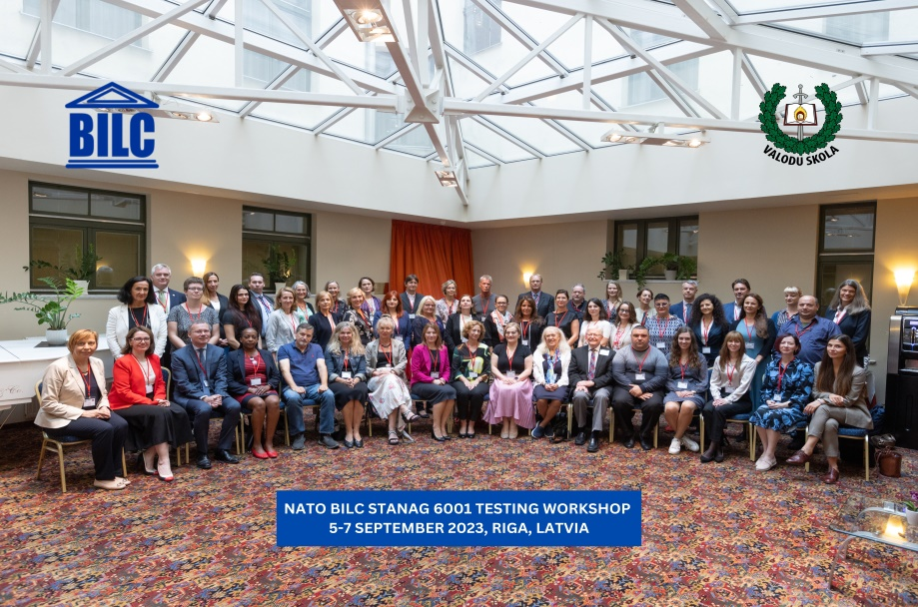
2023 NATO BILC STANAG 6001 Testing Workshop
Riga, LATVIA
5 – 7 September 2023
Theme: Furthering the Validity Argument by Keeping Pace with Technological Developments
Norming
Shared Item Bank accomplishments and practices
Utilizing AI and ChatGPT for test development
Neoclassical Statistical Analysis and IRT Models
Test development and administration in the digital age
(testing writing, authenticity)
Notes:
The STANAG Testing Workshop is explicitly intended for testing professionals/experienced testers.
The primary objectives of the Testing Workshop encompassed the promotion of standardization in language assessment, particularly in the domains of speaking and writing skills; the exchange of insights on the integration of AI technologies in language testing; the presentation of IRT and Neo-classical Statistical Analysis and their application for anchor item linking; and an overview of the Shared Item Bank Project, detailing its current achievements and potential future implications for the language testing community. These objectives were successfully met through a comprehensive program that included ten plenary sessions, seven specialized workshops, five digital poster presentations, and three expert panels. These platforms facilitated an exchange of ideas and best practices among specialists from 25 NATO and partner nations and two NATO bodies (ACO and NMI) on the aforementioned topics.

Slide 8
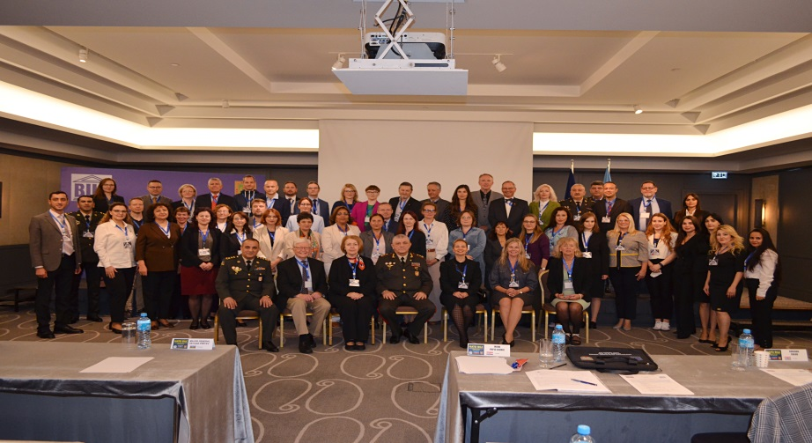
2023 NATO BILC Professional Development Seminar Baku, AZERBAIJAN 16 – 19 October 2023
Language Teaching Theory and the Teaching Practice: Are They Always in Synch?
What does it take to design a good LSP/ESP course: the importance of needs analysis in LSP/ESP course design
Principles of successful integration of general and LSP/ESP content and its assessment
Frameworks for evaluating the success of language programmes
Authenticity in curricula and test design
Interlinks between language, culture and training
Student perceptions of effective teaching practices
Language teaching theory
Enhancing teacher competence and performance through professional development
Native versus non-native teachers
Using technology tools to enhance instruction
Notes:
The seminar theme was “Language Teaching Theory and the Teaching Practice: Are They Always in Synch?”. It was introduced through 20 (twenty) presentations, four digital posters and a set of four simultaneous workshops.
At the end of each set of presentations, panel discussions were organized during which the participants had the possibility to further explore the topic with the presenters.
Focus on ESP/LSP
55 participants from 26 countries and ACO/SHAPE – practioners (teachers and testers)

Slide 9
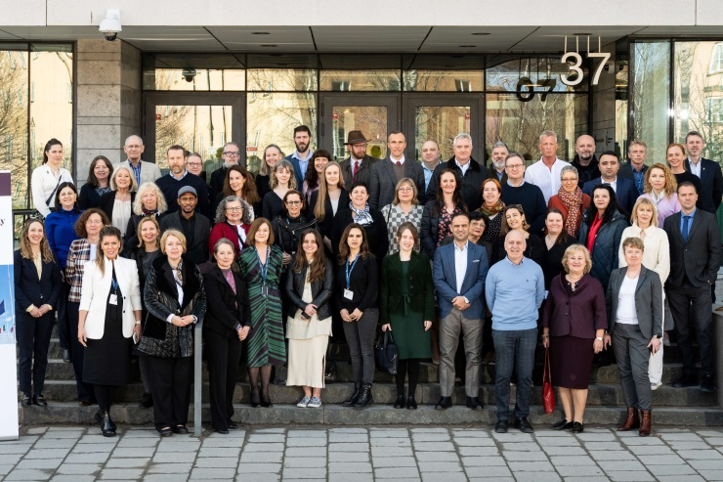
2024 NATO BILC Military Terminology Conference
Stockholm, SWEDEN
9 – 11 April 2024
Terminology Management in the 21st Century and the Potentials of New Technology
Applications of new terminology technology
Innovation in terminology within military education
Terminology management in multilingual settings
Understanding and curating emerging terminologies
Optimizing civil-military collaboration in terminology development
Challenges of defining military terminology
Notes:
Military Terminology Conference
Has been introduced to create opportunities for nations to collaborate in this field, to raise the awareness of the importance of terminology, to initiate terminology management discussions, interoperability, security, capability aspects, and challenges in terminology development.
Why? The military terminology is used in training and numerous documents, and it is essential that it be standardized with the help of linguists and translators. It is, therefore, important to establish close cooperation between military and language SMEs.
This is a biennial event, intended for terminologists, translators, proofreaders, interpreters, military SMEs-terminology developers, managers, ESP programme and materials developers.

Slide 10
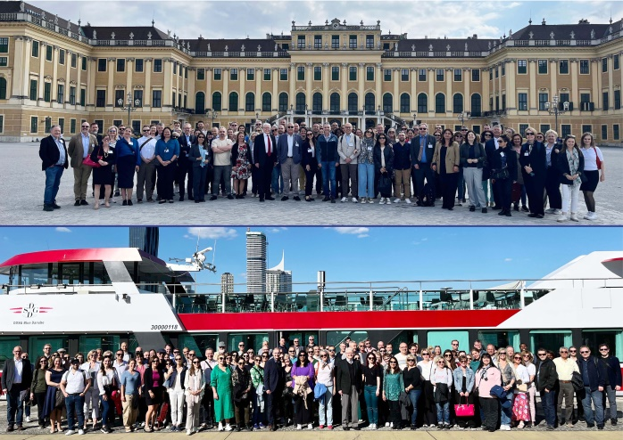
2024 NATO BILC Annual Conference Vienna, Austria 13 – 16 May 2024
“ZEITENWENDE”: Adapting Language Policy and Training Strategies to Meet New Requirements”
Current strategies, policies, and processes underpinning language training and testing in the light of
“Zeitenwende”
Providing a timely response to the ever-shifting training priorities in operational languages
The impact of the wars in Ukraine and the Middle East on language training strategies
New and old best practices in training to meet newly arisen needs
Establishing quality assurance processes for internally conducted or outsourced training
and testing
Developing methodologies to build robust training programs
Defining the optimal ratio of general versus specific training content
Implementing changes based on course evaluation and validation results
Designing effective ESP courses and measuring their success
Communicating effectively with higher-level decision-makers in order to inform and influence policy
The organizational value of having well-defined proficiency outcome standards when making data-driven decisions
Notes:
The annual BILC conference promotes standardization of NATO and Partner nation teaching and testing systems by providing a forum for the exchange of information, best practices and new approaches in the field of language training at higher levels (stakeholders).
TARGET AUDIENCE: Language training managers, language department heads, testing team heads....
______________________
There were 19 presentations on the theme given by BILC members and two (2) given by two guest speakers, i.e. HN high ranking officials. In addition, six study groups, led by distinguished professionals took place. (Defining Language policies, Developing ESP courses – for JTAC, and Aviation) – 98 participants from 35 countries and 2 NATO entities (SHAPE and NMI)

Slide 11
BILC Professional Development Programme in Partnership Cooperation Menu (PCM. i. e. ACT-sponsored BILC courses)
1. Language Testing Seminars (conducted at PLTCE):
Language Testing Seminar, ACT.647, 2 weeks;
Advanced Language Testing Seminar, ACT.658, 3 weeks;
Language Standards and Assessment Seminar, ACT.648, 2 weeks.
2. BILC Methodology Workshops
English Teaching Faculty Development Workshop “Teaching Speaking and Writing for Military Purposes”, ACT.659, 2 weeks. Conducted at 3 PTECs PLTCE, Bulgaria and Slovenia.
Facilitators: BILC teaching & testing experts from 24 nations.
Notes:
The Language Testing Seminars and the Advanced Language Testing Seminars help nations establish independent testing systems, train testers in test development and offer follow-up assistance. They are focused on making STANAG 6001 language tests in each NATO and partner country comparable to each other. Meaning that one country’s Level 3 is the same as another country’s Level 3.
Besides, there are two seminars that were developed for professional training of teachers. The Language Standards and Assessment Seminar is targeted at curriculum developers and classroom teachers who need to understand modern language assessment in regard to STANAG 6001. It deals with familiarizing teachers and language training managers with STANAG 6001, classroom-based assessment and the best methods for helping their students build language proficiency IAW STANAG 6001.
The English Teaching Faculty Development workshop addresses teaching writing and speaking to military personnel as teachers very often (being mostly civilians) have problems defining the formats and situations in which military use their speaking and writing skills.
These seminars are conducted by faculty and experts from many countries. While we offer seminars at PLTCE in Garmisch , the facilitators come from many different countries. Two additional Language school PTECs, in Bulgaria and Slovenia, host iterations of the Faculty Development Workshop as well.
BILC EVENTS AND SEMINARS/WORKSHOPS – ready-made training opportunities, participants share their experience and present experiments and lessons-learned.

Slide 12
SUPPORT TO PARTNER NATIONS
DEEP – Defence Education Enhancement Programme
(https://www.nato.int/cps/en/natohq/topics_139182.htm)
English is NATO’s operational language
Many DEEP military educational institutions have language programs
BILC is ready to continue to support DEEP
DEEP
BILC
Notes:
‹#›
BILC’s assistance to nations is at the forefront of the standardization efforts.
It assists nations in their attempt to reach a standard and interpretations of standards, as well as to enhance and reinforce language teaching and testing methods.
Most NATO and partner nations have relatively large communities of teachers who teach languages at different levels in various military institutions and often need more professional training. Following recommendations from several scoping and advisory visits, BILC started to provide in-country tailor-made faculty development workshops, which help nations to develop and consolidate their language training systems.
The visits and workshops are conducted at a nation’s request. Small teams of experts are formed and led by members of the BILC Secretariat and supported by SHAPE, DEEP, the George Marshall Center, and/or Partner Language Training Center Europe (PLTCE).
For the past two years most of these activities have been carried out under the DEEP umbrella since BILC has actively been supporting DEEP in its efforts to assist military educational systems build efficient language training and testing systems.

Slide 13
BILC focus – teacher/tester/translator training
Armenia - Finalising the policy paper called Roadmap of language training and testing
Azerbaijan - Support for STANAG 6001 testers and teachers on test development, Developing and designing ESP courses
Bosnia-Herzegovina - Continuous Professional Development of English instructors and testers
Colombia - Professional Development of English language instructors
Georgia - Continuous professional development for teachers of English, Support for STANAG 6001 testers on test development
Iraq - Professional Development of English language teachers, Testing IAW STANAG 6001
Jordan - Development of a language testing capacity IAW STANAG 6001
Kazakhstan - STANAG 6001 Testing
Mauritania - Scoping visit; Participation of HIE teachers/instructors in BILC events
Moldova
Mongolia
Tunisia (funded by DCB) - Establishment of language testing capacities
Ukraine - Continuous Professional Development for instructors of English, STANAG 6001 familiarization for language instructors and program managers, Support for STANAG 6001 testers on test development and statistical analysis
Scoping visits planned for autumn 2024

Slide 14
BILC support to DEEP August 2023 – August 2024
AZERBAIJAN
BOSNIA-HERZEGOVINA
COLOMBIA
GEORGIA
IRAQ
JORDAN
KAZAKHSTAN
UKRAINE

Slide 15
BILC WGs & Projects
Shared Item Bank Project
JTAC Working Group
STANAG 6001 Update – Focus Group

Slide 16
Shared Item Bank Project
Working Group:
Project goal:
To create a bank of reading and listening anchor items for Levels 1-3
Total of reading items designed: 47 (L1-12, L2-17, L3-18 items)
CANADA
CROATIA
ESTONIA
LATVIA
ROMANIA
SLOVENIA
SLOVAKIA 2020-2024
Notes:
The BILC Shared Item Bank project was launched in the beginning of 2020 and the working group is comprised of language assessment experts from seven countries: Canada, Croatia, Estonia, Latvia, Romania, Slovakia, and Slovenia. The main goal of this project is to create a bank of reading and listening anchor items for STANAG Levels 1, 2 and 3 in order to ensure that all nations using the STANAG 6001 Language Proficiency scale are normed in their interpretation and application of the standard, and that their items and tests are at the intended STANAG level. Testers from NATO and partner nations will be able to choose items from the item bank and include them in their own national reading and listening tests to serve as anchor items.
So far, reading items have already been trialled out on over one thousand people and statistical analyses have been conducted, as well as final items selected. These items are now ready for use. Six sample items can be viewed on the BILC website. The working group (WG) produced guidelines on the use of the items, as well as a written report on how they were developed. In addition, a non-disclosure document will be sent to interested nations.
Listening items are currently being developed. They will be pre-tested and the working group will request assistance from nations.

Slide 17
Shared Item Bank Project
READING ITEMS
SHARING WITH NATIONS
PREREQUISITES FOR SHARING:
ESTABLISHED TESTING TEAM
LIVE READING TEST
PRETESTING IN 2023
16 COUNTRIES
1,000 CANDIDATES
STATISTICAL ANALYSIS: CTT, IRT
14 ANCHOR ITEMS:
(L1-4, L2-3, L3-7)
6 SAMPLE READING ITEMS
(NATO BILC website)

Slide 18
Shared Item Bank Project
LISTENING ITEMS
Development and moderation of listening items – ongoing process
Inviting nations to join pre-testing efforts in 2025
Future of the SIB Project: launching a new cycle with an expanded Working Group

Slide 19
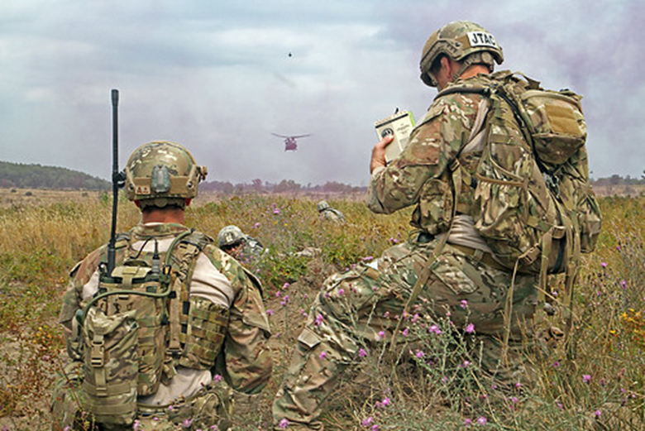
Findings from the 2023 BILC JTAC WG Study
JTACs have a language requirement – SLP 3332
There is misalignment between the STANAG 6001 Level 3 General Proficiency test tasks and the actual JTAC target language use tasks
Unique JTAC linguistic tasks
Communicating under pressure
Demonstrating interactional competence in a
dynamic multinational environment
Comprehending multimodal communications
from digital and human sources
Timely responses with clear pronunciation

Slide 20
BILC Recommends a Dual Approach
The BILC JTAC WG is currently consulting with JTAC SMEs to develop integrated skills performance test tasks, considering the ICAO scale for rating purposes
At the May 2024 BILC Conference, a Study Group recommended
Consulting with SMEs to develop a JTAC-specific language course based on authentic target language use contexts
An exit test, considering both ICAO and STANAG 6001 scales
This Photo by Unknown Author is licensed under CC BY-ND

Slide 21
STANAG 6001 Working Group
Periodic reviews of STANAGs are expected
Noted inconsistencies and inadequacies in French led to opportunity to revisit overall standard
Ongoing discussion on the native speaker as reference point
New contexts of language use, new text genres (social media, etc.)
Focus Group was formed, and consultations began; survey sent out to all POCs
SC approved WG status
Notes:
BILC, as STANAG 6001 custodian, is expected to review the standard periodically. This is expected by the NSO, however, BILC has not reviewed the content of STANAG 6001 in approximately two decades.
At the 2022 BILC Professional Development Seminar in Utah, the French delegate presented on the inconsistencies of the French translation of the STANAG 6001, highlighting some translation flaws, and the fact that the French version did not reflect current socio-cultural norms of the French language.
BILC community members have commented frequently that the time has come to modernize the STANAG, the concept of the native speaker as the reference has been criticized in recent literature and removed from some other well-known scales, such as the ILR, to address the multinational context of language use, and to add general defense and NATO examples and context;
Members have also requested an update to contexts as some are deemed obsolete and others have emerged.
Therefore, the secretariat formed a Focus Group, comprised of several members of the secretariat, and members from Estonia, France, the Netherlands, and Norway, with the purpose of assessing the extent of the review and proposing the way-ahead.
As BILC constituents had remarked in the past on some difficulties with using the STANAG descriptors, the Focus Group developed a survey asking nations to make suggestions on the potential improvements.
Feedback from approx. two dozen nations was obtained feedback from the survey showed that surveyed nations were in favour of making improvements to the scale, and that they were also overwhelmingly in favour of removing the native speaker concept and replacing it with a reference to an exceptionally high proficiency regardless of how it was acquired.
At the Annual BILC Conference in Vienna, in May 2024, the Steering Committee approved the change of status from Focus Group to Working Group.
The WG informed the SC that:

Slide 22
STANAG 6001 Working Group
The levels will not change: no changes to tasks or functions
The STANAG updates will be co-written in English and French
Goal is to remove overlap as much as possible so that the tasks, content/context, text type, and accuracy statements are independent from each other
Goal is to re-sequence the existing statements in a ‘regular’ sequence from skill to skill and level to level
Intent is to add very general military, multi-national flavour.
Notes:
There is absolutely NO intention of changing the levels; the standards would remain the same, all the tasks would remain the same, in both French and English.
The STANAG updates would be co-written in English and French to ensure that the standard was equivalent in both NATO languages
Goal is to remove overlap as much as possible so that the tasks, content/context, text type, and accuracy statements are independent from each other.
Goal is to re-sequence the existing statements in a ‘regular’ sequence from skill to skill and level to level; the WG will be resequencing some statements within each level to make it more user-friendly.
Members have said that there are benefits to adding some general military contexts and non-specialised lexical elements to the scale.

Slide 23
STANAG 6001 Working Group
While consensus has been reached on the removal of the native-speaker reference or construct; however, the exact term has not been confirmed. Goal is to define proficiency in terms of a ‘speaker’ who demonstrates exceptional mastery of the language, without reference to ‘nativeness’.
We aim to first review level 2 speaking descriptors across all skills, and potentially send that out for consultation, to expert reviewers (TBD and TBC).
WG will begin with the base levels.
Notes:
The feedback from the survey showed that nations were in favour of removing the native speaker concept and replacing it with a reference to an exceptionally high proficiency regardless of how it was acquired, however, the exact term has not been confirmed.
We aim to first produce level 2 across all skills and possibly send that out for consultation, to expert reviewers (TBD and TBC).
The WG is currently in the process of mapping out the way ahead, and the estimated timeline for a completed draft update of STANAG 6001 (Base Levels) has been tentatively planned for the next 3-4 years.
While this timeline may appear to be somewhat unambitious, one must consider that all work is performed through voluntary national contributions (VNC), by professionals who have other full-time functions.

Slide 24
BILC site – www.natobilc.org

Slide 25
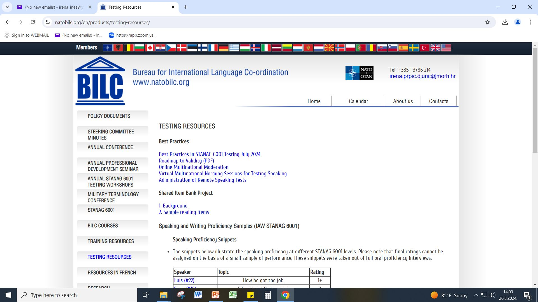
Notes:
This is a snapshot of the TESTING RESOURCES menu.
BEST PRACTICES IN STANAG 6001 Testing – as of July 2024
Roadmap of Validity
Tester Toolbox
Guidelines for Establishing National STANAG 6001 Testing Teams
Norming and Item Moderation video tutorial with Nancy Powers
Self Assessment for National STANAG 6001 Testing Programs (PDF)
Suggestions for STANAG 6001 Tester Training (PDF)
Item Review Checklist (PDF)
Overview of Listening Text Characteristics (PDF)
Overview or Reading Text Characteristics(PDF)
STANAG 6001 Speaking Assessment Criteria (PDF)
STANAG 6001 Writing Assessment Criteria (PDF)
STANAG_6001_Levels_1-3_Summary_Review_on_Receptive_Skills_Testing (PDF)

Slide 26
Introduction to the 2024 STANAG 6001 Testing Workshop
Theme: Plug & Play: Sustaining Validity Through Multinational Collaboration
Moderation of reading and listening items; rater norming for assessing speaking and writing
Integrating AI tools in test development and rating practices
Building professionalism in the testing cadre
Test development and administration in the digital age (testing writing, authenticity)
Workshop Activities:
Presentations
Parallel sessions
Workshops
Moderation and norming sessions
Posters
Sharing of findings from research and special projects
Workshop Goals: Norming; Sharing; Planning Course Updates, New Projects & New Directions

Slide 27
Updates & New Directions
BILC Website, Testing Resources page
How is the BILC testing community keeping up with the times?
Neoclassical Test Theory, IRT & Anchor Items
Jamovi, open-source statistical program
ChatGPT for test development & rating practices
Testing writing in the digital age
More sharing of national practices
BILC Policy Recommendation on generative AI

Slide 28
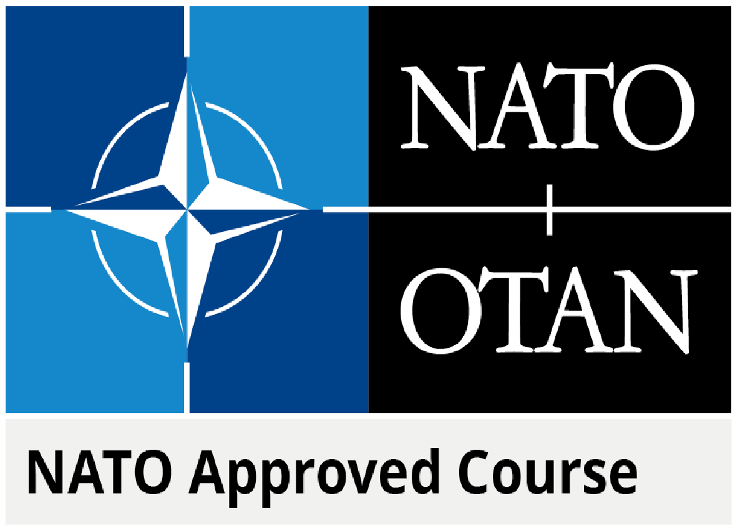
Continuous Improvement
Feedback from participants and facilitators
NATO-approved testing courses:
Language Testing Seminar (LTS)
Advanced Language Testing Seminar (ALTS)
Trends in the field, based on professional conferences, associations, SIGs, webinars
Findings from annual STANAG 6001 testing workshops

Slide 29
Contacts:
BILC site https://natobilc.org
Email : irena.prpic.djuric@morh.hr
BILCteam.hrv@gmail.com

Slide 30
THANK YOU FOR YOUR ATTENTION!!!
💛

