Slide 1
COVID-19 Lessons Learnt: Prospective of the CZ UoD Language Centre BILC Annual Conference May 24th, 2022
1
Colonel (GS) Assoc. Prof. Ing. Vladan Holcner, Ph.D.

Slide 2
Presentation Outline
1. Introduction
2. Impacts of Covid-19 on the Czech military education
3. Approach of the UoD LC to cope with the pandemic restrictions
4. Key Lessons Learnt
5. Conclusion
2
Colonel (GS) Assoc. Prof. Ing. Vladan Holcner, Ph.D.

Slide 3
Presentation Outline
1. Introduction
2. Impacts of Covid-19 on the Czech military education
3. Approach of the UoD LC to cope with the pandemic restrictions
4. Key Lessons Learnt
5. Conclusion
3
Colonel (GS) Assoc. Prof. Ing. Vladan Holcner, Ph.D.

Slide 4
1. Introduction
Czech UoD Language Centre responsible for:
Language testing (incl. STANAG 6001);
Language training for UoD cadets/students;
Language training within courses for Mod/Armed Forces personnel.
Before 2020, technologies like VTC used just marginally.
4
Colonel (GS) Assoc. Prof. Ing. Vladan Holcner, Ph.D.

Slide 5
Presentation Outline
1. Introduction
2. Impacts of Covid-19 on the Czech military education
3. Approach of the UoD LC to cope with the pandemic restrictions
4. Key Lessons Learnt
5. Conclusion
5
Colonel (GS) Assoc. Prof. Ing. Vladan Holcner, Ph.D.

Slide 6
2. Impacts of Covid-19 on the Czech military education
The 2020 first wave meant total lockdown for the country, incl. military education (all activities interrupted for more than 2 months).
Subsequent waves connected with restrictions regarding travel, numbers of participants, physical presence of participants in classes/testing rooms etc.
Repeated switching between presence and on-line form of language education (overall or selective/preventive).
6
Colonel (GS) Assoc. Prof. Ing. Vladan Holcner, Ph.D.

Slide 7
Presentation Outline
1. Introduction
2. Impacts of Covid-19 on the Czech military education
3. Approach of the UoD LC to cope with the pandemic restrictions
4. Key Lessons Learnt
5. Conclusion
7
Colonel (GS) Assoc. Prof. Ing. Vladan Holcner, Ph.D.

Slide 8
3. Approach of the UoD LC to cope with the pandemic restrictions
General changes:
Changes in communication with students and candidates.
Necessity to use adequate HW and SW (+ connection).
Introduction of all personnel to handling with MS Teams and further tools and applications (differing attitudes, abilities, gradual improvements, first organized and subsequently informal sharing of best practices).
Introduction of students to MS Teams.
Administrative consequences.
8
Colonel (GS) Assoc. Prof. Ing. Vladan Holcner, Ph.D.

Slide 9
3. Approach of the UoD LC to cope with the pandemic restrictions
Changes in teaching languages:
Decreased sizes of the classes (subgroups).
Changed scope of compulsory lessons, more voluntary individual consultations.
Adapting to a different nature of interaction within the class (e.g. lower flexibility for role plays – problem of limited emotions sharing in on-line environment).
Changed structure of the lessons (focus on speaking and listening while writing concentrated to homework, partial elimination of regular weekly progress testing).
Necessity to adapt to the tempo/abilities of students to handle on-line education (problem with lower level courses and lower ranks, differing levels of equipment, connection and environment for studying on-line).
9
Colonel (GS) Assoc. Prof. Ing. Vladan Holcner, Ph.D.

Slide 10
3. Approach of the UoD LC to cope with the pandemic restrictions Changes in language testing
Distance Testing
No epidemic risk
No control of correctness (candidate identity, elimination of the use of different aids, tests recording/dissemination etc.
INACCEPTABLE!
Traditional (Face-to-Face) Testing
High epidemic risk (travelling of candidates, personal contacts among candidates and testers)
Traditional high control over testing correctness
IMPOSSIBLE/PROHIBITTED DURING PANDEMIC PEAKS
Compromise - Hybrid Approach
10
Colonel (GS) Assoc. Prof. Ing. Vladan Holcner, Ph.D.

Slide 11
3. Approach of the UoD LC to cope with the pandemic restrictions
Hybrid Testing Model: listening, reading and writing
Test planning/ assignment
Web-based testing
Testing team: test management
Testing location A
Admin.
Web-based testing
Web-based testing
UoD server room:
ETIS database
Admin.
Testing location B
Testing location C
Admin.
11
Colonel (GS) Assoc. Prof. Ing. Vladan Holcner, Ph.D.

Slide 12
3. Approach of the UoD LC to cope with the pandemic restrictions
Hybrid Testing Model: speaking
Videoconference testing
Pair of testers
Testing room A
Videoconference testing
Waiting room - candidates
Testing room B
Admin.
Pair of testers
Videoconference testing
Pair of testers
Testing room C
12
Colonel (GS) Assoc. Prof. Ing. Vladan Holcner, Ph.D.

Slide 13
Presentation Outline
1. Introduction
2. Impacts of Covid-19 on the Czech military education
3. Approach of the UoD LC to cope with the pandemic restrictions
4. Key Lessons Learnt
5. Conclusion
13
Colonel (GS) Assoc. Prof. Ing. Vladan Holcner, Ph.D.

Slide 14
4. Key Lessons Learnt
On-line language teaching is possible and can be an effective option (measured by graduates success).
Regular presence form of language training has been enriched (on-line/interactive tools make learning more attractive, primarily for the young generation of UoD cadets).
On line edcuation means higher demands on teachers preparation and performance (mainly planning, classroom management, awareness of more difficult concentration of students´ attention).
Not only teacher but also students must be prepared for on-line education (technology, organization – superiors, environment).
On-line or blended learning means greater autonomy and responsibility of students (can be advantage as well as disadvantage).
Hybrid testing model provides more flexibility, does not decrease success rate but generally, is not prefer by candidates and testers.
14
Colonel (GS) Assoc. Prof. Ing. Vladan Holcner, Ph.D.

Slide 15
Presentation Outline
1. Introduction
2. Impacts of Covid-19 on the Czech military education
3. Approach of the UoD LC to cope with the pandemic restrictions
4. Key Lessons Learnt
5. Conclusion
15
Colonel (GS) Assoc. Prof. Ing. Vladan Holcner, Ph.D.

Slide 16
5. Conclusion
The pandemic restrictions have forced the UoD LC to many innovations, most of them beneficial even in „normal“ teaching/learning process.
Application of on-line and interactive tools and supports has made the performance of the UoD LC more flexible.
The UoD LC is better prepared to further waves or to potential “new standard“ for education.
16
Colonel (GS) Assoc. Prof. Ing. Vladan Holcner, Ph.D.

Slide 17
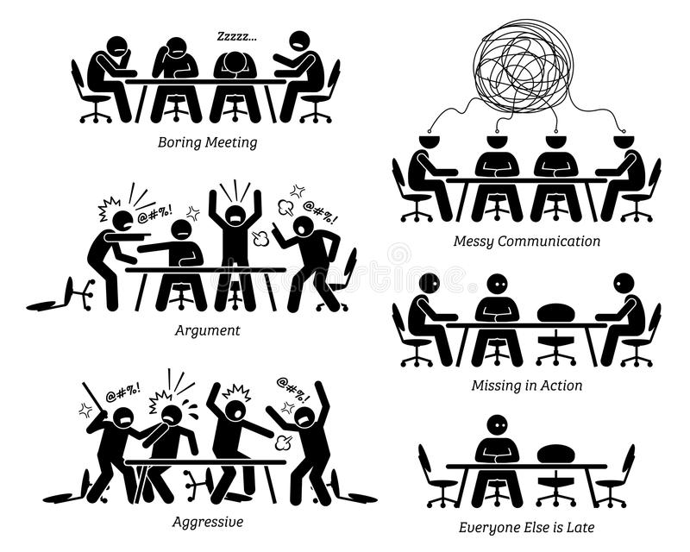
Thank you for your attention!
Questions?
17
Colonel (GS) Assoc. Prof. Ing. Vladan Holcner, Ph.D.

Slide 18
COVID-19 Lessons Learnt: Prospective of the CZ UoD Language Centre BILC Annual Conference May 24th, 2022
18
Colonel (GS) Assoc. Prof. Ing. Vladan Holcner, Ph.D.

