Slide 1
THE GOOD, THE BAD AND THE UGLY The Nexus between Strategic Vision, Learning Goals and Course Design
Emilie Cleret
Senior Advisor to the President of the French Defence University
Chief Academic Officer for English Studies

Slide 2
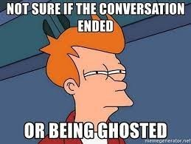

Slide 3
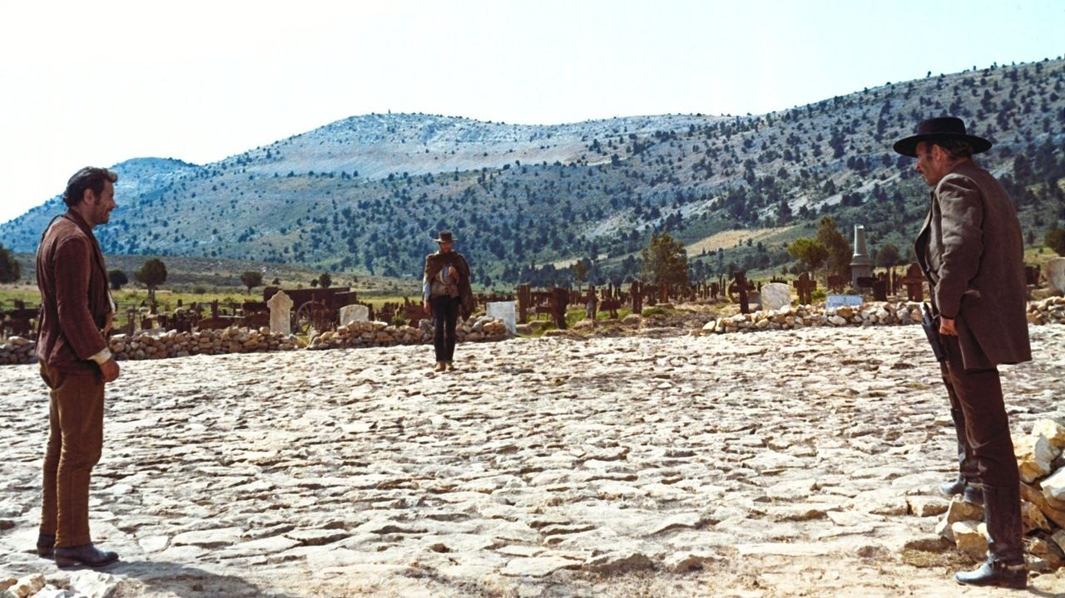

Slide 4
Vision stratégique/Mission
Principes pédagogiques
Compétences / Outils d’évaluation
Learning Goals
Learning Objectives
Learning Outcomes
Language
What learners produce
thanks to
Critical thinking
Instruction
Instruction
Analysis
Discussion
Transfer of content
Analysis /
Case Study
Professional
Creativity
Discussion
Measurable
Observable
EXAMS

Slide 5
The Military
Decision-Makers
Teachers
Serving
 | Professional | Language
Learning Goals – From Strategic to Operational
Learning Objectives
Learning Outcomes
Exams/Tests
Express Needs
Identified by the military
Must NOT be solely linguistic
(they don’t want language experts)
Teaching staff’s mission:
Needs analysis to design relevant language course with consistent activities
Head of Department
Need to convince commanding staff and students
Constantly need to convince that the learning objectives are the most relevant to achieve the learning goals
Teachers
Guidelines for the teachers
Students
Boundary difficult to pass

Slide 6
STUDENTS’ PERCEPTION OF AN ENGLISH COURSE
OBJECTIVE CRITERIA
NO | YES
HAS NEVER SERVED IN AN ENGLISH-SPEAKING ENVIRONMENT | HAS SERVED IN AN ENGLISH-SPEAKING ENVIRONMENT
+ | +++ If the course is well designed | I LOVE ENGLISH | YES | SUBJECTIVE CRITERIA
--- | + Has experienced the need | I HATE ENGLISH | NO

Slide 7
The Military Decision-Makers
Teachers
Serving
 | Professional | Language
Learning Goals | Identified by the military Must NOT be solely linguistic (they don’t want language experts) Need to convince commanding staff and students | Teaching staff’s mission: Needs analysis to design relevant language course with consistent activities
Learning Objectives | Constantly need to convince that the learning obejctives are the most relevant to achieve learning goals | guidelines for the teachers
Learning Outcomes
Exams/Tests
Express Needs
Head of Department
Teachers
Professional skills acquired
Command of language in a specific professional environment
Students
?
PLS 4
PLS 3
TOEIC
Boundary difficult to pass

Slide 8
External decision-makers
Learning goals and outcomes
?
Motivation
Teacher / Learning facilitator
Learners
Pedagogy

Slide 9
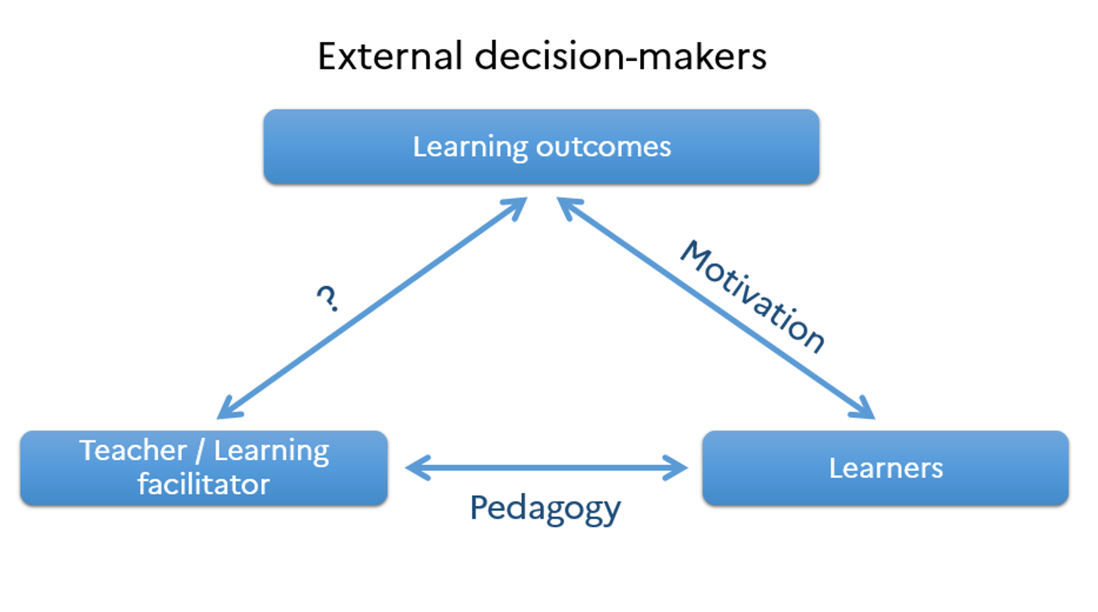
PAST
PRESENT
Delivered by employees
Ownership
&
Autonomy

Slide 10
EFFECTIVE COMMUNICATION WITH DECISION-MAKERS
Kill the myth of the divine general
Find your silver bullet and use it
The importance of framing
Anatomy of an argument (Toulmin model)
Claim
Warrant
Impact

Slide 11
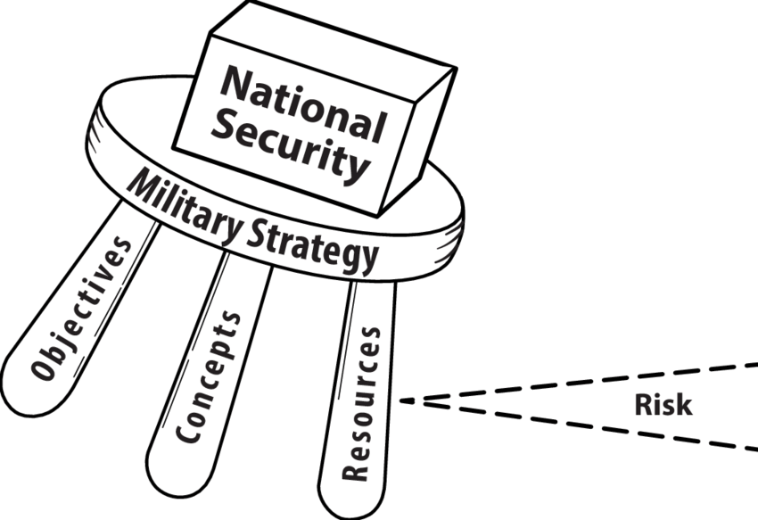
CLAUSEWITZ
ENDS
WAYS
MEANS
ART LYKKE

Slide 12
RECAP OF THE SOLUTIONS YOU HAVE
KILL THE PIPE DREAM OF THE PERFECT SYLLABUS
DON’T PLAY MILITARY, YOU ARE NOT QUALIFIED
SPARE THEM THE LANGUAGE NERD BANTER
DON’T KILL THE MOOD WITH YOUR PASSION FOR THE LEARNING PROCESS
DON’T BEG FOR THEIR ATTENTION
NO VICTORY LAURELS TO REST UPON – KEEP GOING
NEVER CONFRONT, PREPARE, PUSH BACK AND NEVER GIVE UP

Slide 14
