Slide 1
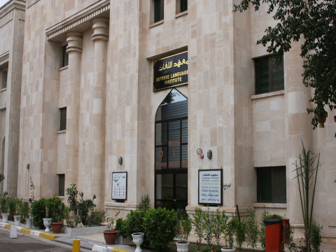
D
L
I
Presented by
S.M.Gen
Al Hamami
Notes:
1

Slide 2
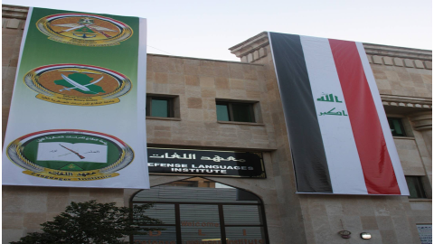
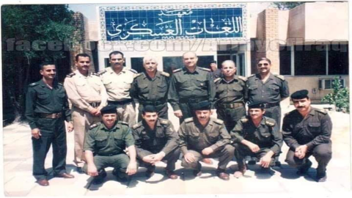
History
- The Defense Languages Institute traces its formal beginning to 1986 at the Al- Rasheed Military Base in Baghdad where foreign languages were taught.
- In 2006, the Iraqi Ministry of Defense re-established the Defense Languages Institute under the control of the Defense University for Higher Military Studies.
2006
1986

Slide 3
To teach Ministry of Defense personnel foreign languages through basic and
advanced courses, and provide appropriate training and support
to upgrade and enhance the capabilities of the Iraqi army
To teach and train Armed Forces personnel in foreign languages
To Cooperate & Coordinate with the foreign institutes
To enhance the level of our faculty through courses &workshops
Twinning with European institutes (Cert.)

Slide 4
Chain of Command
M.O.D
Army Chief of Staff
DUHMS
Defense Languages Institute
Notes:
4

Slide 5
Organizational Structure
HQ
Commandant
Security
Deputy
Logistics Officer
Staff Administrative
Database Section
Data Base Section
Section Manager
3rd Pay Grade
Oriental Languages Dept
European Languages Dept
Officers
22
Persian
Section
English
Section
NCOs
30
Kurdish/Arabic
Section
German/French
Section
Civilians
43
Total
95
Turkish/Hebrew
Section
)
Italian/Spanish
Section
Korean
Section
Russian.
Section

Slide 6
National Defense College
War College
Staff College
Institutions associated
with the University
Strategic Studies and Research Center
Defense Languages Institute
Command College

Slide 7
COURSES

Slide 8
Duration of Course
Course
Institution
English language course
Intensive
Defense Languages Institute
(5) months
(3) Months
Persian language course
Turkish language course
Kurdish language course
Arabic language cource
French language course
Italian language course
Russian language course
German language course
Spanish language course
Hebrew language course
Non Intensive
Notes:
8

Slide 9
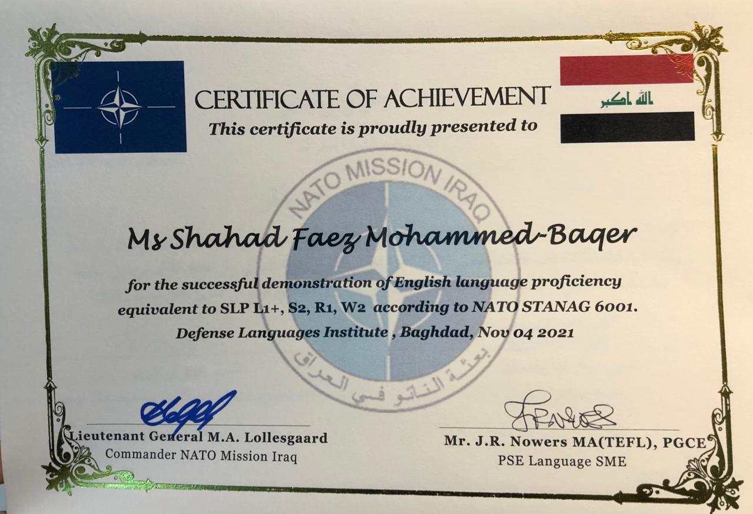
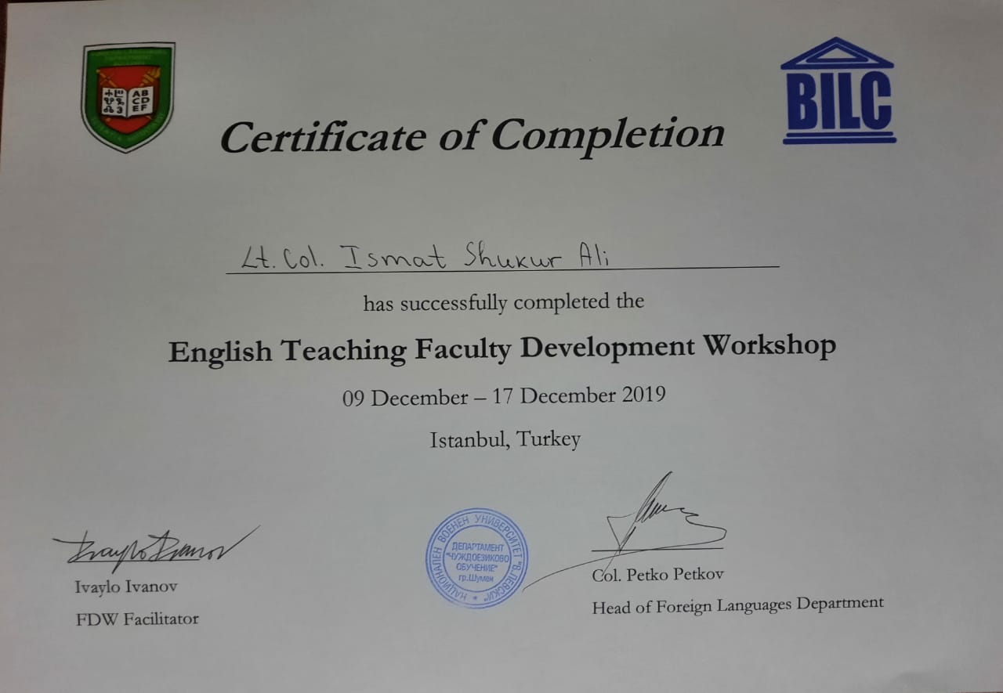
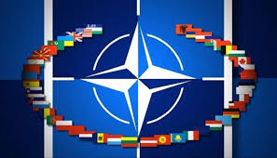
Certificates
Certificate of participation recognized by NATO countries

Slide 10
State Administration
National Defense College 50
Strategic Level
The Levels of Studies
Iraqi War College 150
Operational level
Staff College 75
Command College 50
Tactical Level
Military College 300

Slide 11
Challenges;
Courses Requirements
ECL
NATO
Standards
Infrastructure
E learning
Language Sustainability
Online Teaching
Bilateral Assistance

Slide 12
Achievements
University Certificates for
Ph.D
&
Masters
NATO Standards
STANAG 6001
Testing
Group
Instructor
Exchanges
NATO
OSC-I
SUPPORT
Cooperation with Baghdad University
Center of
Languages
In Iraq

Slide 13
SUGGESTIONS
Notes:
13

Slide 14
HEADQUARTERS
FOR ALL

Slide 15
Thank you for listening

