Slide 1
Defense University of Higher Military Studies
Defense Language Institute
English Language Section

Slide 2
English Language Section
English Language Faculty
Types of Courses
Classrooms
ALC Curriculum Limitation & Challenges
Students Requirements
Testing System

Slide 3
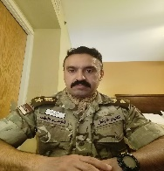
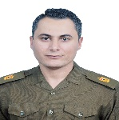
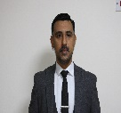
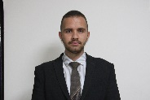
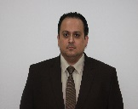
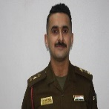
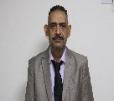
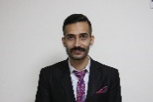
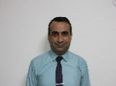
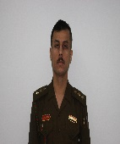
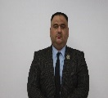
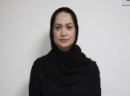
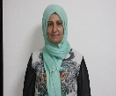
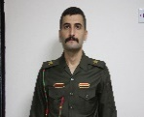
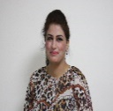
English Language Faculty
Col Faez Mamoori
Head of English Language Section
(BA,GE-BALIC-AELIC)
Military Instructors
Civilian Instructors
Testing
Cell
Maj Ali K
(T3 Course)
Mr. Mohammed
(BA,T3,BALIC)
Mr. Abdullah
(BA,T3)
Mr. Wisam
(BA,BALIC,AELIC)
Maj Ali A
(T3 Course, BALIC, MELT)
Mr. Yossif
(BA, MELT, ALPS1)
Mr. Karrar
(BA,T3)
Mr. Kareem
(BA,BALICC)
Capt Omar
(T3 Course, BALIC, AELIC)
Mr. Safaa
(BA,BALIC, MACS)
Ms. Roa
(BA,T3)
Ms. Shatha
(BA,T3)
Ms. Sarah K
(BA,T3)
1st Lt Waleed
(T3)
Ms. Mariam
(BA,T3)
Ms. Sarah F
(BA,T3)

Slide 4
Types of Courses
Intensive Course
(19 weeks)(Twice a year)
Level 1= Elementary
Level 2 = High-Elementary
Level 3 = Intermediate
Level 4 = High-Intermediate
Non-Intensive Course
(9 weeks) (Twice a year)
Level 1= Vol.1
Level 2 = Vol.2
Level 3 = Vol.3
Level 4 = Vol.4
Advanced Course
(9 weeks)
(Top Students Only)
T3 Course
(16 weeks)

Slide 5
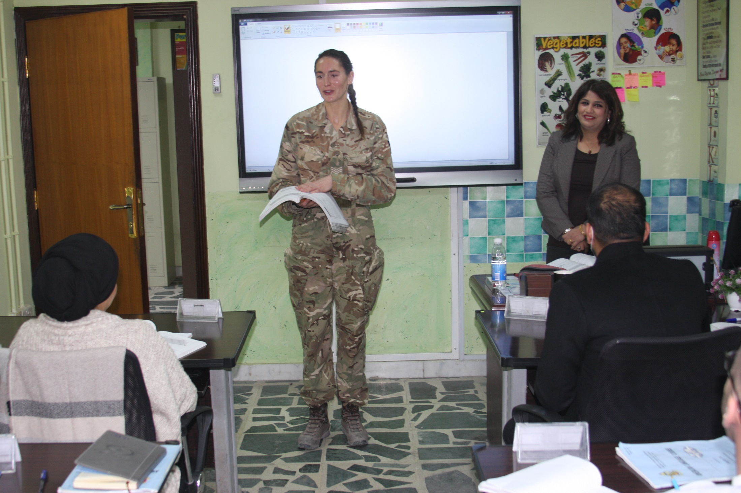
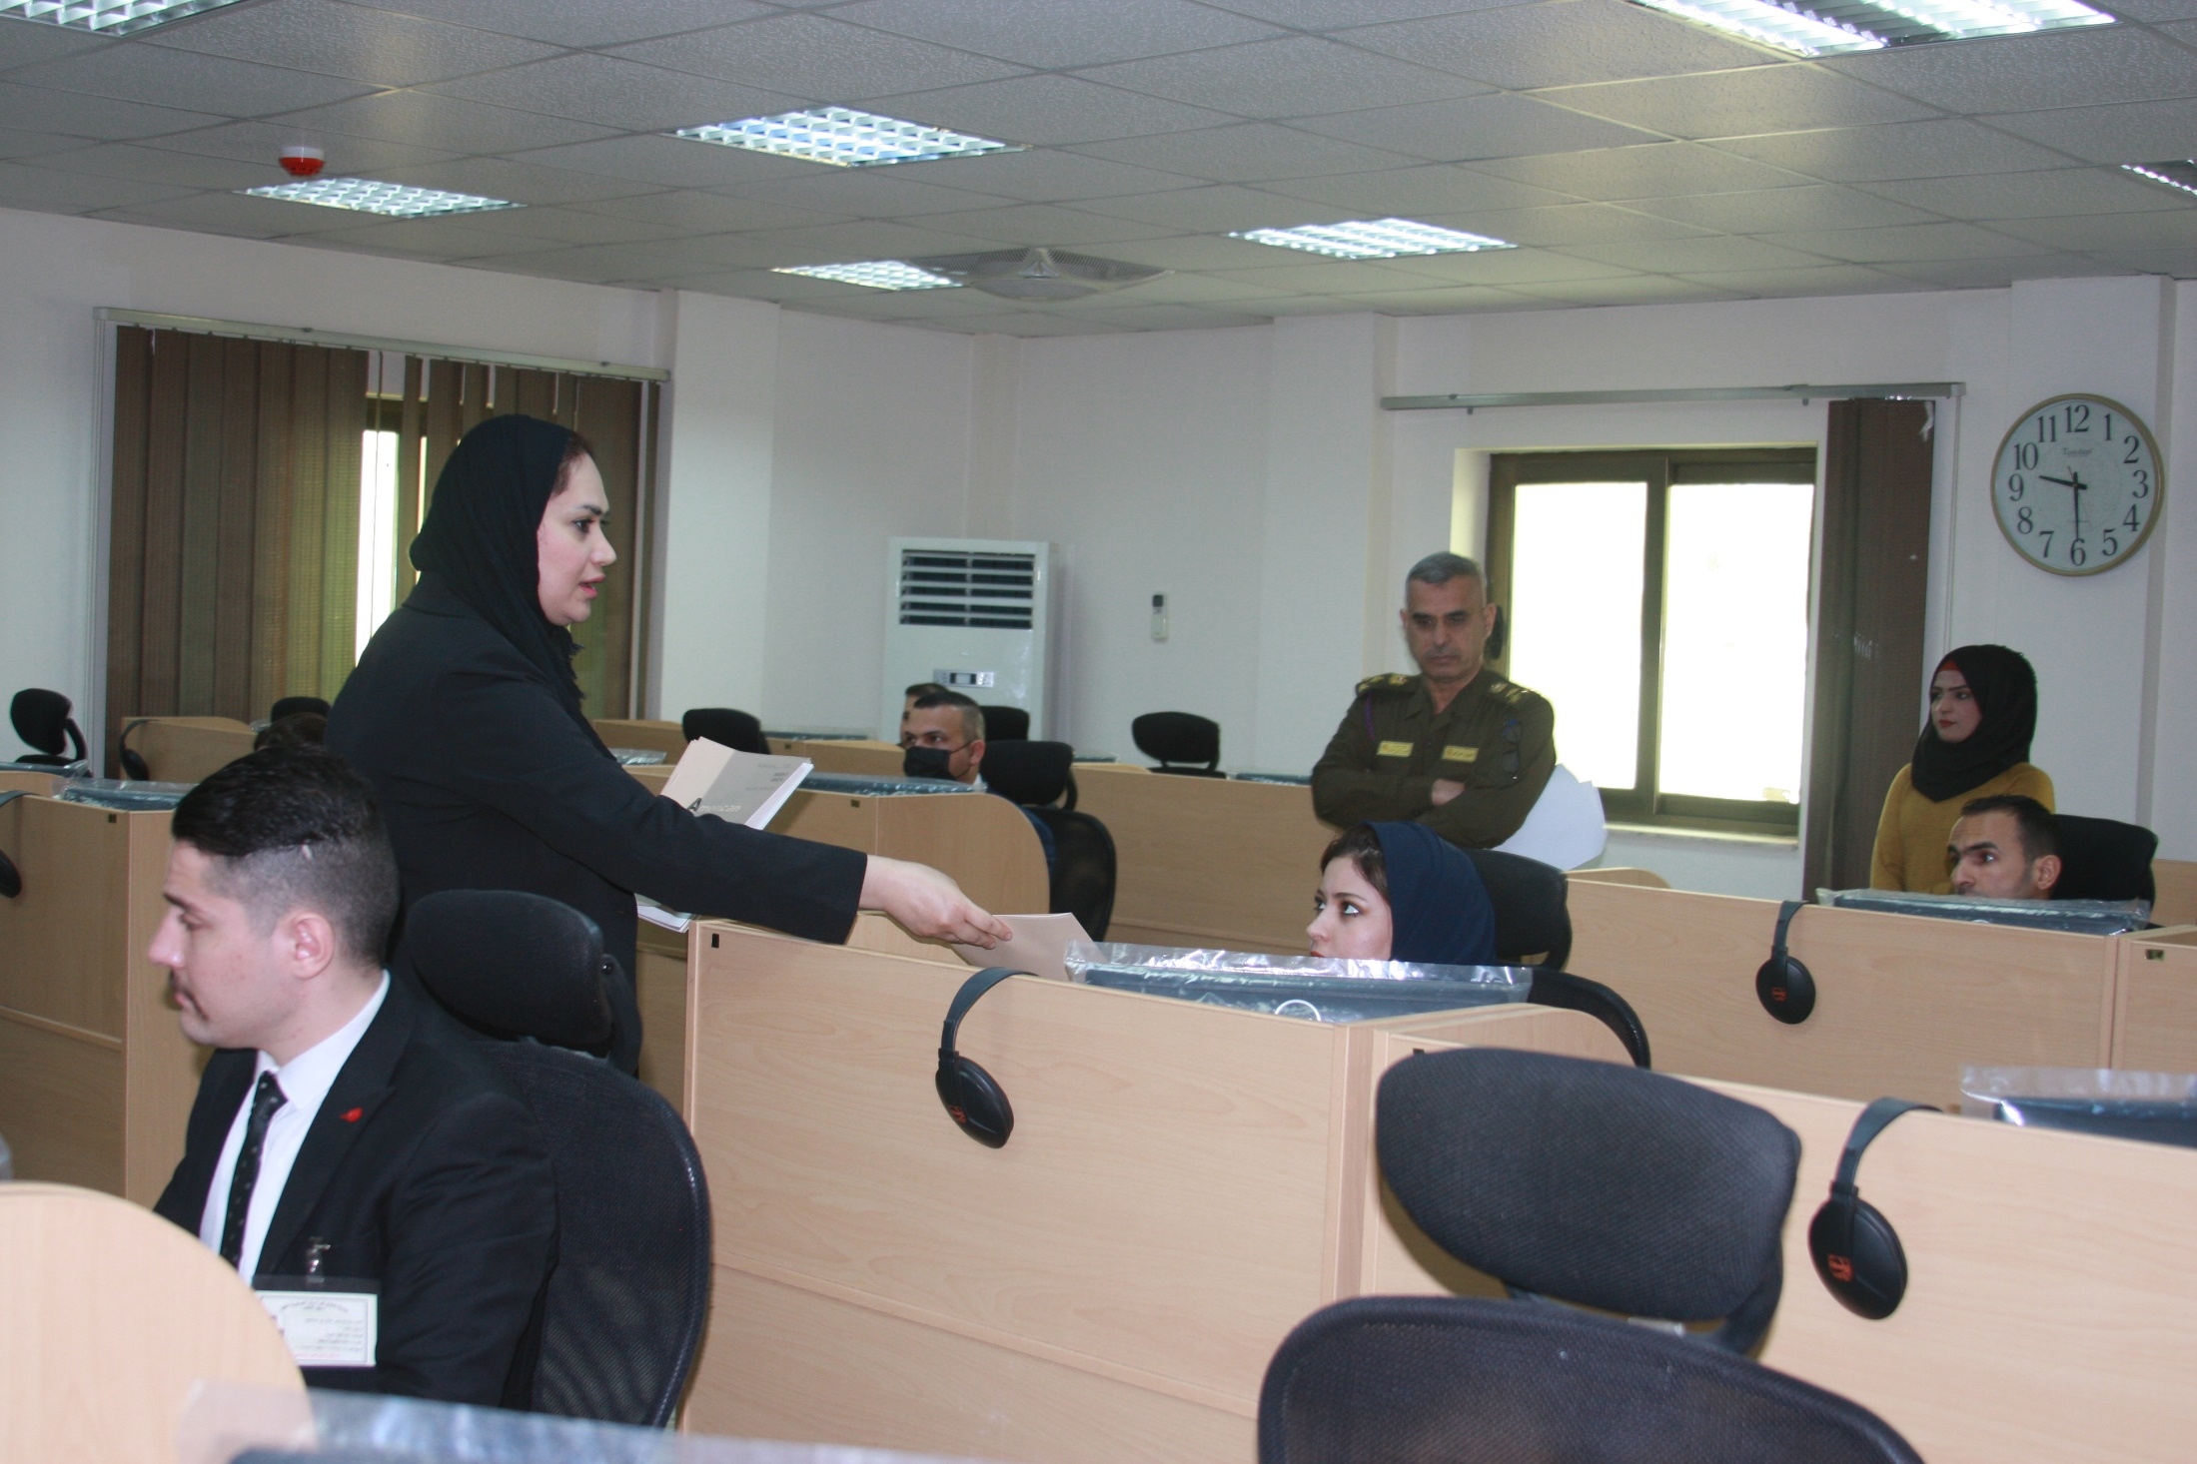
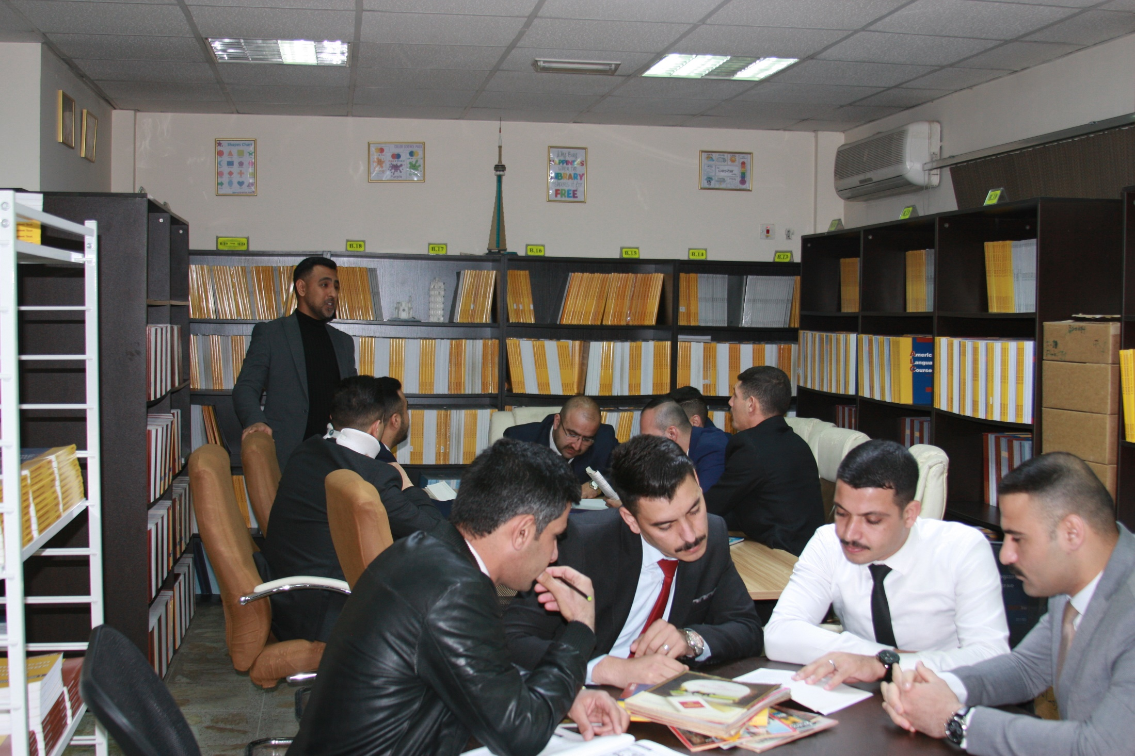
Classrooms
6 Classrooms
4 Labs
Each one has 24 seats.
Each one has 12 seats.
1Library
It’s well-equipped and furnished.

Slide 6
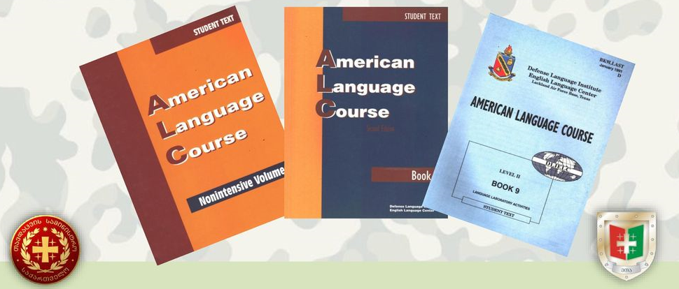
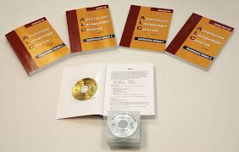
ALC Curriculum
Limitations & Challenges

Slide 7
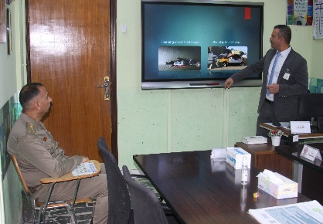
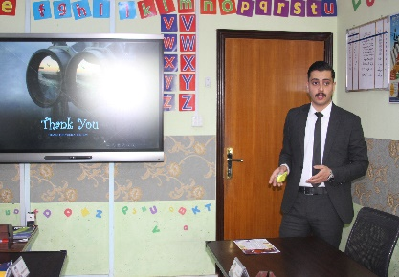
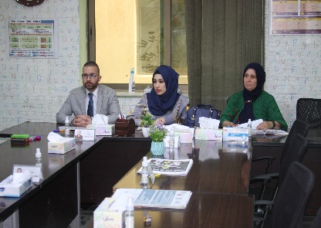
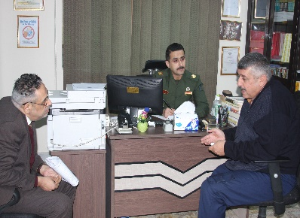
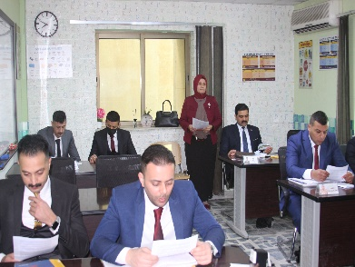
Testing System
ALCPT Test
Book Quizzes
(ALC)
STANAG 6001 Test
Interview& presentation Test

Slide 8
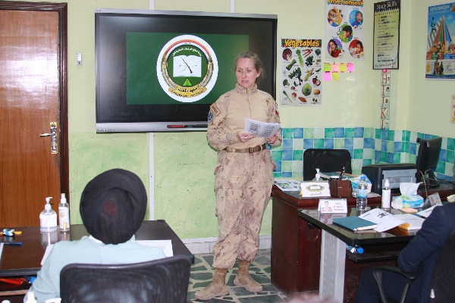
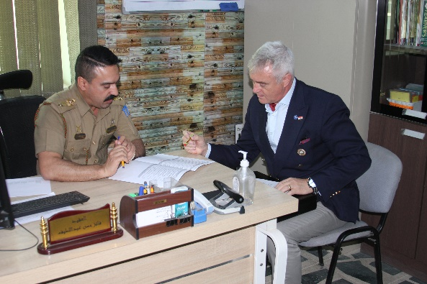
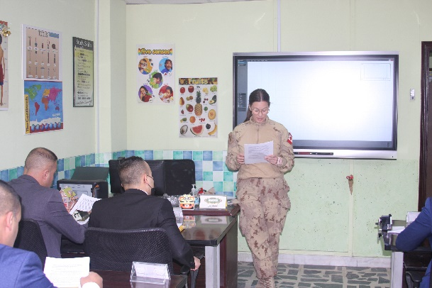
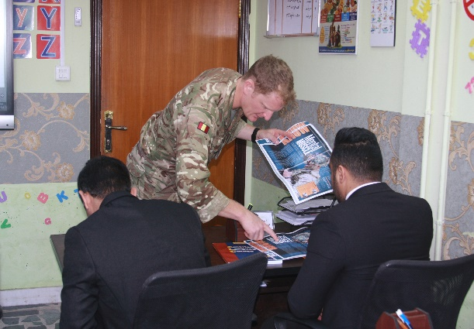
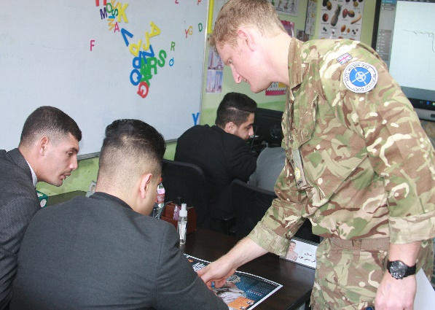
Language Support Program
(NATO MISSION IRAQ)

Slide 9
Questions

