Slide 1
NMI’s Support to the Iraqi DLI Jeremy Nowers, DLI Advisor
Loreto, 24 May 2022.

Slide 3
Contents: - NMI Background. - Faculty Development Activity. - STANAG 6001 Examinations. - Challenges. - Future Plans.

Slide 4
NMI Background

Slide 5
Key Dates:
2004 – 2011: NATO Training Mission in Iraq (NTM-I).
Jul 2015: Defence Capacity Building support.
Apr 2016: Train-the-Trainer courses, Jordan.
Jul 2016: NATO training and capacity-building activities, Iraq.
Jan 2017: Permanent presence in Baghdad.
Feb 2017: Jordan-based training transferred to Baghdad.
Oct 2018: NATO Mission Iraq (NMI) was established.
Nov 2019: BILC’s initial workshop with DLI.

Slide 6
NATO Mission Iraq (NMI) is a non-combat advisory and capacity-building mission.
NMI currently involves several hundred personnel from Allied and partner countries, including Australia, Finland and Sweden.
NMI coordinates with a wide range of other international stakeholders, including the Global Coalition to Defeat Daesh/ISIS, the European Union and the United Nations.
In February 2021, NATO defence ministers agreed to expand NMI, as requested by the Iraqi government.
Notes:
NATO Mission Iraq (NMI) is a non-combat mission that aims to strengthen Iraqi security institutions and forces so that they are able to prevent the return of ISIS, fight terrorism and stabilise their country. It was at the NATO Summit in Brussels in July 2018, following a request from the government of Iraq, that Allied Leaders launched this advisory and capacity-building mission in Iraq, which was established in October 2018.

Slide 7
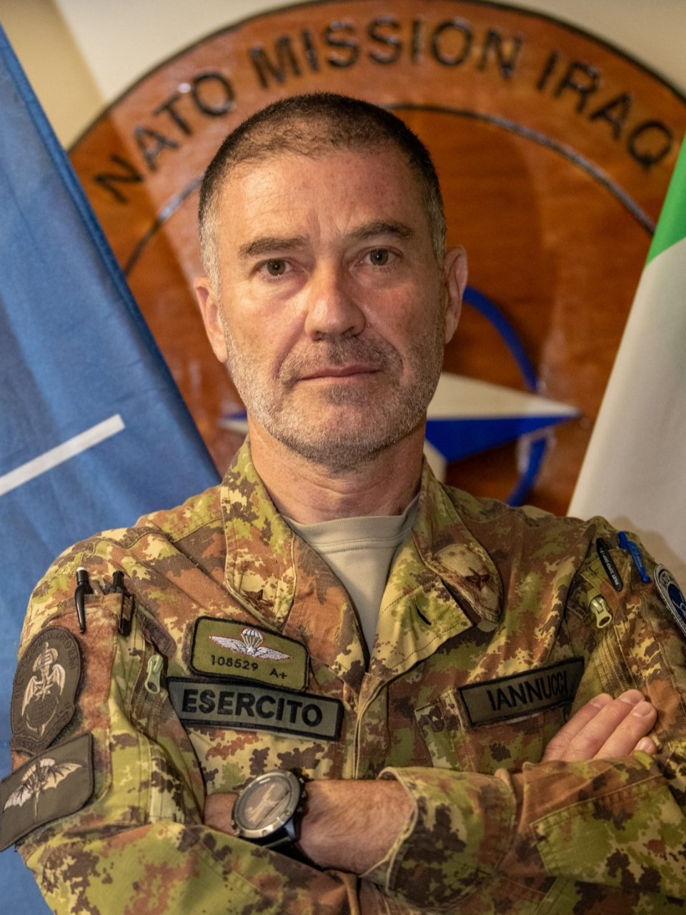
NATO Mission Iraq is commanded by Major General Giovanni Iannucci,
who assumed responsibility for this post on 10 May 2022.
Notes:
NATO Mission Iraq is commanded by Major General Giovanni Iannucci (Italy), who assumed responsibility for this post on 10 May 2022.
NMI falls under the authority of Allied Joint Force Command (JFC) Naples, which is one of NATO’s two operational-level commands that stands ready to plan, conduct and sustain NATO operations of differing size and scope across the full spectrum of military response. In addition to managing operations from Naples or from the theatre of operation, JFC Naples also supports Allied Command Operations and NATO Headquarters in various functions such as training personnel and facilitating cooperation with partners.

Slide 8
Faculty Development Activity

Slide 9
Language Support Programme:
Weekly support with native speakers from NMI in:
English,
French,
German,
Italian and
Turkish.
Notes:
Spanish, next semester

Slide 10
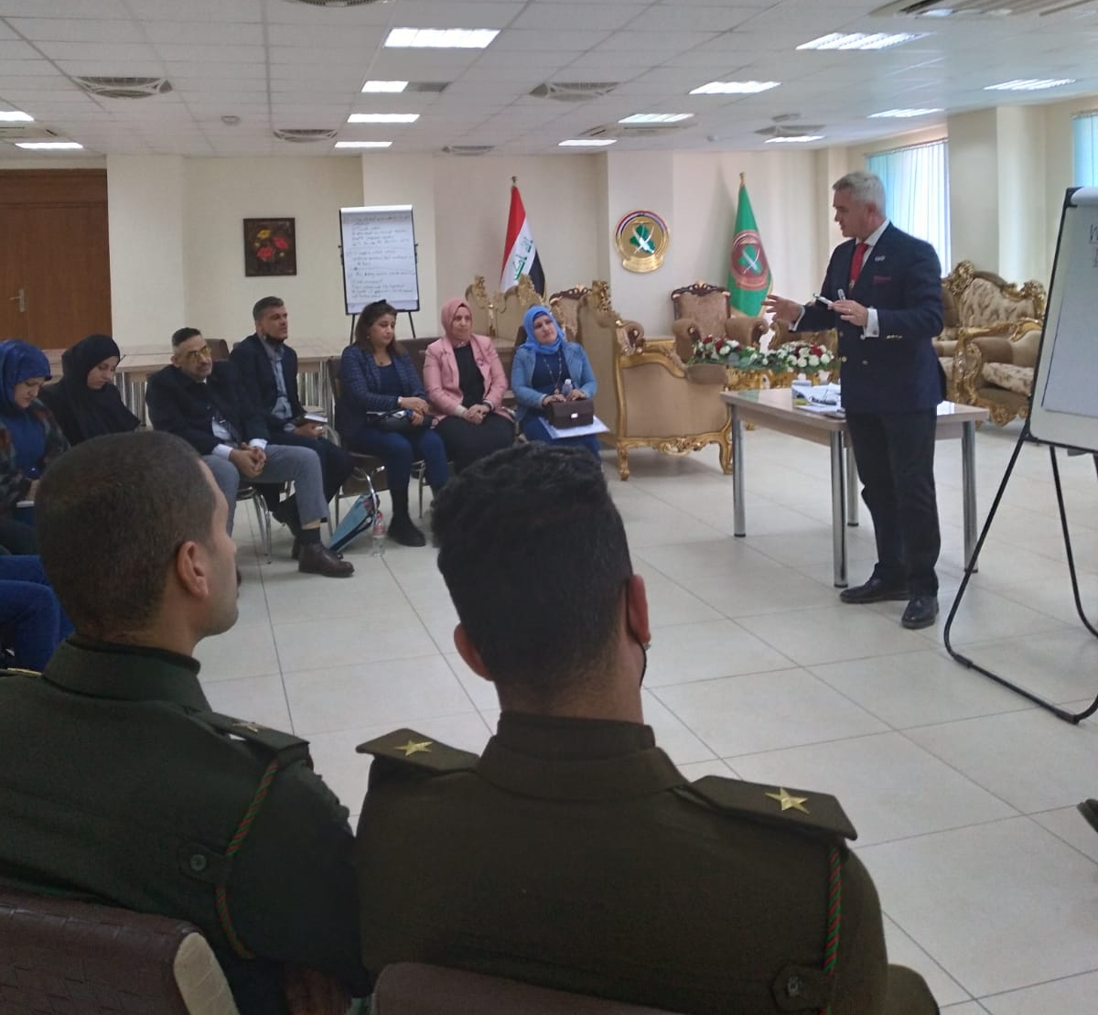
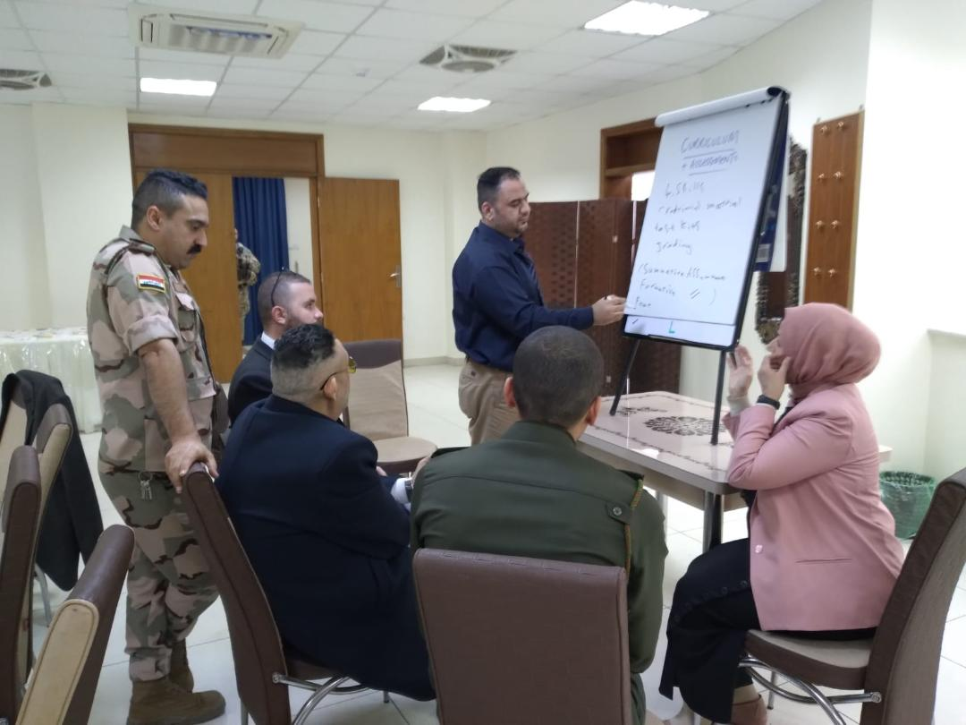
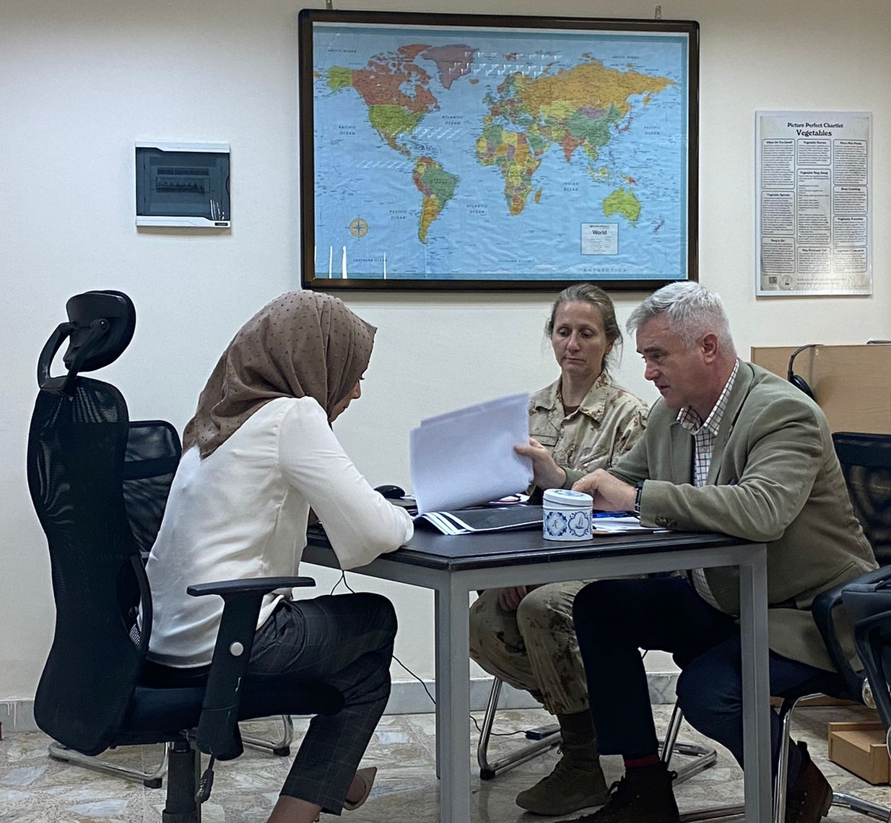
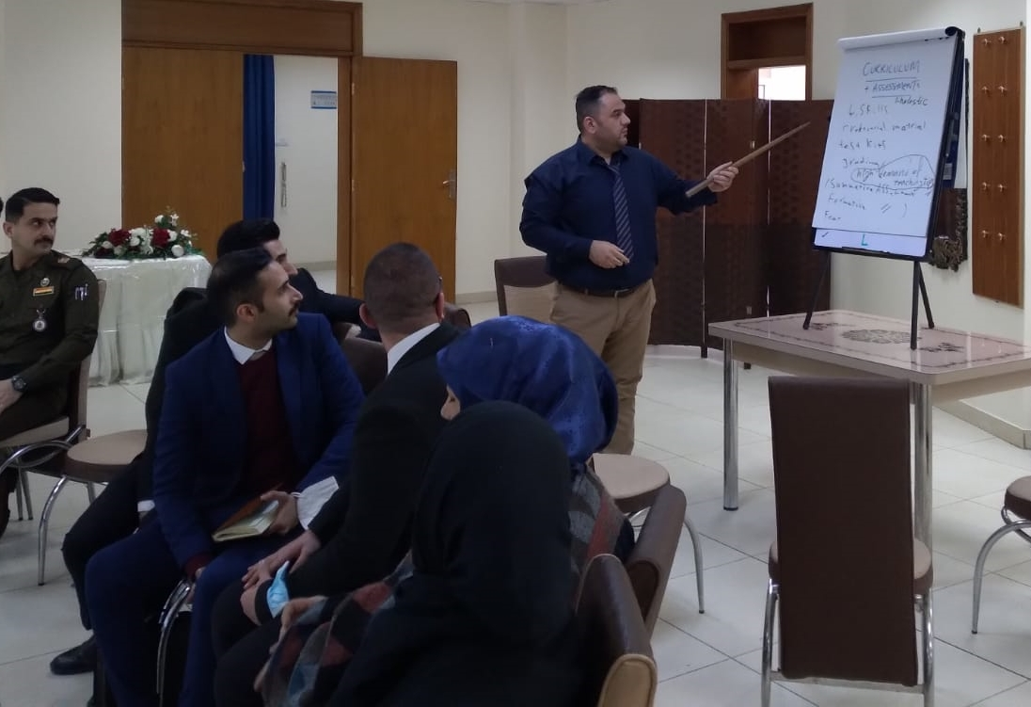
Faculty Development Programme:
Bespoke Workshops in DLI.
12 – 24 Jun: Faculty Development Workshop, Slovenia. ☹
STANAG 6001 Bi-Level 2/3 Testing Nov/Dec 22.
Notes:
Spanish, next semester

Slide 11
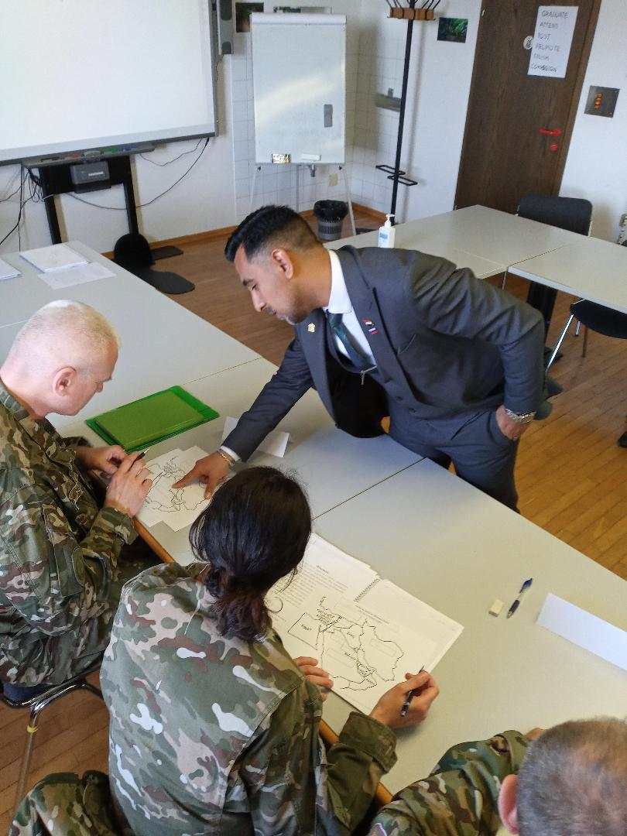
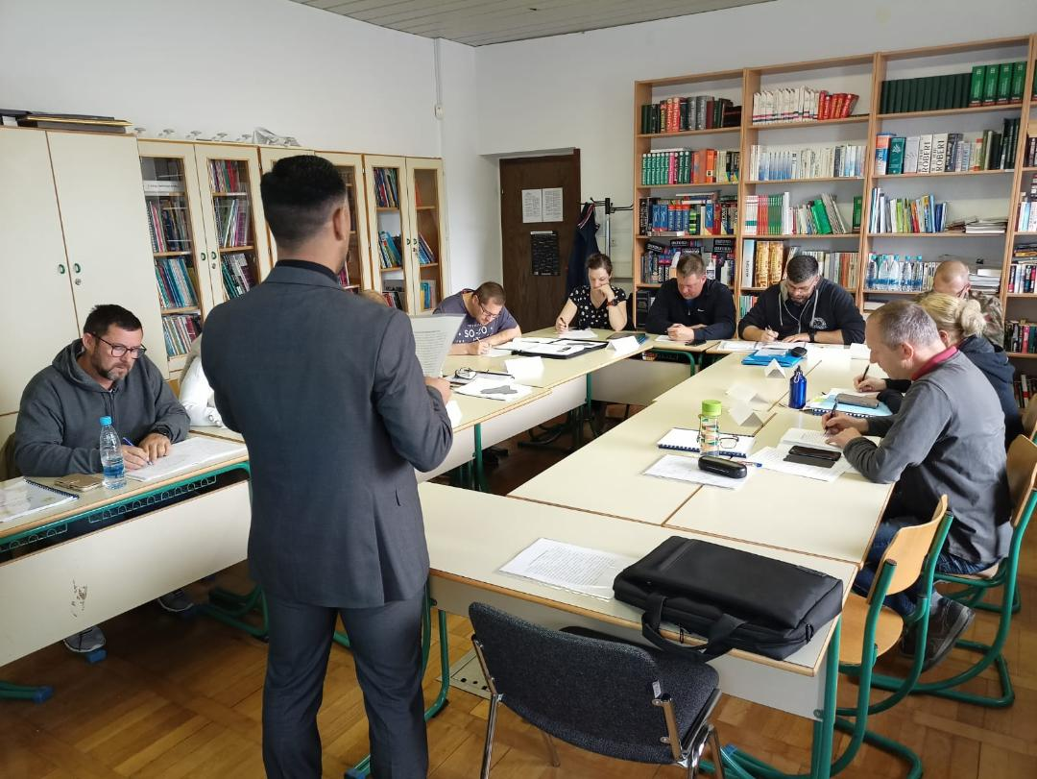
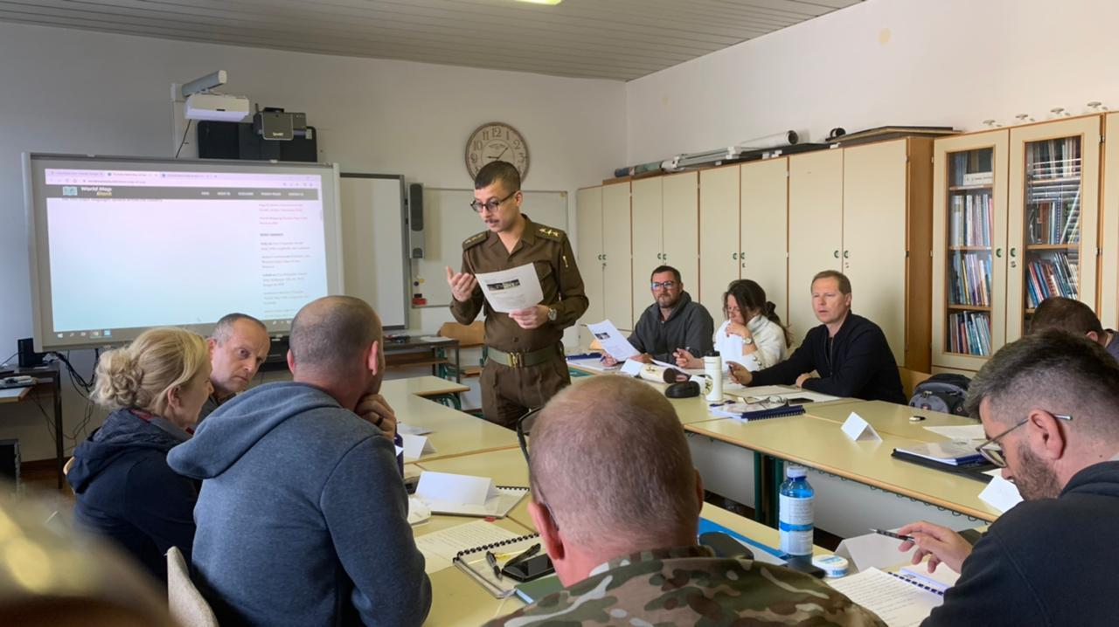
Instructor Exchange Programme:
10 – 22 Apr: Foreign Language School, Poljče, Slovenia.
08 – 20 May: Foreign Language School, Poljče, Slovenia.
Notes:
Spanish, next semester

Slide 12
Attendance on Programmed BILC Training:
6 – 17 Jun: Language Testing Seminar, PLTCE.
12 – 21 Jul: Language Standards and Assessment Seminar, PLTCE.
Notes:
With the establishment of a Testing Cell I n DLI – Mr Wissam & Mr Kareem.

Slide 13
NATO DEEP Clearing House:
13 – 16 Sep 21: Krakow.
20 – 23 Jun 22: Rome.
Notes:
Report back on the activities, and a look forward to the next year.

Slide 14
STANAG 6001 Examinations

Slide 15
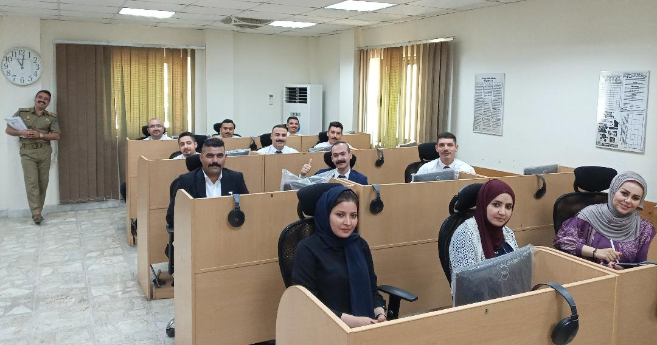
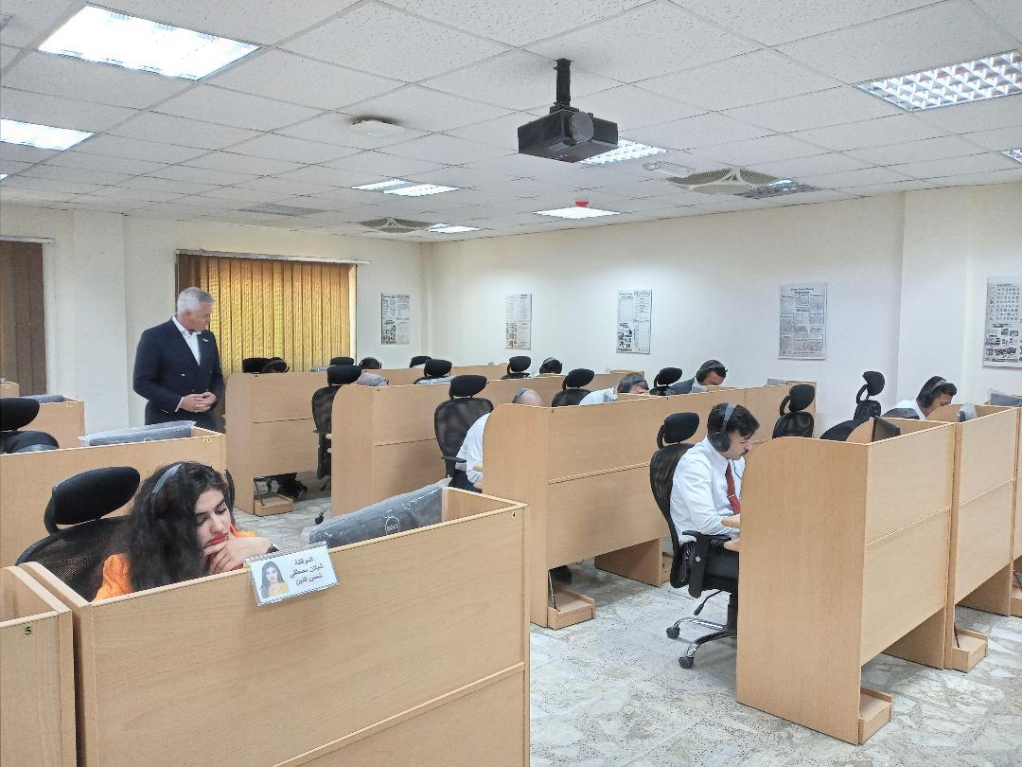

Slide 16
Challenges

Slide 17
Out of Country Activity Process.
Students from outside the Greater Baghdad Area.
DLI as a manning margin.
Resources.

Slide 18
Future Plans

Slide 19
Continued NMI support.
Continued attendance at BILC events.
Continued Faculty Development.
PTEC aspiration.

Slide 20
Contact Us
Jeremy.Nowers@nmi.nato.int
+964 (0) 7722764511
Notes:
Please remember the time difference!

