Slide 1
Self-paced LOTE training packages: Adapting training strategies to meet new requirements
by Anya Ivanova, Australian Defence Force School of Languages (DFSL)

Slide 2
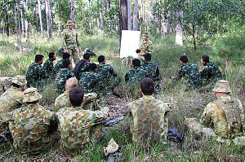
DFSL Mission
To train and assess Defence personnel in LOTE to enhance Defence capability
Main school at RAAF WIL – Melbourne, Victoria
Campus at Fyshwick, Canberra
Outsourced courses to other locations

Slide 3
Languages Taught
Long Courses
Arabic
Chinese
French
German
Indonesian
Japanese
Khmer
Korean
Malay
Portuguese
Spanish
Tetum
Thai
Tok Pisin
Vietnamese
Short Courses
Arabic
Fijian
Filipino
French
Indonesian
Malay
Tetum
Tok Pisin
Urdu
Refresher Courses
Arabic
Chinese
Filipino
French
Indonesian
Japanese
Khmer
Korean
Malay
Portuguese
Russian
Tetum
Thai
Vietnamese
Defence Force School of Languages
Assess Only
Dari
Hindi
Pashtu

Slide 4
LOTE Macroskills
Reception Skills
Production Skills
Reading | Writing
Listening | Speaking
Written Skills
Translating
Oral Skills
Interpreting
Courses train and assess all six skills
Re-qualifying tests are only in reading, listening and speaking

Slide 5
Australian Defence Language Proficiency Rating Scale (ADLPRS)
Level | Speaking / Writing (examinee performance) | Listening / Reading (nature of material)
0+ | Extremely limited proficiency | Extremely simple material
1 | Very limited proficiency | Very simple material
1+ | Limited proficiency | Simple material
2 | Partially effective | Straightforward material
2+ | Generally effective | Mainly uncomplicated / tangible material
3 | Effective | Somewhat complex / conceptual material
3+ | Very effective | Complex / conceptual material
4 | Highly effective | Very complex / conceptual material
5 | Expert user | Highly complex / conceptual material
Language Difficulty Levels:
Level 1: Tok Pisin, Solomon Island Pijin, Bislama
Level 2: Fijian, Filipino, French, German, Indonesian, Malay, Portuguese, Spanish, Tetum (SE/GL courses achieve ADLPRS Level 2+)
Level 3: Dari, Khmer, Pashtu, Thai, Urdu, Vietnamese (GL courses achieve 2/2+)
Level 4: Arabic, Chinese, Japanese, Korean (SE courses achieve Level 2)

Slide 6
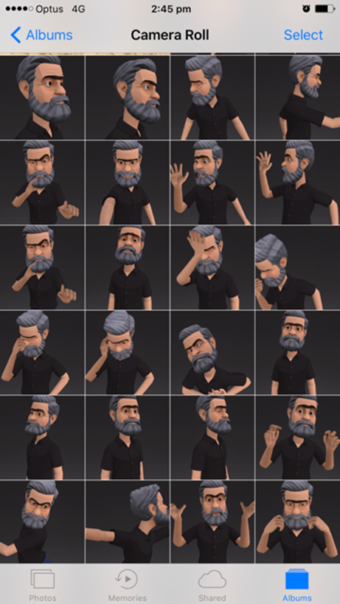
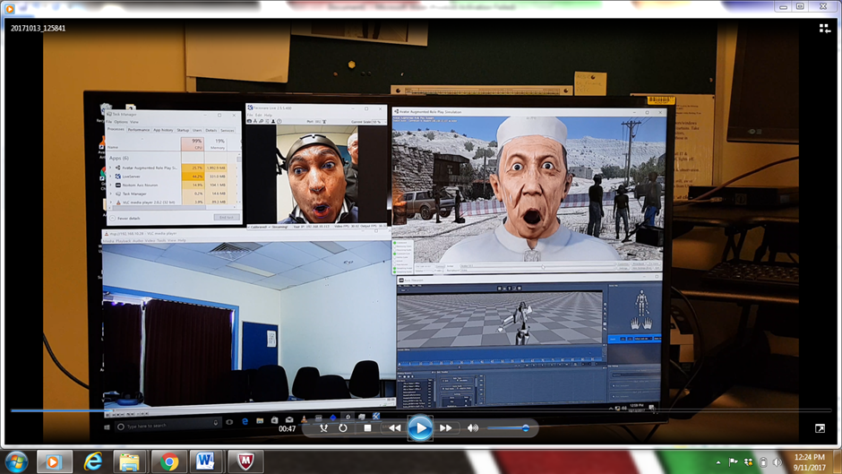
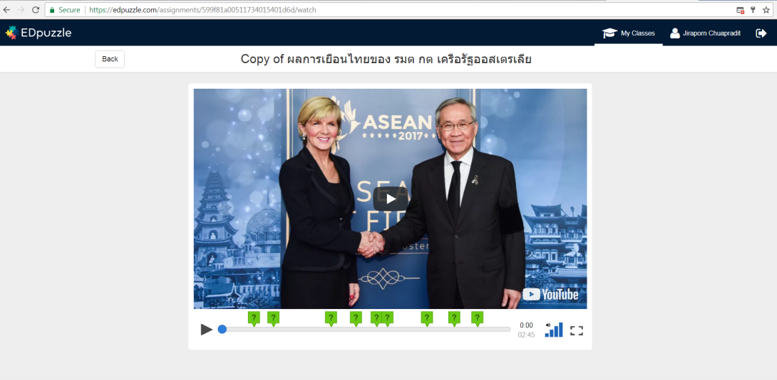
Blended learning at DFSL

Slide 7
DFSL self-paced packages

Slide 8
Online Interpreting Package (OIP): Background
2018 LOTE Performance Needs Analysis (PNA)
‘DFSL to incorporate a greater emphasis on interpreting skills’
‘ADF should strive to provide interpreters as part of its international engagement strategy’

Slide 9
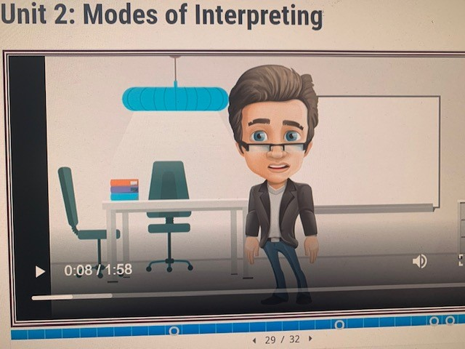
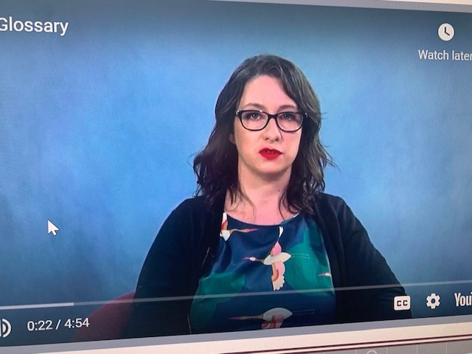
OIP cont.
DFSL first self-paced, online training resource
Located on the DFSL LMS
It is designed to equip DFSL graduates or recently qualified ADF linguists with basic interpreting skills through a mix of theory and practice opportunities

Slide 10
Key goals
To increase DFSL graduates awareness of the different types of ADF specific interpreting tasks and scenarios.
Through in-built Mentorship program, provide OIP learners with feedback on their interpreting performance in practice tasks, discuss any challenges, dilemmas or questions that come up as they progress through the materials, and generally support their learning by sharing of the mentors’ own interpreting experience.

Slide 11
Online Interpreting Package (OIP)

Slide 12
OIP content
Different modes of interpreting (consecutive, simultaneous, chuchotage, sight translation, phone or video interpreting, summary interpreting)
Preparing for interpreting tasks
Building glossaries for interpreting tasks
Memory techniques for interpreting
Note taking skills
Managing challenges: ground rules, briefings, interrupting, miscommunication, cultural awareness, public speaking and physical factors.
+ Multiple practical scenarios, recorded scripts for interpreting practice, etc.

Slide 14
Military SMEs input
Dozens of military linguists were interviewed and provided their input into the content of the OIP
55 ADF linguists helped to write the dialogues, translate them into multiple LOTE and record them for online practice
Many ADF linguists also provided real life/hands on advice to future ADF interpreters. These quotes were included in the package.

Slide 15
OIP launch
Launched in Mar 2022
Hundreds of participants now enrolled in the course
Members can access the package in their own time

Slide 16
Online Reading Packages (ORPs)
ORPs for Group 3 languages (Khmer, Thai and Vietnamese) on DFSL LMS
Designed for members who want to upgrade their Reading proficiency to ADLPRS Level 2+ in order to align with their Speaking and Listening skill levels

Slide 17
Online Reading Packages

Slide 18
Other BL projects

Slide 19
Online Rater Training (ORT) development project
Current state: min of 12 three-day RT/year
ORT will offer flexibility to program participants and Assessment cell staff.
No barrier-of-entry to new staff
Online delivery of theory and confirmation-of-learning activities will allow to shift focus to the all-important practical dimensions of RT
Development of the additional sections, i.e. Writing, Translating and Interpreting skills assessment and formative assessment, not adequately covered by the current training.

Slide 20
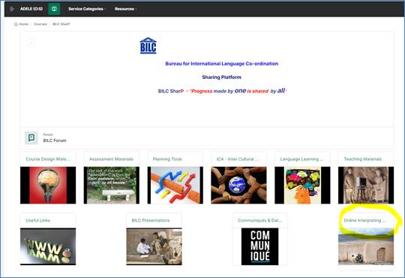
https://www.adele.edu.au/course/view.php?id=408

Slide 21
Questions

