Slide 1
MILITARY UNIVERSITY NAMED AFTER V. SARGSYAN, MoD, RA ARMENIAN LANGUAGE CENTER: IT'S PAST, PRESENT AND FUTURE
REPORTER: E. GALSTYAN
PhD in GENERAL AND APPLIED LINGUISTICS, ASSOCIATE PROFESSOR

Slide 2
OBJECTIVES
OBTAIN KNOWLEDGE
GET RECCOMENDATIONS
GAIN EXPERIENCE

Slide 3
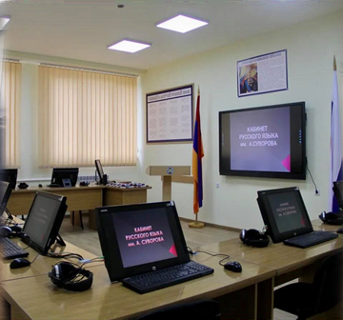
LC SPONSORED BY BRITISH MINISTRY OF DEFENSE AND COMMONWEALTH OFFICE
BRIEF HISTORY
LC BASED IN PEACEKEEPING BRIGADE

Slide 4
MILITARY UNIVERSITY NAMED AFTER V. SARGSYAN

Slide 5
NATIONAL DEFENSE RESEARCH UNIVERSITY

Slide 6
MILITARY AVIATION UNIVERSITY

Slide 7
PEACEKEEPING BRIGADE

Slide 8
THE CORE AIMS OF LC
Designing skill based courses according to NATO standards
Collecting necessary and sufficient resources
Developing assessment standards and scoring criteria
Developing STANAG tests
Developing teaching methodologies
Training instructors

Slide 9
THE CORE AIMS OF LC
Having Specialized English trainings
Having Specific programs for peacekeepers
Exploiting Labs
Establishing and developing E-learning platform
Familiarizing with Western Culture and incorporating cultural knowledge into the teaching process

Slide 10
OUR STANAG COURSES VISION
STANAG 1
200-300 hrs.
10-12 graduates
STANAG 2
400-500 hrs.
10-12 graduates
STANAG 3
500-600 hrs.
10-12 graduates

Slide 11
THANK YOU FOR YOUR ATTENTION

