Slide 1
Defence Centre for Languages & Culture (DCLC)
Lt Col Jo Panayiotou

Slide 2
Defence Centre for Languages and Culture
English Language Wing
Preparation courses
English language training
Foreign Language Wing
23/24 ran 68 foreign language courses for 258 students in 30 languages
The Defence Academy, Shrivenham, UK
Notes:
DCLC is the UK military’s language school.

Slide 3
The problem
Mandarin: 84 weeks to reach SLP3
(Russian, Arabic, Farsi: 65 weeks)
Very weak correlation between MLAT score and exam success
The Defence Academy, Shrivenham, UK
Notes:
We had the challenge of setting up a permanent Chinese Mandarin SLP3 course

Slide 4
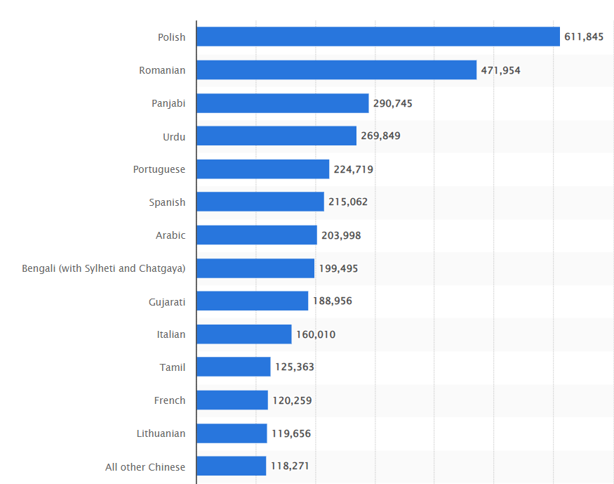
Recruitment Pool
Non-English languages spoken
Number of A-Level entries
Notes:
Number of A Level exam entries in foreign languages in the United Kingdom in 2022 and 2023, by language: - ~717,000 18 year olds in England and Wales in 2022 (best case estimate is 4% take a foreign language A Level)
Most common non-English languages spoken as a main language in England and Wales in 2021, by number of speakers:
- population of England and Wales in 2021 was 59.6m so ~7% non-native English speakers

Slide 5
What makes learning a foreign language hard?
Difference from own language:
Writing system – Latin alphabet
Sounds and distinctions not in native language
xióng māo - panda xiōng máo - chest hair
shuǐ jiǎo - dumpling shuì jiào - to sleep
The lexicon – lack of common roots
Grammar
English has a clear structure for grammar; Chinese grammar is more nuanced
Notes:
Dr Cindy Blanco, senior learning scientist at Duolingo (https://blog.duolingo.com/whats-the-easiest-language-to-learn/):
We're apt to transfer from our first language to the new language—that can include vocabulary and grammar (like saying your new Spanish words in the order you'd say them in English). But we transfer other properties, too, like sounds (for spoken languages), handshapes and movements (for signed languages), rules about politeness, and concepts and meanings (what counts as a "cup" versus a "glass" or "mug"? where does "blue" stop and "green" begin?). Transfer can be helpful if the properties are the same across the languages, but can present a challenge if they differ.
https://www.languagesunlimited.com/why-is-learning-chinese-language-difficult-when-compared-to-learning-the-english-language/
To begin with, it’s important to understand the basic differences between Chinese and English. English is an Indo-European language with its roots in Latin and Greek. The language has a defined set of rules, with a clear structure for grammar, vocabulary, and pronunciation. It uses an alphabet consisting of 26 letters, making it relatively easy to learn and read. On the other hand, Chinese is a tonal language with complex characters that have evolved over thousands of years. The Chinese language has a unique structure and pronunciation system that is vastly different from English. Chinese is made up of tens of thousands of characters, each with its own meaning, and often multiple pronunciations. This makes the language extremely difficult to learn, especially for non-native speakers.
Furthermore, English has a grammatical structure that is relatively straightforward and predictable, while Chinese grammar is much more nuanced and complex. For example, in Chinese, the verb tense does not change, and instead, time markers are used to indicate past, present, and future. In summary, the basic differences between Chinese and English lie in their structure, grammar, pronunciation, and the complexity of the writing system. Understanding these differences is important in comprehending why Chinese is considered a more challenging language to learn than English.
One of the main reasons why learning Chinese is more difficult than learning English is the complexity of Chinese characters. Unlike the English language, which uses the 26 letters of the alphabet, Chinese has tens of thousands of characters that need to be learned in order to read and write effectively. Each character is made up of a combination of strokes, and mastering the correct stroke order and direction is crucial for proper character formation. This can be a daunting task for language learners, as it requires a lot of time, patience, and practice.
Furthermore, many of the characters have multiple meanings depending on the context in which they are used, adding another layer of complexity to the language. While English words can often be deciphered through context clues, this is not always the case with Chinese characters. In addition, Chinese characters are not phonetic, meaning that the pronunciation of a character cannot be determined simply by looking at it. Instead, it must be memorized separately, making the task of learning the language even more challenging. Overall, the complexity of Chinese characters is one of the biggest hurdles that language learners face when trying to master the language.
One of the biggest differences between Chinese and English learning is the grammar. English grammar can be complex with its many tenses, phrasal verbs, and conditional statements. Chinese, on the other hand, has a relatively simple grammar structure with no verb conjugation or gender agreement. In Chinese, sentence structures are built using particles and word order. The subject-verb-object structure is used most often, but it can be rearranged to place emphasis on certain parts of the sentence. For example, “I eat rice” can be rearranged to “Rice, I eat” to emphasize what is being eaten. In English, on the other hand, sentence structure is more rigid. The subject-verb-object structure is used most of the time, and rearranging the sentence can change its meaning entirely. For example, “The cat hurt the woman” and “The woman hurt the cat” have entire different meanings.
One of the most challenging aspects of learning Chinese is mastering its tone system. The Chinese language has four tones, plus a neutral tone, which are used to differentiate words that share the same syllable. This means that the same syllable can have up to five different meanings, depending on the tone used. For example, the syllable “ma” can mean “mother,” “hemp,” “horse,” “scold,” or “question,” depending on the tone used. Mastering the tones can be difficult for English speakers, who are not used to using pitch to differentiate between words. It takes time and practice to train your ear to hear the differences between the tones, and to learn to produce them accurately yourself. Many beginner learners struggle with tone recognition and production, which can lead to misunderstandings and difficulties in communication. It’s important to note that the tone system is an integral part of the Chinese language and cannot be ignored. It takes dedication and patience to master, but once you do, it opens up a whole new world of communication and understanding.
One of the biggest challenges of learning Chinese is mastering the pronunciation. Unlike English, Chinese is a tonal language, which means that the meaning of a word can change depending on the tone used to pronounce it. Chinese has four main tones: flat, rising, falling then rising, and falling. Some dialects of Chinese even have a fifth tone. It is essential to learn and master these tones as mispronouncing a word can lead to confusion or even embarrassment. Another challenge of Chinese pronunciation is that it has a very distinct set of sounds that do not exist in English. For example, the “x” and “q” sounds in Chinese are extremely difficult for English speakers to pronounce correctly. On the other hand, English is relatively easier to pronounce due to its phonetic nature. To master Chinese pronunciation, it takes a lot of practice, patience, and guidance. It’s important to work with a qualified teacher who can help you develop proper pronunciation and tone usage. In addition, listening to Chinese speakers and imitating their sounds can also be helpful in improving your pronunciation skills.
One of the biggest reasons that learning Chinese is more difficult than learning English is due to the vast differences in vocabulary and sentence structure. While English has a relatively simple sentence structure, Chinese is a tonal language with a complex grammar structure that can take years to master. In the Chinese language, there are over 80,000 characters, compared to the English language which has only 26 letters in its alphabet. This means that Chinese learners need to memorize a much larger set of characters and learn how to read, write and pronounce them correctly. Another difference between the two languages is that Chinese is a tonal language, meaning that the meaning of a word can change depending on the tone used when it is spoken. There are four main tones and a neutral tone in Chinese, and each tone has a distinct meaning. This can be difficult for English speakers who are not used to distinguishing between tones. Furthermore, Chinese sentence structure is vastly different from English sentence structure. In English, we use a subject-verb-object (SVO) structure, while Chinese typically uses a subject-object-verb (SOV) structure. This can be confusing for English speakers who are used to the SVO structure and may take time to adjust. Overall, the differences in vocabulary and sentence structure make learning Chinese a more challenging task than learning English. However, with dedication and practice, anyone can master this fascinating language.
Learning any language is much more than just memorizing vocabulary and grammar rules. It is also about understanding the cultural context in which the language is used. This is especially true when it comes to learning Chinese. Chinese language and culture are deeply intertwined, and to fully grasp the language, it is important to understand the cultural context in which it exists. Chinese language learners will need to learn about the customs, traditions, and values of Chinese society to fully understand the language and communicate effectively. For instance, the use of honorifics and the importance of social hierarchy are crucial aspects of Chinese culture that are reflected in the language. In Chinese, the use of honorifics is common and reflects the speaker’s respect for the person they are addressing. Similarly, understanding the social hierarchy of Chinese society is crucial to understanding the use of language in different contexts. Moreover, Chinese language learners often struggle with the concept of “face”, which is the idea of maintaining respect and dignity in social interactions. In Chinese culture, “face” is an important aspect of communication, especially in business settings. It is important to learn how to give and receive “face” to communicate effectively in Chinese. Overall, understanding the cultural context of Chinese language learning is essential to mastering the language. It is important for learners to be aware of and respect the cultural norms and values of Chinese society to effectively communicate and avoid misunderstandings.

Slide 6
Modern Language Aptitude Test
Purpose of the MLAT:
“to predict how well, relative to other individuals, an individual can learn a foreign language in a given amount of time and under given conditions.”
Phonetic coding ability – ability to perceive and remember distinct sounds and their associated symbols
Grammatical sensitivity – ability to recognise the function of a lexical element in a sentence
Rote learning ability – ability to learn and retain associations between words in a new language and their meaning in English
Inductive learning ability – ability to infer or induce rules governing the structure of a language
Notes:
Targeted towards native English speakers
https://lltf.net/aptitude-tests/what-is-language-aptitude/. Language Learning and Testing Foundation LLTF own the MLAT
LLTF don’t release the test to individuals – study books are available and potential students are starting to use them
Dr. John B. Carroll, who created the Modern Language Aptitude Test (MLAT) with his co-author Stanley Sapon, once defined language aptitude as simply an ability or “knack” for learning foreign languages. Virtually everyone has this ability, but some people appear to learn at a faster rate than others. According to Carroll, the purpose of the MLAT was to predict “how well, relative to other individuals, an individual can learn a foreign language in a given amount of time and under given conditions.” In other words, language aptitude is an ability that largely determines how quickly and easily an individual will progress in learning a language in a language course or language training program. As is the case for other kinds of aptitude, such as verbal ability and musical abilities, language aptitude is believed to be relatively stable throughout an individual’s lifetime.
It is important to keep in mind that, given enough time and reasonably good instruction, virtually anyone can learn a second language, but people differ in terms of the rate and ease with which they can learn. Scores from a language aptitude test can therefore be used to help to determine how much time will be sufficient for an individual language learner to accomplish a given goal, assuming that the individual is at least moderately motivated to learn.
Carroll, an internationally acclaimed psychometrician and educational psychologist, conducted a five-year research project in the 1950s to investigate the concept of language aptitude and how it could be measured. During this time, Carroll identified four distinct abilities that factored into language aptitude, separate from motivation and verbal intelligence. Carroll designed the Modern Language Aptitude Test based on this four-part model of language aptitude.
There are good alternatives, but MLAT seen as the best
Anyone can learn another language, MLAT tries to identify those who can learn another language quicker
Has limitations though: developed for native English speakers; not targeted towards tonal languages; doesn’t measure motivation or intelligence or longer-term memory

Slide 7
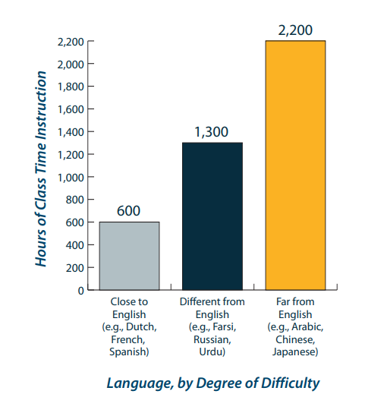
Our Journey So Far – 3 courses since 2020
Length of instruction (84 weeks; 1,680 hours)
Target those who already have a language
1:5 ratios (started at 1:6)
Resources level 2 up
Hanyu Shuiping Kaoshi
Weekly vocab tests
Progress tests (every 6-7 weeks)
Progress review boards
Immersion

Slide 8
What else?
Motivation
Meaningful career path
Financial reward / specialist pay?
Working memory
Cognitive ability eg intelligence and spatial reasoning
Notes:
Motivation
- Exploring additional pay for intelligence linguists, a specialist career stream

Slide 9
References
Slide 4. Diagrams taken from https://www.statista.com/statistics/343020/england-european-language-candidates-a-level/#:~:text=Number%20of%20A%20Level%20entries,in%20the%20UK%202022%2D2023&text=In%202023%2C%20there%20were%208%2C110,modern%20languages%20during%20this%20year and https://www.statista.com/statistics/284010/most-common-non-english-languages-spoken-in-england-and-wales/
Slide 6. Description taken from the Language Learning and Testing Foundation website: https://lltf.net/aptitude-tests/what-is-language-aptitude/
Slide 7. Diagram taken from: ‘Foreign language instruction’ (2006), American Educational Research Association Spring 2006, Vol, 4, issue 1 https://www.aera.net/Portals/38/docs/Publications/Foreign%20Language%20Instruction.pdf

