Slide 1
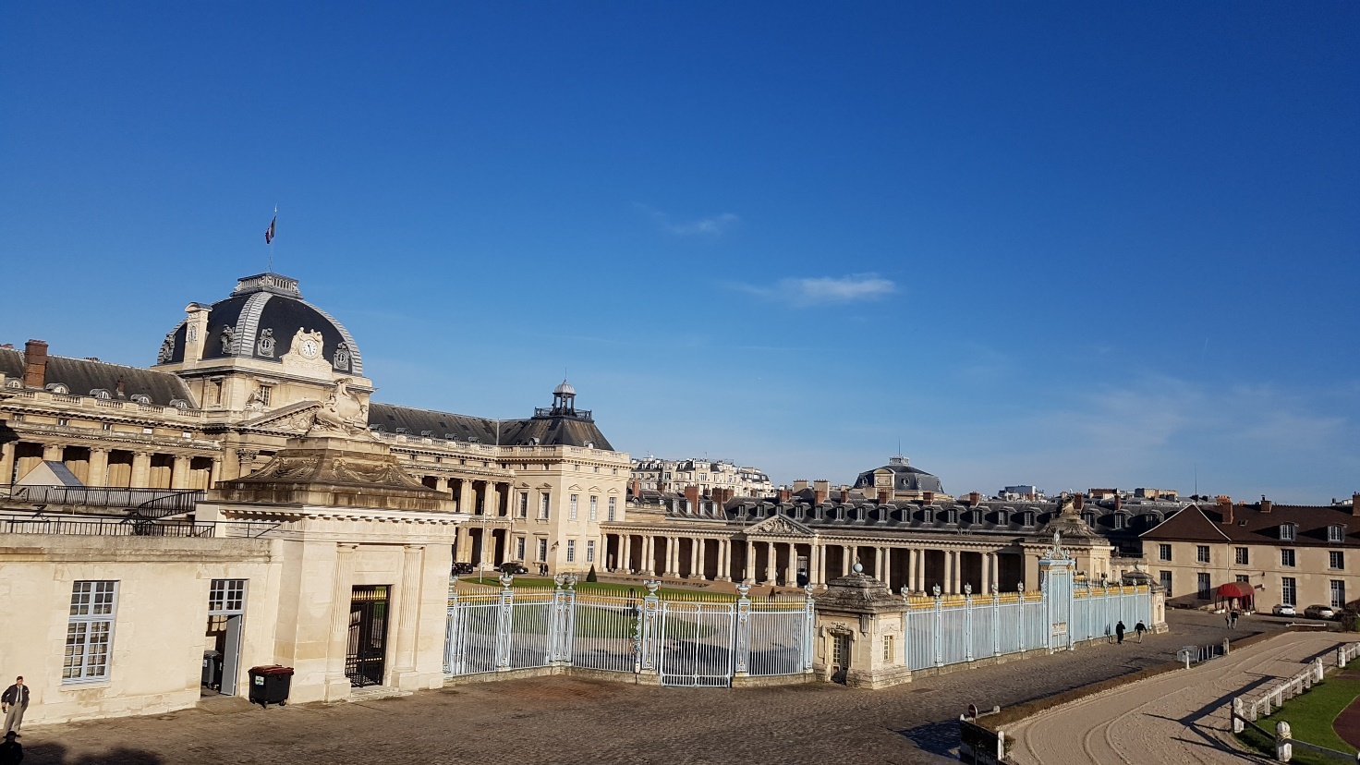
Redefining relationships in the learning space
Part I - Theory
M. Jérôme COLLIN – Ecole de Guerre – French Language Department

Slide 2
I The pedagogical contract
Informative field
Educational field
The impossible balance
II The teaching of "military language"
Military knowledge belongs to the military
The French language belongs to French speakers
III Redefining relationships in the learning space
The stakeholder/teacher relationship
The teacher/student relationship

Slide 4
Instructive field (transfer of knowledge)
STATUS
Institutional relationship (legitimacy)
Silent student, in a position of ignorance, impressed by the knowledge of the professor
authority
❐ What is the student's image of the teacher?
(myth of the perfect master)
Educational field (contribution to personal achievement)
ROLE
Personal relationship (satisfaction)
Participating student, proactive, influenced by teacher's personality
affection
❐ What is the teacher's image of the student
(fantasy of the perfect student)

Slide 5
MASTER
Skill
Teaching
WIZARD
FRAUD
Teaching
Skill
DISCIPLE

Slide 6
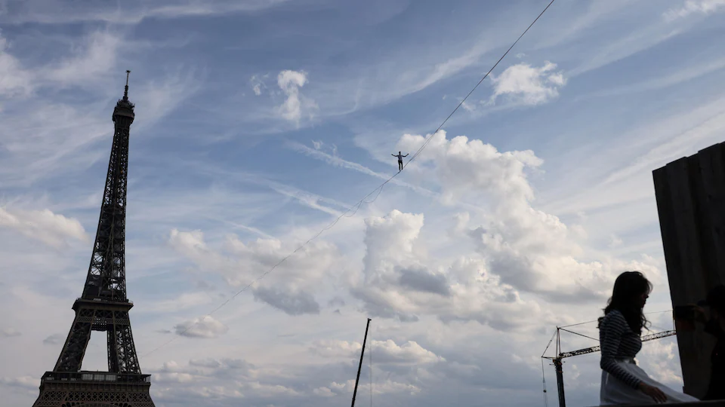

Slide 7
I The pedagogical contract
Informative field
Educational field
The impossible balance
II The teaching of "military language"
Military knowledge belongs to the military
The French language belongs to French speakers
III Redefining relationships in the learning space
The stakeholder/teacher relationship
The teacher/student relationship

Slide 8
Informative field
Educational field

Slide 9
Informative field
Educational field

Slide 10
Informative field
Educational field

Slide 11
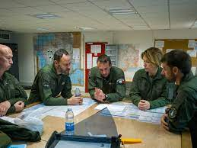
Military knowledge belongs to the military
The centripetal configuration
The French language belongs to French speakers
The centrifugal configuration

Slide 12
Military knowledge belongs to the military
The centripetal configuration
The French language belongs to French speakers
The centrifugal configuration

Slide 13
I The pedagogical contract
Informative field
Educational field
The impossible balance
II The teaching of "military language"
Military knowledge belongs to the military
The French language belongs to French speakers
III Redefining relationships in the learning space
The stakeholder/teacher relationship
The teacher/student relationship

Slide 14
Stakeholder =
employer
Curriculum, classroom visits…
Teacher
=
workforce
textbooks, marks or grading
students

Slide 15
Stakeholder =
selector
select a provider
and
delegate a mission
emancipation and reappropriation
teacher & students
=
co-designers
Mission
no curriculum, no classroom visits…
no textbooks, no marks or grading…

