Slide 1
Redefining relationships in the learning space
PART II

Slide 2
Legal constraint
Focus on the nexus between stakeholders and the learnings
More autonomy in the learning space
1
2
3

Slide 3
Contracting self-employed teachers
Flexibility
Numbers
Planning and adapting activities
Choosing who you work with and continue to work with

Slide 4
Precarious short-term contracts
Legal risk
Contracting
approach
Outsourcing approach
Purchase teaching services from any company (multinational to small businesses and free-lancers)
No compliance risks
Mindset shift

Slide 5
External decision-makers
Learning outcomes
?
Motivation
Teacher / Learning facilitator
Learners
Pedagogy

Slide 6
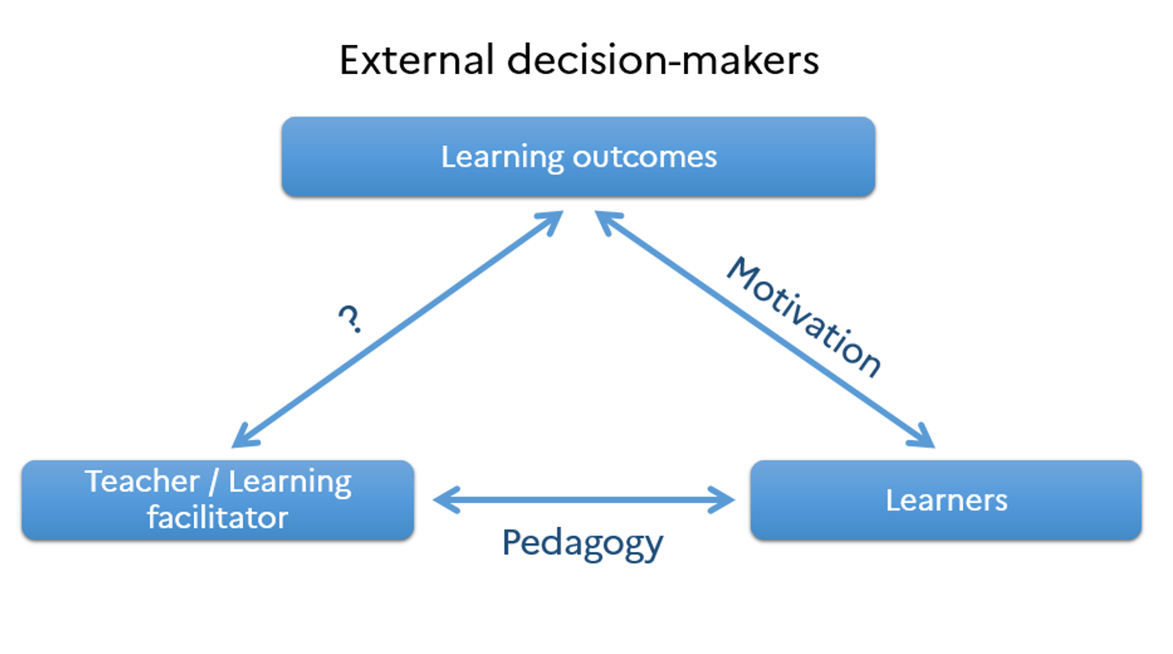
PAST
PRESENT
Delivered by employees
Ownership
&
Autonomy

Slide 7
The teachers must have
A masters degree from an English-speaking university
A qualification to teach English as a second language
Writing / debating / leadership coaching experience
Relevant experience

Slide 8
Operating with freelancers
≠
Operating with full-time employees

Slide 9
Benefits
More open to travel and participate in innovation projects
More autonomy for the teachers
Healthier and more effective relationship between teachers and students

Slide 10
Questions?

