Slide 1
Digital Training in the French Air and Space Force
BILC CONFERENCE
LORETO, ITALY
2022
French (DRHAAE) presentation

Slide 2
PRESENTATION OUTLINE
How digital training is integrated
A. In the French Air and Space Force
DRHAAE 4.O project
Smartschool and Digital Factory schemes
@irlearning digital platform
PIX learning tool
B. In foreign languages teaching and learning
Online distance English learning
NCOs and troops online distance English learning
Language laboratory
Use of applications
2. Limitations, perspectives and ongoing projects
In the French Air and Space Force
Designing resources
Cyber security limitations
Internet access restrictions
Cultural challenges
Smartschool: a scaling up project
B. In foreign languages teaching and learning
Language laboratory exploitation
Designing digital resources
Mobile app for aircraft mechanics
Distance evaluation

Slide 3
Introduction
Training = one of the 6 fundamental capacities in the FASF
Priority: to maintain a high level of expertise in a context of restructuration and modernisation + Operational requirement.
Challenges:
Able to serve anytime, anywhere (joint/combined)
Specialist
New generation = new expectations
Digital training naturally
integrated in the traditions of the FASF
and its modernisation process
Command & Control
Intelligence
Immediate response
Deployment
Training
Security & Protection

Slide 4
How digital training is integrated…
… in the French Air and Space Force
The DRHAAE 4.O project:
A transformation programme to improve our HR performance at the service of the relationship between the manager and the airman
« Inspire more confidence and transparency & encourage skills promotion »
GOALS:
Reduce the attrition rate by 25% per training course,
Reduce the attendance time of students,
and the theoretical duration (from 5% to 10%),
More modularisation of teaching programs
(14 workshops to be delivered in 2022)
Use of technology:
SMARTSCHOOL PROJECT
3 WAYS :
Training adaptation to future weapons systems
Individualisation of the training offer
Optimising teaching techniques
Notes:
Le programme DRHAA 4.0 vise à moderniser l’ensemble des « processus RH [recrutement, formation, gestion, valorisation des compétences, etc.] pour servir la politique de l’armée de l’Air en matière de fidélisation et d’attractivité », tout en mettant l’aviateur au cœur de toutes les initiatives à venir.

Slide 5
How digital training is integrated…
… in the French Air and Space Force
Smartschool schemes (1/2)
Attractivity and retention asset
High technology adequacy
Individualisation
of the training offer
Modernisation of teaching tools
Continuum of training
Creativity and innovation
Continuous Digital growth
Optimisation and simplification
Resilience
Notes:
Digital :
- Is a remarkable asset in terms of retention and attractivity towards the young generation
Allows for a better differentiation and an individualisation of the training offer– central factor of attractivity and retention
Contributes the continuum between basic, specific and professionnal training (continuing education) as well as apprenticeship / mentoring …
- FASF should follow the continuous digital growth within education fied and more generally within civilian society
Digital suits the needs of weapons systems high level training used in the Air and space force
Is an essential accelerator of the modernisation and transformation of teaching tools within the air and space force
- Stimulates creativity and innovation
Optimises teaching by the pedagogical power of the digital – notion of sensible digitalisation and digital simplification
- The pandemic has also showed the need to improve the resilience of training. Digital is a good way to face the constraints of the COVID crisis

Slide 6
How digital training is integrated…
… in the French Air and Space Force
Smartschool schemes (2/2)
TRAIN
Moodle
COMMUNICATE
COLLABORATE
MONITOR
Statistics
Flash news
Chat
Blog
Forum
Visioconference
Address book
Documents
Wiki
Open Office suite

Slide 7
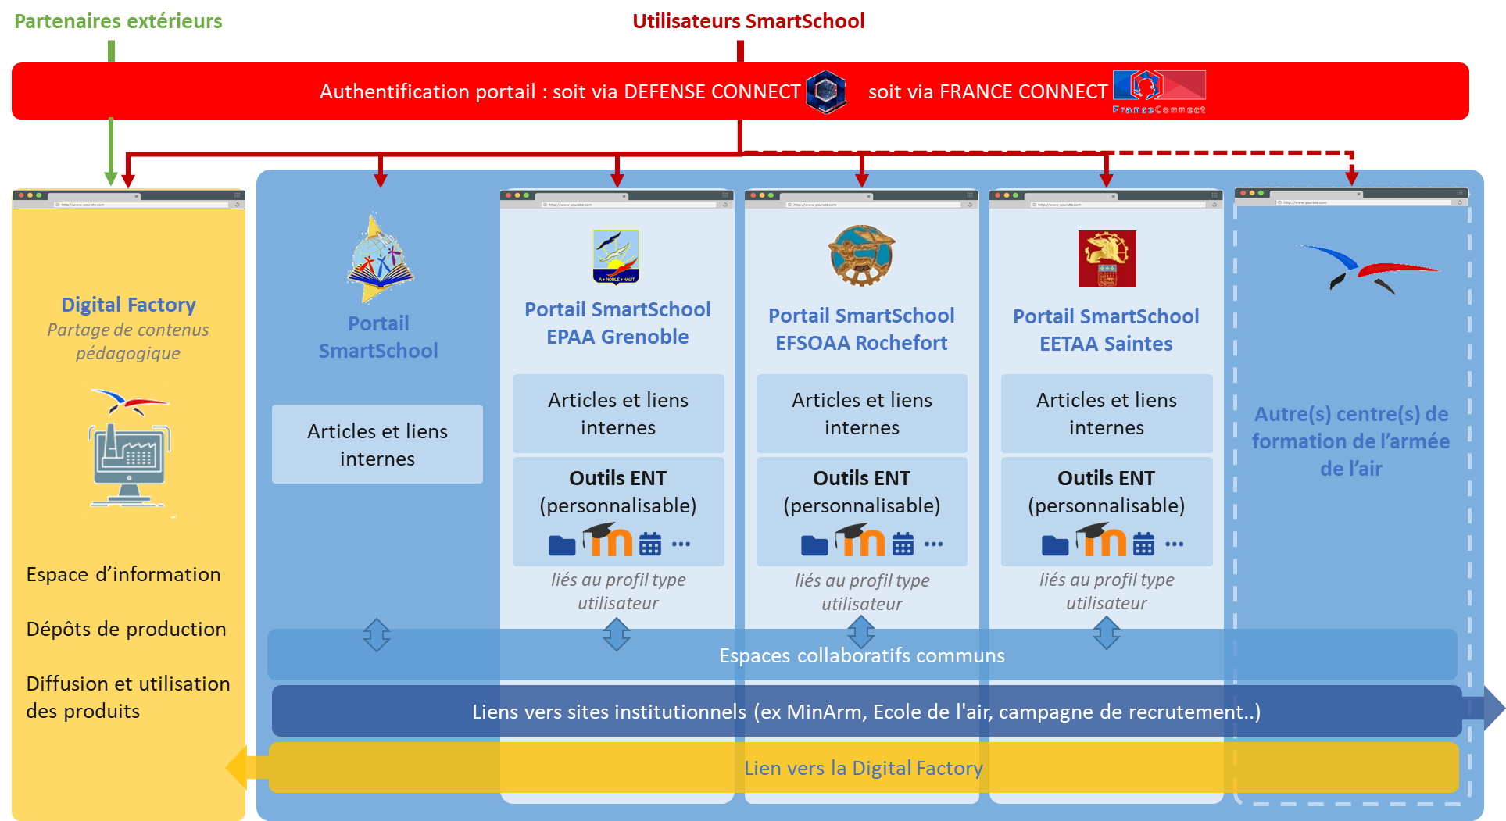
The SmartSchool services portal
Portal accessible via internet
Personalised spaces for schools and training centers
Communication spaces
Teamwork
Virtual classes
Educational tools
Reporting tool
A mobile app linked to the Digital Factory

Slide 8
The Digital Factory
THE OBJECTIVE OF THE DIGITAL FACTORY IS TO SUPPORT THE SMARTSCHOOL PROJECT (DIGITALISATION OF TRAINING) VIA 6 WAYS :
MANAGEMENT AND ANIMATION OF THE INTERNAL ECOSYSTEM
STRUCTURING PROJECTS MANAGEMENT
MANAGEMENT AND COORDINATION OF THE DIGITALISATION APPROACH
MANAGEMENT OF DIGITAL CONTENT AND ANIMATION OF THE EXTERNAL ECOSYSTEM
DIGITAL PEDAGOGICAL MONITORING
COMMUNICATION

Slide 9
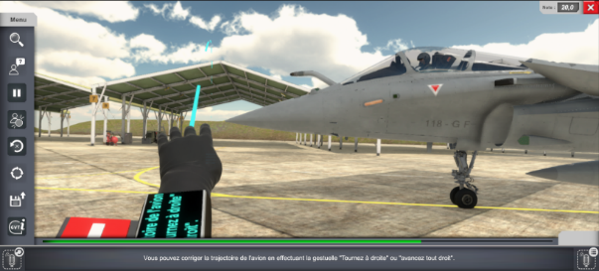
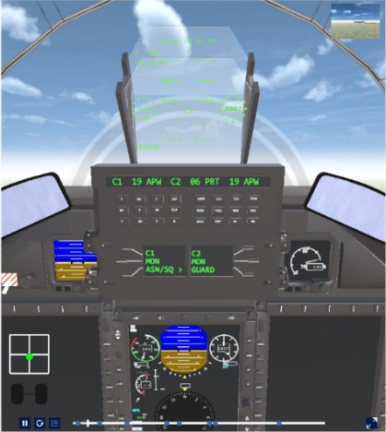
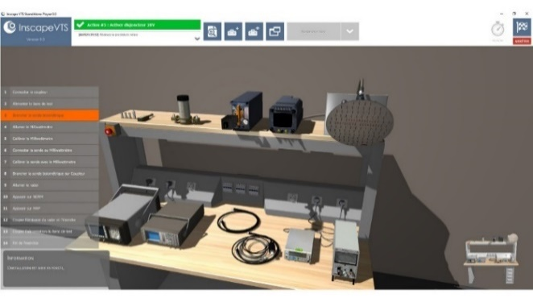
Aeronautical maintenance
NCOs initial training
The use of virtual reality: Marshelling workshop
Curation of teaching contents on the internet (open source)
3D modeling of equipment
Basic military training of NCO’s
Presentation of small arms training technical system (shooting simulator)
Distance learning during pandemic
Use of digital tools for evaluation
Flying training
Use of EFB (Electronic Flight Bag) et LMS (Learning Management system)
Distance learning for pilot and air navigation trainees
The use of virtual reality: missions preparation, mentalising
Ethic, Airmanship, leadership, military values
Notes:
In 2021 creation of a website hosting digital pedagogical modules dedicated to basic training schools using for example virtual reality…
3 topics regarding the initial training of NCOs on aeronautical maintenance :
The use of Virtual Reality (feedback on last achievements);
Curation of teaching contents on the internet (open source) (presentation of the process with ideas on sharing the identified sources);
3D modeling of equipment (softwares being used, modeling methods/production techniques, examples of 3D modeling)

Slide 10
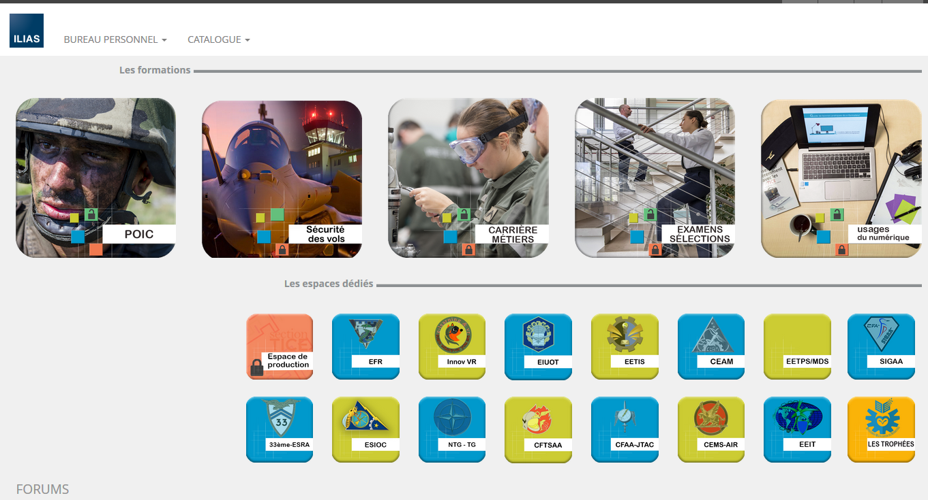
How digital training is integrated…
… in the French Air and Space Force
@irlearning digital platform
Keys features :
Training tool
Open to every Air entity
Qualifying training
About 20,000 connections per month

Slide 11
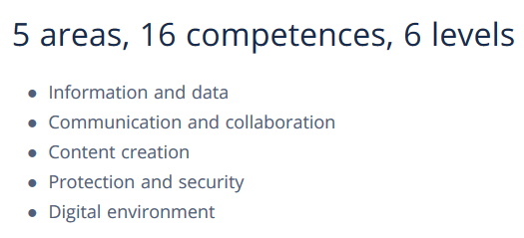
How digital training is integrated…
… in the French Air and Space Force
PIX learning tool:

Slide 12
How digital training is integrated...
… in foreign languages teaching and learning
Online distance English learning
Keys features :
Approx. 400 learners per year,
06 months + 1 TOEIC test after the training,
Registrations all along the year,
Customised training, based on a diagnostic assessment
Online distance English learning
for NCOs and troops
Key features:
About 900 registrations/year,
Efficient blended learning (face to face + MyCow)

Slide 13
How digital training is integrated...
… in foreign languages teaching and learning
Online distance Arabic learning
Key features:
Specific need : for commandos / Special forces
Specific training : focused on oral expression and comprehension

Slide 14
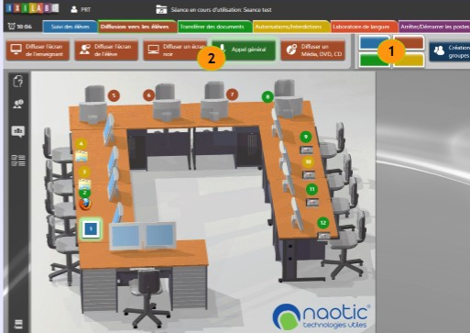
How digital training is integrated...
… in foreign languages teaching and learning
Language laboratory
The CLAS:
(Aeronautical English language centre)
Tours-based,
Expert teachers in technical and aeronautical English
13 language centres -> 13 labs,
Connected to Intradef (ARIAL project),
Teaching support provided by the CLAS
Use of softwares and applications
English training softwares (ATACOM…),
Moodle

Slide 15
Limitations, perspectives and ongoing projects…
… in the French Air and Space Force
Designing resources
Cyber security limitations
Internet access restrictions
Cultural challenges
Smartschool: a scaling up project

Slide 16
Limitations, perspectives and ongoing projects…
… in foreign languages teaching and learning
Language laboratory exploitation
Designing digital resources
Reluctance towards change
Mobile app for aircraft mechanics
Distance evaluation

Slide 17
Questions ?

