Slide 1
The Defence Force School of Languages
Defence Force School of Languages
Wing Commander Paul Deighton
Commanding Officer

Slide 2
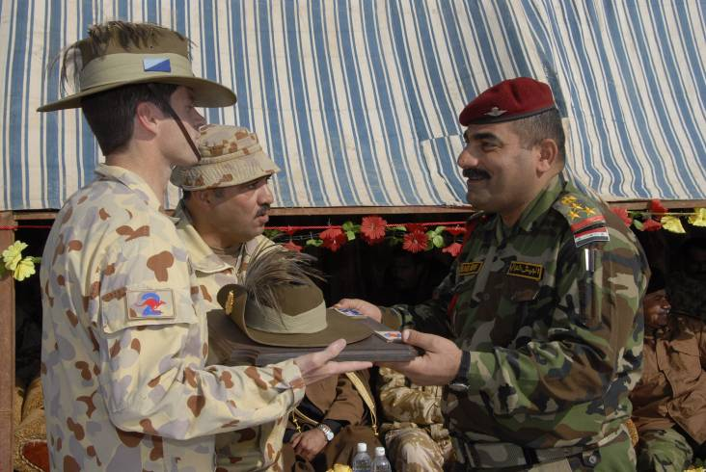
DFSL Mission
To train and assess Defence personnel
in languages other than English
to enhance Defence capability.
Defence Force School of Languages

Slide 3
2017 Courses
Long Courses
Short Courses
Strategic Engagement (SE)
46 weeks
Chinese, Indonesian, Japanese, Thai
Joint Tactical Interaction (JTI)
5, 8 or 10 weeks
Arabic, French, Indonesian, Malay, Pashtu, Dari, Tetum, Tok Pisin,
Operational Engagement (OE)
36 or 38 weeks
Arabic, French, Malay, Korean, Portuguese, Tetum, Tok Pisin (16 wks)
Refresher
2 weeks
For graduates – 24 in 15 languages in 2016
Defence Force School of Languages
Military Communication Skills
22 weeks
Specialist courses for trades
Basic / Conversion
12 weeks / 5 weeks
Filipino, Khmer / Javanese, SI Pijin
General Language (GL)
46 weeks
German, Spanish, Vietnamese
All SE, OE, GL and Bridging courses conduct in-country training for two weeks

Slide 4
BILC SharP Update
Currently 104 participants from 14 countries enrolled into BILC SharP platform:
Turkey, Moldova, Netherlands, Estonia, Netherlands, Italy, France, Spain, Sweden, Macedonia, Germany, UK, Ukraine, Australia
Enrolled members are checking and downloading available resources
Latest contribution is from our colleagues from Spain!
Reminder: For the platform to be functional/useful – we need your contributions!
Contact: DFSL.BLCell@defence.gov.au
Notes:
BILC SharP (Resource Sharing platform) is one of many Moodle instances DFSL offers though its Learning Management System.
Created in 2015 for all BILC members. Idea behind it: for everyone to share successfully trialled military language training materials so that other BILC members could benefit from these resources. So this platform is supposed to serve as the online repository of successfully trialled resources from all participating countries. Apart from avail resources members can use forum, messages and calendar features available.
Just a reminder: any staff member from your organisations can gain access to BS.
BILC SharP POCs responsibilities:
- Provide DFSL with enrolment details for their staff: full name, country and official/work email address
- Collate any resources your organisation wishes to share with fellow BILC members
- Forward those resources to DFSL via email/DropBox/post
- Disseminate information to your staff if needed
- Let us know if any of your staff leave their job/posting so that we can de-activate their account
Please provide feedback to us on the format, folder structure, usefulness of uploaded materials, etc.
…So if you are willing to share some materials with your fellow BILCers, please contact us. I have a few copies of the new BILC Communiqués here for those of you who haven’t received an electronic copy last week.

Slide 5
Our problem….
Notes:
So now to my problem….
This is the status of LOTE within the Australian Defence context

Slide 6
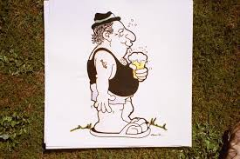
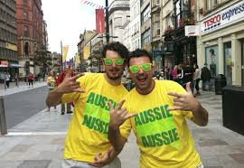
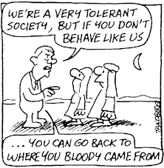
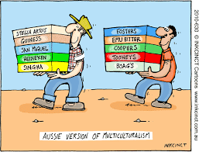
Our problem….
Notes:
We have a white Anglo-Saxon, English-speaking heritage which is our greatest impediment to cultivating a sufficient LOTE capability within Defence.
It is a societal contradiction – 28 % of Australians were born overseas and over 40 % have a parent who was born overseas however, our education system has struggled for decades developing a LOTE curriculum that was consistently applied across the country.
The Australian Defence Force demographic does not reflect the wider community. The percentages of ADF members born overseas is far less than in society.

Slide 7
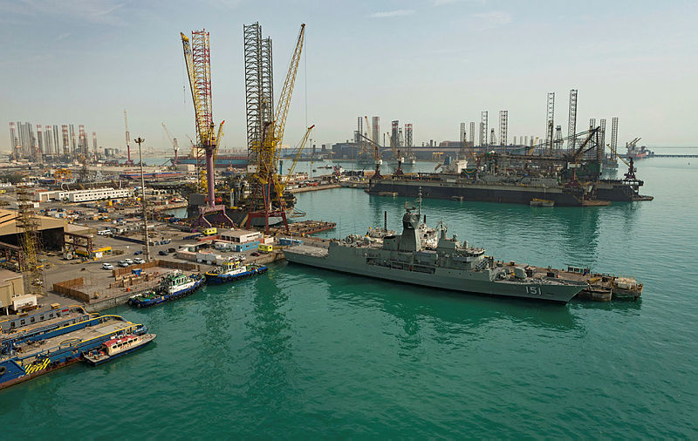
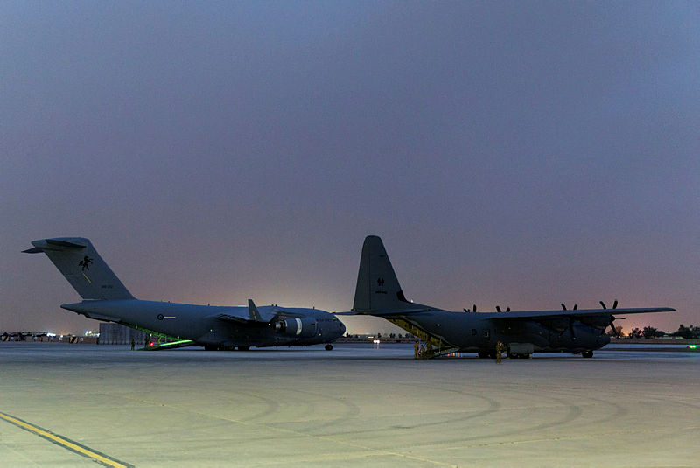
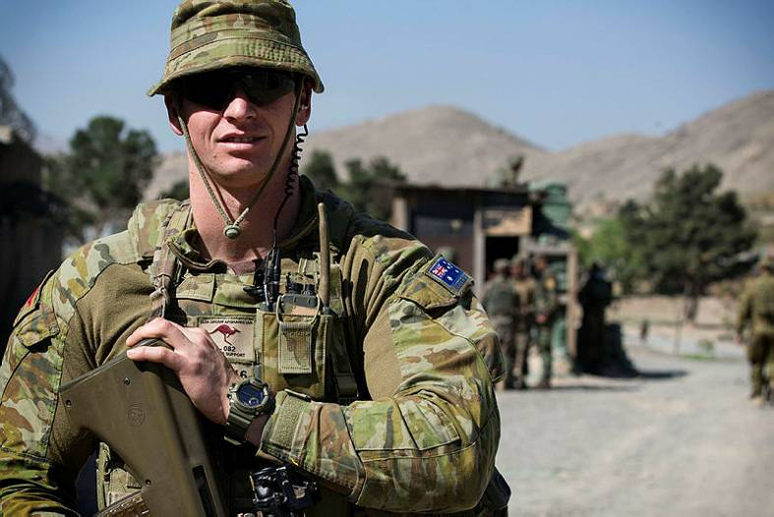
Not our problem….
Notes:
To a degree, this then manifests itself as an issue for developing the LOTE capability in the ADF:
Everyone else speaks English so we don’t need LOTE
There are too many languages that we could potentially need in our region
We are too small to have and maintain dedicated linguist streams of employment
We’ve got by so far without needing an improved LOTE capability
We can contract any linguists we need
It takes too long and is too costly to train someone up outside their normal trade
It doesn’t help me drop my bombs or fight my ships

Slide 8
Why it is my problem….
An organisational performance requirement is analysed and the most appropriate intervention specified
The intervention is measured for its effectiveness in addressing the organisational requirement
The best options for implementing the intervention are selected and designed.
A learning intervention is implemented in the workplace or learning/training establishment.
The materials and equipment required in order to implement the intervention are prepared and tested
Notes:
This is our Systems Approach to Defence Learning with the five stages of the training cycle

Slide 9
Why it is my problem….
An organisational performance requirement is analysed and the most appropriate intervention specified
The intervention is measured for its effectiveness in addressing the organisational requirement
The best options for implementing the intervention are selected and designed.
A learning intervention is implemented in the workplace or learning/training establishment.
The materials and equipment required in order to implement the intervention are prepared and tested
Notes:
For LOTE, my school is responsible for these two. And we do it pretty well with our course development and implementation
I am very conscious that we could use world’s best practice….but if it does not suit the Defence need, then we are wasting our time and using a lot of resources and opening ourselves up for criticism
It is like crafting the finest size 10 shoe – when we need size 12
This is why I have realised that I have to tackle the analyse, design and evaluate phases. Part of addressing the Analyse phase is educating decision-makers in Defence of the LOTE capability required. I am way outside my lane here but I worked out quickly that the LOTE capability is very much a bottom-up driven capability in the Australian context

Slide 10
A LOTE Capability for Defence
Tactical
Operational
Strategic
Mentoring/ training host nation forces
Senior Leadership Engagement
Attache roles
Engagement with locals
Civil-Military Cooperation
Intelligence
Delegation visits
De-briefing / docmt analysis
Intelligence
Liaison with host nation forces
Industry liaison & acquisitions
Exercises
ISR
Force protection/CI
Liaison with coalition forces
Education and staff college attendance
Logistics
CI
Border Protection
Human’n Asst Disaster Relief
Notes:
These are some of the roles where a LOTE capability is required to enable us to achieve our objectives. I compiled this knowledge of PORs, my own experiences, and talking with some other linguists.

Slide 11
A LOTE Capability for Defence
Tactical
Operational
Strategic
Mentoring/ training host nation forces
Senior Leadership Engagement
Attache roles
Engagement with locals
Civil-Military Cooperation
Intelligence
Delegation visits
De-briefing / docmt analysis
Intelligence
Liaison with host nation forces
Industry liaison & acquisitions
Exercises
ISR
Force protection/CI
Liaison with coalition forces
Education and staff college attendance
Logistics
CI
Border Protection
Human’n Asst Disaster Relief
Notes:
Unfortunately, most people only consider the three in yellow when thinking about LOTE requirements – which is just the tip of the iceberg. Just because we have survived this far without using LOTE in these contexts, doesn’t mean we shouldn’t be.
There is a flaw to this structure though:
As an attache, I had some very tactical conversations with PLA and with other attaches about the PLA eg Russians
Soldiers engaging at the tactical level can have strategic effects
Our pers in the strat agencies can work at the tactical and operational level – so the delineation is not so clear cut.
What actually happens in our context is that we train someone from any service on our long courses and then expect them to handle all contexts

Slide 12
White Paper 2016 Implications
Paragraph 6.31:
Defence will increase the number of personnel with intermediate and advanced language skills to support our enhanced international engagement with a focus on languages in the Indo-Pacific region
Paragraph 6.9:
Defence will gradually increase the numbers of overseas military attaches to support the program of enhanced international engagement
Student numbers for 2016 and 2017 and forecast for 2018:
Defence Force School of Languages
 | 2016 | 2017 | 2018 (Planned)
Arabic | 6 | 8 | 10
Chinese | 9 | 11 | 15
Indonesian | 49 | 51 | 72
Japanese | 6 | 7 | 11
Korean | 3 | 4 | 11
Vietnamese | 2 | 7 | 9
Notes:
There is some cause for optimism though because of our latest white paper
And this is translating into increased numbers on course – but that still doesn’t address for me whether we are still capability-focussed.

Slide 13
A LOTE Capability for Defence
A LOTE Capability is required for three domains (all categories on previous slide fit under these three headings):
Intelligence
International Engagement
Operations and Operational Support
A LOTE capability requires a long-term strategy:
It takes a number of years to develop a linguist to an experienced level of proficiency that can handle varied contexts
Technology can aid but not supplant a linguist
Cultural competence can go hand in hand with LOTE competence.
It can present as a single point of failure, or success
Notes:
So now my briefs to any visitors to the school including senior officers (Deputy Chief of Army) spends half the brief on the capability requirement and the other half on the school.

Slide 14
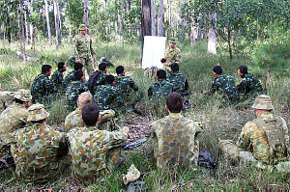
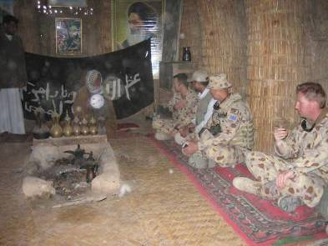
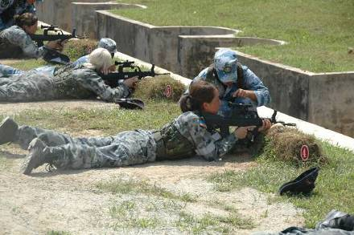
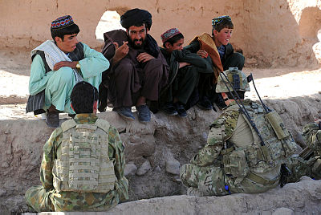
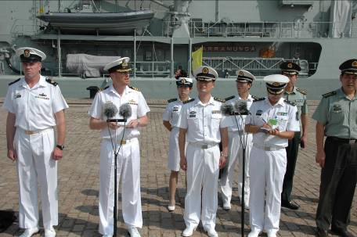
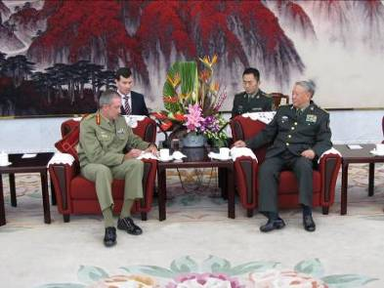
A LOTE Capability for Defence
We need a mindset that doesn’t expect everyone we deal with to speak our language
We need a mindset that is hungry to know what we have missed out on because we don’t speak our host’s language or know their culture.
We need a mindset that is not biased towards understanding technical capability against understanding the people capability
We need a mindset that respects our partners – the greatest respect we can show our partners is to speak their language and show knowledge of their cultural practices
Defence Force School of Languages
Notes:
I argue international engagement means that we operate seamlessly across the globe enabled by LOTE and to do that we need …
The greatest difficulty is articulating the need and convincing seniors that a LOTE capability will enhance our ability to operate seamlessly across the globe to achieve our objectives

Slide 15
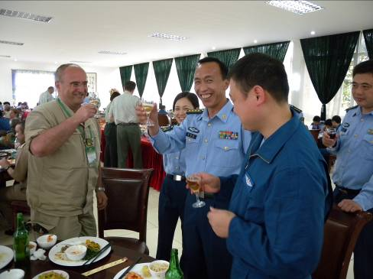
Comments…

