Slide 1
Tactical Considerations Prior to Deploying Computers in Language Testing
NATO BILC Conference
22-27 May 2022
z
Troy L. Cox, PhD
Associate Professor, Linguistics
TESOL MA Graduate Coordinator
Associate Director Research and Assessment Center for Language Studies (2013-present)
Technology and Assessment Coordinator at the English Language Center (1996-2013)
Brigham Young University

Slide 2
Get out your phone or computer and open the http://bilc.home QR code on the back of your badge. Login: <email address> Password: 123 Be prepared. You will be tested soon.

Slide 3
Who is Troy Cox?
•Disciple •Husband •Father •Amateur Cyclist, Yogi, Cook, Photographer & Boston Terrier Breeder •Professor (Applied Linguistics/Testing) at Brigham Young University

Slide 4
#MyRelationshipWithTechnology
What MOVIE title best represents your relationship with technology?
Get in small groups and discuss your title. Why did you choose it?
You have 3 minutes to complete this task.
Post it in BILC/HOME

Slide 5
Adopting a New Technology: A Cautionary Tale
z

Slide 6
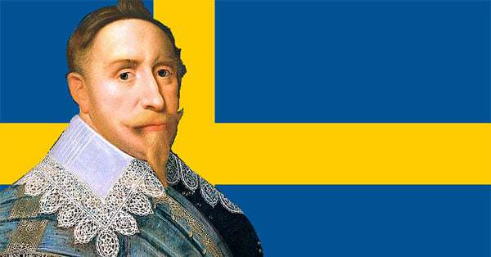
Gustavus Adolphus of Sweden
Notes:
“The gunpowder king” isn’t an official moniker for Gustav like “Lion of the North” is, but it is certainly fitting. Gustav was a master at developing gunpowder technology and tactics, but Sweden was already heading full-steam in this direction when he took the throne.
Cannons needed iron or bronze, and a lot of it. Sweden just so happens to be rich in such materials. But early cannons needed skilled craftsmen, inventors, and technicians. Initially, Sweden didn’t have too many of these skilled laborers, but again the religious strife comes into play.
Early gunpowder use in Europe was quite often a mess. Infantry had a mix of spears and muskets, crossbows, Arquebus’ and more. Artillery was heavy and static, often the cheap and plentiful cast iron variety that was inaccurate and might just explode and kill the crew. Most armies had mercenaries or levy troops that formed bulky lines dozens of ranks deep. Defensive formations were the norm and outside of the continual advancements in firearms, little innovation occurred.
Gustav radically changed the status quo and formed his army into a unique fighting unit that was unlike any other in Europe. A believer in swift offensive attacks, Gustav’s first major change was turning the usually static artillery into a mobile unit.

Slide 7
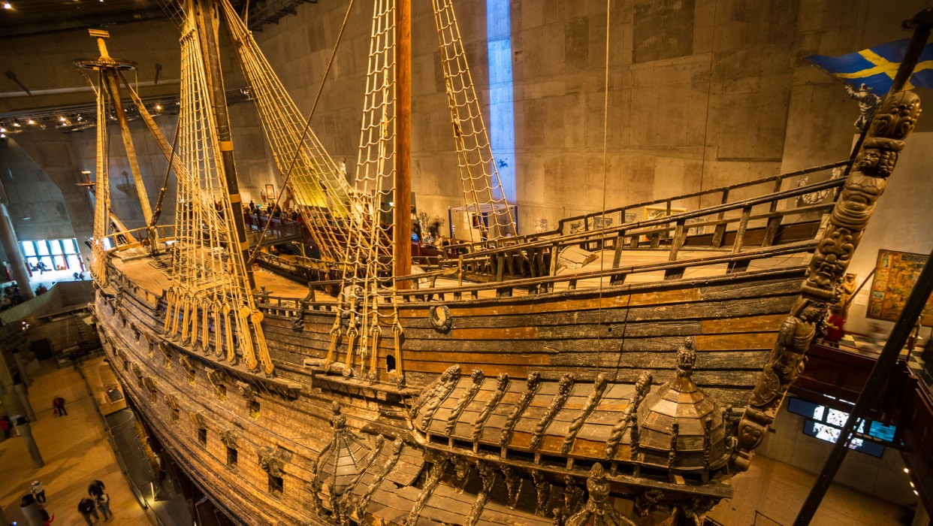
Vasa
Notes:
Sinking of the Swedish Warship, The Vasa
The Vasa was a Swedish warship built between 1626 and 1628. The ship sank after only sailing roughly 1,400 yards into its maiden voyage on August 10, 1628. Now, resurrected from the sea, the Vasa represents a widely-recognized symbol of the Swedish “great power period.” Vasa is now housed permanently in a museum dedicated to her, the Vasa Museum, and is one of Sweden’s most popular tourist attractions with more than 35 million visitors. While Vasa is triumphant today, her seafaring was not. What caused this ship to sink?
The Vasa was built on the orders of King of Sweden Gustavus Adolphus. Hoping to expand his military, Adolphus initiated a war with Poland-Lithuania. The Vasa was constructed in the navy yard in Stockholm and armed with bronze cannons. At her completion, the Vasa was one of the most powerfully armed vessels in the world. However, all that armor made the Vasa dangerously unstable and too much weight was placed in the upper structure of the hull.
King Adolphus was eager to send Vasa out; he was leading the army in Poland and wanted Vasa to take up station as a flagship in Älvsnabben, a small archipelago south of Stockholm. The King’s subordinates, who may have realized the unstable weight, lacked the courage to openly speak about some of the ship’s issues or to make a motion to suggest a postponement of the ship’s departure. As a result, the Vasa quickly sank when faced with a breeze.

Slide 8
Cycles in Technology
Gartner Hype Cycle
Technology Adoption Lifecycle (Rogers, 1962)

Slide 9
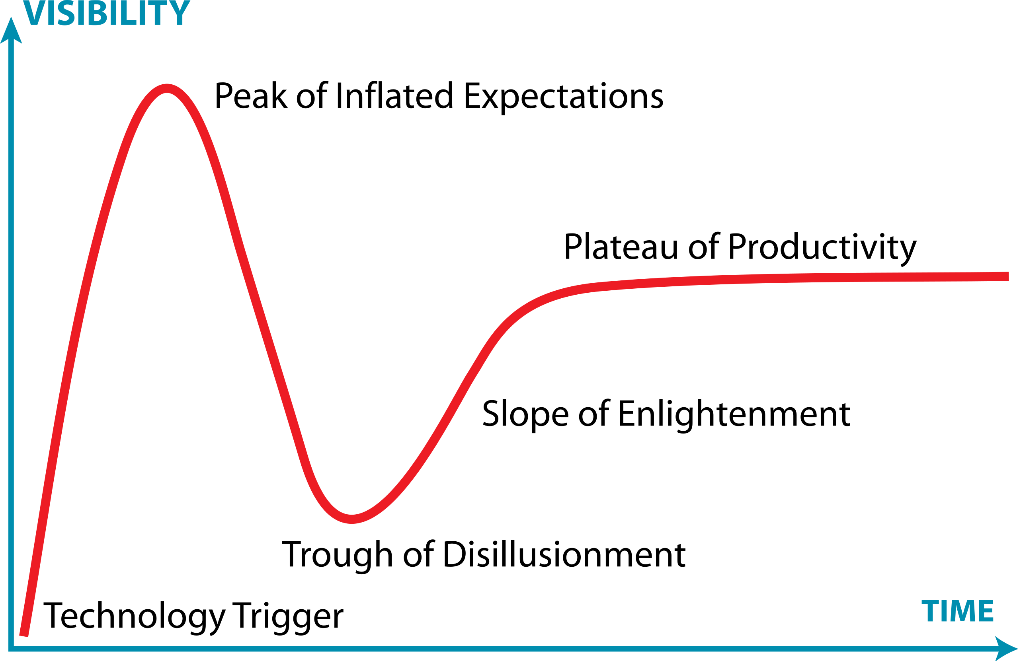
Gartner Hype Cycle
Notes:
When new technologies make bold promises, how do you discern the hype from what’s commercially viable? And when will such claims pay off, if at all? Gartner Hype Cycles provide a graphic representation of the maturity and adoption of technologies and applications, and how they are potentially relevant to solving real business problems and exploiting new opportunities. Gartner Hype Cycle methodology gives you a view of how a technology or application will evolve over time, providing a sound source of insight to manage its deployment within the context of your specific business goals.
How do Hype Cycles work?
Each Hype Cycle drills down into the five key phases of a technology’s life cycle.
Innovation Trigger: A potential technology breakthrough kicks things off. Early proof-of-concept stories and media interest trigger significant publicity. Often no usable products exist and commercial viability is unproven.
Peak of Inflated Expectations: Early publicity produces a number of success stories — often accompanied by scores of failures. Some companies take action; many do not.
Trough of Disillusionment: Interest wanes as experiments and implementations fail to deliver. Producers of the technology shake out or fail. Investments continue only if the surviving providers improve their products to the satisfaction of early adopters.
Slope of Enlightenment: More instances of how the technology can benefit the enterprise start to crystallize and become more widely understood. Second- and third-generation products appear from technology providers. More enterprises fund pilots; conservative companies remain cautious.
Plateau of Productivity: Mainstream adoption starts to take off. Criteria for assessing provider viability are more clearly defined. The technology's broad market applicability and relevance are clearly paying off.
Hype Cycles help you:
Separate hype from the real drivers of a technology’s commercial promise
Reduce the risk of your technology investment decisions
Compare your understanding of a technology’s business value with the objectivity of experienced IT analysts

Slide 10
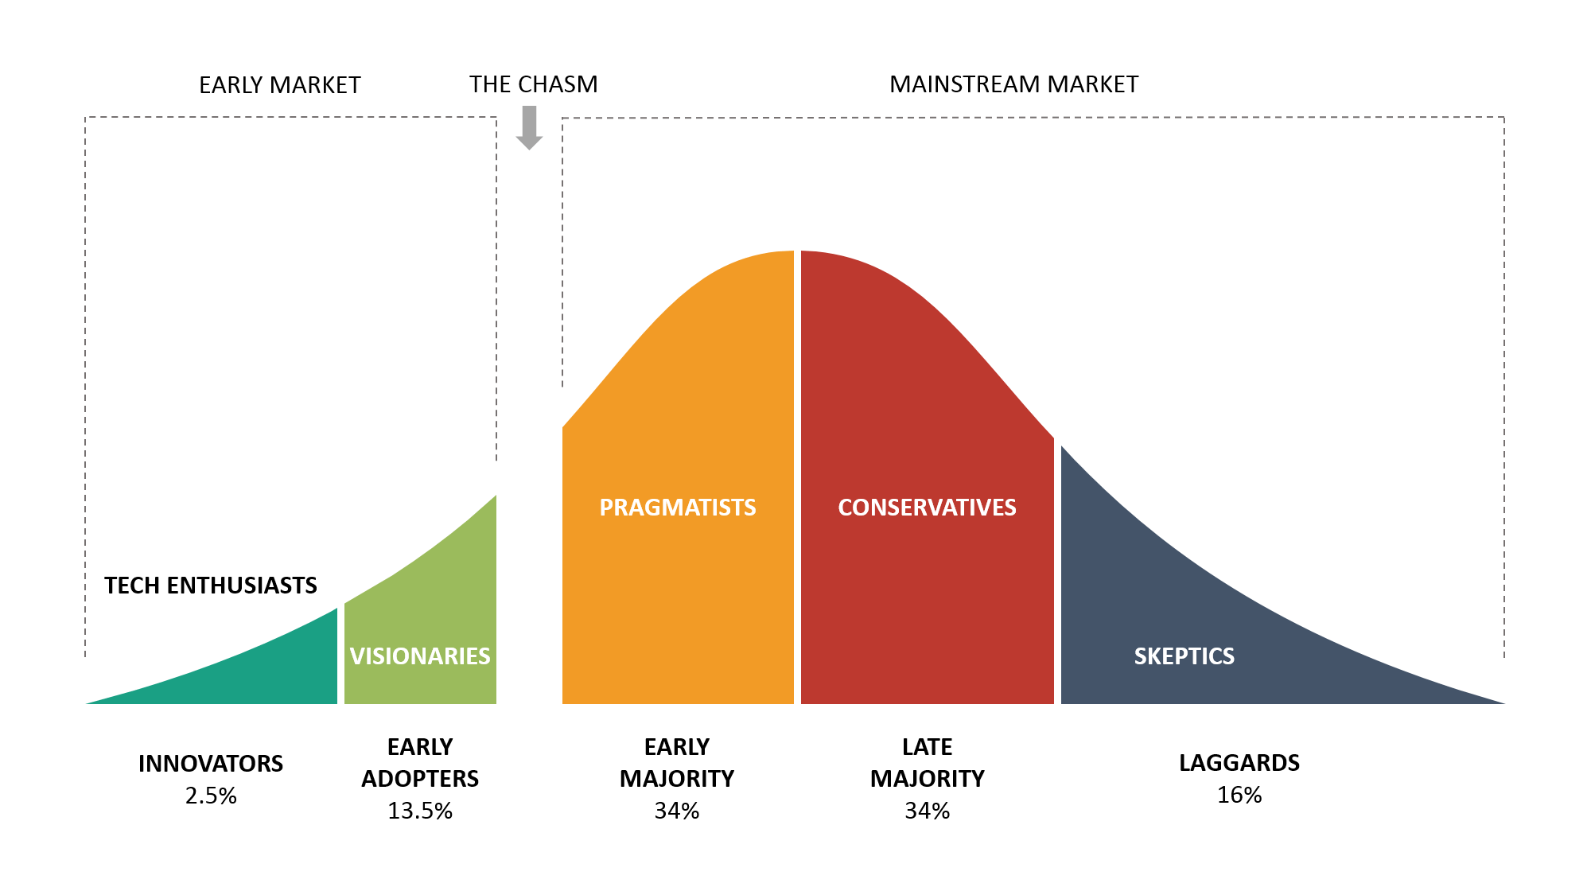
Technology Adoption Lifecycle (Rogers, 1962)

Slide 11
Navigating the Chasms

Slide 12
Results of Survey
How many people were successful using the technology?

Slide 13
Technology and Language Testing
Classroom
Program-wide
Tests are low stakes
Easy to experiment
Failures are often unnoticed
Tests are high stakes
Harder to experiment
Failures are highly visible

Slide 14
A Non-Exhaustive List of Things to Consider prior to Deploying Computer-Based Testing
Physical Set-up
Test Creation
Test Security
Test Administration
Test Scoring
Test Reporting
Item Validation
Adaptive Testing

Slide 15
Physical Set-up
What resources are needed to start testing with computers?
z

Slide 16
Physical Set-up
Do you have the funds for computers?
Do you have a network with access to servers?
If not, are you prepared to distribute and gather results one at a time?
Do you have the technical expertise to set up the computers?

Slide 17
Physical Set-up (Cont.)
Do you have (or have access to) the technical expertise to install the software?
Do you have a way to restrict the IP addresses of the computers (client and server) to improve test security and reduce the likelihood of external, unauthorized access?

Slide 18
Test Creation
What resources are needed to create computerized tests?
z

Slide 19
Test Creation
Do you have the funds for the software to create the tests?
Is there existing software?
How will you support it?
If hiring a programmer, what steps need to be taken to ensure continuity of the product?

Slide 20
Test Security
What you do need to do to ensure your tests are secure?
z

Slide 21
Test Security
Do you have a plan on how your items will be secure and less likely to be compromised when stored and accessed digitally?
Do you have a Non-Disclosure Agreement (NDA) for anyone that will have access to the items?

Slide 22
Test Security (cont.)
Do you have end user and proctor agreements in place to safeguard item integrity?
Do you have a system in place to check-in students and ensure the identity of the test-taker?

Slide 23
Test Administration
What resources are needed to administer computer-based tests?
z

Slide 24
Test Administration
Do you have adequate staffing (proctors, tech support) to ensure smooth test delivery?
Do you have system in place to log problem or irregularities that occurred?

Slide 25
Test Administration (cont.)
Do you have adequate numbers of devices (including accessories like headphones) to serve your testing circumstances?
Do you have any back-ups for equipment failure?

Slide 26
Test Scoring
How will responses will be scored/graded?
z

Slide 27
Test Scoring
Do you have a system in place to store results in a central location such as a server?
If not, do you have staffing to move from machine to machine to copy results to a portable drive?
Do you have software to score the tests automatically?

Slide 28
Test Scoring (Cont)
Do you have software to assign raters to judge open-ended assessments such as speaking or writing?
Do you have a system to ensure the raters are assigned in a manner to minimize rater drift?
Do you have method to account for rater disagreement established?

Slide 29
Test Reporting
What decisions need to be made about reporting the results?
z

Slide 30
Test Reporting
Will the examinees receive their scores at the time they take the assessment?
If so, do you have a way to ensure answers aren’t exposed via brain dumps?
Will the examinees have an electronically secure method to receive their scores?

Slide 31
Item Validation
How easily can your items be validated for computer-based testing?
z

Slide 32
Some Terms
Test Specification (Blueprint)
Item Specification (Spec sheets)

Slide 33
Item Specifications
Contain
General Description
Instructions
Prompt Attributes
L1 or L2
Timing constraints
Response Attributes
Sample Item
Instructions to assemble tests that maximize local independence
Be detailed enough that someone else can write an item based on the description

Slide 34
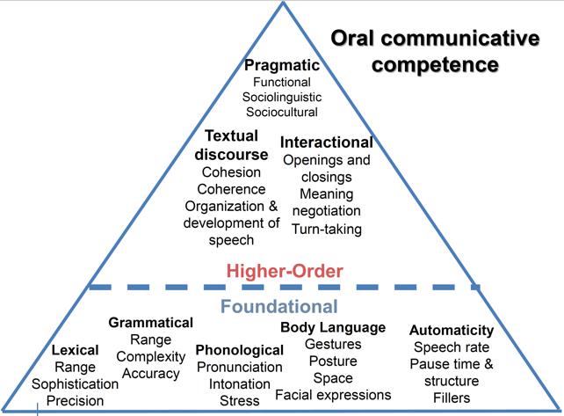
Item Development Considerations
Timing Parameters
Local Independence
Xi, 2016
Each item needs to act independently of all the other items.

Slide 35
Test Specifications
Total time
Number of items
Point values
Allocated time per item

Slide 36
Item Validation
Were item specifications used?
Did experts judge the items?
Were cultural sensitivity checks performed?
Were the items & instructions proofread or copy-edited?

Slide 37
Item Validation (Cont.)
Were items administered to ensure they are functioning as intended?
Did you keep an incident log to note any anomalies during trialing?
Were item statistics used to investigate anomalies?

Slide 38
Computer Adaptive Testing
Do you have all the pieces to move into Computer Adaptive Testing?
z

Slide 39
Computer Adaptive Testing
Does the validation process support the use of Item Response Theory?
Have you compared the strengths and weakness of the two types of testing?

Slide 40
Computer Adaptive Tests
Advantages
Disadvantages
Test is tailored to each examinee
Cheating by looking at neighbors is diminished
Test CAN be shorter
Item exposure can be reduced
Examinees can’t go back and change answers (local independence)
Development is MUCH more expensive
All items need to be calibrated prior to being included
Item exposure needs to be carefully monitored-some items might be overexposed due to ability of examinees
Examinees can’t go back and change answers (face validity)

Slide 41
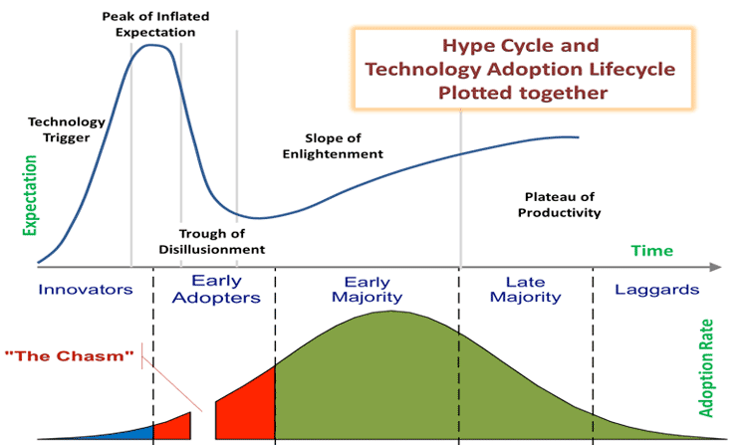
Self-Assessment Dunning-Kruger Effect
If you or your colleagues are very confident about your ability to start implementing testing on computers, you might be summiting the peak referenced above.

Slide 42
If there is a trough of disillusionment and a chasm when adopting new technologies, what should we do?
Before acting, ask some questions:
What leads us to that assumption?
Why do we think it is correct?
What might happen if we’re wrong?
What are the uncertainties in our analysis?
What are the disadvantages?

Slide 43
Remember the Vasa
It’s okay to wait.
You don’t have to be on the “bleeding edge.”
We will all fail with a new technology somehow, so plan for it.
Minimize the impact. Remember to breath.
Notes:
Sinking of the Swedish Warship, The Vasa
The Vasa was a Swedish warship built between 1626 and 1628. The ship sank after only sailing roughly 1,400 yards into its maiden voyage on August 10, 1628. Now, resurrected from the sea, the Vasa represents a widely-recognized symbol of the Swedish “great power period.” Vasa is now housed permanently in a museum dedicated to her, the Vasa Museum, and is one of Sweden’s most popular tourist attractions with more than 35 million visitors. While Vasa is triumphant today, her seafaring was not. What caused this ship to sink?
The Vasa was built on the orders of King of Sweden Gustavus Adolphus. Hoping to expand his military, Adolphus initiated a war with Poland-Lithuania. The Vasa was constructed in the navy yard in Stockholm and armed with bronze cannons. At her completion, the Vasa was one of the most powerfully armed vessels in the world. However, all that armor made the Vasa dangerously unstable and too much weight was placed in the upper structure of the hull.
King Adolphus was eager to send Vasa out; he was leading the army in Poland and wanted Vasa to take up station as a flagship in Älvsnabben, a small archipelago south of Stockholm. The King’s subordinates, who may have realized the unstable weight, lacked the courage to openly speak about some of the ship’s issues or to make a motion to suggest a postponement of the ship’s departure. As a result, the Vasa quickly sank when faced with a breeze.

Slide 45
The Lion of the North
Gustavus Adolphus
His integration of infantry, cavalry, logistics, and particularly his use of artillery, earned him the title of the "Father of Modern Warfare".
Notes:
“The gunpowder king” isn’t an official moniker for Gustav like “Lion of the North” is, but it is certainly fitting. Gustav was a master at developing gunpowder technology and tactics, but Sweden was already heading full-steam in this direction when he took the throne.
Cannons needed iron or bronze, and a lot of it. Sweden just so happens to be rich in such materials. But early cannons needed skilled craftsmen, inventors, and technicians. Initially, Sweden didn’t have too many of these skilled laborers, but again the religious strife comes into play.
Early gunpowder use in Europe was quite often a mess. Infantry had a mix of spears and muskets, crossbows, Arquebus’ and more. Artillery was heavy and static, often the cheap and plentiful cast iron variety that was inaccurate and might just explode and kill the crew. Most armies had mercenaries or levy troops that formed bulky lines dozens of ranks deep. Defensive formations were the norm and outside of the continual advancements in firearms, little innovation occurred.
Gustav radically changed the status quo and formed his army into a unique fighting unit that was unlike any other in Europe. A believer in swift offensive attacks, Gustav’s first major change was turning the usually static artillery into a mobile unit.

Slide 46
References
The Lion of the North: The Story of Gustavus Adolphus, Sweden’s Gunpowder King https://historycollection.com/lion-north-gustavus-adolphus-gunpowder-king-sweden/
Vasa or Wasa (Ship) https://en.wikipedia.org/wiki/Vasa_(ship)
Hype Cycle for Emerging Technologies https://amrapali.ac.in/blog/2020/03/29/hype-cycle-for-emerging-technologies/
5 Trends Drive the Gartner Hype Cycle for Emerging Technologies, 2020 https://www.gartner.com/smarterwithgartner/5-trends-drive-the-gartner-hype-cycle-for-emerging-technologies-2020
In a Nutshell: The Technology Adoption Lifecycle and Crossing the Chasm https://www.parkersoftware.com/blog/in-a-nutshell-the-technology-adoption-lifecycle-and-crossing-the-chasm/
Pirates of the Caribbean: The Curse of the Black Pearl https://en.wikipedia.org/wiki/Pirates_of_the_Caribbean:_The_Curse_of_the_Black_Pearl

