Slide 1
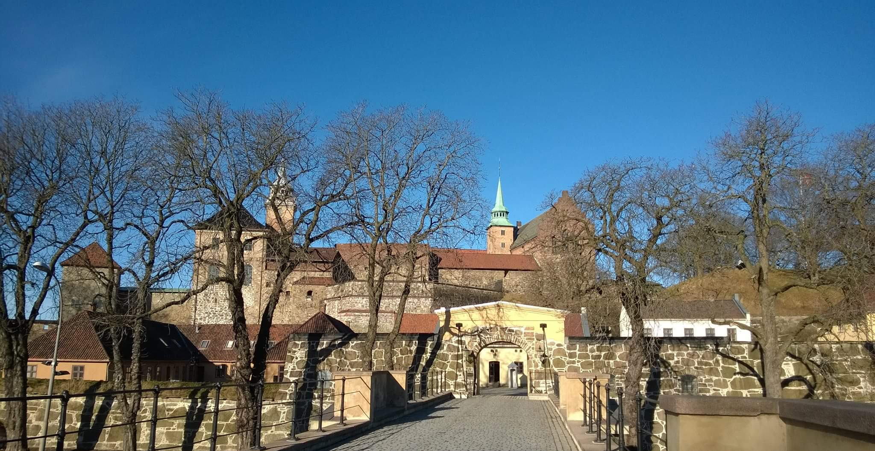
BILC Conference Oslo, 2020
Notes:
Very pleased to invite you to Oslo, to the 2020 BILC Conference. Oslo is the capital of Norway, and in the picture here you see Akershus Fortress, where the University Defence College is located. This is also where the Conference will be held.

Slide 2
Planning is all…..
Tentative dates:
24-29 May, 2020
Venue:
Akershus fortress,
Norwegian Defence University College
Notes:
This is still far ahead, so I don’t have much solid information to convey yet, apart from some key facts: time and place. Needless to say, there is busy planning going on behind the scenes, and as we all know, planning is all, the plan is nothing. This is what we have so far:

Slide 3
Planning is all…..
Conference theme: TBD
Social/cultural programme:
Accommodation – hotels in various price ranges will be suggested
Conference fee: 250 euros
https://www.youtube.com/user/VisitOSLO
Notes:
As a little teaser, I will show you a video promoting Oslo, and I hope to see you all in Oslo next year.

