Slide 1
BILC Update May 2022 – May 2023
Irena Prpic Djuric BILC Chair

Slide 2
What is BILC?
Bureau for
International
Language
Co-ordination
a consultative and advisory body for language training and language testing matters in NATO

Slide 3
Bureau for International
Language Co-ordination
1966 – DEU, FRA, GBR, ITA, USA
1978 – 2011 – the Joint Services Sub-Group within NATO Training Group (NTG)
2011 – onwards – under the auspices of the Supreme Allied Commander Transformation (HQ SACT); the HQ SACT Joint Force Development, Human Capital Enhancement & Individual Training Branch (HCEIT Branch) → MEMORANDUM OF COOPERATION between SACT and BILC (2019)

Slide 4
BILC Steering Committee
GBR (1966-1981)
DEU (1982-1996)
USA (1997-2008)
CAN (2008-2014)
USA (2014-2016)
BGR (2016-2019)
SVN (2019-2022)
HRV (2022-2025)
Chair
Irena Prpić Đurić
Senior Advisor
Dr. Ray Clifford
Secretaries
Suzana Horvat
Borjana Soldo
Associate Secretaries
Keith Wert
Peggy Garza
Julie Dubeau
Jana Vasilj-Begovic

Slide 5
Bureau for International
Language Co-ordination
Mission:
To promote and foster interoperability among NATO and Partner nations by furthering standardization of language training and testing.
To support the Alliance's operations through the exchange of knowledge and best practices, IAW established procedures and agreements.
Vision:
To achieve levels of excellence where progress made by one is shared by all.

Slide 6
Bureau for International
Language Co-ordination
Purpose: To foster cooperative professional support among BILC member nations and to extend support to NATO within the field of language training and education and language assessment.
Active participation in BILC activities from 27 NATO nations and more than 25 partner nations.

Slide 7
STANAG 6001 Key to Interoperability
Main responsibility: custodian of STANAG 6001
Language proficiency descriptions developed by BILC
Adopted by NATO in 1976
SLP (Standardized Language Profile) SLP 3232
Four numbers for Listening, Speaking, Reading, and Writing
0-5 scale (0: No Ability; L1: Survival: L2: Functional; L3: Professional; L4: Expert; L5: equivalent to a highly-articulate, well–educated native speaker)
SLPs in job descriptions, prerequisites for training, Language Capability Goals, Partnership Goals, etc.
BILC is responsible for periodically updating STANAG 6001

Slide 8
NATO Language Context
Each nation is responsible for own training / testing program
No common tests - only a common standard - STANAG 6001
Varying interpretations of standard? Nations certify their own military and give their members Standardized Language Profiles (SLPs) based on their own STANAG – based tests.
Language is viewed as a critical factor in the interoperability shortfall

Slide 9
Major BILC Events
BILC Annual Conference in May
BILC STANAG 6001 Testing Workshop in September
BILC Professional Development Seminar in October
BILC Military Terminology Conference in April (bi-annually)

Slide 10
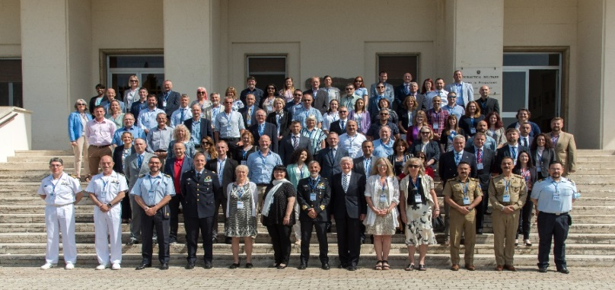
2022 NATO-BILC Annual Conference Loreto, Italy 22 – 26 May, 2022
Learning from the Past and Building for the Future
Topics:
Re-examining the systems approach to training
Adhering to the basic principles of course evaluation and validation
Designing new approaches to meet the new needs
Designing training for special missions
Adapting assessment tools to new training realities
Blending online and in-person training to create the best learning experience
Training the writing skill in the 21st century
Enhancing instruction through technology
Managing contract teachers and non-permanent staff
Can we really do more with less?
Study groups:
Towards an effective teacher evaluation framework
Building the case against the pressure for continuous online language training
Getting back to the basics in the post-pandemic reality: a manager’s perspective
How do we know what and how well we are doing
Organizing and executing training of languages other than English
Activities: 21 presentations, 5 study groups , 4 panel Q&A sessions

Slide 11
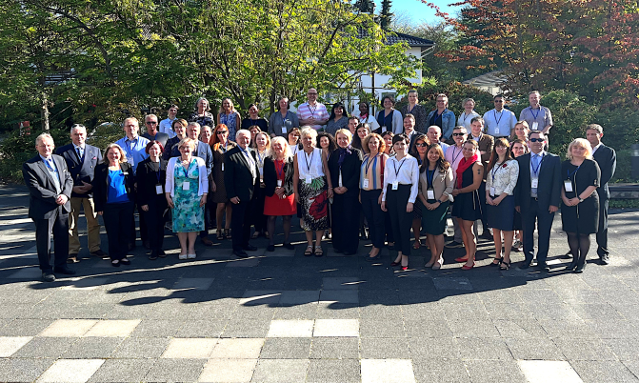
2022 NATO-BILC STANAG 6001 Testing Workshop Bonn, Germany 6 – 8 September, 2022
Increasing Standardization and Efficiency of STANAG 6001 Testing in the Digital Age
Topics:
Testing Level 1
Testing Level 4
Statistics
Efficiencies for test development
Virtual speaking tests
Remote proctoring
Authenticity in the digital age
Online testing considerations (format, visuals, layout)
Activities:
10 presentations + 4 digital poster presentations
3 workshops
6 mini-workshops
4 Q & A panels
Scoring models
Multistage adaptive testing algorithms
Automated scoring
New platforms for test analysis
Digital tools for collecting feedback
Online norming and item moderation
Shared Item Bank

Slide 12
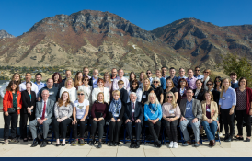
2022 NATO-BILC Professional Development Seminar Provo, Utah, USA 16 – 20 October, 2022
Applied Research and Practical Experience in Teaching and Learning Languages
Topics:
Utilizing language acquisition principles to optimize adult learner engagement
Benefits of self-directed learning in language studies
Developing STANAG 6001/proficiency-based curricula in languages other than English
Operationalizing the STANAG 6001 construct in test development practices
Enhancing adult student motivation and content retention
Learning by doing: benefits of experiential learning
Conducting basic research to enrich the classroom experience
Attaining teaching excellence by integrating research into practice
Setting training goals and developing curricula using the backward
design
Activities: 19 presentations + 3 digital poster presentations
8 workshops, 3 Q&A panels

Slide 13
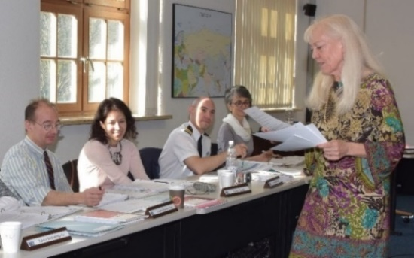
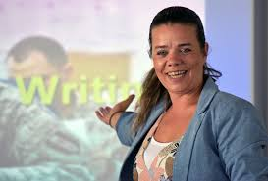
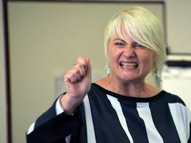
BILC Professional Development Programme in Partnership Cooperation Menu (PCM. i. e. ACT-sponsored BILC courses)
1. Language Testing Seminars (conducted at PLTCE):
Language Testing Seminar, ACT.647, 2 weeks;
Advanced Language Testing Seminar, ACT.658, 3 weeks;
Language Standards and Assessment Seminar, ACT.648, 2 weeks.
2. BILC Methodology Workshops
English Teaching Faculty Development Workshop “Teaching Speaking and Writing for Military Purposes”, ACT.659, 2 weeks. Conducted at 3 PTECs PLTCE, Bulgaria and Slovenia.
Facilitators: BILC teaching & testing experts from 24 nations.

Slide 14
Other BILC activities
Standardization efforts and support:
- Non-resident activities (in person and online - DEEP, DCB TF, cooperative visits)
DEEP – Defence Education Enhancement Programme
(https://www.nato.int/cps/en/natohq/topics_139182.htm)
- June 20 – 22, 2022, 11th DEEP Clearing House, Rome, Italy

Slide 15
BILC Support May 2022 – May 2023
Armenia
Azerbaijan
Bosnia-Herzegovina
Colombia
Georgia
Iraq
Kuwait & Qatar (online)
Mauritania
Tunisia
Ukraine

Slide 16
CIOR - La Confédération Interalliée des Officiers de Réserve (the Interallied Confederation of Reserve Officers)
2) Israel – J5, Desk of International Training (the Military Diplomacy School)

Slide 17
BILC WGs & Projects
Shared Item Bank Project
JTAC Working group
Testing French Language Proficiency IAW STANAG 6001
Military Terminology Conference
Notes:
Slide 16 Now for the updates….
I have good news and bad news. The good news is that we will have a new website! As many of you know, the Gov’t of Canada regulations made it impossible for the BILC website to continue being hosted on Canadian gov’t server. After many obstacles and delays I am pleased to announce that we have purchased the domain name NATOBILC.org and that we are now hosted on a commercial server. The bad news is that this was supposed to already be finished. Setting it up was somewhat more complicated than I anticipated and we are still in the process of fixing all of the broken links, of polishing up all of the pages and organizing the information so that it is functional and attractive. That said, we hope to be “live” any day now, and will send an email to all announcing the ‘re-birth’ of the BILC website, asap.
Next item is the STANAG for Non-Specialists document which we produced last year: has been through a number of drafts, but it is now a final document that is available to all for distribution. It will also be available on the BILC website. It is intended for HR staff and other non language professionals to use as a quick reference. We will pilot its use when we assist SACT with the language needs analysis of HQ posts.
Which brings me to bullet number three: The former Chairman and I travelled to ACT in Norfolk, Virginia in March to have meetings with education specialists, with our BILC POC, Cdr Khilkevich, who will address you later this morning, and we met with JFT – Joint Force Trainer, General Viereck whom we briefed on the work BILC has performed this year. I’m happy to report that it was confirmed that BILC will be assisting that HQ in the next round of positional reviews and we will perform a small LNA of positions. More to follow on that later this year.
Another issue that has recurred this year relates to a table of language scale equivalencies produced by the International staff and posted on the NATO website. We were made aware of this table last year and our former Chairman wrote to the IS to tell them that BILC would not recognize it as accurate. As the custodian of STANAG 6001, BILC considers such charts and tables as rough approximations and does not recognize transferability of levels and results on tests from one scale to another with the notable exception of the ILR (Interagency language Roundtable) proficiency descriptors.
It is our view that test results acquired on non NATO STANAG test should NOT be recognized in terms of STANAG levels. BILC has drafted and will issue a formal statement to this effect, after it has been presented to the steering committee later this week. It too will eventually be posted on the BILC website for nations to use as a support mechanism.
Next, the BILC WG on Level 4 has produced a Report for nations who want to know more about the complexities tied to testing at this very high level of proficiency. An executive summary is available and the full document will also be posted on the website.
Last but not least, the BILC WG on Translation and Terminology has completed Phase 1 of their review of terms in AAP-5 in order to supplement with additional definitions where needed, and are moving on to the next document. You are welcome to speak with our Austrian delegates for details of this important work.
That’s it for my briefing. This week, as I said, this week should prove informative and interesting-- so, as a last comment, I invite you to work hard, play hard and aim high!!
What’s the worst that can happen?! NEXT SLIDE

Slide 18
BILC site – www.natobilc.org

Slide 19
BILC site – www.natobilc.org
Recommendations and policy documents
The STANAG 6001 Overview for Non-Specialists
Presentations from events
Materials on Level 4
Materials on STANAG 6001 testing
Resources in French
Updated version of the calendar 2023

Slide 20
THANK YOU FOR YOUR ATTENTION!
Questions

