Slide 1
NATO Defense Capacity Building (DCB) Projects for Language Interoperability
A NATO IS, BILC & PLTCE Collaboration

Slide 2
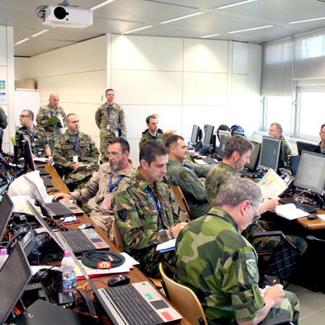
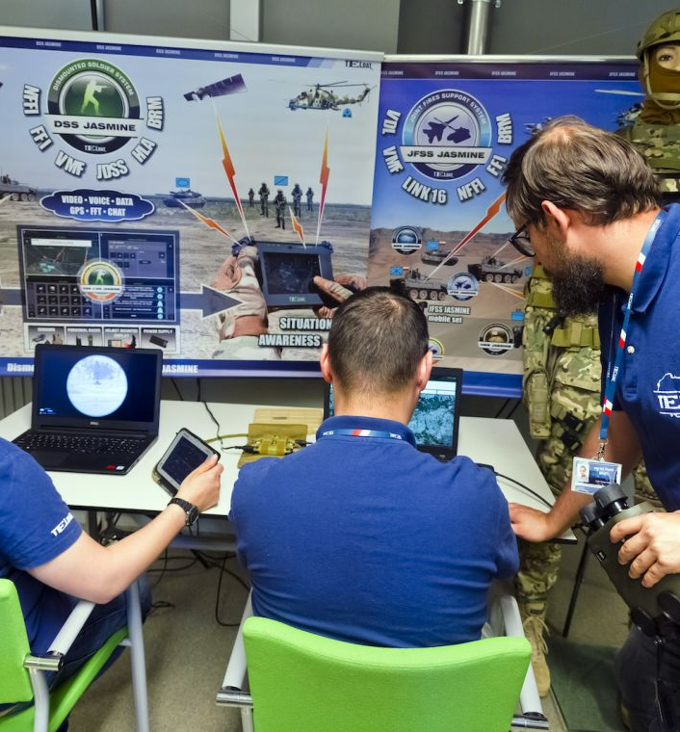
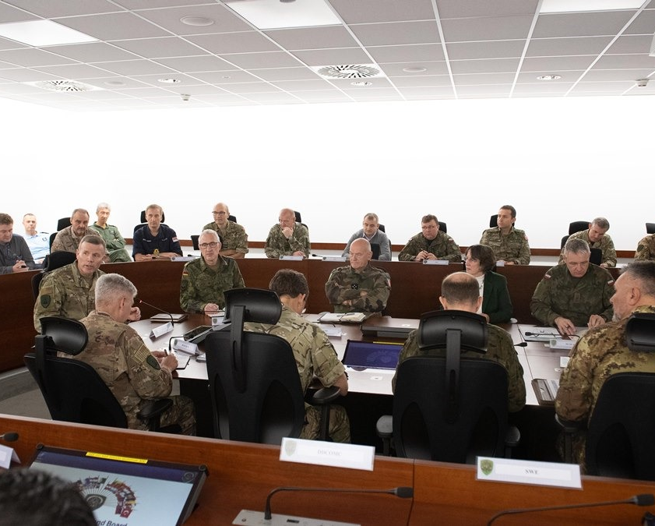
NATO DCB Projects in Support of Language Requirements for Interoperability
Competency in English language skills is a prerequisite for participation in exercises, operations, and interactions with NATO or other multinational headquarters.
Credit: NATO
Notes:
Rationale: Competency in English language skills is a prerequisite for participation in exercises, operations, and interactions with NATO or other multinational headquarters. This training should be expanded to all relevant personnel from higher headquarters down to the individual unit commanders deployed with a NATO-led multinational force, as they must be able to conduct tactical communications in English. Staff officers at all appropriate levels of national headquarters must be able to read and understand NATO documents in order to save time and avoid unnecessary translations, and individual team members must be able to conduct tactical (on-site) communications in English.
PHOTOS
Supreme Allied Commander Europe, General Tod D. Wolters delivers closing remark to leaders and staff at Supreme Headquarters Allied Powers Europe, Nov. 14, 2019, as Trident Jupiter 19-1 drew to an end. -NATO photo by SSG Ross Fernie (https://shape.nato.int/news-archive/2019/exercise-trident-jupiter-draws-to-a-close)
Article "Exercise TRIDENT JUNCTURE 16 in retrospect" Jan 17, 2017, JWC's Training Team in Naples. Photo by JWC PAO (https://www.jwc.nato.int/articles/exercise-trident-juncture-16-retrospect) . (TRIDENT JUNCTURE 16 (TRJE16), the computer-assisted/command post exercise (CAX/CPX) sponsored by Allied Command Transformation (ACT), certified NATO's Joint Force Command Naples (JFC Naples) to lead the NATO Response Force (NRF) in 2017.)
Article "CWIX – Improving Interoperability for 22 Nations Across 10 Times Zones" Jun 25, 2020, The first-ever distributed Coalition Warrior Interoperability eXercise (CWIX) concludes today, on 26 June 2020. NATO’s largest interoperability event drew to a successful close today. The Coalition Warrior Interoperability eXercise (CWIX) took place from June 8th to June 26th and spread from San Diego on the West Coast of the USA all the way to Ankara in Turkey. (https://www.act.nato.int/articles/cwix-improving-interoperability-for-22-nations-across-10-times-zones)
Same CWIX exercise as #3

Slide 3
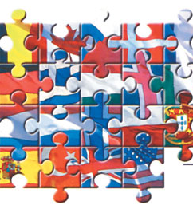
NATO DCB Projects in Support of Language Requirements for Interoperability
International collaboration
Assistance designed to support the development of, e.g.,
language strategy in line with military and civilian personnel policy
language program quality assurance process
a STANAG 6001 testing capacity
NATO IS
BILC
PLTCE
NATO Graphics
Notes:
WHO & WHAT
NATO DCB assistance was designed to support the Tunisian MND in developing a multi-year language strategy in line with military and civilian personnel policy, which would allow for long-term language planning and for a better use of training resources and courses. This also included support for the development of a language planning process and the establishment of a STANAG 6001 testing capacity. The Bureau for International Language Cooperation (BILC) was designated as the leading coordination body.
The BILC together with the Partner Language Training Centre Europe (PLTCE) in Garmisch-Partenkirchen and NATO IS, developed a DCB Trust Fund project in support of Tunisian English Language Requirements. The DCB Trust Fund project proposal was issued on 2 May 2019 with reference AC/340-N(2019)0040 (INV).
PHOTO
http://www.journal.forces.gc.ca/vo5/no1/nato-otan-eng.asp

Slide 4
What might a DCB project look like?
OUTCOME: A highly proficient language testing capability IAW STANAG 6001 is in place
BILC Team: Initial scoping visit
National team: Attend advanced language skills course
BILC Testing Experts: Work directly with national program and team
National team: Attend professional testing workshop
BILC Experts: Final visit to national program

Slide 5
Current DCB Projects
Tunisia
Jordan
NATO IS
Jose-Luis Marquez
BILC Multi-National Cooperation
Branka Petek
Corina Biszak Ispas
Michael Campbell
Edelmira Nickels
NATO IS
Nicolien Wellen
BILC Multi-National Cooperation
Inga Fārte-Zālīte
Merit Kompus
Andrea Gjorevski
Edelmira Nickels
Notes:
STATUS of Each DCB:
TUNISIA: Scoping Visit was accomplished prior to COVID. The Advanced Language Enhancement for potential testing team members is in progress. The next step is for the BILC team to visit Tunisia for work on the testing framework and planning for next steps.
JORDAN: Scoping Visit is slated for July. The Advanced Language Enhancement for potential testing team members is slated for August.
ADDITIONAL INFORMATION:
OBJECTIVES
TUNISIA: to build a cadre of highly proficient language instructors and to develop them into a STANAG 60011 testing team. A necessary concomitant objective is to cooperatively review and assess the TAF language training planning process to ensure that the establishment of a STANAG 6001 testing team is fully synchronised with the long range planning of the TAF language education requirements identification and language training execution strategies and processes. The project also aims to provide support for the training of English language interpreters.
JORDAN: to improve the English teaching capacity of the JAF with a focus on improving the Jordanian Armed Forces Language Institute (JAFLI).
WHY
TUNISIA: English language proficiency of Tunisia’s military personnel was identified as an important factor in Tunisia’s ability to meet its force contribution related goals. In accordance with its PG on Language Requirements, Tunisia requested DCB support to achieve the goal of improving the language training capacity and standards at the military academies, and providing English language training for senior officers involved in NATO cooperation. In addition, Tunisia also sought NATO support to strengthen the management and quality assurance of English language training courses and standards for training and testing, while enhancing the qualifications of instructors. Tunisia also aimed at improving the English language skills of all Tunisian personnel who are to cooperate with NATO forces or with NATO staff.
JORDAN: keen to improve various capabilities as well as their interoperability with NATO and individual Allies. English language skills are central to these efforts; however, they have been a barrier; particularly at unit levels and among lower ranking JAF personnel. A broad array of language assistance was requested by the JAF, ranging from professional pedagogical and language testing assistance, to improvement of language teaching facilities and equipment support. The development of the English teaching and testing capability within the JAF would serve as a force multiplier in various reform efforts of the JAF.

Slide 6
NATO Defense Capacity Building (DCB) Projects for Language Interoperability
A NATO IS, BILC & PLTCE Collaboration

