Slide 1
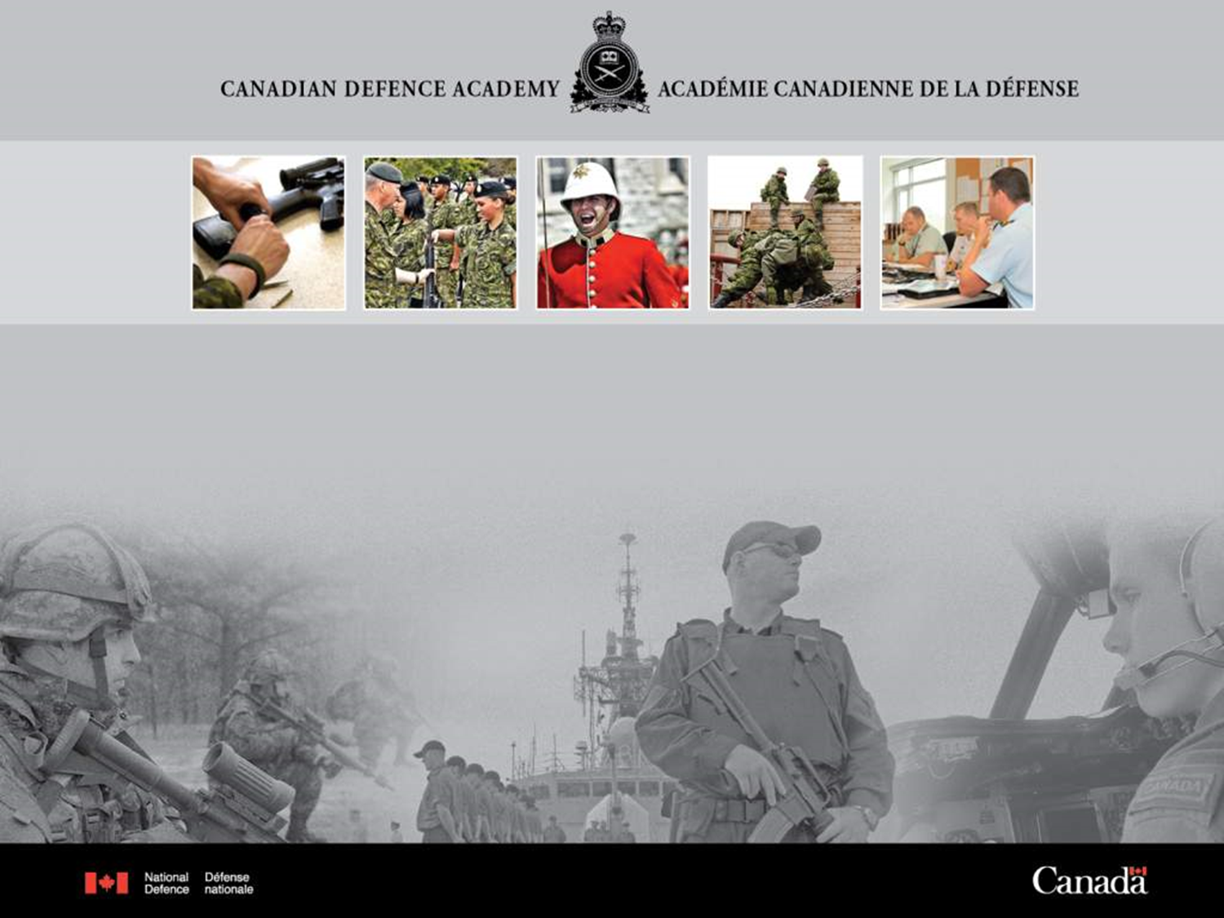
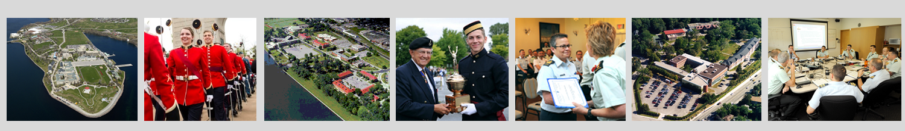

Language Programs, Foreign language Section
Integrating Feedback into Course Content and Training Strategies
BILC Professional Development Seminar,
Prague, 16 Oct 2024
Notes:
My name is Julie Dubeau, Chief of Standards for FL programmes and this is my colleague Jana Vasilj-Begovic, the Standards Officer for FL programs.
Today, we wanted to say a few words about how we go about “Integrating Feedback into Course Content and Training Strategies”.
Teachers know very well that gathering feedback from their students is essential IOT ensure they have enabled them to achieve the objectives; to see if students are satisfied learners or customers, and, as teaching professionals, to learn from their own teaching effectiveness.
And while there are many different types of feedback and purposes for collecting feedback, today, we will focus on feedback we gather from graduates from our program.
Slide one: here’s the outline of what we will discuss today.

Slide 2
Presentation Outline
Foreign Language Program - Mandate
Systems Approach to Training
Validation Process
Sample Feedback Comments
From Feedback to Products
Challenges - Take Aways
Notes:
- I will present the context, functions and mandate of the Canadian Defence Academy’s foreign language program,
how we use the system’s approach, and Jana will take you through our validation process specifically
that is, the information we gather from our students once they have gone on to their job, or have been posted abroad,
and we’ll discuss what we do with these findings.

Slide 3
FOREIGN LANGUAGE PROGRAM
Define objectives through Language Needs Analyses (LNA)
Chair QS boards and produce training plans & directives
Approve FL Training
Task the Canadian Forces Language School (CFLS)
to deliver
Notes:
The CDA is responsible for language programs in a systemic way, not language delivery or teaching.
We work with various military units to help them define their requirements in terms of ‘how much language’ is required to perform the threshold job using the foreign language, or what is required abroad on the posting.
We Chair the Qualification Standards Boards, and produce all training plans and related documentation, and finally, once we know that everything is in place, we task the school to deliver FL training.
The CFLS delivers the FL courses.
CFLS as well as the three environments (Army, Navy, AF), also deliver French language training to approx. 2,000 full-time students, excluding cadets in the two military colleges, and English language training to approx. 300 students in total. English is clearly not a pressing requirement in Canada, although the number of military members who master neither official language is growing. But that’s a topic for another day.
Our unit’s focus is only on the foreign language program and it’s a smaller requirement in terms of numbers, but no less important.

Slide 4
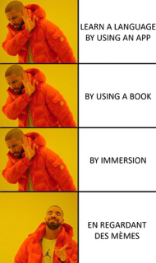
FOREIGN LANGUAGE PROGRAM
20 courses per year
50 students
15 languages
in-class and virtually
Priority to “Specialists” Mandarin, Russian, Arabic
Exchange students
Canadian Defence Attachés
Notes:
CFLS delivers approx. 20 courses every year to about 50 students, in 15 languages, in-class and virtually
Priority to Mandarin, Russian and Arabic “Specialists”; Exchange students, Canadian Defence Attachés, others
While the numbers are small, each student expects quality training, nonetheless.

Slide 5
FOREIGN LANGUAGE PROGRAM
Develop formative & summative tests
Provide Certification testing to all CAF (~ 200)
Provide Oral Proficiency Interviews (OPI)
Conduct course evaluation & validation
Develop curricula
Manage contracts
Notes:
We are responsible to prepare classroom materials – core curricula, either acquired through partners, purchased or developed; we develop military modules to complement the curricula,
We develop the formative or achievement tests administered through Moodle, as well as testing instruments for translation and transcription skills
and our unit is the only unit that does certification testing for foreign languages, a few hundred per year mostly in Russian, mandarin, Ukrainian, Polish, Spanish etc.
We manage the contracts for teaching and testing, and conduct evaluations, and of course, conduct validation

Slide 6
SYSTEMS APPROACH TO TRAINING - CFITES
Design
Conduct
Evaluation
Validation
Analysis
Development
Strategic Guidance
Needs
Assessment
Operations
Notes:
The Canadian Forces Individual Training & Education System is a management system designed to optimize the quality and quantity of IT&E, while minimizing the resources dedicated to IT&E programmes. It applies a systematic process, which is essentially a logical thought process, a way of thinking about problems, understanding issues, and identifying solutions in systems terms.
It is an interconnected cycle.
The CFITES is engaged when a needs assessment, driven by adjustments to strategic guidance or operational requirements, reveals a performance deficiency or opportunity that can only be addressed through formal training and / or education.
In the training context, it ensures that what a member learns meets the requirements of his/her tasks and duties.

Slide 7
SYSTEMS APPROACH TO TRAINING - CFITES
Design
Conduct
Evaluation
Validation
Analysis
Development
Strategic Guidance
Needs
Assessment
Operations
Notes:
And IOT find out if the training has enabled the members to perform their tasks adequately, one important aspect is the validation process.
Over to you, Jana:
The validation stage of the systems approach to training is the main formal source from which we obtain feedback on how effective training was in preparing students for their posts outside or inside Canada. Validation is conducted via a questionnaire, which asks former students, who have been in their foreign posts for a couple of years, a variety of questions. Some of the questions inquire about the percentage of language used at work and outside of work, which language skills are used most, relevancy of tasks and content covered during the training for the work performed, and as this slide shows, we gather information about the tasks and content that were not trained, but are needed for work, tasks that had been overtrained, etc. We analyze the responses carefully and generate reports along with recommendations on how to improve training by integrating feedback.

Slide 8
Validation
Job
Tasks that don’t
need training
Missing tasks
/ content
Tasks
/ content
trained
that were
not required
Tasks that
need training
Tasks / content
overtrained
Training
effective
as job prep.
Notes:
The validation stage of the systems approach to training is the main formal source from which we obtain feedback on how effective the training was in preparing students for their posts outside or inside Canada, so it will be the focus of this discussion. Validation is conducted via a questionnaire, which asks former students, who have been in their foreign posts for a couple of years, a variety of questions. Some of the questions inquire about the percentage of language used at work and outside of work, which language skills are used most, relevancy of tasks and content covered during the training for the work performed, tasks and content that were not trained, but are needed for work, which tasks were overtrained etc. We analyze the feedback carefully and generate reports along with recommendations on how to improve training by integrating feedback.

Slide 9
Feedback Comments - Attachés
Tasks or Content Missing from Training:
Military content
Booking venues for event hosting
Negotiating hospitality with restaurants
Understanding written technical specifications of equipment at trade shows
Signs at railway stations
Understanding longer military lectures
Using technical vocabulary related to overflights, ship visits
Romania
China
Germany
Spain
Notes:
These are examples of comments gathered via the validation process involving military attaches and their assistants. Most attaches found the military content insufficient, which is also logical as in many cases commercial books are used in training. Some of the tasks and content areas former students found were missing in training, but were needed at work were for example, booking venues for various events, understanding technical specs of equipment, using technical vocab related to ship or base visits etc. The Chinese attache, e.g. also found some content covered in the commercial books irrelevant, for example the whole theme of dating and student life. Overall, however, most attaches found that the training was effective as preparation for the post.

Slide 10


Slide 11
Formal Feedback from Specialists
(Russian, Arabic, Mandarin)
Tasks or Content Missing from Training:
Understanding colloquial, informal & slang language
Discussing military content, such as weapons and armaments
Explaining
defence industry, maritime operations
Notes:
The final performance objectives of these students are to transcribe target language texts in the respective language and to translate written texts into English. This feedback came from the validation questionnaire; that is, it was collected in a formal way. Understanding colloquial and slang language was identified as the biggest gap in content that was used in training.

Slide 12


Slide 13
Informal Feedback
Informal feedback on translation
Use of AI in classroom for translation purposes
Does the use of AI at work or in classroom reduce relevance of training & testing this skill?
Dilemma: how to train and test translation
Notes:
This feedback came from a debrief with a student after she had taken tests in the listening and reading skills used to measure progress and readiness for on-the-job part of training. As previously mentioned, students have the translation skill as one of their two performance objectives. When asked about the dictionaries used in class for translation activities, this student mentioned that AI-powered tools, such as Reverso dictionary and translator, as well as Google translate were used. This came as a surprise, as it created an immediate dilemma and made us wonder if the use of AI in class and also possibly at work is reducing the relevance of how we train and assess the translation skill?

Slide 14
From Feedback to Products
Stand-alone military modules for all Attaché courses
A book of role-plays in English adaptable to different languages
Guideline for teachers on integrating colloquial language into instruction
Curricula updates to replace outdated vocabulary with current expressions and complement commercial learning resources.
Notes:
As military content was identified as lacking in training of attache students, stand-alone military modules were developed in a number of languages covering proficiency up to level 2. For e.g. for the purposes of Spanish training of military attaches, separate modules were developed and tailored for context/content of the country and language specifics (so we have these modules for Spanish for Colombia, Chile, Mexico, Spain and Cuba).
Also, linguistic and cultural reference resources are currently being included into the training plans, which we call language training frameworks, to meet communication needs of learners when interacting with people in the target country.
We also developed a guideline to assist teachers with the integration of colloquial language into the formal variant of training. Some have teachers reported that it was extremely easy to find content; however, as the domains are huge, they have difficulty deciding what exactly to select. Our recommendation was to follow the themes in the curricula and include in parallel colloquial expressions. The informal feedback from our Mandarin students revealed that colloquial language is, indeed being taught in parallel and they have become used to dealing with both the formal and informal language without feeling overwhelmed. Our teachers also stated what I had also noticed when I was a teacher, and what will I am sure not surprise you is that once students learn slang, and especially profanities, they typically use it without making any mistakes. All the case endings are there in Slavic languages.
Another product in the development stage is a book of 100 role-plays through which students can practice using language in situations relevant for work.
And of course, curricula are continually reviewed and updated.

Slide 15

FOREIGN LANGUAGE PROGRAM
Challenges
Course length not always based on building language proficiency
Not all students have language aptitude required
Few students per lang.
Quality still required!
Few SMEs
Reliance on external contracts and agencies, MOUs, & relationships
Notes:
Course lengths not always based on building language proficiency
Personnel may require levels much too high to attain in the time given, esp. Cat 3 & 4 languages, like Mandarin, Japanese, Arabic
Certain personnel do not always have language aptitude required to learn such different languages in a short time.

Slide 16
Take Aways
Training requirements may shift over time
Adding new content to an already voluminous course poses challenges
Technological advancements require continual adjustments to course content
Language evolves
Notes:
Training requirements may shift over time –
Technological advancements require continual adjustments to course content, delivery method etc.
Language evolves - words become obsolete, new expression need to be learned
Adding new content such as more colloquial language, for example, to an already voluminous course poses challenges – somethings got to go!
The team is always adapting the material to reflect current usages and needs.

Slide 17


Slide 18
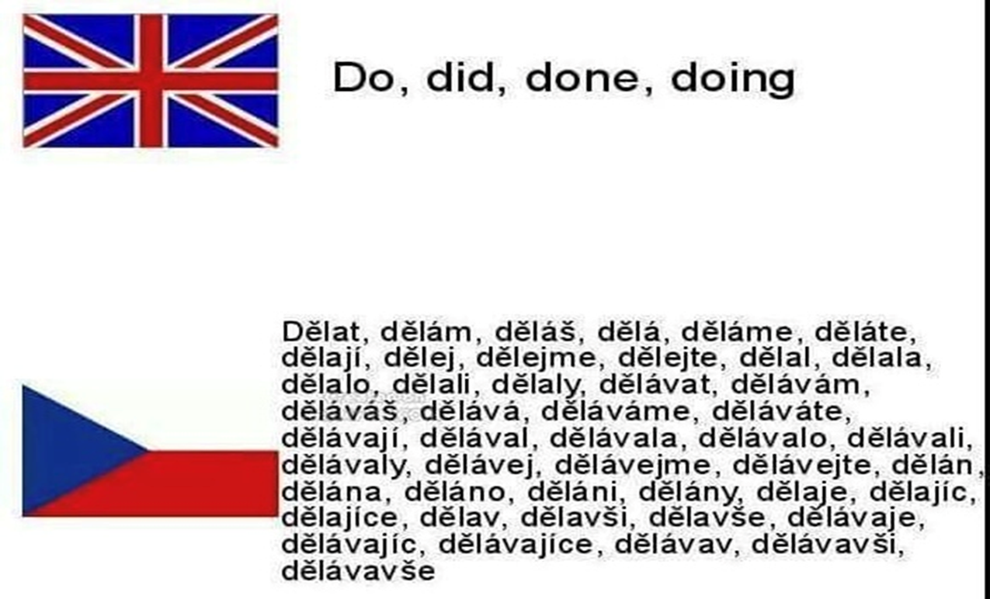
Děkuji za pozornost !
Julie.Dubeau@forces.gc.ca
Jana.Vasilj-Begovic@forces.gc.ca

