Slide 1
Report on the BILC Survey on Testing Writing in the Digital Age
STANAG 6001 Testing Workshop 2024, Bergen
Merit Kompus, Head of Language Testing Section
Estonian Military Academy

Slide 2
Survey Participants
Albania, Azerbaijan, Austria, Belgium, Bulgaria, Canada, Croatia, Czech Republic, Denmark, Estonia, Finland, France, Georgia, Germany, Hungary, Italy, Latvia, Lithuania, Macedonia, Norway, Romania, SHAPE, Slovakia, Slovenia, Spain, Sweden, Ukraine

Slide 3
BILC Review of Writing Assessment Practices
Riga 2023.
Discussion Group: Rethinking Recommended Practices for Testing Writing.
ALTS 2024.
Gathering prompts and scripts for training purposes
Bergen 2024.
Norming for Rating Writing & Selecting Training Materials
2024. BILC Survey on Testing Writing in the Digital Age

Slide 4
Q1: Proficiency Levels Tested

Slide 5
Q2: Number of Prompts/Tasks, Required Word Count, Allocated Time for the Test

Slide 6
Q3: Test Development and Moderation
Common Practices
Team Collaboration
Moderation
Use of Level Descriptors and Specifications
Ongoing Development
Areas for Improvement

Slide 7
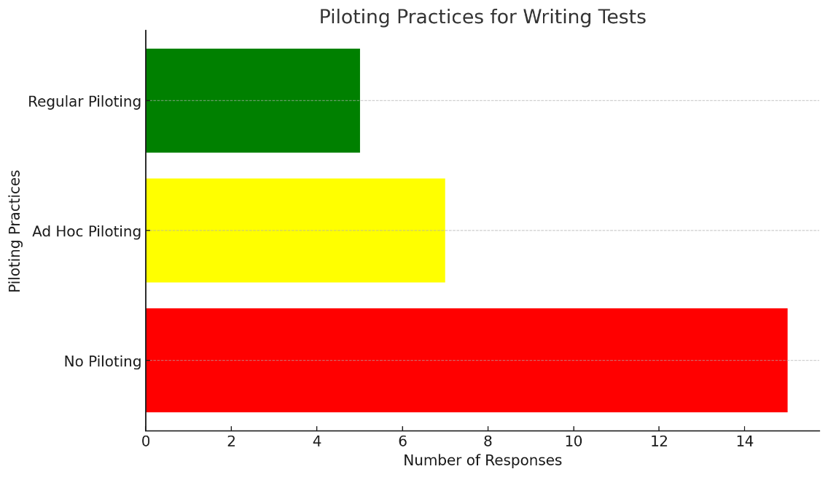
Q4: Piloting
Piloting is a process “devoutly to be wished” but “more honoured in the breach than the observance”.

Slide 8
Q5: Prompt/Task Replacement
Prompt Replacement
Every Session
Annually
Biannually or Less Frequently
No Strict Replacement Rules
Key Observations
Frequent updates
Regular review and rotation
Avoiding repetition

Slide 9
Q6: Test Format

Slide 10
Q7: Use of Aids in Writing Tests

Slide 11
Q7: Use of Aids in Writing Tests CONT’D
“For the bi-level test, all available tools in Microsoft Word are allowed, since these tools will be available to them in the work situation.”
“Spell checkers are accepted as it reflects the modern working environment.”
“Typing is different from writing by hand – there are lots of typos. Spell checker is a useful tool once one has mastered vocabulary anyway.”
“We aim to make the writing test as realistic as possible, without allowing AI platforms or other programs that can be used for drafting output.”

Slide 12
Q8: Making Notes and Writing Drafts
Common Practices
Notes/drafts are permitted
Notes/drafts are collected but not rated
Test takers are informed about the time limit
In some cases, making notes is encouraged:
“The candidates are encouraged to jot down their ideas in the allocated section of the test booklet. These notes can be written in their native language and are not evaluated.”
“We advise them to first draft a skeleton.”

Slide 13
Q9: Satisfaction with Writing Tests

Slide 14
Q9: Satisfaction with Writing Tests CONT’D
Very Satisfied
“We feel that our direct writing tests truly demonstrate writing proficiency because candidates are required to produce a text on 2 different tasks per level. With this format, there is evidence of whether or not a candidate can write consistently across tasks.”
“[In computer-based testing] marking is way faster than it used to be with hand-written tests. It is more authentic - they can edit, write notes/drafts, check for spelling mistakes.”

Slide 15
Q9: Satisfaction with Writing Tests CONT’D
Somewhat Satisfied
"Having single-level tests for level 1 and 2 creates great results, as these really stimulate the levels well. However, for the level 3 and 4 bi-level test, we are not happy. One reason is that testing level 4 is quite a challenge, which would need a completely different approach. To be able to implement one to do so, will need some changes in the overall system. "

Slide 16
Q9: Satisfaction with Writing Tests CONT’D
Computer-based writing tests
“Use of computers adds to the authenticity of the writing process.”
“Tests could and perhaps should be computer-based, but hardware resources do not currently allow for that (too many test takers at the same time).”
“We want to transition to computer-assisted W tests asap. Two reasons: 1. people can't edit/swap paragraphs/move sentences 2. legibility of the samples (rater issue).”

Slide 17
Q9: Satisfaction with Writing Tests CONT’D
“We are satisfied with having 2 prompts at level 2 which provide enough evidence to determine the level. We are less satisfied with the essay task at level 3 because we find it somewhat artificial, but unfortunately we have not found a better solution yet.”
“With the coming of AI, we need to look at new ways of assessing written language skills, or a platform that will not permit AI being used.”
“Although being a teacher can be a hindrance while engaged in testing, with writing we find that the teaching does feed nicely into our writing tests. Our approach to writing stays both ‘fresh’ and critical.”

Slide 18
Q9: Satisfaction with Writing Tests CONT’D
Somewhat dissatisfied
“Finding different topics becomes very hard with every passing season; sometimes it seems we have exhausted the topics and finding new ones becomes stressful.”
“It is interesting that you should ask for information about writing tasks as it is precisely the one task my team and I feel we need to work on and find the most difficult to provide the best framework for, particularly in terms of piloting… We believe our prompts are well aligned to the expected skills and quite attractive to the candidates. Yet, we are aware that we could/should be better at ensuring our items' quality by piloting them more systematically.”
“We are testing ca 4500 people per year. Due to this fact we do not manage to pilot/pretest the writing prompts. We hope that the STANAG 6001 requirements for every soldier will be modified/reduced in the foreseeable future.”

Slide 19
Q10: Testing Writing in the Digital Age
“We believe that testing writing by pen and paper in the digital age should be just a backup plan in case of technical issues.”
“I think in the digital age spell checkers should be allowed if you have computer-based testing. However, since some countries have paper-based testing, it will create discrepancies between the countries.”
“Transitioning to online testing has brought significant changes. We had to rethink (or at least question) our specifications in terms of allocated time (so as not to penalise less keyboard savvy candidates for example). We are also reviewing the layout as online testing can't just be the plain translation of a paper exam.”

Slide 20
Q10: Testing Writing in the Digital Age CONT’D
“Despite having paper based exams we have attempted to replicate digital writing skills by including email and SMS etc. text types as well as response formats.”
“Just a general sense that writing has been so de-prioritized in this brave new world of tweets and blurbs that the demands we place on text quality may not reflect reality.”

Slide 21
Q10: Testing Writing in the Digital Age CONT’D
“No breakthroughs yet - but using laptops would make a lot of sense - both in terms of practicality and authenticity. Although the use of AI is a risk, I personally do not see AI as being a ‘death knoll’ for using laptops in testing. I trust protocols/processes will be come up with!”
“I'm interested in knowing more about how AI could help us analyze writing samples IAW our construct.”

Slide 22
Testing Writing in the Digital Age

Slide 23
Key Issues and Way Forward
Collaboration in Prompt Development and Piloting
Computer-Based Writing Tests
Real-World Writing Tasks
Use of Aids
Way Forward

Slide 24
Thank you for listening, and let’s continue exploring together!

