Slide 1
(No) Can Do? NATO Language Capability Targets and Norwegian officer cadets
Birgitte Grande
Hege Skilleås

Slide 2
Agenda
Background for the study
NDUC education reform
English at NDUC redefined
Research questions
Methodology
Preliminary findings

Slide 3
Background
Norwegian Armed Forces education reform (2018)
Norwegian Defence University College
BA Military Studies
Restructured organisation

Slide 4
Norwegian Defence University College 2018
NDUC
NCO School
Army Academy
Naval Academy
Air Force Academy
Cyber Engineer Academy
Language and Intelligence Academy
Staff College
Institute for Defence Studies

Slide 5
English «redefined»?
No longer a subject per se
Integrated in interdisciplinary modules
No English language exam
No testing iaw STANAG 6001
No armed forces language policy documents, other than…
NATO Capability Targets (E1101N)

Slide 6
Research questions
To what extent do Norwegian officer cadets meet NCT when graduating with a BA in Military Studies?
To what extent are STANAG test results comparable between the army/navy/air force academies?
What are Norwegian officer cadets’ perceptions of English language training at the NDUC?

Slide 7
Methodology RQ1 & RQ2
Testing iaw STANAG 6001
Army/navy/air force academy
Equal-sized groups (N= 25)
Data analyses (IBM SPSS)
Comparing results to NCT
Comparing groups

Slide 8
RQ3
Likert-scale questionnaire
Basic personal information
20 statements
«English tuition at my academy has prepared me well for communicating effectively with allies.»
«English tuition at the military academies should be attended on a voluntary basis.»

Slide 9
Preliminary findings
 | Listening | Speaking | Reading | Writing
L3 | 13.6% | 45.5% | 45.5% | 36.4%
L2+ | 50.0% | 36.4% | 31.8% | 31.8%
L2 | 31.8% | 18.2% | 18.2% | 31.8%
Unrat. | 4.5% | - | 4.5% | -
Total (N= 22) | 100% | 100% | 100% | 100%
BA cadets at the Royal Norwegian Air Force Academy tested 2-3 May (N= 22)
Gender-balanced sample (48% female)
Jagged profiles
NATO Language Capability Target (OF): 3333 iaw STANAG 6001

Slide 10
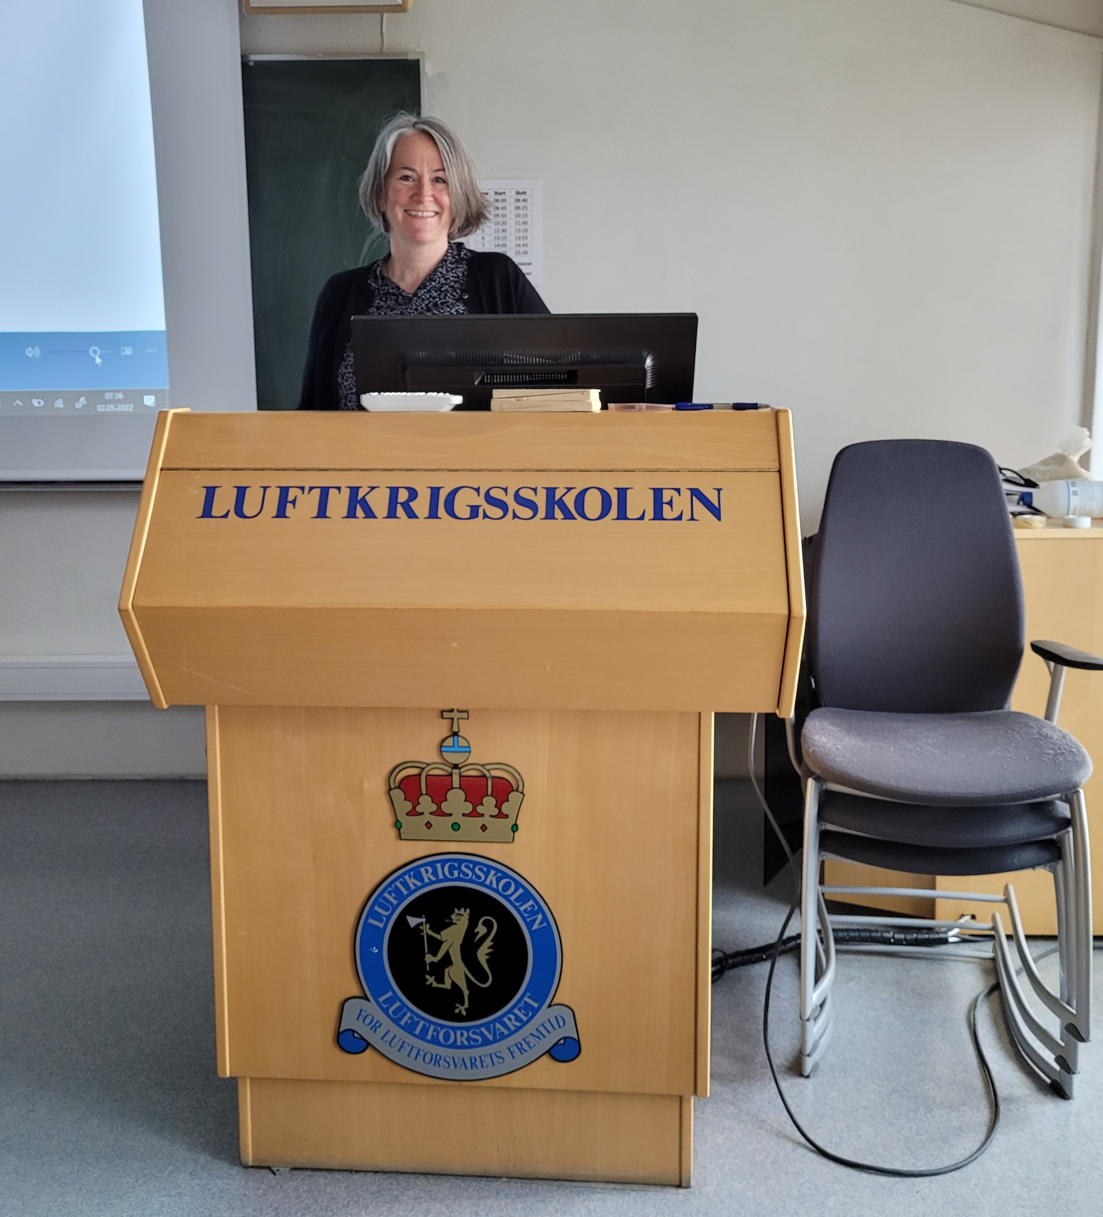
Thank you for your kind attention.

