Slide 1
Defence Requirements Authority for Culture and Language (DRACL)
“Bringing order to Chaos”
Lt Col Craig Mullen MSc AGC(SPS)
BILC – May 2017

Slide 2
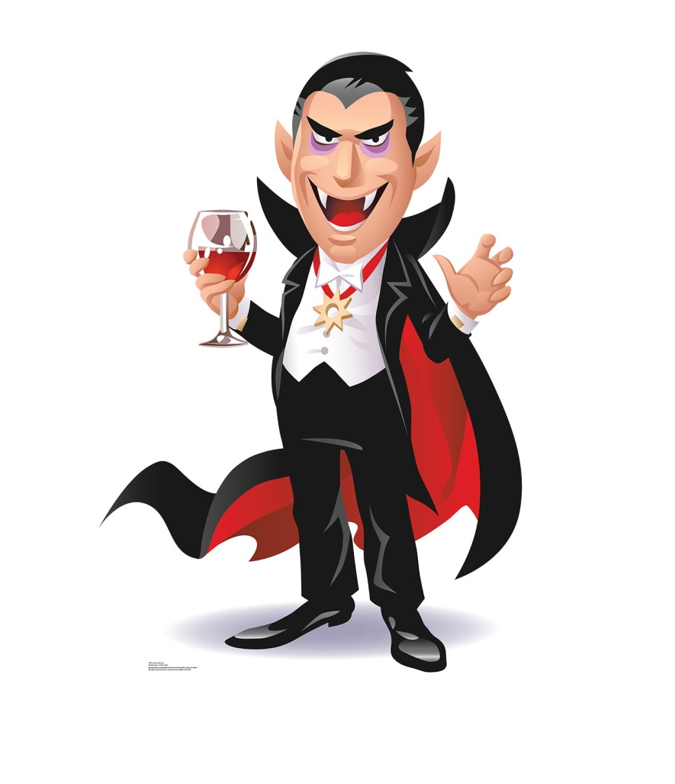
SO1 Defence Requirements Authority for Culture and Language (DRACL)

Slide 3
DRACL Mission
DRACL, on behalf of ACDS (Ops) (Training Requirements Authority (TRA) and Senior Responsible Owner (SRO) for culture and language (C&L) in Defence), is to act as the TRA’s agent and Defence capability custodian, carrying out TRA responsibilities in order to bring coherence and Defence Systems Approach to Training (DSAT) rigour across the C&L portfolio.

Slide 4
VIDEO

Slide 5
Stakeholders
IDT
DE&S
Navy Pers
SIGINT
4*
Navy
DBS NSV
The Big Word
HUMINT
CONDO
JACIG
C4ISR
IDT
ADOC
2*
PJHQ
IDev
4*
Army
2*
JSCSC
3*
DefAc
3* JFD
4*
JFC
DRACL
SO1
DCLC
4*
RAF
AWC
IDT (22 Trg GP)
1*
JW
ACDS (DE)
SO1
DCSU
4*
MOD CS
NATO EASP
DE Strat
X-Gov Dept
MOD
(OPS DIR)
2*
ACDS (Ops)
SRO - TRA
DALSC
1*
DSF

Slide 6
DRACL – “Bringing Order to Chaos”
Aim
Why?
How?
What?
Success
Challenges
Questions?

Slide 7
Culture & Language Governance Structure
Joint Influence Board (JIB)
Sponsoring Group
Directs Capability
Chair ACDS(Ops), SRO
Training Requirements Authority (TRA)
FLCs
Provision of pers
Custodians of latent capability
JFC CMG
Resources training activity
Publishes C&L Capability Management Plan
Defence C&L Steering Group
(DCLSG)
Def C&L Programme Board
Chair: JFC JW Head Warfare Development
Defence Requirements Authority for Culture and Language (DRACL)
TRA Implementation, acting as TRA agent
Defence C&L Working Group
(DCLWG)
Development, Delivery staffing
Chair: JFC JW AH Development
Defence Academy
Lead Training Delivery Authority (TDA)
Joint Service Command and Staff College (JSCSC)
Training Delivery Authority (TDA)
Defence Centre for Language and Culture (DCLC)
Culture & Language Training Provider

Slide 8
Defence Systems Approach to Training (DSAT)
1. Analysis
Analysis is the first part of the DSAT process and is usually trigger by
an evidence-based Statement of Requirement (SOR), reflecting the need for a new or revised
analysis of the requirements of a job.
2. Design
The Design stage follows the Analysis stage and is
itself split into 2 different stages, taken from the Role PS.
STAGE 1
Formal Training Statement (FTS)
Consists of:
STAGE 1
A. Training Needs Analysis
Steering Gp (TNASG)
Training
Objectives (TOs)
Training
Performance
Statement (TPS)
Workplace
Training
Statement (WTS)
Residual Training
Gap Statement
(RTGS)
Scoping Exercise
Enabling Objectives (EO)
&
Key Learning Points (KLPs)
TrAD Raised
Analysis
STAGE 2
Role Analysis (RA)
which then creates the
Role Performance Statement (RPS)
STAGE 2
Methods & Media Analysis
Learning Scalar
Assessment Strategy (AStrat)
Assessment Specification (Aspec
Knowledge, Skills and Attitude (KSA)
DSAT
Evaluation
Design
Task Analysis
OR
Competence Analysis.
Training Design Review
Delivery
3. Delivery
The key output of the delivery stage is manpower trained to the required
standard, specified as TOs in the FTS. This is achieved through the
delivery and evaluation of the trg by various personnel within the
organisation.
Training Gap Analysis (TGA)
Trained Output
Requirement Review
4. Evaluation
Training Needs Report (TNR)
Return Of Investment
(ROI)
Training Needs Evaluation (TNE)
Statement of Training Task (SOTT)
Statement of Trained Requirement
(SOTR)
Defence Culture & Language (DC&L)
Governance Structure
Internal Validation
(InVal)
Trainee and Trainer Management
Defence Trainer Capability (DTC)
Risk/Assumption Management
Continuous Improvement (CI)
External Validation
(ExVal)
1st Party
Audit (1PA)
2nd Party
Audit (2PA)
3rd Party
Audit (3PA)
External
Training Quality Manual (QM)
Training Preparation
Lesson Planning
Programming
Resourcing
Pipeline Management.
Service Command responsibility to ensure
correct numbers and types of personnel
Commander’s Risk Assessment (CRA)
Piloting
Management of Training Deficiency

Slide 9
DRACL – Capability Areas
Foreign Language Capability
Culture Capability
English Language Training

Slide 10
DRACL – Additional Outputs
Language assessments - MoDLAB
Language awards (over £1M spend per year)
Coordination of the Training Requirement (SOTR)
Language Training Evaluation (including External Validation)
Language data analysis

Slide 11
Defence Requirements Authority for Culture and Language (DRACL)
“Bringing order to Chaos”
Maj David Gibb MA AGC(ETS)
BILC – May 2017

Slide 12
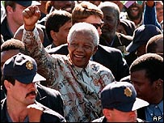
"If you talk to a man in a language he understands, that goes to his head. If you talk to him in his language, that goes to his heart"

Slide 13
Foreign language assessment
UK MOD Language Assessment Board (MODLAB)
In partnership with IoL Educational Trust (IoLET):
IoLET – the Awarding Organisation of the Chartered Institute of Linguists
The only specialist languages Awarding Organisation in the UK
National recognition and accreditation through Office of Qualifications and Examinations Regulation (Ofqual)
Track record with government and public sector
High level public examinations for professional language skills
50+ languages annually

Slide 14
Multi-Level Assessment (MLA)
NATO STANAG 6001 proficiency levels
General language proficiency assessment
Content to include general language and broad military contexts
Single multi-level scheme for all (SLP 1-4):
Survival
Functional
Professional
Expert
Preparedness for national accreditation (Ofqual)

Slide 15
Assessment Development
Scheme established summer 2016
Reviewed and revised – robust structure for future
Assessment design includes:
Authoring of tasks at each level
Tasks reviewed and tested
IoLET-MoD Setting Board
Further testing and piloting
IoLET-MoD Final Setting Board
Preparation of assessments in different languages

Slide 16
Assessment Overview
Active skills: Speaking/Writing – tasks allowing performance at all levels
Passive skills: Listening/Reading – a multi-part, multiple choice assessment of progressive difficulty

Slide 17
Listening Assessment
Time: approx 50 minutes
4 parts: SLP 1 – SLP 4
Maximum marks = 10 per SLP level
Numerical marking
Pass mark of 70% within each level and across levels to achieve an SLP score

Slide 18
Speaking Assessment
The structure:
Part 1 – Interaction (10 minutes)
Part 2 – Task Resolution (15 minutes)
Part 3 – Presentation (15 minutes: up to 10 to present, 5 for questions)
Module Assessment:
Criteria marking by SLP level and strength within SLP banding (Interaction – Fluency – Vocabulary – Grammar – Discourse)
Overall SLP result based on criteria profile
The assessment is recorded

Slide 19
Reading Assessment
Time: 1 hour 15 minutes
4 parts: SLP 1 – SLP 4
Maximum marks = 10 per SLP level
Numerical marking
Pass mark of 70% within each level and across levels to achieve an SLP score

Slide 20
Writing Assessment
Format:
60 minutes
One task, selected from a choice of 5 tasks
Dictionaries not allowed
Module Assessment:
Criteria marking by SLP level and strength within SLP banding (Theme – Coherence – Vocabulary – Grammar – Presentation)
Overall SLP result based on criteria profile

Slide 21
Foreign Language Assessment – General
All marking and grading moderated internally by IoLET and at IoLET-MOD Moderation Board
Final results confirmed at Moderation Board
MLA used where realistic target is SLP 2210 and above for:
DCLC students
Independent candidates
Contract for 2 years with options to extend. Currently assessing:
Some 500 candidates a year
In approx 30 languages
Separate SLP 1111 assessment

Slide 22
Cultural Training
UK Strategic Defence and Security Review 2015
Defence Cultural Capability Competency Framework (DCCCF):
Awareness
Practitioner
Expert
2 courses being developed:
Cultural Practitioner
Cultural Expert
Initial demand approx 700 personnel from across Defence (from Training Year 17/18)

Slide 23
Defence Cultural Capability Competency Framework
Categories:
Understanding culture
Social organisation
Political organisation
Economic organisation
Beliefs and values
Physical environment
Communication & Interpersonal Skills

Slide 24
DCCCF – Example
Understanding Culture
Description: An individual cannot deliver understanding within the Culture and Human Terrain environment without knowing ‘about’ culture. They must understand the components of culture in order to analyse other cultures; this includes an understanding of their own culture as well about others. An introduction to cultural theory, an ability to understand how culture influences our perceptions and bias and various research and data analysis methods are key sub-categories to achieve competence in this category.
Level 1 – Awareness | Level 2 - Practitioner | Level 3 - Expert
To be aware of how our own culture differs from others in order to prevent cultural conflict on interaction with others. | To be able to identify the differences between cultures and apply this understand to develop and maintain good working relations with allies, partners and indigenous forces. | To be able to critically analyse and evaluate what distinguishes other cultures from our own and examine how this knowledge can be applied to support mission success.

Slide 25
DCCCF – Example
Competence Objective | Knowledge, Skills and Attitudes
 | Awareness | Practitioner | Expert
1.1 Define Culture | State the definition and main features of culture. | Analyse and differentiate between the main features of culture in order to observe cultural practices and social structures. | Critically analyse and evaluate the main features of culture, human nature and personality, and cultural patterns, practices and social structures and apply this knowledge effectively to develop appropriate courses of action.

Slide 26
Areas of Success
DRACL established and well known - rigour and accountability to capability area of culture and language
New MLA delivers value for money and gives SLP from 1- 4 in one assessment
DCCCF created and courses being developed to deliver new cultural capability

Slide 27
Challenges
Fiscal environment challenging against competing resource demands
Agility in reacting to changing demands
Managing stakeholders’ expectations

Slide 28
Summary
In the UK, Culture and Language is under 4* scrutiny
Without senior buy-in, progress is challenging. Effective governance is key
DRACL has no agenda and brings order to chaos
UK is developing both enduring contingent and operational language proficiency
Culture (Expert and Practitioner) is now a discreet capability

Slide 29
SO1 Defence Requirements Authority for Culture and Language (DRACL)
Questions

