Slide 1
2019 BILC Conference 27-30 May, Tartu, Estonia
CLOSING REMARKS

Slide 2
2019 BILC Conference 27-30 May, Tartu, Estonia
87 participants
(3 VIP NATO representatives – ACT, IMS and SHAPE)
from 37 countries
4 continents

Slide 3
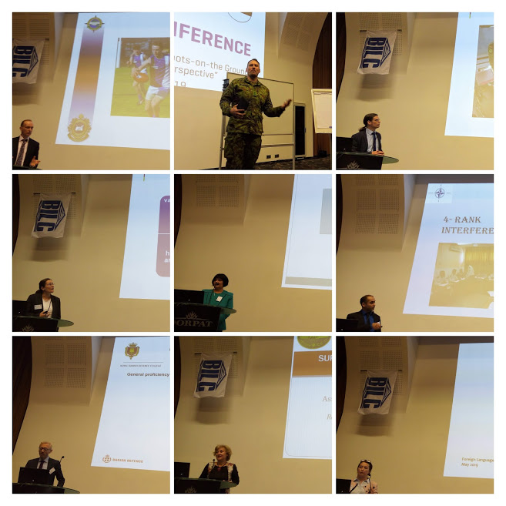
2019 BILC Conference 27-30 May, Tartu, Estonia 23 presentations + 4 guest speakers

Slide 4
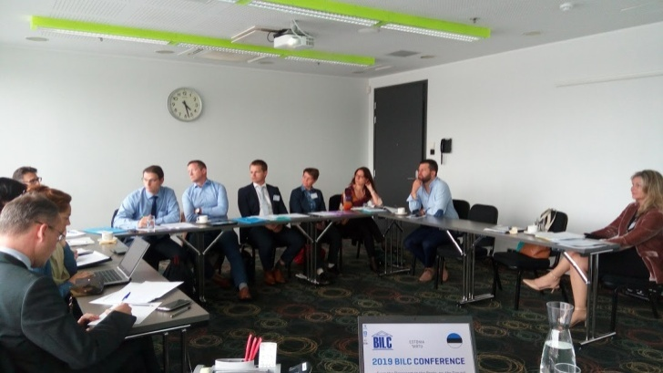
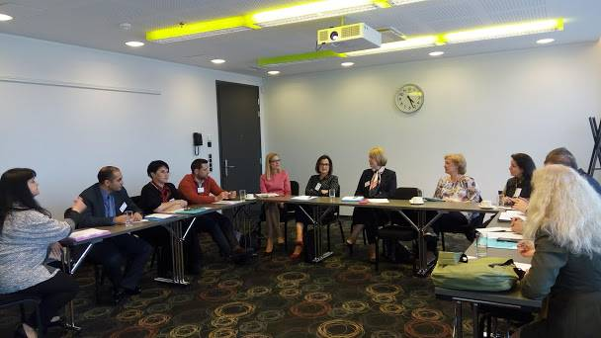
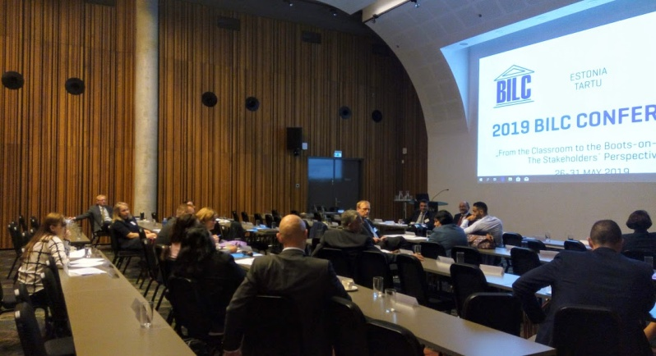
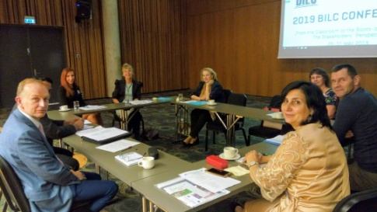
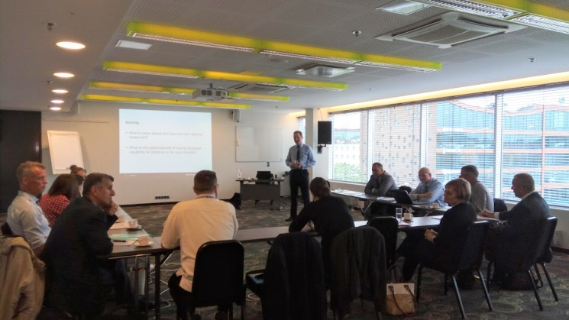
2019 BILC Conference 27-30 May, Tartu, Estonia
6 Study Groups

Slide 5
2019 BILC Conference 27-30 May, Tartu, Estonia Steering Committee Meeting

Slide 6
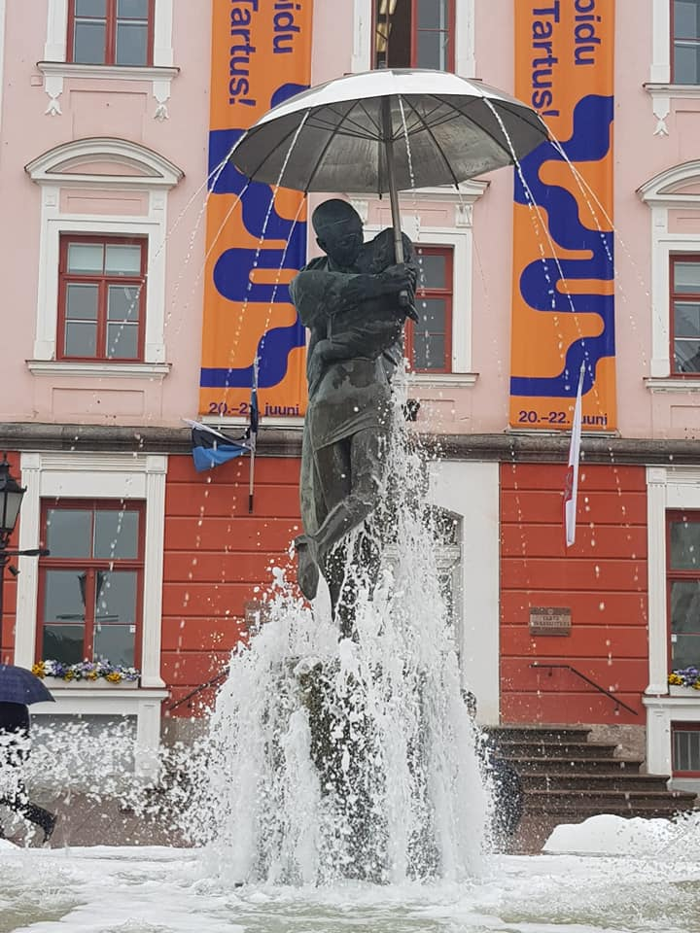
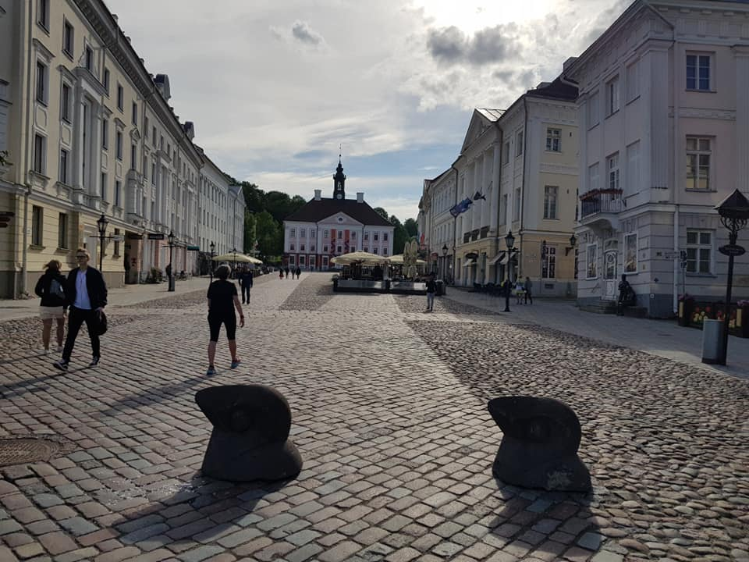
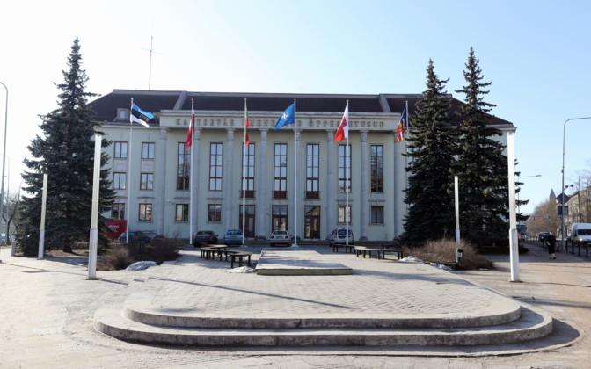
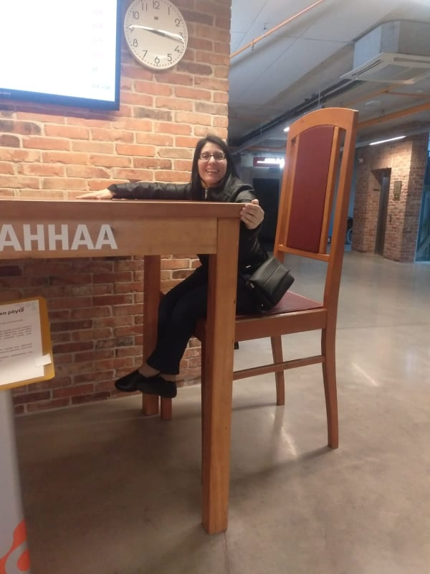
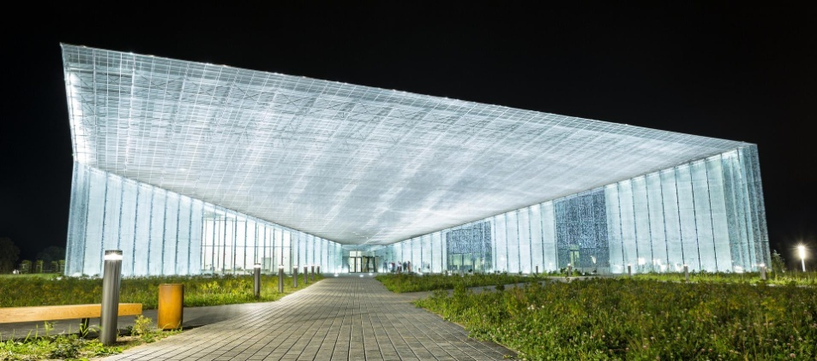
2019 BILC Conference 27-30 May, Tartu, Estonia BILC motto “Work Hard, Play Hard”

Slide 7
DEAR ALL,

