Slide 1
Defence Foreign Language Stakeholders – a UK perspective
BILC Conference – Tartu, Estonia, May 2019

Slide 2
Defence Requirements Authority for Culture and Language (DRACL):
Lt Col Matt Sharp
Maj David Gibb
Defence Centre for Languages and Culture (DCLC):
Maj Fasiel Iqbal
Mr Kris Steele

Slide 3
Scope
Seminar theme: “From the Classroom to the Boots-on-the-Ground: The Stakeholders’ Perspective”.
Aim of presentation: To outline the UK’s approach to dealing with foreign language stakeholders across Defence:
Organisational stakeholders (DRACL).
Students – innovation in language learning (DCLC).

Slide 4
Ministry of Defence plan (extracts)
Our objectives – we will:
Protect our people:
Defend and contribute to the security and resilience of the UK and Overseas Territories against state and non-state threats.
Conduct overseas defence activity.
Project our global influence:
Influence through international Defence engagement.
Promote our prosperity:
Promote UK prosperity and civil society:
Promote UK defence exports providing the lead on strategic export campaigns.

Slide 5
Where did I put the hunny...?

Slide 6
Might foreign languages be useful….?

Slide 7
Governance
DRACL – Training Requirements Authority’s Agent
Defence Academy – Training Delivery
Authority
Analysis
Design
Evaluation
(ExVal)
Delivery
(including InVal)
DCLC – Training Provider
Assessment
Defence Systems Approach to Training (DSAT)

Slide 8
The foreign language requirement
Standing.
Current operational.
Contingent operational.

Slide 9
The foreign language capability
Military personnel with language skills:
DCLC students.
Independent candidates.
Proficiency tested periodically.
Proficiency recorded on personnel database.
Incentives?

Slide 10
Outside of the training environment, what can we do to improve motivation?
The individual may be thinking:
This will be long and difficult.
This may be career negative.
Why can’t I just speak English?
Possible motivators:
Organisational culture.
Encourage (mandate?) foreign language learning.
Make learning materials available – and advertise them.
Career management.
Assess existing language skills.
Financial incentives.
Link to promotion?
A better understanding of the benefits to Defence.

Slide 11
Stakeholders
sS and JFC.
Culture and Language governance structure.
Sponsor organisations.
Manning organisations.
Employing organisations.
Defence Academy / DCLC.
Practitioners.
Contractors.
Other Government Departments.
Other countries (NATO and partners).

Slide 12
DRACL
Organisational stakeholders
DCLC
Students – innovation in language learning

Slide 13
Innovation and gamification

Slide 14
What is innovation?
Innovation does not have to be something new
Context of the innovative activity is important
Students must be engaged to aid motivation
Activity should be constantly developing
Murnane and Nelson (1984) described innovation in the context of education as resulting from experimentation, iteration, trying different and unfamiliar techniques.

Slide 15
3 years ago
…very simple campaign/missions

Slide 16
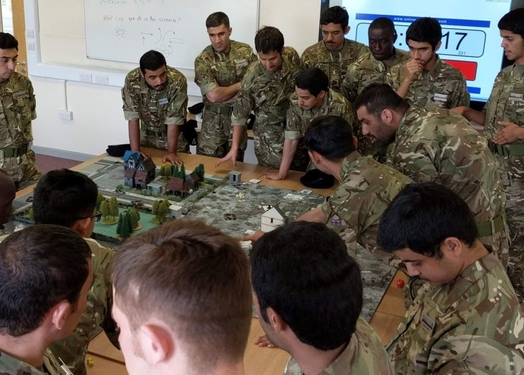
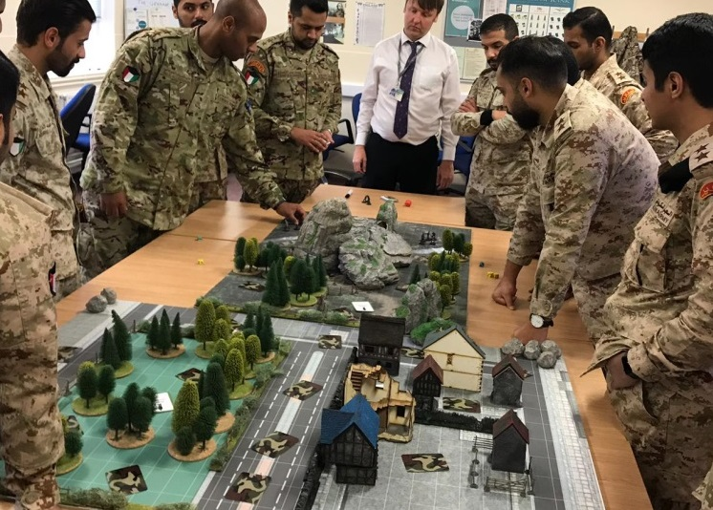
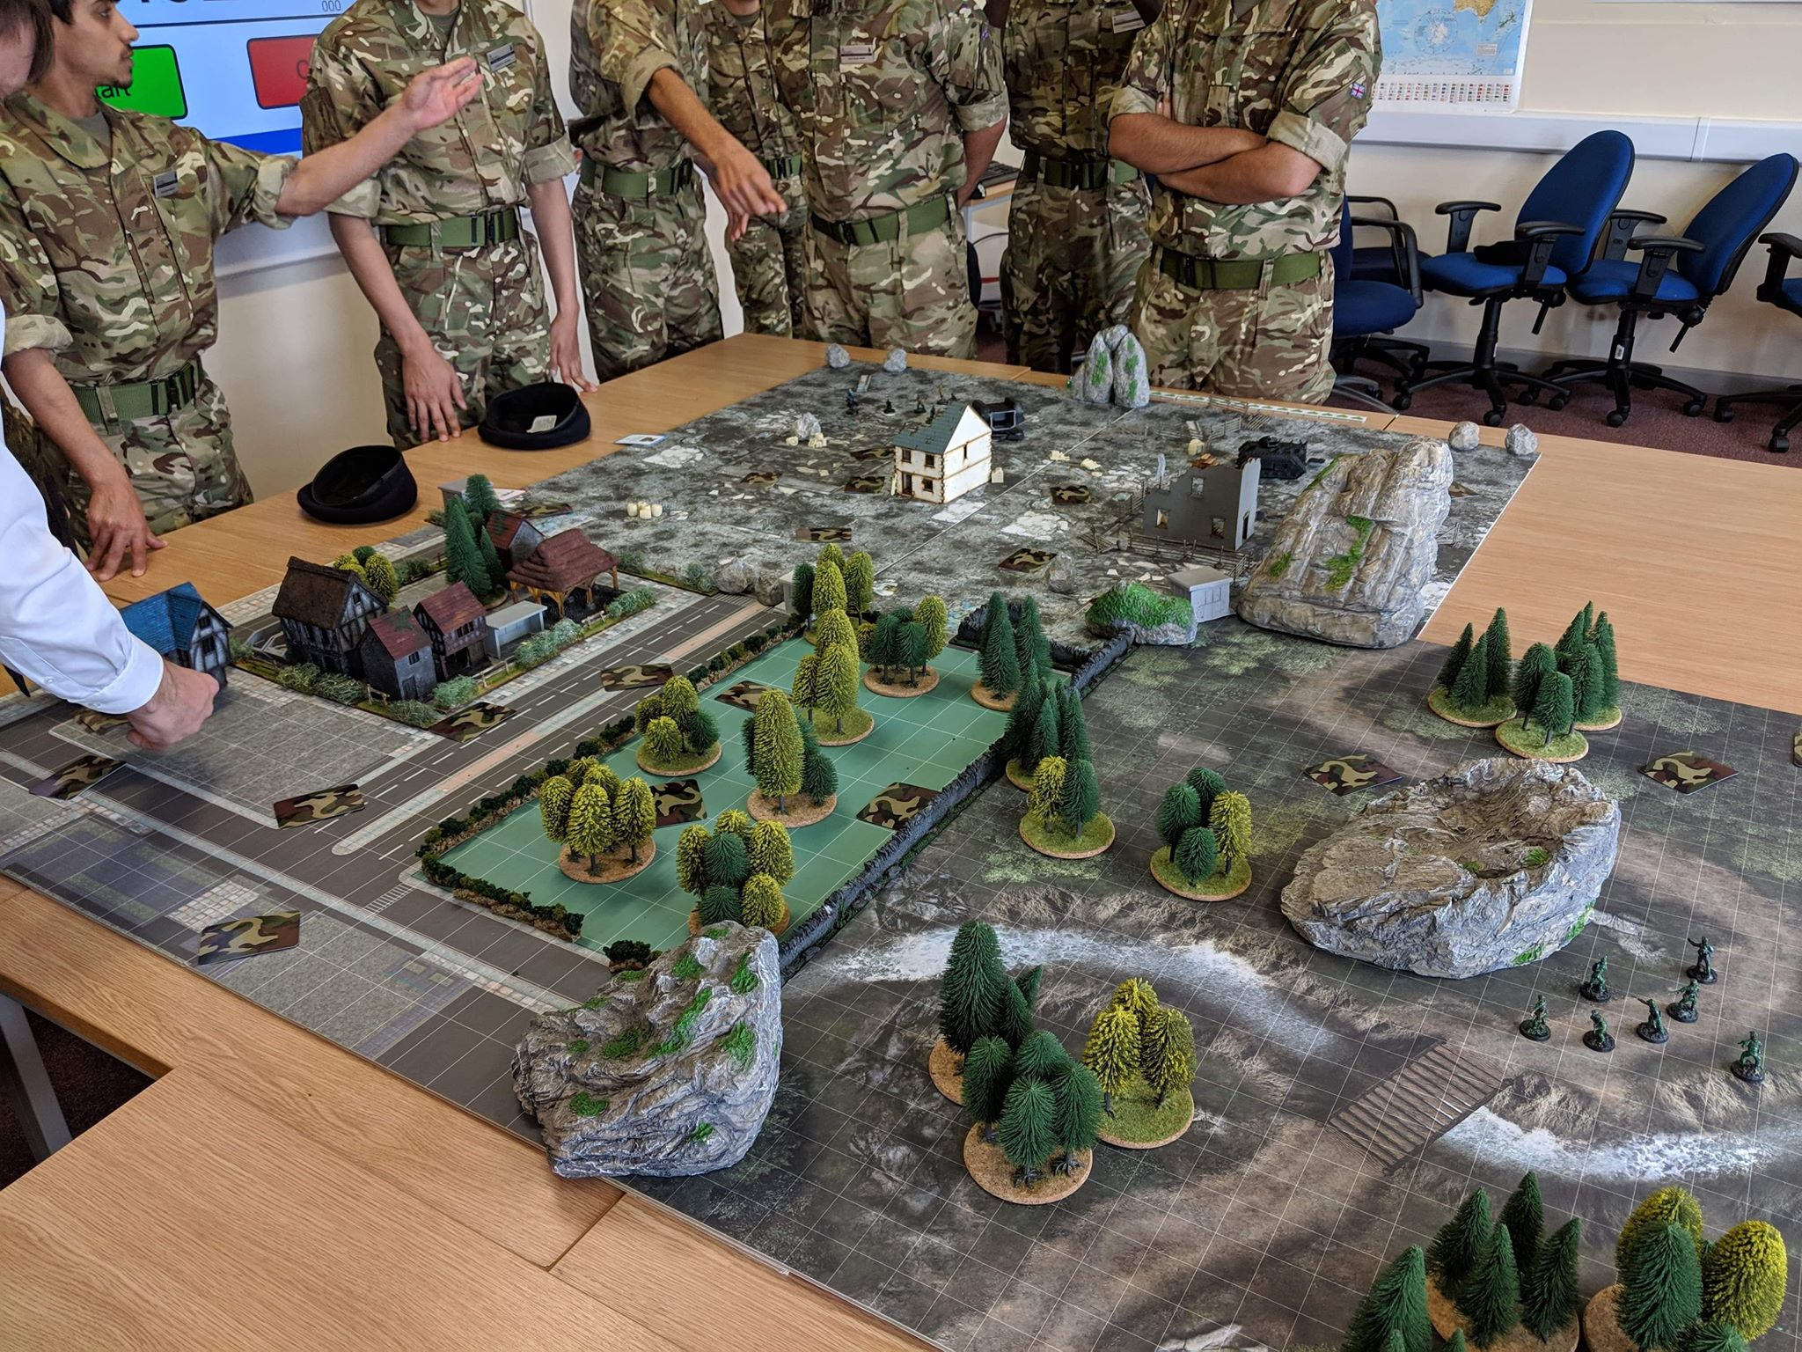

Slide 17
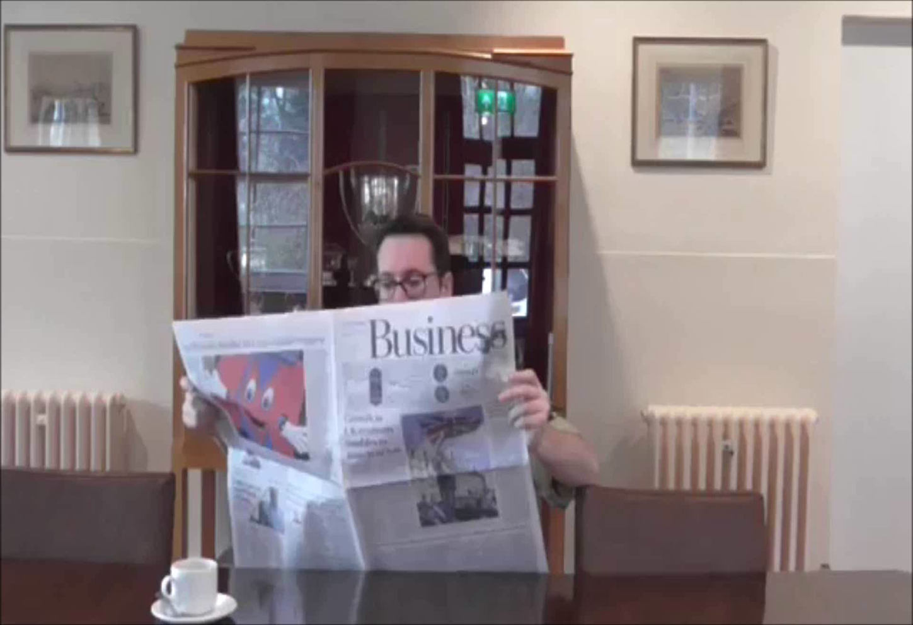

Slide 18
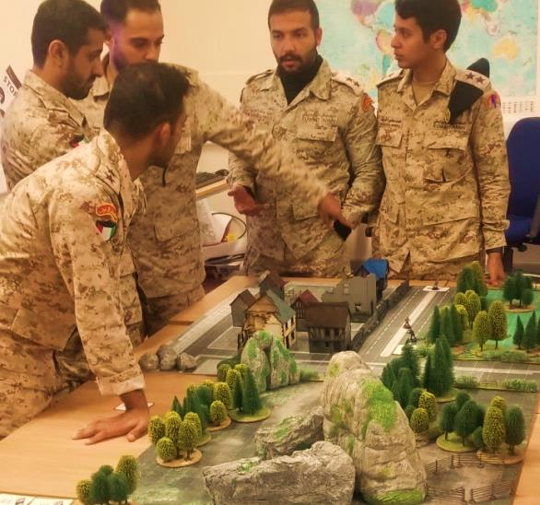
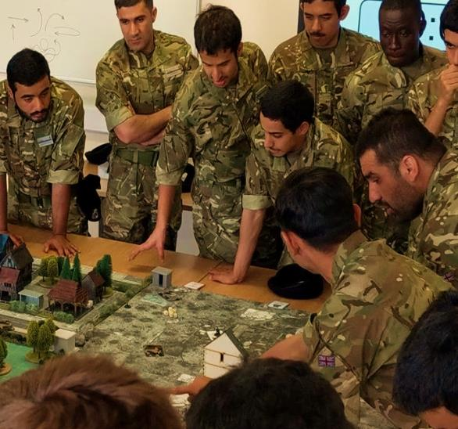
A typical scenario day
Language input lesson - terrain and prepositions
The mission briefing - listening lesson for the mission
Table top gameplay - conduct the mission
Incident report - write about the mission

Slide 19
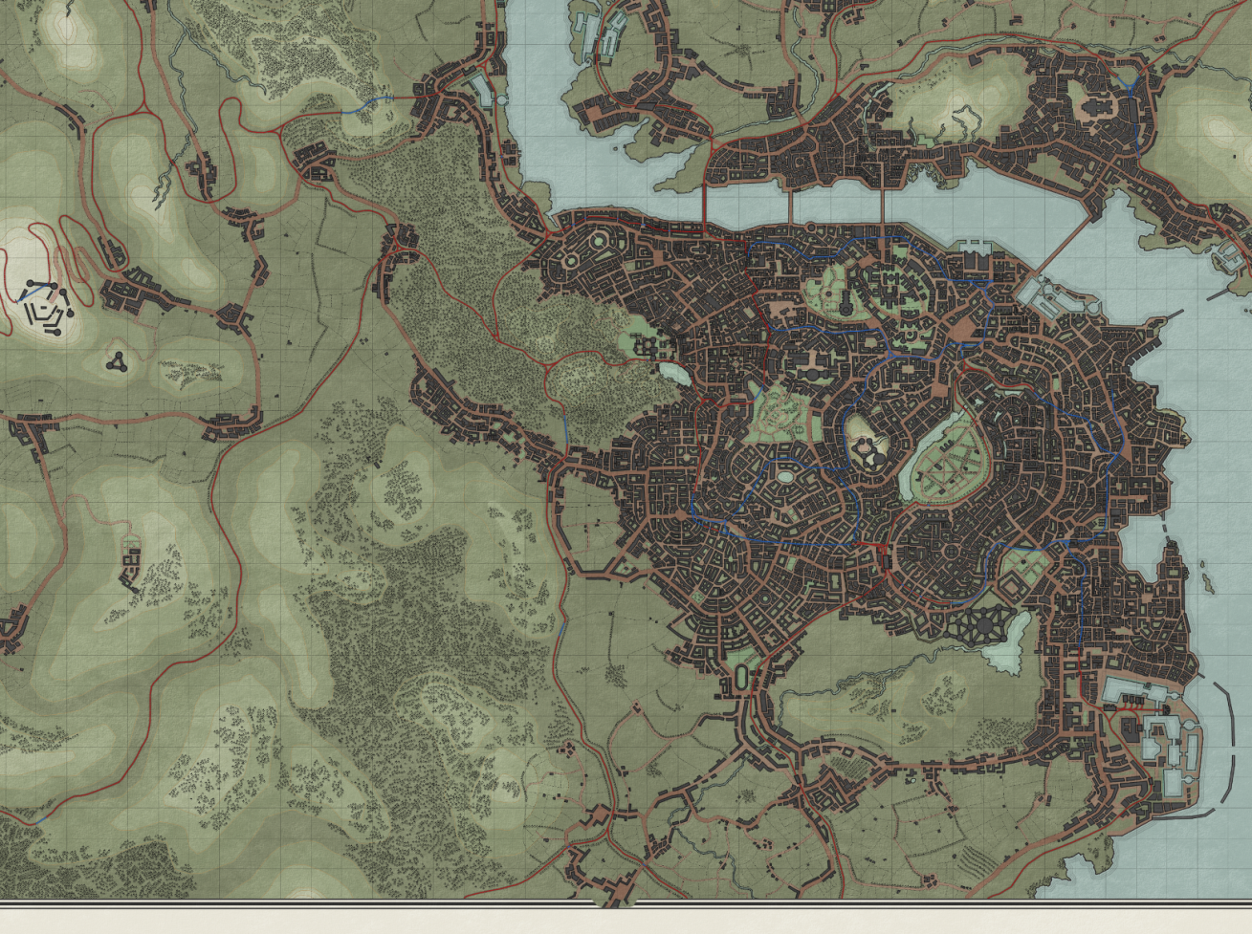
Operation Thunderstrike
Warbridge Town
Mission 3
Blackheart Village
Mission 2
Hungerdale
Final mission
Hackfall village
Mission 1

Slide 20
ELW will be offering a 2 week course in 2020
It will:
Explain the use of gaming in language teaching
Mentor participants in the use of gaming
Develop and design scenarios for participants
Provide a basic gaming board

Slide 21
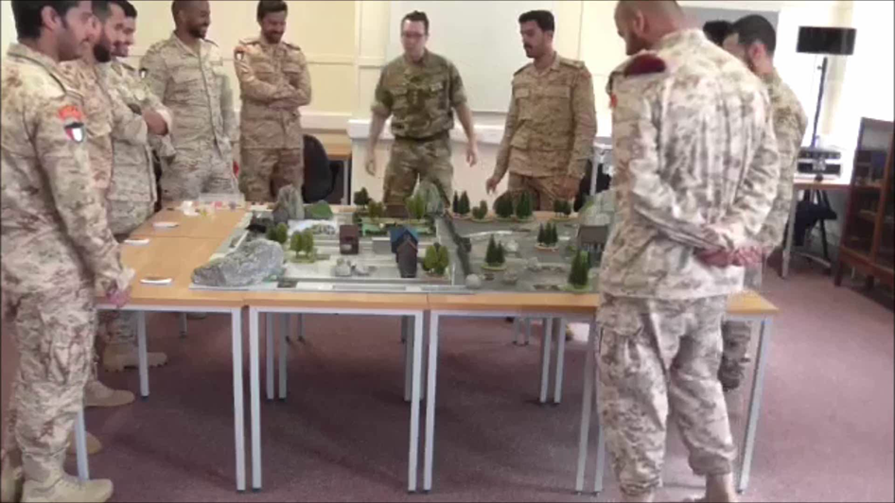
Questions?

