Slide 1
Relearned Freedom: Off line to Immersive
Director DCLC
Head English Language Wing

Slide 2
Mission
To deliver language training and cultural awareness to British and international defence personnel in accordance with NATO standards
Notes:
What we do – this is our mission
One of the tools to achieve this has been immersion training i.e. a period of time when the language student is sent to study, function and live in a country where they are surrounded by the language and culture – total immersion

Slide 3
Off line to immersion … immersive
How we used to do it
Pre-COVID
During COVID
Lessons from 2 pasts
What we do now and how: building for the future
Other factors
Global geopolitics
Culture
EL
Immersive – tabletop wargaming
Notes:
So the scope of this session is to take you through a journey .
From F2F off line, then on line, and coming off line again
I’m sure much of this will resonate with you
How we used to do it
Pre-COVID
During COVID
What’s changed?
Lessons from 2 pasts
What we do now and how: building for the future
Other factors
AI
EL
Culture
Summary

Slide 4
What we did
Pre-COVID
Immersion training!
During COVID
Isolation training
Cultural training
Notes:
Time spent immersed in a country is the single most beneficial experience in when learning a language increasing:
- fluidity in speaking
- Listening, especially to individual accents
- confidence
Additional benefits
– exposure to language in ‘real’ situations – the students can’t control their surroundings, can only control how they interact
- cultural experience (more on this later) – observations of behaviour, sharing of experience – helps to discuss (with native speakers, colleagues, tutors ..)
However, difficult to measure the benefits of immersion trg. Cannot compare one student’s performance had they not experienced immersion trg, nor can compare student A and student B.
Value unquantifiable and difficult to prove .

Slide 5
Lessons from 2 pasts
Immersion trg increases:
- fluidity in speaking
- listening, especially to individual accents
- confidence
- speed
During COVID: results seemed to by 1 x SLP level
Formal external evaluation:
Notes:
Not all lessons are negative: immersion trg is good!

Slide 6
Lessons
A key part [of language training] has always been an in-country module for immersion training … the impact of [not having immersion training] has been an individual who arrives … much less productive.
theory on the course was “solid but hard to employ” because it was “not immersive enough”.
Exchanges are frequently littered with jargon, slang, acronyms etc and it is somewhat challenging to operate effectively …. recommend time in country before starting
I was able to benefit from a lengthy placement … I benefitted from a long period of time in the country
… the immersion training on the course was extremely helpful … appreciated the immersion training but said 1 month was insufficient … the motivational and confidence benefits of immersion training …praised the immersion training for providing confidence …more immersion training
The most valuable & important aspect of the training is the immersion package; this combined an excellent balance of daily teaching with cultural & language immersion.

Slide 7
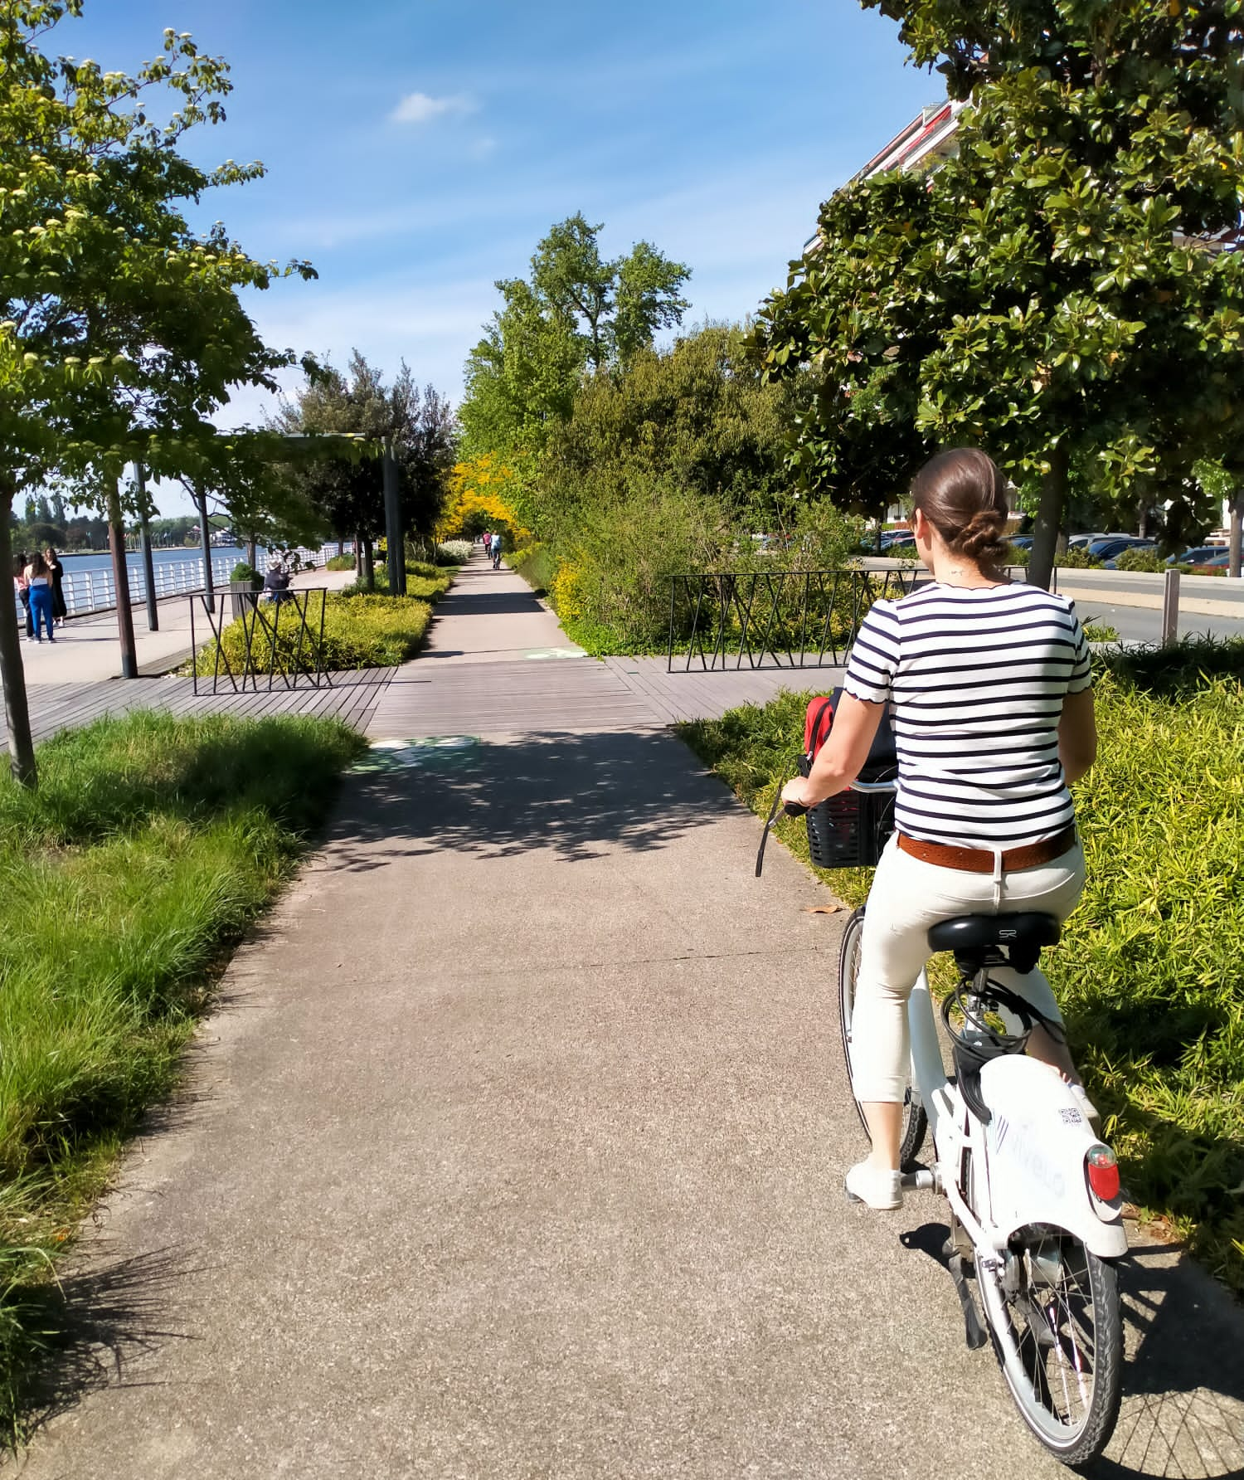
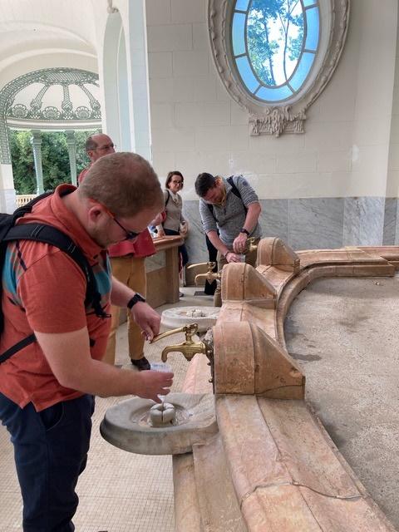
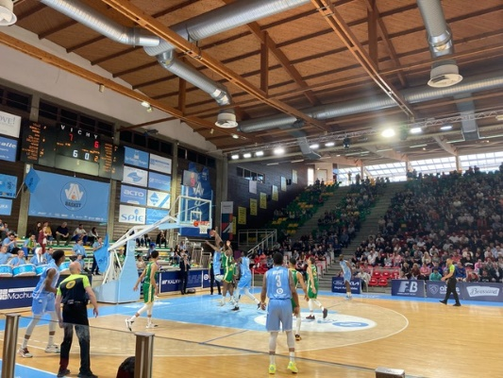
What we do now
Reinstated immersion
Dedicated post
Tailored
If cannot do immersion:
Isolation
Intense cultural prog
Notes:
Reinstated immersion trg
Gravitas – dedicated CS (Major equivalent) post: SO2 International Placements
Much reduced budget:
- tailored, targeted programme – mi placement // homestay // location (eg Arabic dialect)
- SLP2+ only (below good SLP2 the language levels are too rudimentary to benefit from immersion trg enough and within the schedule)
Homestay vs ‘lodge’
Many languages cannot do immersion – geopolitical situation.
‘isolation’ / pseudo-immersion – Explain.
- contractors
- cannot replicate exact experience
- US have well-developed and v good prog – eager to learn about this, and other countries’
Intense cultural prog
- in situ but change: students wear civ clothes; practical exercises and mil exercises such as orienteering, first aid
- interaction with other native or fluent speakers F2F or presentations/discussions online
- evenings and weekends too: movies, meals,

Slide 8
Other factors
Global geopolitics – a constraint
Culture
English Language Wing
AI: Immersive
Notes:
Geopolitics

Slide 9
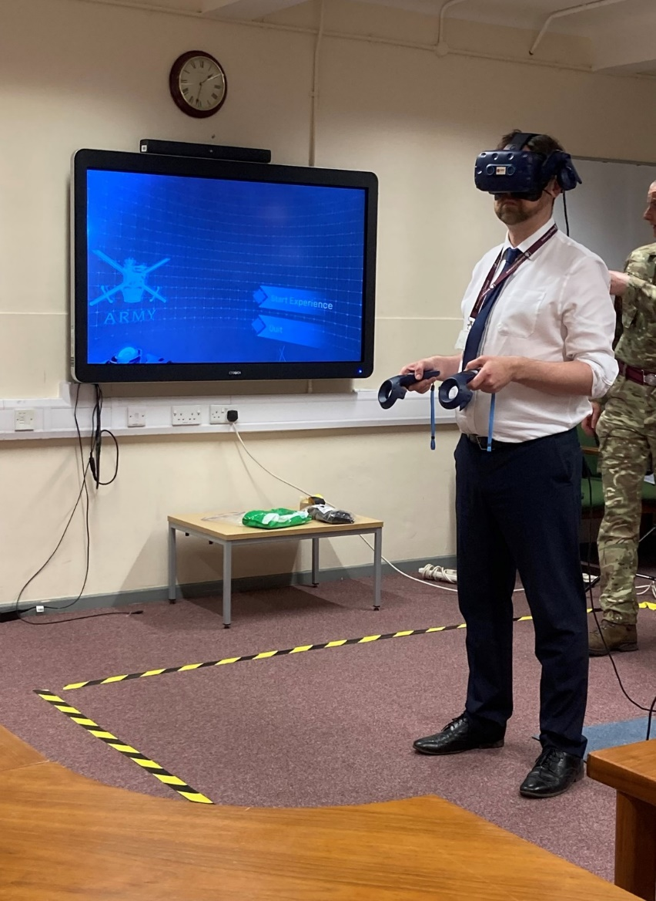
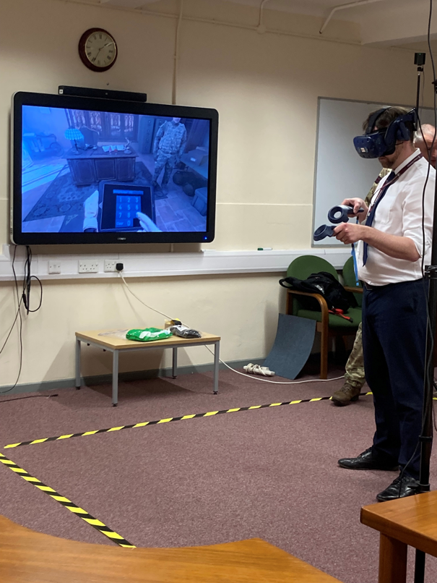
Other factors: Immersive
Notes:
Chris!
Experience

Slide 10
Summary
Immersion training is invaluable
There are ways to mitigate its loss, but not the same
Can be costly – but VfM
Risks
Is AI the future?
We look forward to discussing and learning together

