Slide 1
Teaching ”Generation Z”
English on intermediate level
- challenges and propensities.
CAPT. Krzysztof WOLAK
Lecturer
Foreign Languages Department
General Tadeusz Kościuszko
Military University of Land Forces
Loreto, May 2022

Slide 2
PRESENTATION OVERVIEW
Generation Z – definition and traits
English on intermediate level
Teaching Generation Z

Slide 3
THE AIM OF THE PRESENTATION
To familiarize listeners with:
The term ’’generation Z” and its unique traits.
Learning preferences of ’’generation Z”.
The outline of the teaching methods .

Slide 4
GENERATION Z
Generation Z (or Gen Z for short), colloquially also known as zoomers, is the demographic cohort succeeding Millennials and preceding Generation Alpha. Researchers and popular media use the mid-to-late 1990s as starting birth years and the early 2010s as ending birth years. Most members of Generation Z are children of Generation X.
Notes:
The Merriam-Webster and Oxford dictionaries both have official entries for Generation Z.

Slide 5
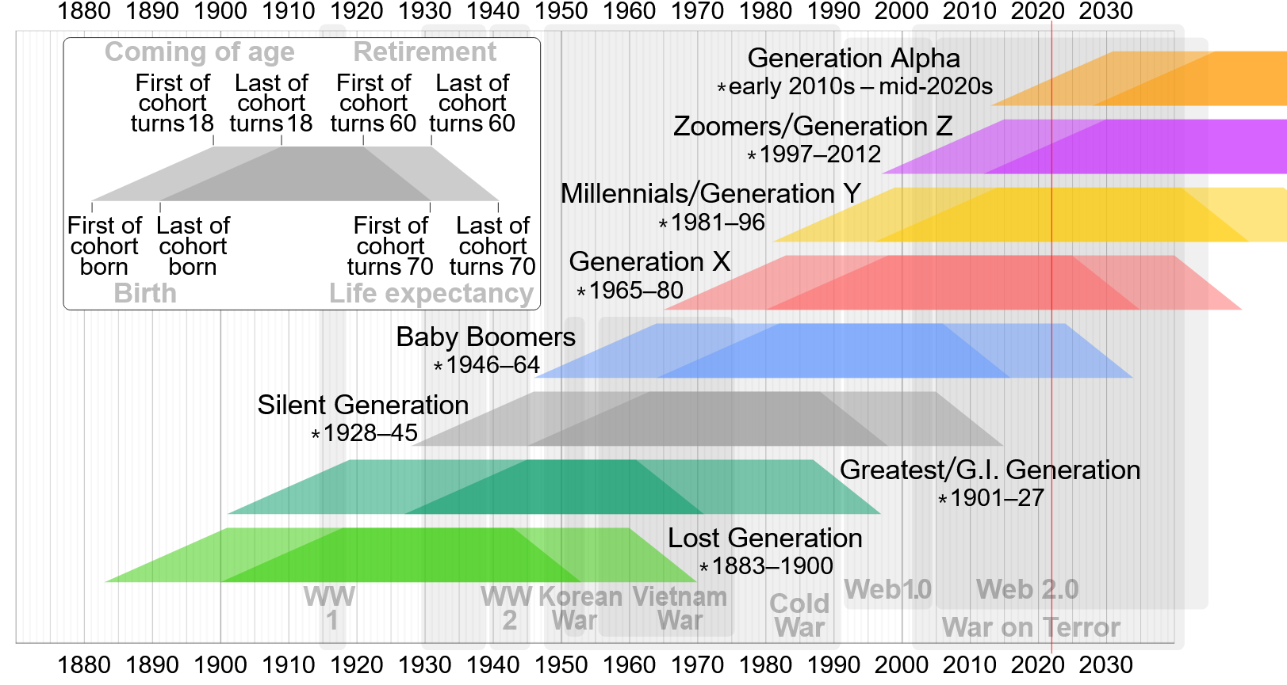
GENERATION Z
Notes:
The generations overlap each other because the terms are used to describe a worldwide trend. Technological development has its own pace in different countries.
What is the invention that is crucial for Generation Z individuality? Web 2.0
Web 2.0 (also known as participative (or participatory) web and social web) refers to websites that emphasize user-generated content, ease of use, participatory culture and interoperability (i.e., compatibility with other products, systems, and devices) for end users. A Web 2.0 website allows users to interact and collaborate with each other through social media dialogue as creators of user-generated content in a virtual community. This contrasts the first generation of Web 1.0-era websites where people were limited to viewing content in a passive manner. Examples of Web 2.0 features include social networking sites or social media sites (e.g., Facebook), blogs, wikis, folksonomies ("tagging" keywords on websites and links), video sharing sites (e.g., YouTube), image sharing sites (e.g., Flickr), hosted services, Web applications ("apps"), collaborative consumption platforms, and mashup applications.
The Oxford Dictionaries describes Generation Z as "the generation reaching adulthood in the second decade of the 21st century.„ The Oxford Learner's Dictionaries describes Gen Z as "the group of people who were born between the late 1990s and the early 2010s". The Merriam-Webster Online Dictionary defines Generation Z as "the generation of people born in the late 1990s and early 2000s."

Slide 6
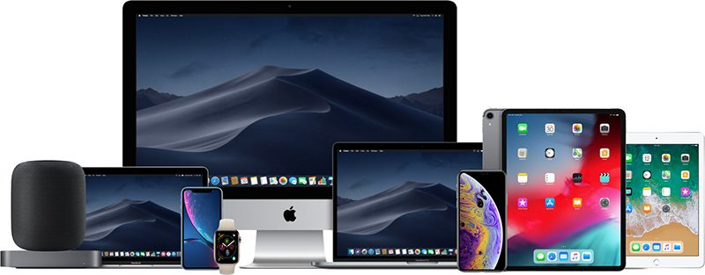
GENERATION Z – OTHER NAMES
Generation Z has been dubbed as:
iGeneration;
Net Gen (Internet Generation);
Notes:
Even though the google trends show that the term „generation Z” is the most popular query…
iGeneration – especially western countries
Psychology professor and author Jean Twenge used the term iGeneration (or iGen for short), originally intending to use it as the title of her 2006 book about Millennials, Generation Me, before being overruled by her publisher. At that time, there were iPods and iMac computers but no iPhones or iPads. Twenge later used the term for her 2017 book iGen. The name has also been asserted to have been created by demographer Cheryl Russell in 2009.

Slide 7
GENERATION Z – OTHER NAMES
Generation Z has been dubbed as:
(neo) Digital Natives;
Centennials;
Zoomers.
Notes:
Digital Natives – born during or after the Digital Age, always ON, attached to a phone or other device, intuitive learners, multitask and rapidly task-switch, extremely social (not 1 or 2 people they are close friends with), multimedia oriented – Neo because some think Millenials to be true natives
Centennials – in reference to them being born in the first century of the second millennium
Zoomer – combines the term boomer (stemming from baby boomers)

Slide 8
GENERATION Z – CORE TRAITS
The Internet has always been there;
Financially focused;
Entrepreneurial, competetive and multitasking;
Universal culture;
Educated consumers;
Always ON - social (FOMO);
Aware of the online threats – tech savvies;
Speedy – short attention span.
Notes:
Unlike their Millennial counterparts who often need to love what they do, Gen Z understands that work is performed for financial reasons. They’ll readily accept employment that provides a steady income and necessary benefits even if it isn’t their dream job.
Generation Z is used to competition and enjoys the challenge of putting themselves to the test against someone else. They know, thanks to social media, how succesul their peers are. If you can encourage a healthy sense of competition in your classroom, particularly during the training stage, you can keep young employees motivated and help them do their best work.
Popular franchises like Harry Potter, Star Trek, Marvel, DC Comics etc.
As con­sumers, Gen Z’s behav­ior reflects their val­ues — and the influ­ence of an increas­ing­ly dig­i­tal world. Gen Z kids can rely on their tech savvy and exten­sive social net­works to make informed pur­chas­ing deci­sions. Their prag­ma­tism leads them to explore and eval­u­ate a range of options before set­tling on a prod­uct. In addi­tion, they are more like­ly to be swayed by the rec­om­men­da­tions of real-life users than by celebri­ty endorsements.
In much the same way that Gen Z‑ers use social media as a means to curate their own per­son­al brand, they also look at their pur­chas­ing deci­sions as an expres­sion of their val­ues and iden­ti­ty. As an exam­ple, they are drawn to sus­tain­able prod­ucts and brands — and are often will­ing to pay more for them. They val­ue per­son­al­ized prod­ucts, and they are drawn to brands who share their point of view on polit­i­cal issues
A short attention span, perhaps brought on by the tendency to multitask, also requires information to be delivered in rapid, short bursts if it is to be understood. Generation Z thrives on instant gratification. With this has made us harder to teach, so teachers turn to more technologically advanced forms of teaching. We‘re all adapting to this new form of life alongside technology, because society isn‘t going to go backwards. We‘ve come so far and now people need to cope with these advantages, while still keeping our work ethic in check. With developing technology we have lost the patience and work ethic that older generations had. Now the next step is finding a way for both of these to coexist.

Slide 9
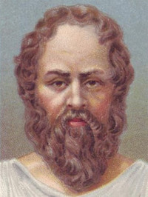
GENERATION Z – WORSE? BETTER?
“The children now love luxury; they have bad manners, contempt for authority; they show disrespect for elders and love chatter in place of exercise. Children are now tyrants, not the servants of their households. They no longer rise when elders enter the room. They contradict their parents, chatter before company, gobble up dainties at the table, cross their legs, and tyrannize their teachers.”
SOCRATES
c. 470–399 BC

Slide 10
GENERATION Z – DIFFERENT

Slide 11
INTERMEDIATE LEVEL - DISAMBIGUATION
Notes:
For the purpose of this presentation, I will focus on English on Intermediate level. This level has been chosen because of the following:
beginning of language development, not only building from scratch;
Present in every country;
Lack of true beginners;
Zoomers were already taught on basic/pre-intermediate level in their primary education institutions;
Fits into level 2 STANAG 6001 agreement;

Slide 12
INTERMEDIATE LEVEL - DISAMBIGUATION
STANAG 6001 Standardized agreement 6001 NATO - BILC | CEF Common European Framework | COE Council of Europe | ALTE: Association of Language Testers in Europe | ALTE SCALE | Cambridge ESOL (formerly UCLES) | IELTS
3 | B2+ | Vantage | Upper intermediate | 3 – Independent user | FCE | 5-6
2 | B1/B1+ | Threshold | Lower intermediate | 2- Threshold user | PET | 4-5
Notes:
For the purpose of this presentation, I will focus on English on Intermediate level. This level has been chosen because of the following:

Slide 13
GENERATION Z AND ENGLISH LANGUAGE
Low percentage of true beginners;
Prefer multimedia material to books and static sources;
Collaborative projects instead of individual, monotask assignemnts (Vygotsky’s theory of proximal development);
Short attention spans;
Multitasking.
Notes:
Cognizant with terms derived from English like „clickbait”, „snap”
In terms of academic teaching, there are virtually no beginners, elementRY AND HIGH SCHools provide education on elementary level
These students are able to intuitively use a variety of IT devices & browse the Internet. They like to tinker with the up-to-date electronic gadgets, such as iPods, MP3 players, and cell phones. These students like that because they can touch and play with these devices. They also like to explore the Internet to learn something new, to make new friends, to make your own photo album, or to learn a new tool for blogging and more. They enjoy learning through self-discovery and taking the initiative to learn new tools.
Media-rich environment is natural to them. When the Net Generation looks for information online, not only will they try different search engines (like Google and Yahoo), but they also search for interactive materials from YouTube.com. Usually THEY suffer from massive information overload. They excel in findinf information but lack in arranging them.
In general, these students are more likely to prefer learning in a supportive environment with teamwork. An activity, such as a Wiki project that can be undertaken with their instructors and peers is probably preferred by the Net Generation more than an individual assignment. This learning characteristic fits Lev Vygotsky‘s zone of proximal growth theory. The Net Generations like to build up their learning by working with peers, because the slower learners are supported by the fast learners, and they learn by scaffolding the knowledge from each other. If learning is taken as to be an individual task without support from peers, more students will be left behind. As a result, the Net Generation fits Vygotsky‘s scaffolding theory, because most of them like to work in groups with their classmates. They gain confidence and support when cooperating with peers, and
they scaffold knowledge together. Learning is not only for the individual. There is nothing to be ashamed of if you do not understand when you first learn something new; rather, they like to share their experiences in groups. Google has developed many innovative applications to create a good working environment for these learner
- The media-rich environment that the Net-Generation has become accustomed to appears to have shortened their attention span. If you ask them to work on the same thing for hours, it would probably overwhelm or frustrate them. They will probably enjoy the activities more if they can get several things done simultaneously, because they can usually shift attention rapidly from one task to another. They are generally able to multi-task better than their parents and can split their attention between different activities. Thus, an instructor should not be surprised by seeing a student listening to music, surfing the Internet, and talking to friends on the phone while doing homework. These diverse activities are all part of the Net Generations‘ daily lives.

Slide 14
GENERATION Z AND TEACHING ENGLISH
The main obstacle in implementing new teaching methods are not students, their habits, date of birth, generation or preferences.

Slide 15
GENERATION Z AND TEACHING ENGLISH
It is within teachers’ remit to adapt, improve or change their teaching strategies accordingly.
Notes:
Some teachers might object to this call to change. It is probably fair to say that many prefer to stay on their current course because it is familiar and has reaped some benefits. This attitude is unfortunate because for learning to occur, teachers need to update their teaching strategies. They need to adopt more technology-based tasks, include visual content, and provide the opportunity to be physically active in the classroom. If students are not given ample opportunities to practice and receive feedback, then the classroom experience wanes in comparison with learners‘ personal lives. The relationship between teacher and student becomes more tenuous, and student interest in learning drops.

Slide 16
GENERATION Z AND TEACHING ENGLISH
PROPOSED METHODS
If the teaching methods used in a particular place have not been updated for a considerable period of time, changes should be introduced gradually, with small steps, constant surveillance and adaptation along with periodic evaluation.
Notes:
There are a few premises which have to be taken into consideration: An overnight change will probably cause reluctance on the teachers’ part and uneasiness and confusion among students.
It is imperative to gain ackonwledgemnt from the teachers. Moreover, the teaching methods should be universal in a given school,
teachers are advised not to throw away all the traditional methods in favour of the new technology based teaching strategies. The most practical way to look at this is for teachers to innovate, technify, change within reason. As one saying goes, “If it ain’t broke, don’t fix it.

Slide 17
GENERATION Z AND ENGLISH LANGUAGE
PROPOSED METHODS
Simple online methods
Notes:
The outbreak of covid-19 pandemic proved to be a sort of catalyst in introducing elearning. Teaching centres responded to the challenge usually with the introduction of elearning software. Its usage should be continued as it enables teachers to make their lessons more attractive in terms of multimedia availability. Not complicated – rehearse. Don’t be afraid because the students are not usually tech savvies but tech-comfies.
This should be an ADDITION, not the basis.
This may be difficult as more experienced teachers tend to put too much emphasis on teaching English per se and are not familiar with current trends
Generation of multitaskers, Find person who…
Allow students to record your classes, make everything transparent and available

Slide 18
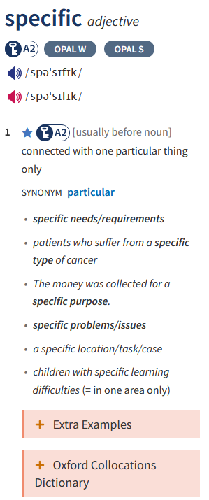
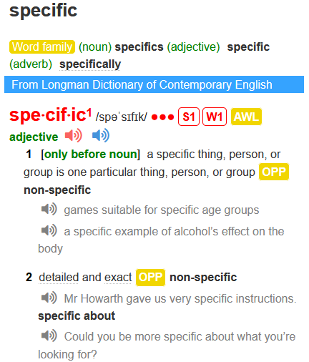
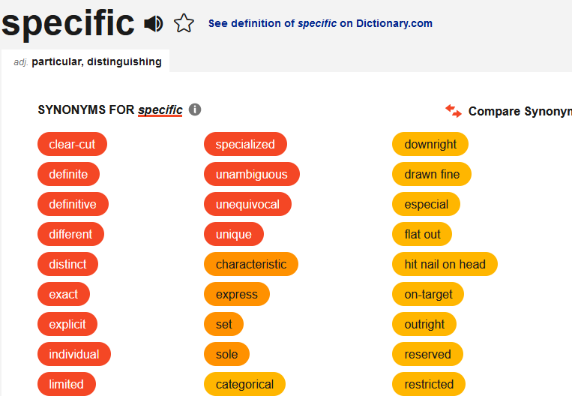
GENERATION Z AND ENGLISH LANGUAGE
PROPOSED METHODS
Teach vocabulary with context.
Notes:
Best introduced from the very beginning
Resort to translation when it’s absolutely necessary or to greatly facilitate communication

Slide 19
GENERATION Z AND ENGLISH LANGUAGE
PROPOSED METHODS
Bring movies, music, pop-culture – combine them with specific aims.
„How Expensive Were Candles in the Middle Ages”
Source: https://www.youtube.com/watch?v=mW8DZPTT13M
Notes:
This may be difficult as more experienced teachers tend to put too much emphasis on teaching English per se and are not familiar with current trends
Generation of multitaskers, Find person who…
The broader the experience of learning the better the student’s experience, as long as it is compatible with the good principles of teaching.
Visual and graphic methods help in integrating and consolidating knowledge

Slide 20
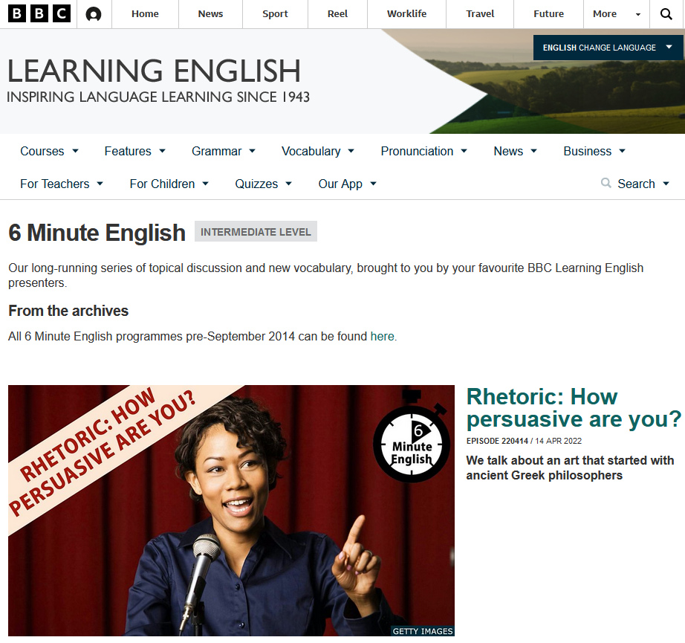
GENERATION Z AND ENGLISH LANGUAGE
PROPOSED METHODS
Bring movies, music, pop-culture – combine them with specific aims.
Source: https://www.bbc.co.uk/learningenglish/english/features/6-minute-english
Notes:
This may be difficult as more experienced students tend to put too much emphasis on teaching English per se and are not familiar with current trends
Generation of multitaskers, Find person who…
The broader the experience of learning the better the student’s experience, as long as it is compatible with the good principles of learning.

Slide 21
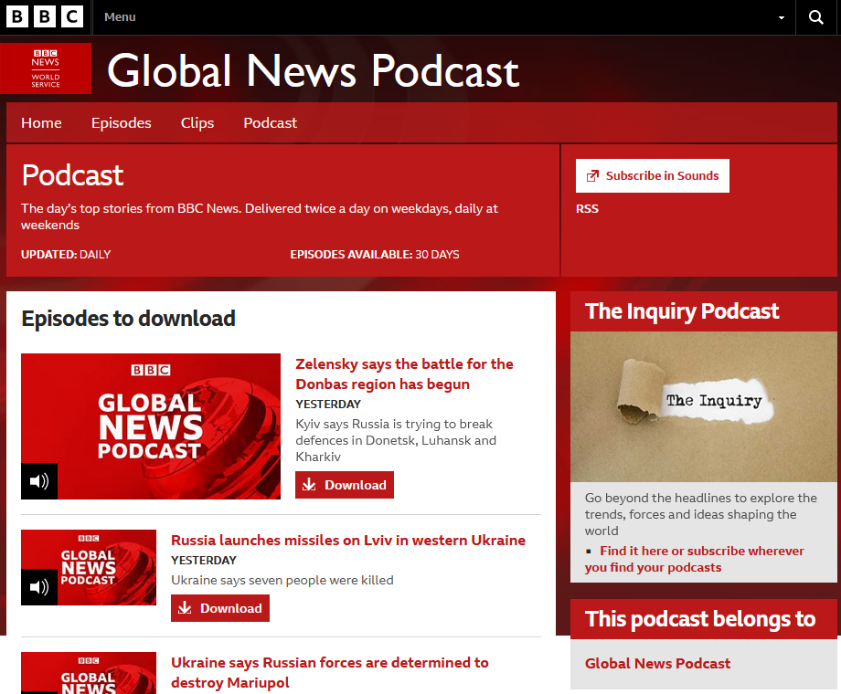
GENERATION Z AND ENGLISH LANGUAGE
PROPOSED METHODS
Bring movies, music, pop-culture – combine them with specific aims.
Source: https://www.bbc.co.uk/programmes/p02nq0gn/episodes/downloads
Notes:
Especially for STANAG listening preparations
Worth puting RSS notifications – if not familiar = introduce

Slide 22
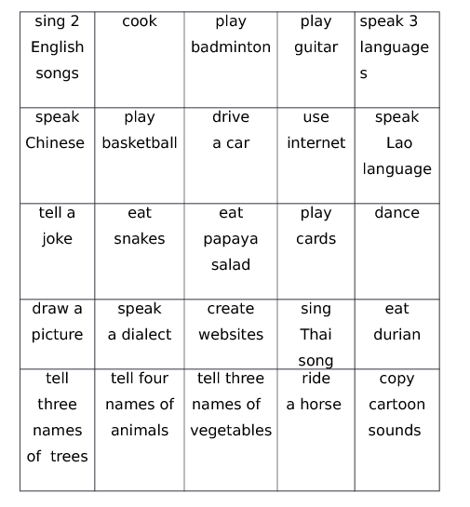
GENERATION Z AND ENGLISH LANGUAGE
PROPOSED METHODS
Combine methods with multitasking
Notes:
e.g. self-search and analysis of information in a group assignment);
Generation of multitaskers, Find person who can…
Allow students to record your classes, make everything transparent and available
Instant gratification – just a couple of red lines at the Edge of an assignment won’t do anymore. Use recordings or face to face (online) explanations.

Slide 23
IT IS NOT RECOMMENDED TO:
Pre-record lectures;
Assign long term papers;
Encourage to buy the hardcopy version of the book;
Discourage the usage of smartphones to complete a task.
OTHER IDEAS?
Notes:
Be it for the convenience of teaching the same material in many groups – no interaction, this presentation could have been recorded beforehands and played – would it have the same effect though?

Slide 24
Literature and reference material
"Words We're Watching: 'Zoomer'". Merriam-Webster. October 2021. Retrieved: April 15, 2022.
"zoomer". Dictionary.com, Retrieved: April 15, 2022.
June, Sophia (July 10, 2021). "Could Gen Z Free the World From Email?". The New York Times, Retrieved: April 15, 2022.
https://www.facultyfocus.com/articles/teaching-and-learning/generation-z-re-thinking-teaching-and-learning-strategies/ Retrieved: April 15, 2022.
https://www.facultyfocus.com/articles/teaching-and-learning/generation-z-re-thinking-teaching-and-learning-strategies/ Retrieved: April 15, 2022.
https://www.nato.int/structur/recruit/info-doc/Language%20test%20equivalence%20table_FINAL2011.pdf Retrieved: April 15, 2022.
https://www.natobilc.org/documents/TrainingResources/STANAG%206001%20Overview%20Feb%202019.pdf Retrieved: April 15, 2022.
https://www.natobilc.org/files/file/6001EFed05.pdf Retrieved: April 15, 2022.
https://www.indeed.com/career-advice/career-development/vygotsky-scaffolding Retrieved: April 15, 2022.
https://www.ldoceonline.com/
https://www.oxfordlearnersdictionaries.com/
https://www.thesaurus.com/
Reilly, Peter. 2012. Understanding and Teaching Generation Y. English Teaching Forum. Number 1 year 2012.
https://digitalcommons.salve.edu/cgi/viewcontent.cgi?article=1075&context=fac_staff_pub Retrieved: April 15, 2022.

Slide 25
Pictures
https://iclinica.pl/wp-content/uploads/2019/09/apple-2019.jpg
https://hsto.org/getpro/habr/post_images/f83/ff7/5e2/f83ff75e20693a3417156acd3c6f41e7.jpg
https://pl.m.wikipedia.org/wiki/Plik:Kahoot_Logo.svg
https://miro.medium.com/max/1200/0*tj0vXkPS5NPeU9sw.png
https://euronet.net.pl/wp-content/uploads/2021/03/MS-Teams-Icon-1024x245-1.png
https://www.youtube.com/watch?v=mW8DZPTT13M
https://www.bbc.co.uk/programmes/p02nq0gn/episodes/downloads
https://www.bbc.co.uk/learningenglish/english/features/6-minute-english

Slide 26
THANK YOU FOR YOUR ATTENTION

