Slide 1
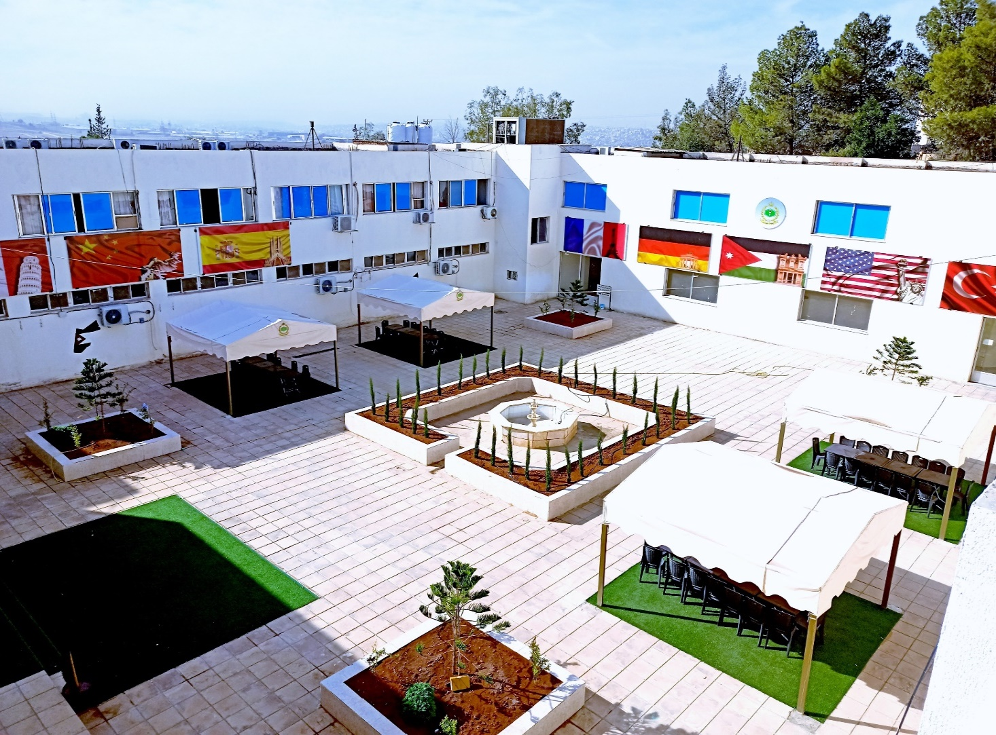
Jordanian Armed Forces
Language Institute - JAFLI
JAFLI
JAFLI
Current Situation and (e)Future
NATO BILC CONFERENCE – LORETO, ITALY
May. 2022
Col Dr Saleh Khalailah – Commandant of JAFLI

Slide 2
JAFLI – Areas of Expertise
Areas of Expertise
JAFLI
TEACHING
TESTING
12 Languages: Arabic, English, German, Turkish, French, Chinese, Hebrew, Russian, Italian, Spanish, Greek, Farsi
56 Language Teachers: 28 English ALC, 28 other FLs
Placement tests, achievement tests, progressive tests, alternative tests & Standard Level tests according to CEFR & (soon) STANAG 6001
TRANSLATION
Since 1968
Translation and interpreting according to JAF needs. We started establishing a regional center for translation services

Slide 3
Language Training in JAFLI
JAFLI
Languages taught currently | Main courses, length and no. of teaching units (held twice a year each, except for Arabic) For all languages, advanced and specialized courses can be offered upon request and need. | Number of participants 2021
English | Basic: 24 w. – 640 TUs (Equi. CEFR A2-A2+; STANAG 6001 1-1+,IELTS 3-3.3) Interm.: 24 w. – 640 TUs (CEFR B1-B1+; STANAG 6001 2+,IELTS 3.5 – 5) Advanced: 12 w. - 320 TUs (CEFR B2+; STANAG 6001 2+-3; IELTS 4.5-6.5) | 420 152 10
Arabic | BALC: 16 w. - 365 TUs RALC: 4 w. - 100 TUs
German | Basic: 23 w. – 620 TUs (CEFR A2-A2+; STANAG 6001 1-1+; Goethe-Zertifikat A2) | 22
Spanish | Basic: 23 w. – 620 TUs (CEFR A2-A2+; STANAG 6001 1-1+; DELE A2) | 21
Turkish | Basic: 23 w. – 620 TUs (CEFR A2-A2+; STANAG 6001 1-1+) | 24
Chinese | Basic: 23 w. – 620 TUs (CEFR A2-A2+; STANAG 6001 1-1+; HSK 2) | 21
French | Basic: 23 w. – 620 TUs (CEFR A2-A2+; STANAG 6001 1-1+; DELF A2) | 35
Hebrew Persian | Basic: 23 w. – 620 TUs Basic: 18 w. - 360 TUs | 26 23

Slide 4
Pandemic Impact – Timeline
JAFLI
Timeline & procedures
16.March 2020
In-JAFLI activities scaled down dramatically – students sent back to units
Courses stopped for 3 weeks
Online training MS
9. April 2020
24. May 2020
Strict physical distancing requirements and hygienic measures
Back to JAFLI
Back to JAFLI
16. Sept. 2020
Blended Learning for 3 weeks, 50% in class, 50% at home
Since 2021
27. April
Online Courses
MS Teams
JAFLI + blended when needed
eTandem, CAT, Online OPIs…

Slide 5
Pandemic Impact on Training & Testing
JAFLI
Technical:
infrastructure in JAFLI, Hardware & Software
Intensive technical support needed
Organizational and pedagogical:
Transformative effect on training & testing
Challenges for planning and providing strategies
Digital pedagogy – blended learning & the new Normal
Training the Trainers & Students
Workload (had to be reduced and adapted to the course needs)
International cooperation
Negative effect on the number of international learners of Arabic at JAFLI
Difficult planning for further training of trainers at partner language schools
Negative effect on trainer exchange programs
Better online contact
Testing:
New regulations, more time and effort needed
Testing Lab. capacities were reduced to 50%
Online Testing? Decision was made not to test online. Only in JAFLI.

Slide 6
Language Training at JAFI / now & future
JAFLI
Working on hiring high qualified civilians in the near future (Instructors & Examiners), possibly with military background.
Starting direct online connection of JAFLI with some NATO language schools and centers– online classes by native speakers. JAFLI offers offer Arabic training within online exchange programs
Working on providing JAFLI with one native language teacher for the offered languages at JAFLI English, German, French, Spanish and Turkish (full time). Possibly through language trainer exchange programs.
Offering JAFLI teachers (online) refresher and specialized language (English, German, French, Spanish and Turkish) courses on a regular basis. JAFLI can help in training Arabic language trainers of BILC partners
JAFLI works on receiving support in the evaluation process of new language trainers at JAFLI and regular evaluation and assessment of language training capacity in JAFLI in general.

Slide 7
Blended Learning and (e)Future
JAFLI
BL & Online learning seen as a new Normal integral part of our role as teachers and learners.
Focus on blended Learning as learning process & on learning processes and learning outcomes.
Establishing a Center for New Technologies in Teaching & Learning Languages
Building on the limitations of both online and in-person or/and combining the best of both
BL should not only be meant to supplement but also to transform the language learning process.
eTandem project to compensate for the limited interaction with native speakers – on-going project.

Slide 8
Testing – the New 2020-2022
JAFLI
Big support from NATO (BILC) to create Jordan STANAG 6001 team. Training within DCB starts soon.
New Organization for the testing department include :
English Language courses testing team
STANAG testing team
Testing team for externals
Intensive internal training for both examiners and teachers on testing & evaluation
New language labs. (8 labs x 30 each) – some used for conduction CAT to Jordanian officers and NCOs directly through DLIELC
New test statistics program (helped much to create new testing policy in the near future)

Slide 9
Arabic Language Training in JAFLI
JAFLI
Participants:
Since 1993, the institute got underway of teaching Arabic language for Non-Native Speaker attendants from USA, UK, Russia, Denmark, Austria, Germany, Turkey, Taiwan, Malaysia, Romania, Italy, Azerbaijan, and Australia
Courses:
So far, 80 Non-Native speaker Arabic courses have been held, 25 basic courses, 3 advanced courses, 46 refresher courses and 6 Cultural exchange courses for Australian side (ICT). All 449 attendants of these courses get intensive classes of 5 hours a day x 5 days a week with a total number of 400 hours by the end of basic course, 200 hours for the advanced course and 100 hours for the refresher course
1. Basic Arabic Language Course BALC for 16 weeks from the beginning of March to the end of June.
2. Advanced Arabic Language Course RALC for 8 weeks in the second half of the year.
3. Arabic Language Refresher Course for 4 weeks in the second half of the year.
4. Cultural Exchange Course for Australian side (ICT) for 5 days in the second half of the year.

Slide 10
Arabic – the New
JAFLI
The New in 2020-2021: JAFLI is working on new standard tests for Arabic for non-native speakers according to CEFR (A1 & A2), ACTFL (A1 & A2) and STANAG 6001 (1 & 2); almost ready. Will be officially introduced soon.
New Arabic language courses (different durations and levels) will be launched this year (2022).
ALC level tests will be available online this year (2022).
JAFLI started offering Arabic online courses for our partners
JAFLI started to offer online support in teaching Arabic to language schools from BILC community
JAFLI supports partners in Military Terminology (Arabic – all other languages, mainly English)

Slide 11
JAFLI
.
THANK YOU
Commandant of Language Institute JAFLI
Col Dr. Saleh Khalailah
Saleh.khalailah@jaf.mil.jo
Saleh_khalailah@yahoo.com
jafli.jaf.mil.jo
Whatsapp: 00962796001067

