Slide 1
Developing teaching materials for specific missions/ESP courses: AF MNE
Maja Maskovic
Jelena Mrkaic
BILC Conference
May 23 – 27 2022

Slide 2
Presentation overview
General overview of ELT in Montenegro.
Why ESP? How is ESP different from GE?
Strategic planning: Needs assessment process
Developing teaching materials for ESP: course design
ESP materials - from texts to handouts and textbooks
Language - Content continuum and methodology
ESP tasks
Practical application

Slide 3
General overview of ELT in Montenegro
MNE EDUCATIONAL SYSTEM
MNE ARMED FORCES
2008 – present GE courses
Headway English Course
ALC (American Language Course)
2013-2017 British Council: PELT MNE project
ESP projects developed within the project
Negotiating skills
Communication skills
Giving presentations
Report writing
Radio English
IELTS preparation
GE courses following the programs/curricula set by the authorities
Educational reforms and policies
Strategy for preschool and early education
Strategy for higher education
Strategy for internationalization of the University
Reforming Foreign Languages in Academia in Montenegro – ReFLAME EU, Erasmus project
Notes:
We will start by introducing the general landscape of English language learning in MNE. Up until recently - focus on general English. Distinctive features of EFL teaching in MNE were top bottom courses imposed by the authorities, grammar/translation methodology – in other words, focus placed on defining formal language features. On the other hand, the new educational realities called for innovative, optimal and sustainable approaches in efl/esl. Educational reforms and policies, NATO membership required transition from a traditional English language teaching classroom to a learner-centered classroom environment. In both contexts - shift towards learner-centered approaches. As far as the education system is concerned, recent curricular changes due to the rise of EMI courses meant that the classroom materials and methods have come to increasingly rely on discipline-specific corpora, giving better access to the language of the target community. The need for EMI courses brought about the need for language instruction across diverse contexts that concentrates more on language in context than on teaching grammar and language structures. It resulted in a shift towards a learner-centered instruction bringing to the forefront of attention ESP approach with its emphasis on needs analysis as the basis for designing instruction and developing strategic and purposeful curricula. Based on the learner-centered movement, ESP has become a more learning-centered approach, focusing not only on what people learn but also on what they need the language for.
In the military context, membership in NATO and new language requirements (interoperability goals, international setting, exercises, missions, appropriate STANAG levels required for promotion to higher ranks…) brought about the need for more content-specific courses and EFL teaching approaches, ESP in particular. Nevertheless, there was no shift towards the more comprehensive approaches to cater for the new realities. Bearing this in mind, it would be vitally important to introduce ESP courses tailored to specific professional activities organized along a continuum that progresses from the courses aimed at equipping military personnel to meet critical requirements of an assignment (Radio English course) to providing orientation or honing certain English language skills (Presentation/Negotiating skills), both in the short/term for current operations and in the long term for strategic programs.

Slide 4
1. Why
ESP?
ESP is an approach to language teaching that targets the current and/or future needs of learners, focuses on the necessary language, genres, and skills to address these needs, and assists learners in meeting these needs through the use of general and/or discipline specific teaching materials and methods (Anthony, 2018: 10-11).
Notes:
ESP focuses on building courses around learner profiles and attitudes towards language. Priority given to learner-centeredness in ESP means that the course or program administrator, the instructor in the classroom, and even the learners themselves should always be considering how language items, activities, and explanations will ultimately help the learners meet their current and/or future ‘non-linguistic’ target needs.

Slide 5
1. Why ESP? How is ESP different from general language teaching?
  Didactic dimension
  Relevance to learners’ needs
  Pragmatic, linguistic and professional dimensions
  Contextualization: Focus on assisting learners towards competence in particular genres/contexts/ particular subset of tasks or skills.
  Goal and process oriented (how is language used and how is language best acquired)
  Content/needs driven with the use of linguistically sensitive strategies - turning language learners to language users (effective use of language in professional setting)
  Educational psychology dimension
  Central importance of the learners and their attitudes to learning
  Ethic of transparency grounded in dialogue: partnership of learners and instructors
  Motivation – meaningful activities that lead to autonomy and self-direction
Notes:
From didactic perspective, the most important aspect is relevance to learner’s needs. Motivation - build the courses around learner profiles and attitudes toward English.

Slide 6


2. How is ESP different from general language teaching?
  ADVANTAGES
many possible foci depending on the context
clear goals and subject boundaries
faster acquisition of required linguistic items
follows the native acquisition pattern
maximum use of learning resources
Notes:
In most of the traditional (GE) programs, learning objectives are expressed in terms of the traditional categories of grammar and vocabulary. Lesson and course goals are built on concepts such as mastering the tenses; using main, modal, and auxiliary verbs correctly; constructing simple, complex, and compound sentence patterns; expressing ideas in the active and passive voice; learning the rules of article usage; asking questions, etc. Register/Genre analysis of content specific materials provides ESP course designers and instructors with a solid foundation for targeting and teaching ESP-focused grammar, setting the clear boundaries and ensuring faster and more meaningful learning of the target language units, be it lexis or grammar. Corpus linguistics tools and software may help us decide what is common/frequent in language and what is not, helping us in getting an accurate picture of what should be taught in classroom.

Slide 7
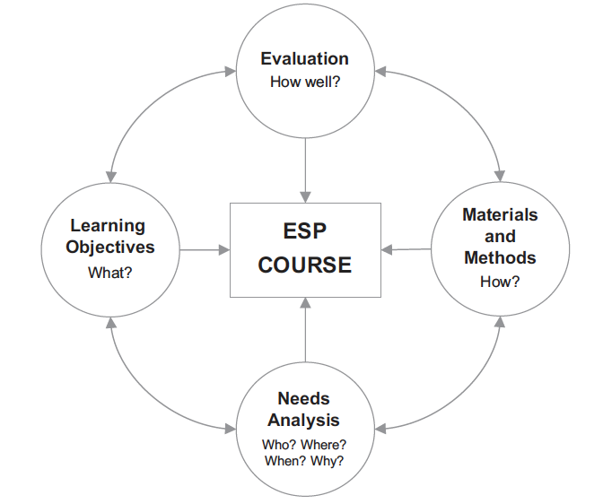
2. How is ESP different from general language teaching?
The four pillars of ESP (Anthony, 2018)
Notes:
Anthony’s four pillars provide the groundwork for creating a viable and theoretically-grounded ESP course. We will briefly explain the theories and practices that form
the basis of the four key ‘pillars’ of ESP. The first pillar is needs analysis which helps us not only in establishing what to teach the learners, but also
which teaching methodologies are likely to be successful with them. Learning objectives - establish what language, genres, and skills the learners might be expected to use in a target situation and form a set of learning objectives for the class. Once you have decided on a set of learning objectives, you then need to
consider how to sequence these in a way that is not only clear and logical, but also interesting and enjoyable. Evaluation – we evaluate the success of the ESP course itself, and also the quality of instruction. In the case of a call-center English course, therefore, you might first want to measure how much the call-center staff had overcome the lacks that were identified at the needs analysis stage. In other words, you would need to establish to what degree the learners had successfully achieved the goals of the course.

Slide 8
Strategic Planning
Organizational Needs Assessment Chart
Organizational needs assessment chart
STAKEHOLDERS
PRACTITIONERS
LEARNING CONTEXT
LEARNERS
Notes:
We proceed to discuss the basic concepts underlying the 4 pillars, the first being the needs analysis that helps us to conceive of needs at various levels, depending on whether they are learner-based, instructor-based or administration and stakeholder-based. Unfortunately, it is not unusual that course designers rely on established ‘assumptions’ about their learners rather than on the actual needs analysis. ESP instructors in a well established program can be confident that the courses they teach have been constructed based on an extensive analysis of learner needs carried out at different levels.

Slide 9
Needs Assessment Process
TARGET SITUATION ANALYSIS (TSA)
PRESENT SITUATION ANALYSIS (PSA)
CONTEXT ANALYSIS (CA)
Notes:
Several possible ways to conduct a needs analysis.

Slide 10
TSA
What tasks do the learners need to be able to do by the end of the course?
Why is it important for them to perform these tasks in English?
Why do learners want or need to learn these skills?
Notes:
What do the learners need to be able to do in the target language by the end of the course? This includes understanding the needs and expectation of the sponsoring organization. By conducting an effective TSA, the ESP practitioner is able to provide an initial listing of the target goals of the course. The TSA seeks to answer the following questions:

Slide 11
PSA
What is the learner’s current level of English? What strengths and weaknesses do they have in speaking, listening, reading, and writing?
What do the learners who will use your curriculum already know about the content?
What is their background in this area or about the job? What is their background in this area? Which key job skills do they have or lack?
What are their past language learning experiences and expectations? Why are they
Why are they attending the course and what are their personal goals?
Notes:
Through the Present Situation Analysis (PSA), the ESP practitioner describes the people who are most likely to need and take the instructional program you will develop. What are they able to do now in the target language? What are their strengths and weaknesses in language and skills, and what are their past language learning experiences that can affect how they learn? Questions to ask in this process include:

Slide 12
CA
Factors to Consider When Defining the Context
People
Physical setting of the course
Nature of the course
Teaching resources
Time
Notes:
The Context Analysis examines the environment in which the learners will be taught. The Context Analysis often provides a “splash of reality” when viewing the gap between the desired learner outcomes for the course (TSA) and where the learners are at present in terms of language proficiency and skills (PSA). This information can help the training provider negotiate more realistic outcomes within a given time frame or gain additional resources to achieve the desired goals. Optional notes/questions for CA Who are stakeholders, learners. Course: face to face, online, facilities, attendance, testing.

Slide 13
Sources of Information
The current target learners
Content experts (People working or studying in the field who are familiar with the tasks the learners need to perform)
Former students who have knowledge of the skills needed
Sample written or oral texts relevant to the field (e.g. textbooks, training manuals, DVDs, videotapes, business correspondence)
Employers, supervisors
Colleagues
ESP research in the field
Notes:
In line with the learner-centredness, the first and the foremost source of info are the learners. However, we don’t get the whole/realistic picture with their perspective only, so we need to invite involvement from other stakeholders….As far as ESP is concerned, there is an ongoing debate on who should be teaching ESP and whether ESP instructors must also have specialist knowledge. While the author concludes that some background knowledge is helpful, it is especially important to pair up with a subject specialist, suggesting that teaching ESP should not be considered as an individual endeavor, but as a team project. It is vital that ESP administrators and instructors draw on the insights of target specialists not only within their own institutions, but also through published research on specialist language.

Slide 14
Data Collection Methods
Questionnaires
Examining samples of written or oral texts
Discussions
Structured interviews
Observations (“shadowing” people in courses or on the job)

Slide 15
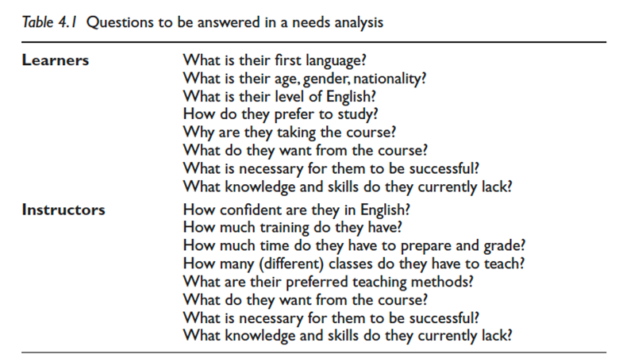
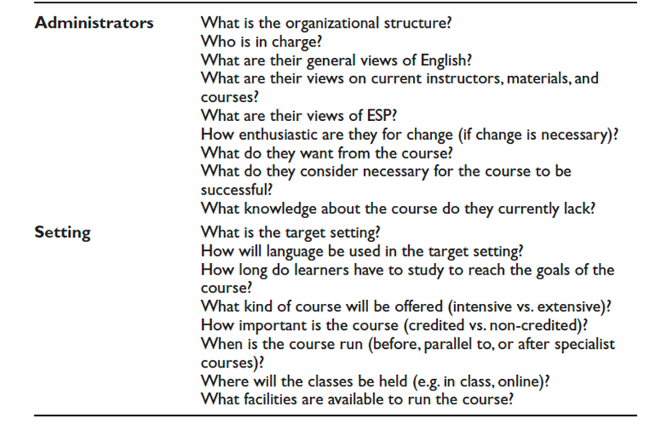
Sample Questionnaire

Slide 16
Developing Teaching Materials For ESP: Course/Syllabus Design
Selection of ESP materials
Syllabus design – breakdown of materials selected into manageable instructional units.
Syllabus – specifies the content, sequencing of instructional blocks, skills to be developed, learning outcomes, methodology, modes of evaluation.
ESP syllabus- determined by teaching materials selected/created by the author who decides the contexts in which the language will appear, the number and type of exercises to be spent on any aspect of language, the degree of recycling and revision.
Notes:
Texts should be selected systematically based on specific criteria. Syllabus – breakdown of the course plan into manageable instruction units. This breakdown has to be based on certain criteria (instructional blocks may be organized around areas of grammar/lexis, skills, strategies, etc.)

Slide 17
What are ESP Materials?
(Near) Authentic samples of the target discourse
Reflect both the language and disciplinary content.
Reflect the target communicative situations.
Notes:
Authentic materials may be used as is or changed in some way to make texts more accessible for students and/or easier to exploit from a language-learning point of view. In ESP the role of materials has an added significance in comparison to general language teaching, since the learners are often concerned with learning both language and disciplinary content. The most important aspect of ESP materials is that they reflect the target communicative situations.

Slide 18
Developing Teaching Materials For ESP:
From Texts To Handouts And Textbooks
From texts to textbooks
Compiling relevant content-specific corpora (from existing EL corpora, subject textbooks, specialist periodicals, reports, presentations and other samples produced by the target discourse community).
Analysis of the genre to identify linguistic features and communicative situations that will make up the course materials.
Notes:
Register/Genre analysis provides ESP course designers and instructors with a solid foundation for targeting and teaching ESP-focused grammar. By identifying the communicative purpose, structure, style, content, and intended audience of target texts they can formulate course and program objectives that will ensure
that learners will be able to recognize genre features and use them in their own language output, helping the learners conform to the practices of their discourse
community.

Slide 19
Language Content Continuum and Methodology
Approaches that complement ESP (Task-Based Language Teaching (TBLT)) or compete with it Content-Based Instruction (CBI), CLIL English-Medium Instruction (EMI).
Notes:
Approach usually incorporates elements from Communicative Language Teaching (CLT), Task-Based Language Teaching (TBLT), Project-Based Learning (PBL) ( Richards & Rodgers, 2014 ), and many other teaching approaches, but also has its own unique features, including a commitment to learner-centeredness, a close connection with specialist subjects, and a focus on collaborationin both planning and teaching.

Slide 20
ESP Tasks
Connect the language practiced in the classroom with real-life situations in which the learners may find themselves.
Reconstructing real-life communicative situations through the use of tasks.
Tasks: goal-oriented, do not have an obvious linguistic purpose.

Slide 21
Sample Tasks
(Radio English MNE)
A Your call sign is S2o. You have set up a check point near the town of Yola at grid 518 246. Suddenly you hear gunshots near the checkpoint and you see a hostile group of the local militia approaching the checkpoint. Send a message to T25. Report the incident and give your location and ask for support. Confirm the message from T25 and say you will comply.
B Your call sign is T25. You receive a message from S20 about a shooting incident near a check point. Ask about the safety of the situation. After receiving the answer send a message for them to remain at the location. An APC will be sent to extract them. Ask for confirmation.
Notes:
The importance of such tasks reflects on evaluation as well. One way to evaluate learner’s progress is to ask the learners to carry out a real-world task (or a simulation of a real-world task) and evaluate their performance on it. One challenge in doing this, however, is your own ability to judge the success of the learner. This can be particularly problematic when you are asked to teach an ESP course that is very much outside of your experience. In such cases, again, the use of specialist informants can be particularly useful. For example, we could ask a member of the company management team to come in and evaluate the performances of staff members while they answer a real or simulated call.

Slide 22
Practical Application

Slide 23
Practical Application

Slide 24
Practical Application

Slide 25
Questions?

