Slide 1
BILC Conference 2022
Where are we tomorrow? The changing focus in blending online and in-person training in the Bundeswehr General Staff Candidates‘ English Course
Dr. Dugald Sturges, Federal Office of Languages, Hürth, Germany
Loreto, Italy
26 May 2022

Slide 2
BILC Conference 2022
This presentation will look at…
Blended learning strategies implemented at the Federal Office of Languages 2020-2022.
How their focus has been adapted and augmented to fit the changing parameters due to the pandemic.
How this affected the Bundeswehr General Staff Candidates‘ English Course.

Slide 3
Learning from the past vs. Living in the past

Slide 4
Prologue: The Good Old Days
The world before COVID –

Slide 5
Prologue: The Good Old Days
The world before COVID –
Full classrooms
No social distancing
Exclusively in-person instruction
Online platforms and material available, but only sporadically used – a “nice to have”
Various levels of digital affinity among learners and instructors
Where warranted: excursions possible

Slide 6
LGAN

Slide 7
LGAN
Lehrgang Generalstabs-/Admiralstabsdienst National (LGAN): course for German General and Admiral‘s Staff candidates.
Annual two-year course held at the Command and Staff College, Hamburg
Preselected participants: career officers, by invitation only
Primarily German officers, but also selected officers from other NATO and Partner countries
Participants are required to have at least a valid 3333 in English, whereby a 4343 is preferred
The Bundeswehr General Staff Candidates‘ English Course is conducted by the Federal Office of Languages annually prior to the General Staff Course

Slide 8
LGAN English Course (Army and Medical Corps) up to 2019
LGAN Language Course – Phase A (approx. 50 Students – 3 to 4 classes)
12 week SLP course 3333-4444 (April – June)
4 weeks‘ leave (July)
Students already in possession of a valid 4343 in English received instruction in a further language (usually French)
LGAN Language Course – Phase B
- 1 week Command & Staff College Excursion (August - week 1)
- 3 week specific language element (military English) (weeks 2-4)
- For all participants (also those who took other languages in Phase A)

Slide 9
2020: The First Lockdown and its Aftermath

Slide 10
The Situation
March 2020: First “Lockdown” – all language training suspended indefinitely
Unsure when live language instruction could resume – dynamic pandemic situation made planning difficult
Possibility that the General Staff course could be postponed or cancelled entirely
LGAN English course had to be entirely reengineered to be ready when and if teaching could resume
Mid-May 2020 – Live instruction under strict hygiene regulations (social distancing, reduced class sizes, masks in common areas, ventilation of classrooms, disinfectant stations) resumes – only for the LGAN, as high priority course

Slide 11
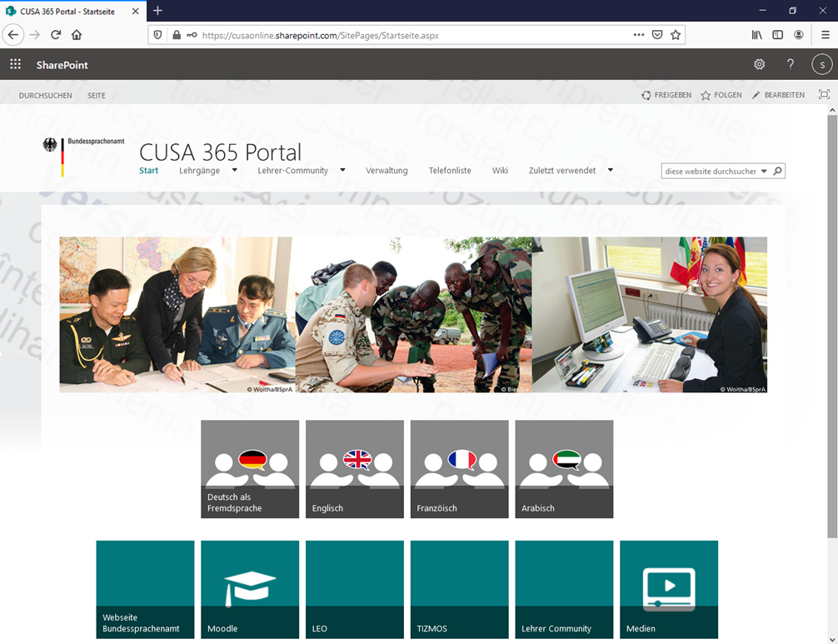
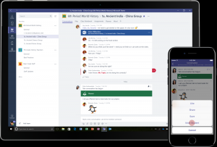
Enter the Distance Classroom
The required technology, the platforms, teaching and practice materials were already in place
Previously used to augment conventional in-person teaching or as part of “Kombi” (hybrid) courses
Technical support and backup was provided
Inhouse training and support for teachers available
New challenge: to implement these tools into a viable system which could work in tandem with the “live” classroom

Slide 12
2020: LGAN Blended Learning
LGAN Phase A
all English teaching staff required (7 groups)
All other English courses cancelled (April – June)
LGAN Phase B
Excursion cancelled
3 week military language phase extended to 4 weeks
3 SQEP Military English instructors (only 3 groups at a time)
Other English courses required to run
Class sizes to be no larger than 8 (room size)
Alternating 2-week “shifts”: On site and online component

Slide 13
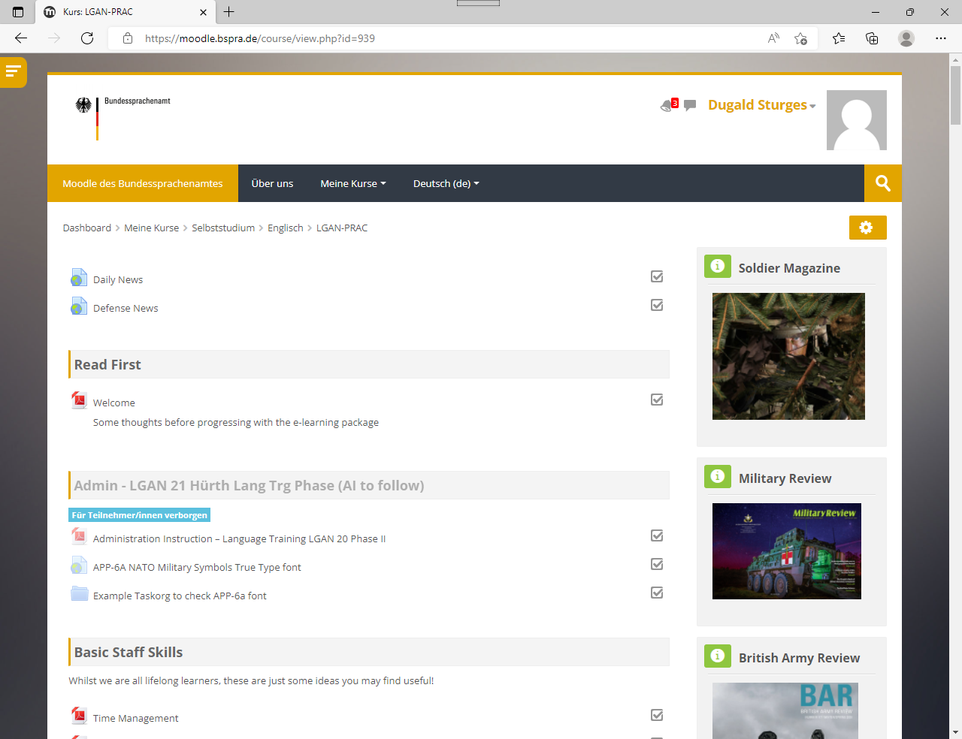
LGAN-Specific Moodle Course

Slide 14
Lessons learned
Both phases were well received by students
Students grateful that we made it happen at all
Additional time and effort required to make it happen
Home study phase surpassed student expectations
Uniformly high level of English
Broad branch experience – peer learning
Focus was on practical training during both residential and home study phases
Student achievement was greatest during on site training
A viable temporary substitute: making the best of the available possibilities made it work

Slide 15
2021: The Second Lockdown - Here we go again

Slide 16
2021: The Situation
January 2021 – Explosive increase in number of infections (the post-Christmas vacation “Second Wave”)
12 January 2021 – Online courses implemented temporarily until “live“ courses could resume
Over the next three months: worsening COVID 19 situation in Germany resulted in that date being postponed several times
In the end, the entire 11-week teaching phase was conducted in distance format
Students were only present in Hürth for a 3-day exam phase at the conclusion of the course
The LGAN course was scheduled to begin on 12 April 2021

Slide 17
2021: LGAN Hybrid approach
LGAN Phase A
Three week on site 3333-4444 English SLP course at the Army Officer School, Dresden (all students); Six classes
LGAN Phase B
Two week online (virtual classroom) continuation 3333-4444 English SLP course (all students)
LGAN Phase C
Six week phase, alternating every two weeks - two classes in on site Specialist Military English module (focus on operational planning), while the other four classes continue online SLP course (shift system)
LGAN Phase D
One week SLP examinations on site at the Army Officer School, Dresden (all students)

Slide 18
Lessons learned
Spreading the teaching burden between various schools made it possible to teach other courses, reducing backlog
Required a great deal of long-distance coordination between different sections of the Federal Office of Languages
Increased travel (three locations, 3-4 times)
Increased student expectations regarding distance learning
Blending the two in a hybrid format made it better, but there was still much room for improvement

Slide 19
2022: The Third Lockdown – Same procedure as every year?

Slide 20
2022: The Situation (Or: Déjà vu all over again)
January 2022 – Explosive increase in number of infections - again (the post-Christmas Vacation “Third Wave”)
11 January 2022 – Online courses implemented again temporarily until “live“ courses could resume
Despite worsening COVID 19 situation in Germany, on site classes resumed on 07 February 2022 under even stricter hygiene regulations (almost all students and staff fully vaccinated, masks worn everywhere at all times, regular mandatory self-tests for students and staff)

Slide 21
2022: LGAN – Augmenting Classroom teaching with online materials and technology
LGAN - One Phase
12 weeks combined SLP and Specialist Language Military English content
Possibility of instruction in a further language
Excursion phase, but no summer language training phase
In class teaching augmented by online self-study material

Slide 22
Lessons learned (so far)
Coordination, development and delivery by a single section of the Federal Office of Languages in one location
Training in a further language again possible
A one-term compact course
Online course material used to augment and support in person language instruction
Augmenting classroom teaching with online materials and technology has proven so far to be a viable way to best serve instructional goals.
A post-course evaluation will be conducted to validate this new model and indicate further changes to optimize the program

Slide 23
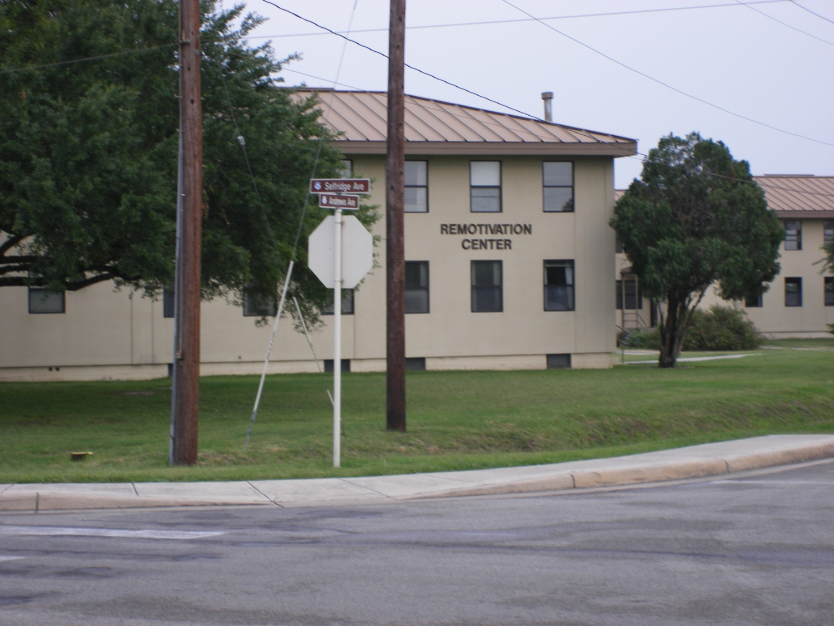
Remotivation: Reflection as chance for improvement

Slide 24
Learning from the Past and Building for the Future?
The constantly changing situation due to the COVID-19 pandemic has caused a radical re-examining of our approaches to all training.
The key to successfully master this kinetic environment is not only flexibility but also adherence to the basic principles of course evaluation and validation
Designing new approaches to meet the new needs can be done on the basis of platforms, technologies and know-how already in place
However, these must undergo constant critical scrutiny on order to ensure that they are employed in a way to best suit the training objectives

Slide 25
Learning from the Past and Building for the Future? (continued)
Designing training for special courses such as the Bundeswehr General Staff Candidates‘ English Course requires particular attention to the specialized need of this clientele
Blending online and in-person training has proven to be useful in creating an optimal learning experience
This must de done, however, in a manner in which only new methods and technologies are employed which truly enhance the in-person language learning process
And where are we tomorrow?
The focus in blending online and in-person training may change – but the focus on the training goal, achieving the highest possible language proficiency, may not.

Slide 26
Grazie per la vostre attenzione.

