Slide 1
Navigating the digital maze: strategies for conquering computer-based testing hurdles (Macedonian experience)
Maja Gjurovikj (MKD)
Vladimir Trpkoski (MKD)

Slide 2
Table of contents
Short update
Advantages of a multistage adaptive test (MST)
MST basics
MST models
The algorithm
Other hurdles

Slide 3
SHORT UPDATE
3-member team
NATO ally since 2020
SLPs as a requirement for promotion
amendments in English language curricula
target levels: 2, 2+, 3
multi-level test (1, 1+, 2, 2+, 3)

Slide 4
ADVANTAGES OF A MULTISTAGE ADAPTIVE TEST (mst)
adapt to each examinee’s ability
fewer items and shorter testing time
reduce item exposure
reduce cheating
reduce examinees’ testing time
automated statistical analysis
tests preassembled before administration
give real-time score

Slide 5
Mst basiCs
Panel - basic structure of assembled MST tests
Stages - chances to tailor the test for each examinee by selecting an item set that matches the examinee’s ability based on his/her responses to previous stages
Testlets (modules) - different difficulty levels
Pathways - the complete route an examinee takes through the test which contains one module from each stage

Slide 6
Which way to go?
M - middle difficulty
H – high difficulty
E – easy difficulty
How many stages do we need?
How many testlets per stage?
How many items in a testlet?
How many routing rules?

Slide 7
Which way did we go?
2H
Level 1
2E
1M 3M
Level 3
Level 2 Level 2
2H
2E
3M
1M
How many stages do we need? - 3
How many testlets per stage? - 1 or 2
How many items in a testlet? - 10 or 20
How many routing rules? - 4 in total

Slide 8
The algorithm
Level 2
(10 questions)
Level 1
(20 questions)
Level 0
(result)
Level 0+
(result)
Level 3
(20 questions)
Less than 50% (result)
Level 3
(result)
Level 1
(result)
Level 2
(10 questions)
Level 1+
(result)
Level 2
(result)
Level 2+
(result)
Level 2
(10 questions)
Level 1+
(result)
Level 2
(result)
STAGE 1
STAGE 2
RESULTS
STAGE 3
RESULTS

Slide 9
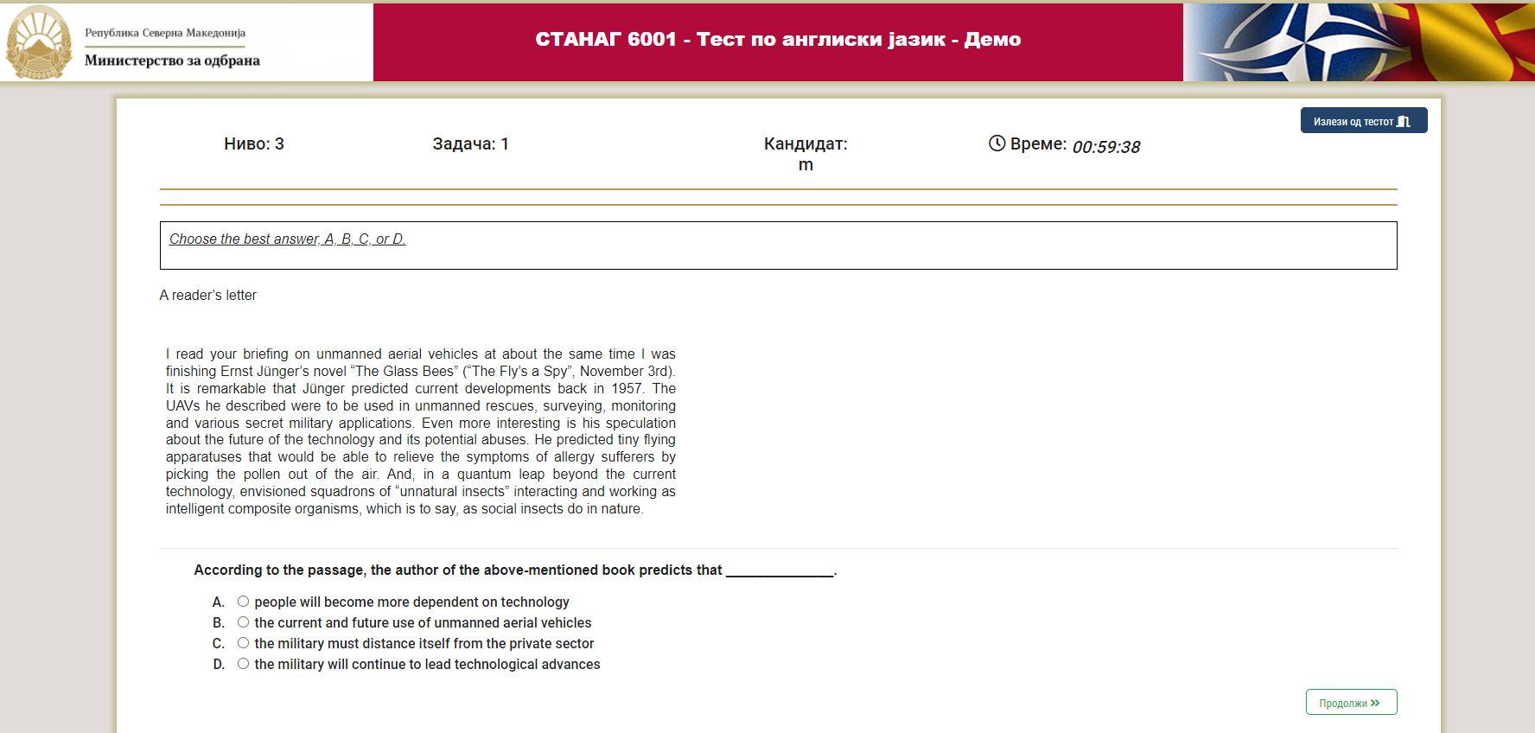

Slide 10
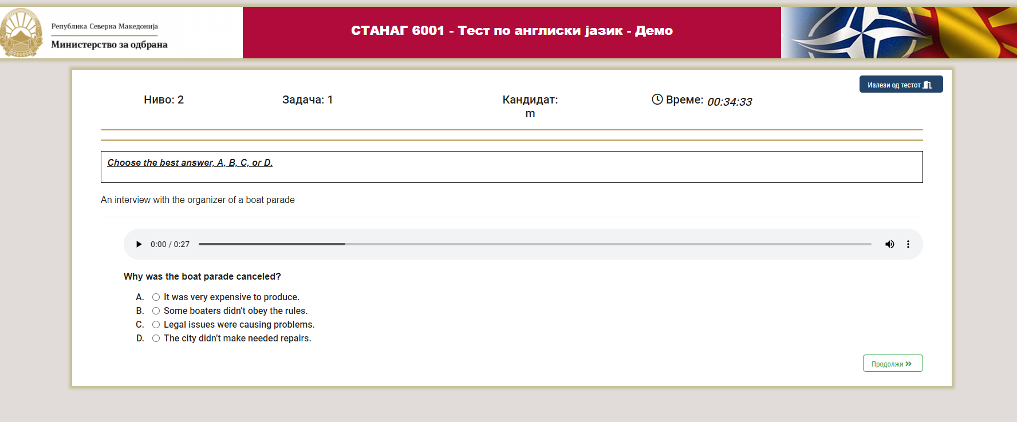

Slide 15
Other hurdles
Technical Issues
Ensure reliable hardware and software
Regular updates and maintenance
Backup systems and technical support
User Interface Challenges
Practice using demo versions
Clear and concise instructions
Feedback and Improvement
Collect user feedback
Continuous improvement

Slide 16
THANK YOU FOR YOUR ATTENTION!
QUESTIONS?

