Slide 1
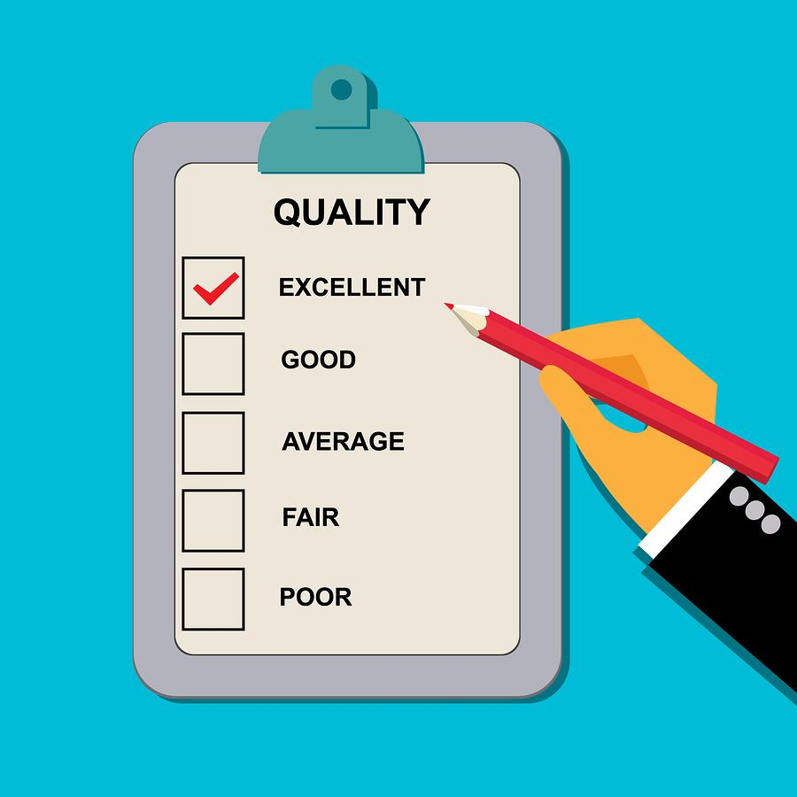
Study Group 4
How do we know what and how well we are doing?

Slide 2
Our questions
How does senior language school management know whether the courses offered are meeting quality assurance principles?
Quality
Assurance
What are the quality assurance principles, and what can management do to ensure that the programmes actually adhere to these principles?

Slide 3
topics for discussion
quality assurance processes in your institutions
course development and course execution evaluations
performance indicators
student feedback
teacher hiring and teacher evaluations
meeting defence structure requirements
engaging in programme reviews with higher HQs

Slide 4
quality assurance processes in your institutions
Most, not all, have an overarching policy for training and International Students
Military Directives/SOPs dictate the processes
QA System for course evaluation and graduation requirements
Iterative approach/cycle of QA
Student feedback/surveys
Did the course prepare you for your job?
When?

Slide 5
Performance indicators
Pre-course (predictive)
Sifting and Selection of students with aptitude testing, personality and motivational questionnaires, also details on language learning background, language and related qualifications, and experience in using foreign languages, in whatever capacity.
During the course (actual/measurable)
Student wash-out rates, and formative scores, per course/curriculum stage.
End-of-course
Final results, scores, grades.
Post-course (attitudinal) PIs:
External feedback from commander or job supervisor.
Other factors
What level of funding does language training have? As compared to last year, etc?
What is the retention rate for long-term linguists?

Slide 6
Course development and course execution evaluations
Are course objectives aligned with the course purpose?
How does the course fit into the overall program?
Who does the course design, and are they trained to do it?
Does the design start with a needs analysis to ensure it meets the requirements?
Is there a method to validate the course to ensure it is meeting its objectives?

Slide 7
Student feedback
Feedback should be valued and collected in order to deliver better learning outcomes
Feedback should be considered an integral part of the program performance indicators
First, we must ask: Why do we need feedback and How will it help us?
What should we collect?
TARGETED and COMPREHENSIVE
Teacher performance/methodology
Materials- applicability
How well course objectives have been covered/met
Assessment measurements
Link--Objectives and results
Job readiness
How and when do we gather it?
Pre/During/Post course feedback
Online or paper surveys
Formal and Informal
Anonymous?
Likert scale with short answer responses\provide mechanism to follow-up
Group or individual interviews/focus groups
What do we do with it?
Who will analyze and view trends?
Process results to provide meaningful action and results
Publish results? Transparency?
EX: Give to teachers to discuss progress, S/W in the teaching program; to organize CPD for teachers

Slide 8
Teacher hiring and teacher evaluations
Selection/hiring process is crucial
Different evaluation systems
Based on national requirements
How valuable is St. opinion on teacher performance?
What is the impact of the evaluation?
Finance?
Promotion?
Opportunities?

Slide 9
Recommendations
Inform BILC community about ACT Policy/Quality Assurance
Create a WG to develop a framework for student feedback on language courses

