Slide 1
BILC JTAC Working Group (WG) Update

Slide 2
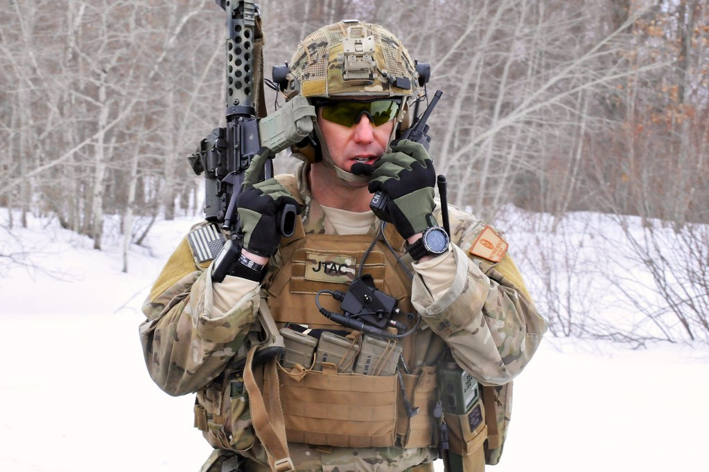
How is BILC Involved?
JTACs have a language requirement per ATP-3.3.2.2
STANAG 6001 SLP 3332
JTAC stakeholders asked BILC to conduct a language needs analysis
Analyze the unique JTAC language tasks
Include a mix of nationalities in the research
Consider a “more focused test” taking the JTAC environment into account
This Photo by Unknown Author is licensed under CC BY-ND

Slide 3
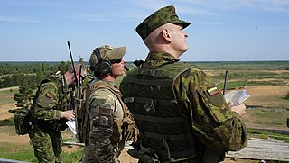
Update
25 May: briefed 75 JTAC Program Managers at a CAS Conference
at Ramstein AFB
28 May-3 June: Adriatic Strike Exercise in Slovenia
Will brief 300 JTACs on the project
Will observe the exercise
Will design questionnaires for three different audiences
JTACs (experienced and novice)
JTAC trainers and evaluators
Native English speaking JTACs
This Photo by Unknown Author is licensed under CC BY-SA

Slide 4
Survey Results from BILC Delegation Heads N=25

Slide 5
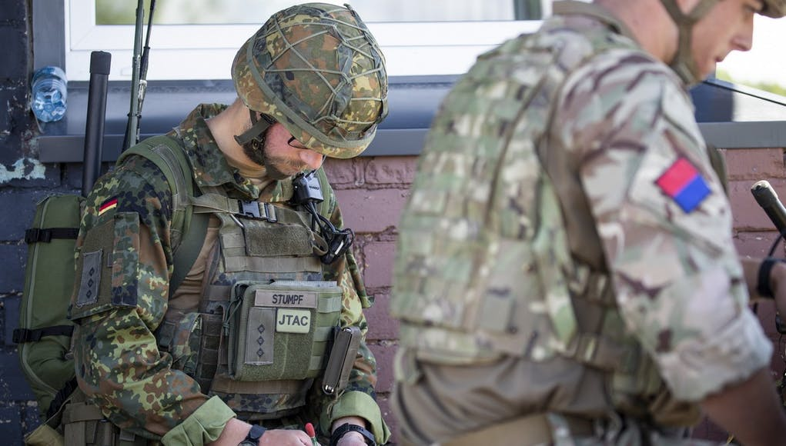
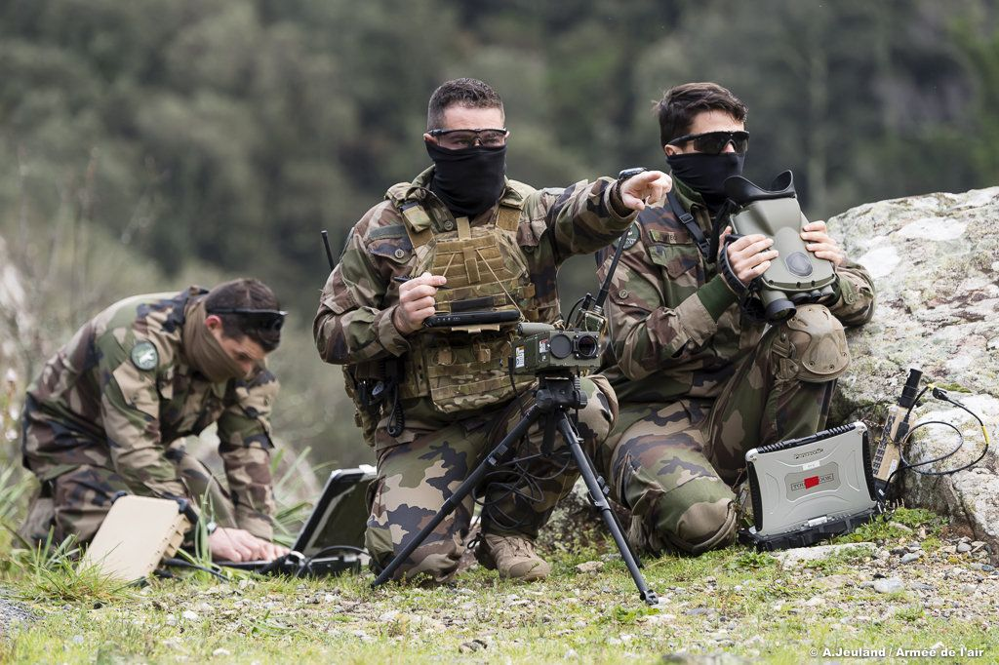
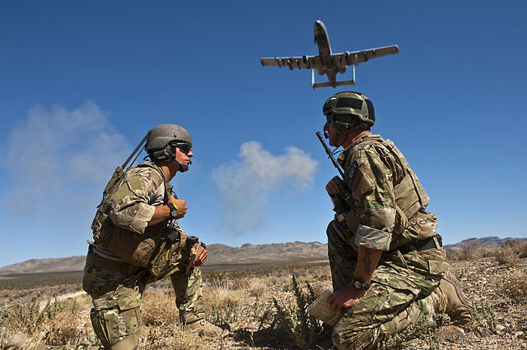
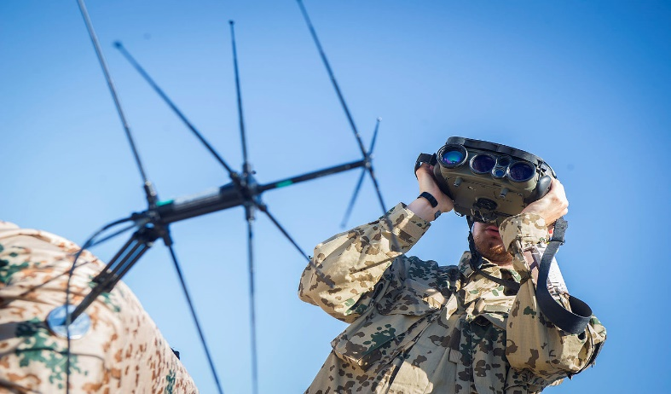
We appreciate the BILC member nations that have offered their input and assistance.
BILC@marshallcenter.org
This Photo by Unknown Author is licensed under CC BY-SA
This Photo by Unknown Author is licensed under CC BY-SA

