Slide 1
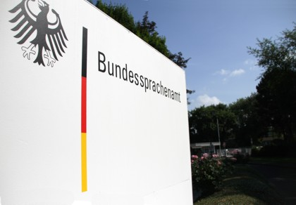
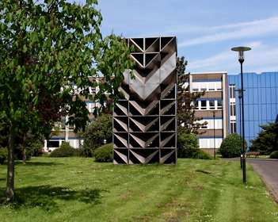
BILC STANAG 6001 Testing Workshop 2022
Images: BSprA

Slide 2
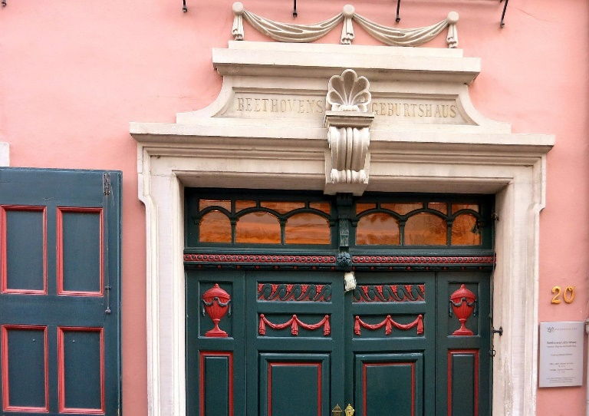
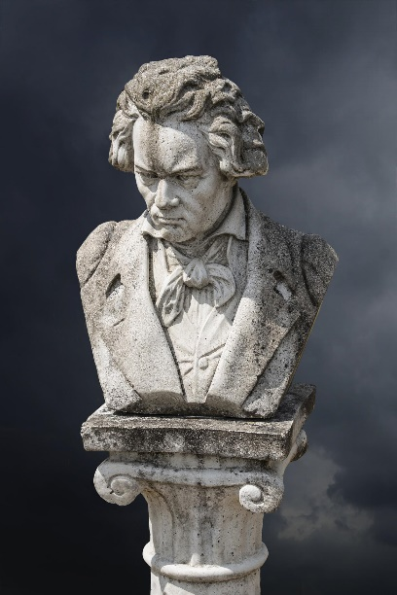
Welcome to Bonn!
Images: Pixabay, Wikimedia Commons: Public Domain

Slide 3
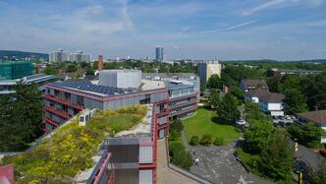
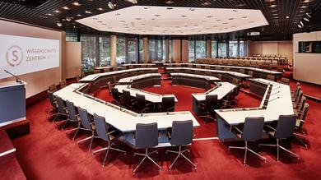
Venue: Wissenschaftszentrum Bonn
Hotel: MotelOne Bonn Hauptbahnhof
Date: 5-9 September 2022
Theme: tba

Slide 4
Good to know:
Transport Options –
Cologne-Bonn Airport
Frankfurt Airport + ICE
Cologne Main Station
Hotel Costs
Room = Euros 79 PPPN
Breakfast = 13.50 Per Day
Attendees
Testing Experts/Practitioners
Pre-Workshop Activities

Slide 5
Thank you for your attention!
www.bundessprachenamt.de
Image: BSprA

